Slide 1
Surface tension modelling
DS1 – liquids
DS2 – polymers (molar volume)
292 organic liquids
23 organic polymers
5 carbonate
1 anhydride
1 formic acid
1 furan
5 containing C#C/R3/R4/R7/R8
16
silicone containing
13
Calculated from density
SciFinder
ChemSpider
vendors (TCI, Sigma, etc.)
263
smiles
mv
Feature engineering
used
smiles
st
mv
C, H, C=C, C#C, Ar, O-alc, O-eth, O-ald, O-ket, O-acid, O-ester, R3, R4, R5, R6, R7, R8, M, density
Feature engineering
C, H, C=C, C#C, Ar, O-alc, O-eth, O-ald, O-ket, O-acid, O-ester, R3 (3-membered ring), R4, R5, R6, R7, R8, M, density
predictors
targets
mv models
predictors
targets
st models
mv models
mv and density are the same information. One can be calculated from the other.

Slide 2
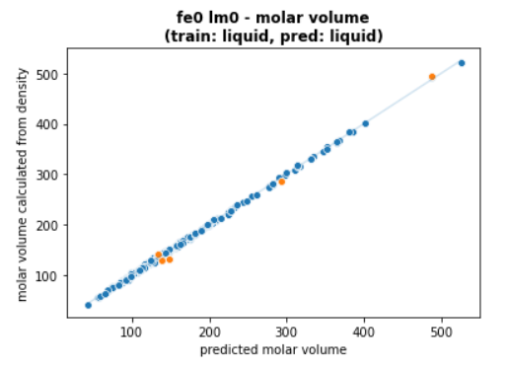
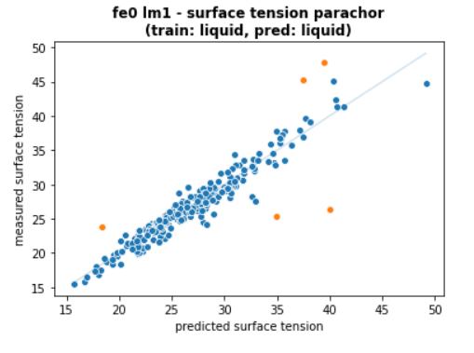
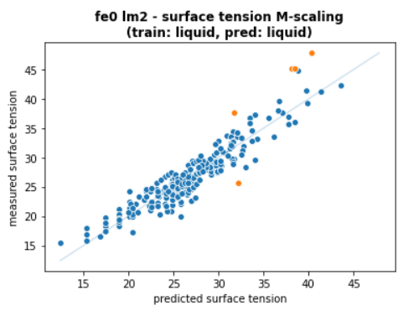
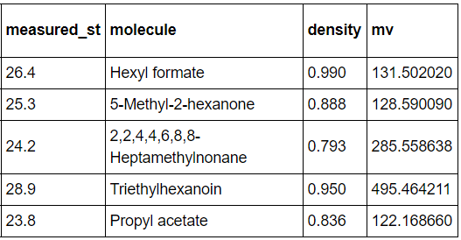
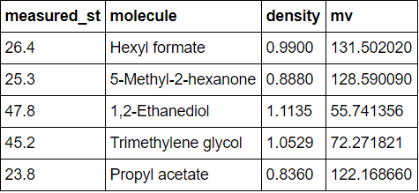
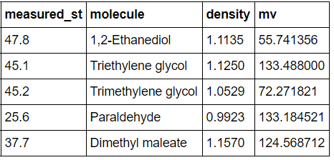





Regressors:
C, H, C=C, (C#C), Ar, O-alc, O-eth, O-ald, O-ket, O-acid, O-ester, (R3), (R4), R5, R6, (R7), (R8)
Features in bracket are excluded
Surface tension modelling – linear model (DS1 – liquids)
mv
st
st
rmse = 2.43
mae = 1.61
rmse = 1.78
mae = 1.06
rmse = 1.92
mae = 1.42
$$mv= θ_{1}X_{1}+ θ_{2}X_{2}+ …$$
Parachor model
$$γ^{1/4}. mv= θ_{1}X_{1}+ θ_{2}X_{2}+ …$$
$$γ= θ_{1}X_{1}+ θ_{2}X_{2}+ …$$
$X_{i}$ = fragment counts
$X_{i}$ = fragment counts / M
Good fit
Mistakes in SciFinder’s densities:
Hexyl formate → 0.879
5-Methyl-2-hexanone → 0.814
Propyl acetate → 0.888
# TODO: correct this
Good fit, but prone to error (due to power term)
3/5 outliers match mv model’s outliers, the other 2 are diols
Direct relationship between fragments and st has a degree of linearity
Simple, but possibility of missing features. E.g. at 15 < x < 20.

Slide 3
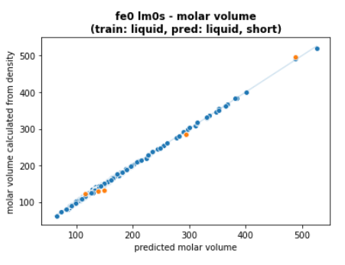
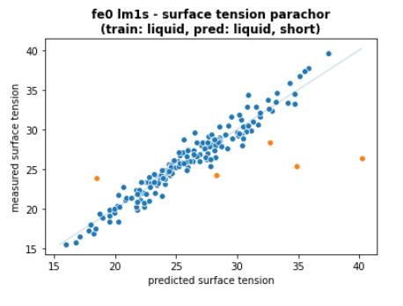
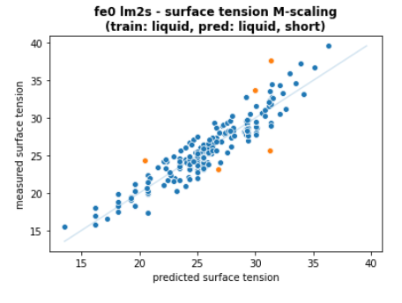
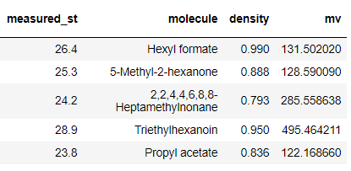
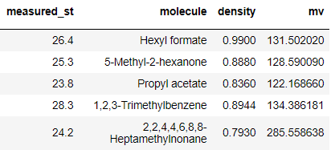
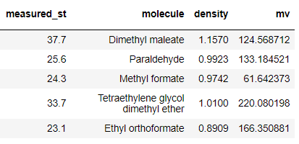


Regressors:
C, H, C=C, (C#C), Ar, (O-alc), O-eth, (O-ald), O-ket, (O-acid), O-ester, (R3), (R4), R5, R6, (R7), (R8)
Features in bracket are excluded
Surface tension modelling – linear model (DS1 – liquids) - short
Short = excluding alcohols, acids, aldehydes
st
st
mv
rmse = 1.67
mae = 0.93
rmse = 1.59
mae = 1.23
rmse = 2.62
mae = 1.80
$$γ^{1/4}. mv= θ_{1}X_{1}+ θ_{2}X_{2}+ …$$
$$γ= θ_{1}X_{1}+ θ_{2}X_{2}+ …$$
$$mv= θ_{1}X_{1}+ θ_{2}X_{2}+ …$$
$X_{i}$ = fragment counts
$X_{i}$ = fragment counts / M

Slide 4
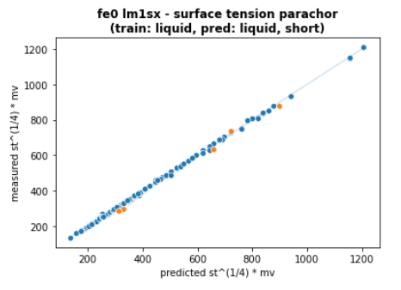
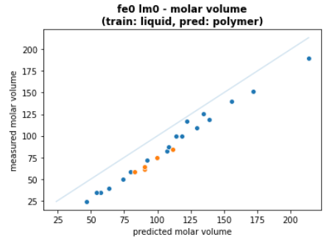
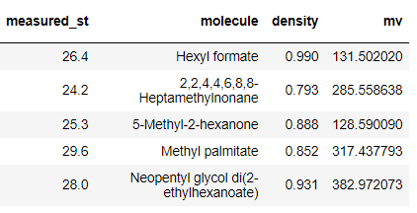
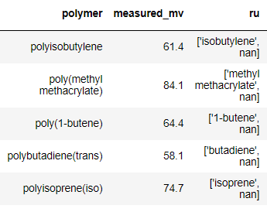
Surface tension modelling – linear model (DS1 – liquids, DS2 - Polymers)
rmse = 5.97
mae = 3.63
mv
rmse = 21.65
mae = 20.97
Predicted mv of polymers are consistently below measured value. This is easily explained by the increase in density as degree of polymerization increases
Dataset is very limited due to absence of molecular weight. The overestimation of molar volume interestingly seems to be constant.
Without correction of molar volume, it is impossible to use liquids dataset to predict st of polymers. Even then, parachor model is very sensitive to error in molar volume.
When density can be accurately measured, there is a good chance polymer st can be predicted with linear model, at least within a class of similar polymers.
#TODO: build linear model for mv from DS2
Before transformation, linearity holds. This is hardly special since the surface tension reduced to the power of 1/4th is highly swamped by mv which is proven to be a linear combination of fragments

Slide 5


Surface tension modelling – XGB (DS1 – liquids)
Bayesian Optimization – Hyperopt
validation
Workflow
263 datapoints are split into test set (23) and train set (240).
Test data points are picked as suggested by the literature from which DS1 is taken from.
Training loop
For each iteration (out of 250):
Train set is split into 5 (fixed seed)
For each split (out of 5):
1 split → validation set
4 splits → cv train set
XGB is trained on cv train set and tested on validation set
Average score for 5 splits is computed
BO with tpe suggests new hyperparameters for next iteration
Final model is trained on the full train set (240) with best hyperparameters.
Final model is then tested on test set.
48
48
5-fold CV
score
$$h_{opt}$$
192
train
$h$
(hyperparameters)
192
model
Feature engineering
training
263
240
250 iterations with tpe
23
Final model
test
23
results

Slide 6
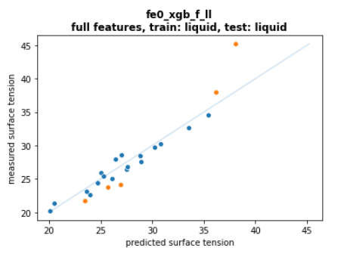
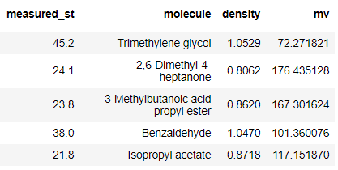
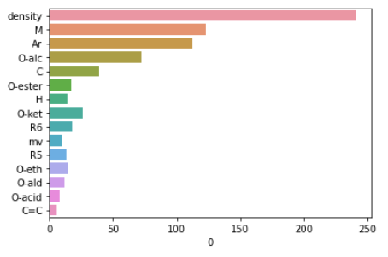
Surface tension modelling – XGB (DS1 – liquids)
st
Top 5 error
rmse = 1.91
mae = 1.30
Decent fit except for trimethylene glycol
Most important feature is density. Conceptually, density is correlated to surface tension since both seems to arise from intermolecular force.
# TODO: do all diols have large error in training? Are they underrepresented? The answer seems to be yes, as observed also in the linear model.
# TODO: train “short” models without irrelevant functional groups in polyester (OH, acid, aldehyde)
Feature importances
Features
C, H, C=C, (C#C), Ar, O-alc, O-eth, O-ald, O-ket, O-acid, O-ester, (R3), (R4), R5, R6, (R7), (R8), M, density, mv
Features in bracket are excluded

Slide 7
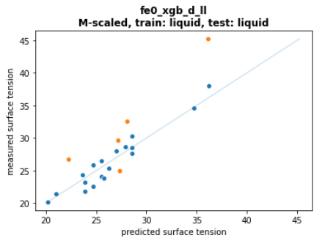
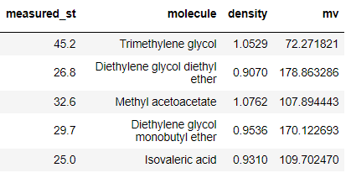
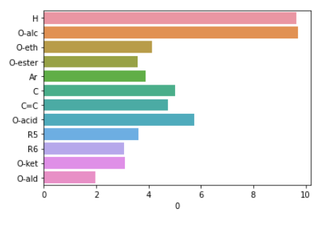
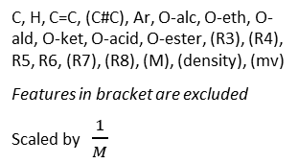
Surface tension modelling – XGB (DS1 – liquids)
M
st
Top 5 error
rmse = 2.15
mae = 1.15
Most simple, does not consider density or mv, but worst fit.
Feature importances
Features
C, H, C=C, (C#C), Ar, O-alc, O-eth, O-ald, O-ket, O-acid, O-ester, (R3), (R4), R5, R6, (R7), (R8), (M), (density), (mv)
Features in bracket are excluded
Scaled by$\frac{1}{M}$

Slide 8
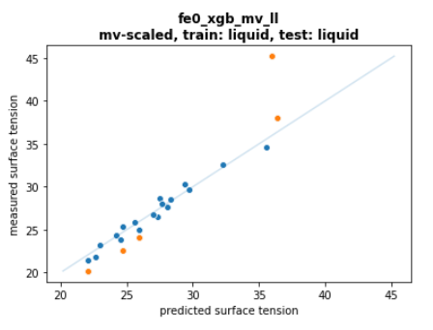
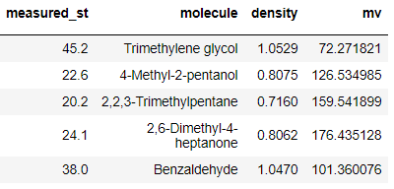
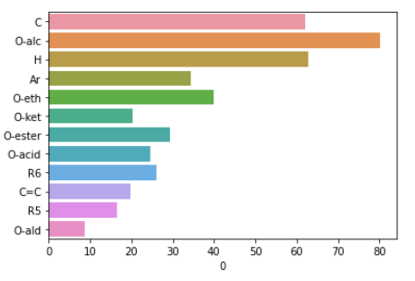
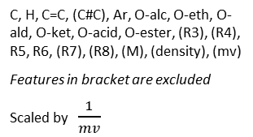
Surface tension modelling – XGB (DS1 – liquids)
st
Top 5 error
rmse = 2.15
mae = 1.15
Decent fit except for trimethylene glycol
St seems to be a volume phenomenon, not mass (comparing to M-scaled model)
Feature importances are more evenly spread, suggesting the importance of mv (and hence density)
Presence of hydroxyl affects surface tension greatly
C and H are possibly indicators of size, as larger molecules tend to have higher st because of higher density.
Highly branched structure are potentially giving large error (entry 3&4 in top 5)
# TODO: plot correlations. Density and st have some collinearity
# TODO: try different feature engineering, maybe less atomic based more group based
# TODO: determine the feature space explored in DS1. XGB does not extrapolate well
Feature importances
Features
C, H, C=C, (C#C), Ar, O-alc, O-eth, O-ald, O-ket, O-acid, O-ester, (R3), (R4), R5, R6, (R7), (R8), (M), (density), (mv)
Features in bracket are excluded
Scaled by$\frac{1}{mv}$

Slide 9
Important findings
Density and mv are important data to predict st
Chemical nature strongly influences st
Assuming high accuracy of measurements, parachor model seems decent to predict st
Scaling by 1/mv seems effective to open possibilities of predicting diverse polymers (e.g. multiple repeating units)
Feature engineering can be refined, e.g. considering branching (CH3, CH2, CH, … instead of C atoms, H atoms)

