Slide 1
LHL Mini Project IV :
Loan Prediction and Model Deployment
Matthew John Coffey • 2021.12.10

Slide 2
Motivation: Why predict loans?
Banks’ and Financial Institutions’ profit and loss depend largely on whether or not clients pay back loans.
By predicting loan approvals, these institutions are able to reduce non-performing assets while maximizing revenue in the form of interest payments.

Slide 3
Motivation: Why predict loans?
For individuals, and for the economy as a whole, loans provide liquidity and increase stability.
By better understanding personal access to loans, individuals can make better financial plans and work to increase their access. Economically, increased access to loans improves GDP and acts as an economic stabilizer.
Notes:
Knock-on effects include
Economic progress has been proven to have a positive correlation with enlargement of credit markets

Slide 4
Workflow

Slide 5
Explore the data, identifying features and isolating challenges for modeling
Prepare the web interface, ensure all connections between elements are robust
Test the final product and ensure it is working as intended.
Data Exploration
Modeling
Interface Design
Deployment
Testing
Train the model, iteratively tune data preprocessing and hyperparameters
Deploy the model to the web app.

Slide 6
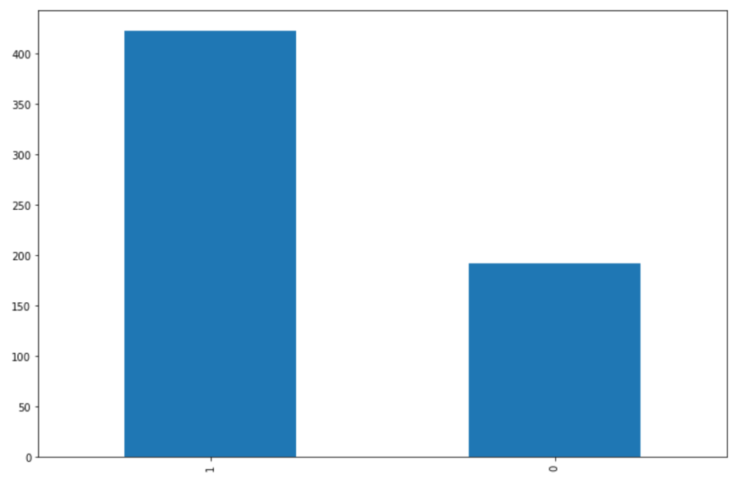
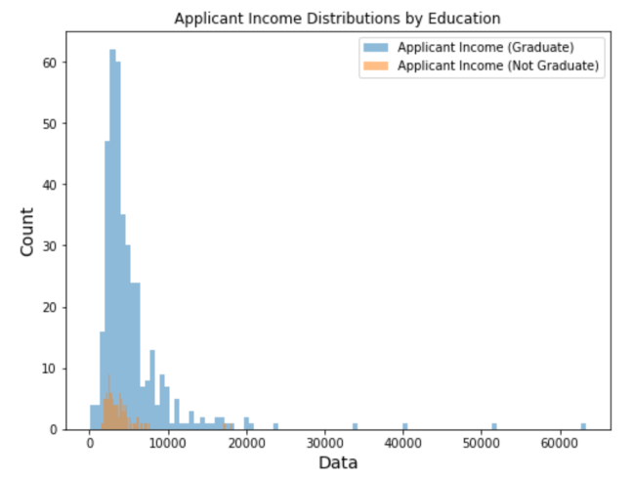
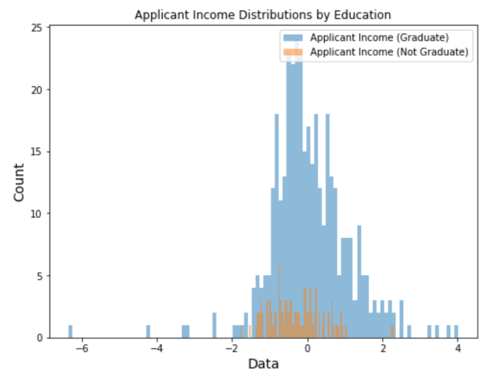
Data Exploration
Loan Approval Distribution
Class Imbalance
In this data, there exists a class imbalance in the target variable
This was overcome using oversampling functionalities in the ‘imblearn’ package
Distribution Skew
Applicant Income, Coapplicant Income, and Loan Amount suffer from skewed distribution
This was overcome using PowerTransformation functionalities from the ‘sklearn’ package.
Yes
No

Slide 7


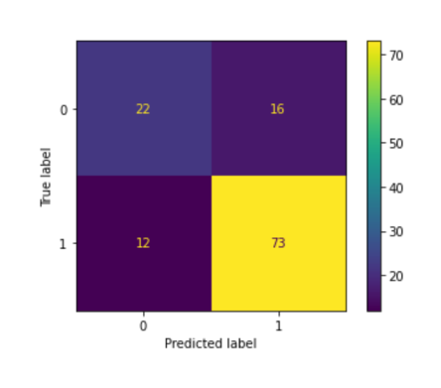
Modeling
Overfitting of Test Data
Smaller dataset lends itself to overfitting
Using a less complex model (RandomForestClassifier) and limiting tree depth reduced overfitting

Slide 8
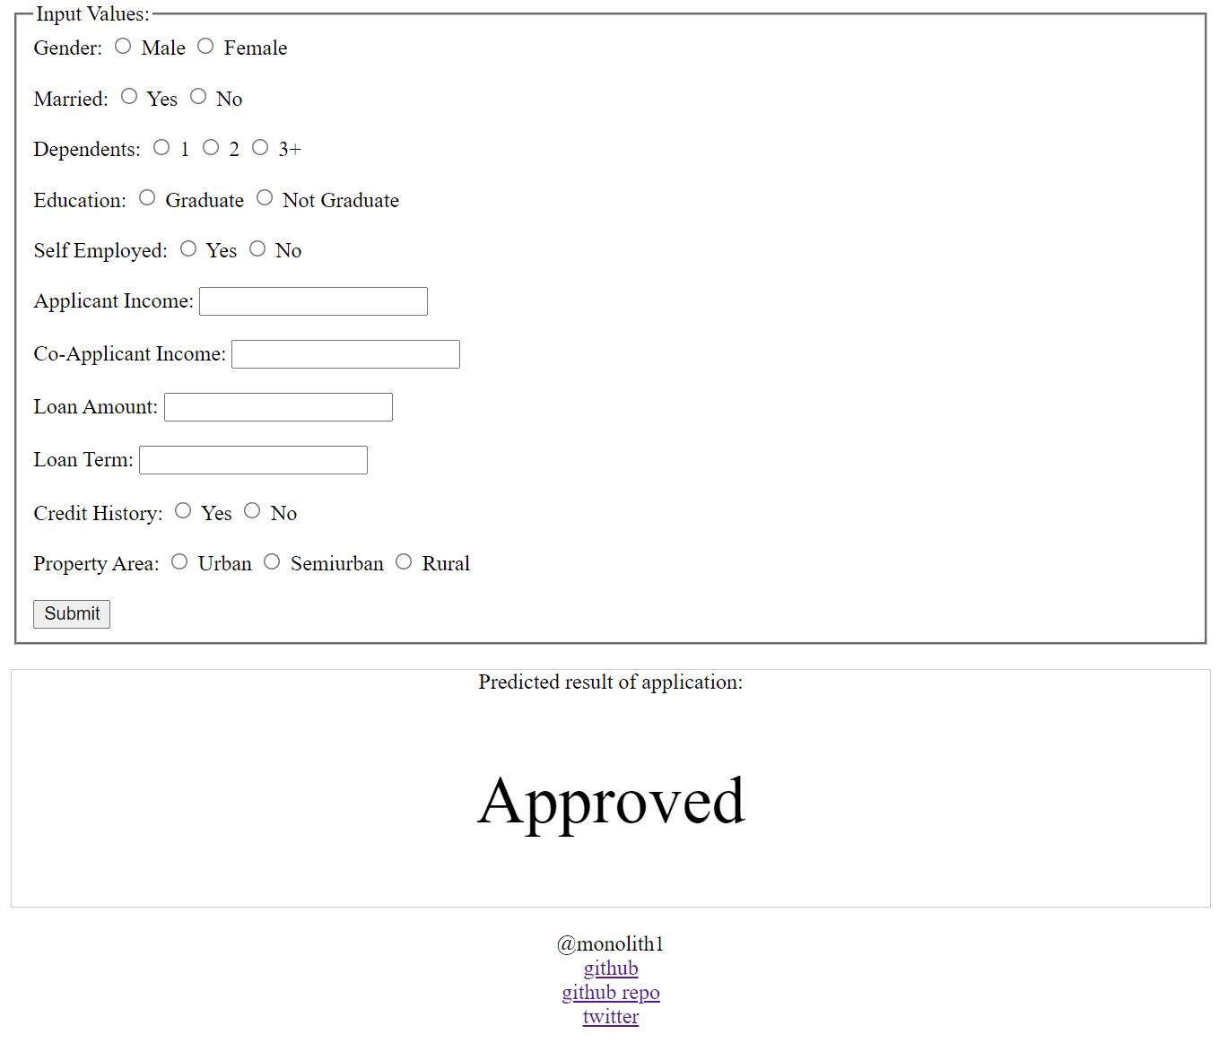
Interface Design, Deployment, and Testing
Manage Components
Components of webapp include Flask API, Model, and HTML landing page
Communicating between HTML and Python using API requests

Slide 9
Next steps
Batch Processing
Allow the user to submit batch data for predictive analysis
Iterative Learning
Allow the model to learn from new data as it becomes available
Better UI
Improve look and interactivity of web app

Slide 10
https://bit.ly/3oHbvyP
Check it out!

