Slide 1
Automated Adjudication of Write-in Votes
Matthew John Coffey
Notes:
My name is Matthew John Coffey
Here to talk about election writein resolution via handwritten optical character recognition
A little about me:
Worked in various tech for last decade
Last 5 years in elections
Serving jurisdictions, helping them get the most out of their elections technology, and helping to manage the flow of large volumes of geopolitical and results data
Joined lhl to get a bit deeper into some of the _other_ ways that we can work with data

Slide 2
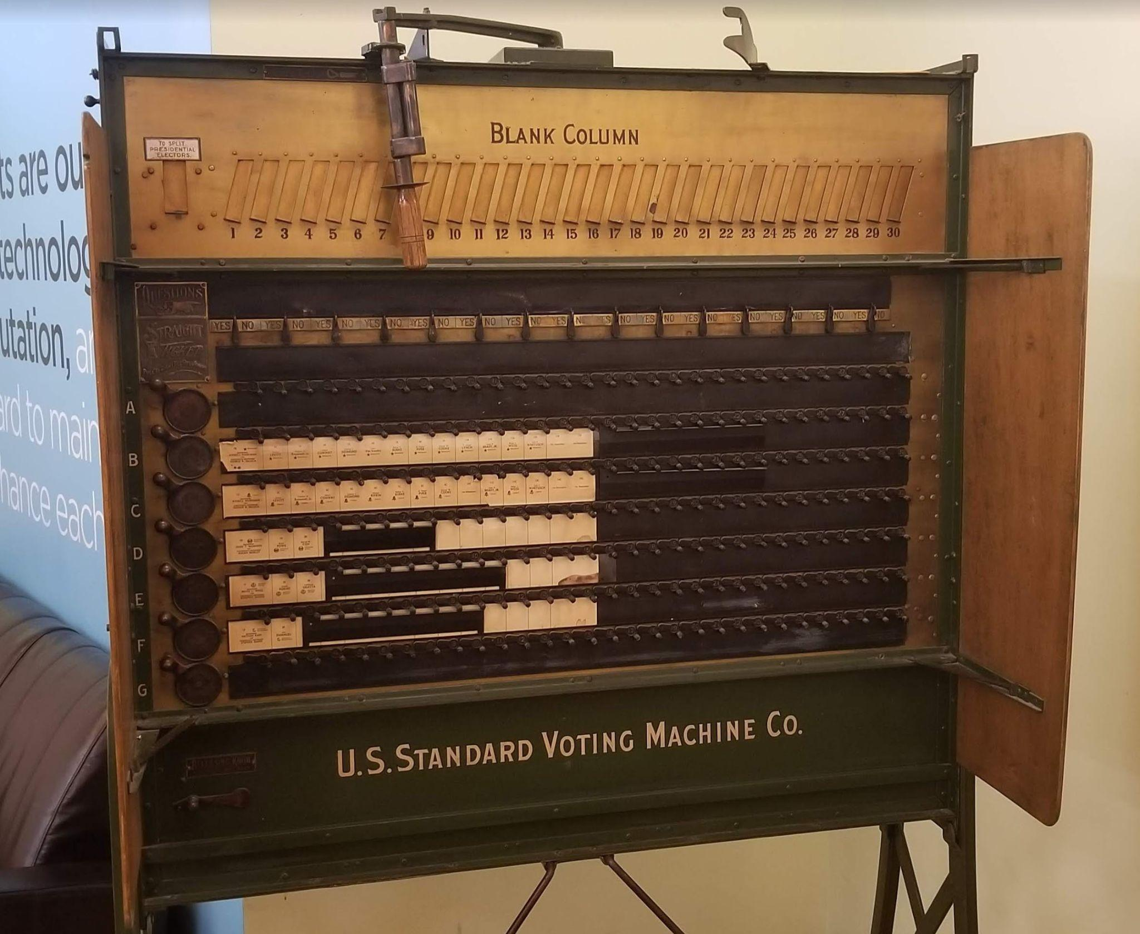
Elections are a foundational part of our democracy.
With growing scrutiny and a more engaged voting public, election jurisdictions are under increasing pressure to provide results quickly and accurately.
Notes:
Problem Domain
As we all know, Elections are foundational
As some of you may not know, modern elections are very labor-intensive in some areas
Labor-intensive areas such as centralized ballot scanning and adjudication of ballots are most time expensive - contributes to delay in results delivery
Adjudication is a process where election judges review ballots that cannot be automatically resolved - judges provide resolution and forward to tally
Several reasons why a ballot might not be able to be automatically resolved, but today we’ll focus on closed write-ins
Writein votes are votes for candidates who are registered to a contest but do not appear on the ballot - instead the voter handwritten their name
For this project, I've tapped my experience working with election systems in the US and Canada to create a robust solution for the automatic adjudication of write-in votes
Please keep in mind this also applies to other areas such as education (digitized notes) or healthcare (digitized forms / prescriptions).

Slide 3
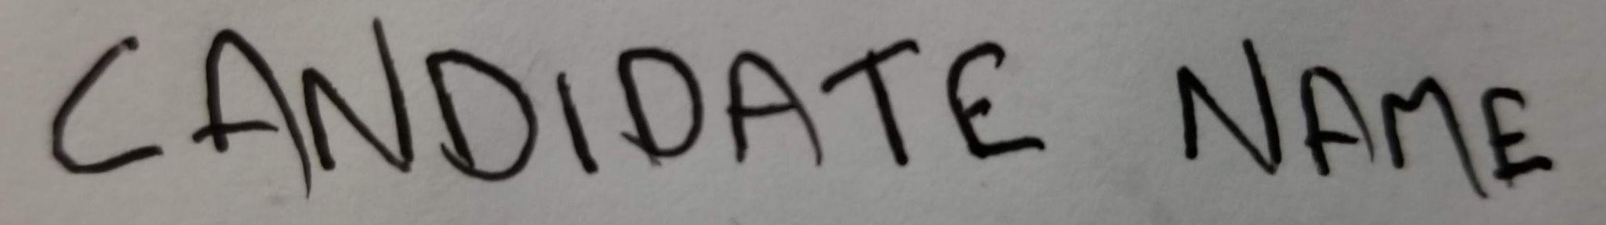

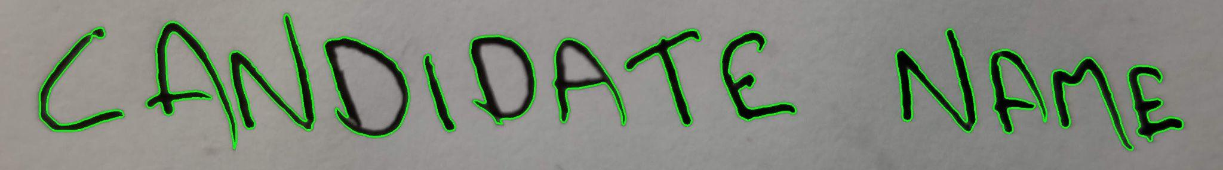
Application Overview
FEATURE EXTRACTION
The application takes an image or folder of images containing handwritten text as input.
Images are preprocessed.
Individual characters are isolated and extracted from each image.
Notes:
Command Line
Registered candidates

Slide 4
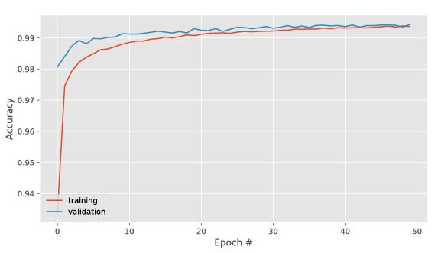
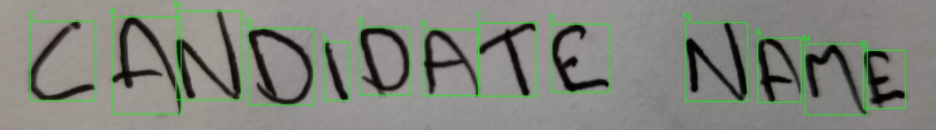
Application Overview
MODELING AND CLASSIFICATION
Each character is passed to a deep artificial neural network to be classified.
This neural network was trained and tested on over 810,000 images of letters written by over 3,600 people.
Notes:
This model employs Convolutional Neural Network layers in order to extract features from the characters presented to it, as well as Long Short-term Memory (a type of Recurrent Neural Network) layers in order to contextualize feature sequences.
NIST Special Database 19

Slide 5
Application Overview
CANDIDATE RESOLUTION
Due to the nature of handwriting, not all letters will be classified correctly.
The application compares the model output with each registered candidate, creating a similarity score.
The vote is resolved to the most similar candidate, as long as the similarity score is above the similarity score threshold.
“CANDLDATE NAME”
CANDIDATE NAME
Notes:
- not all classified exactly correct - > similar to how humans read the handwriting of others
- like the human brain, app designed with contextual expectations - in this case registered writeins
- compare presented to valid, highest score wins
- HOWEVER, this application has the ability to say ‘I don’t know’.
- a minimum similarity score is in place - if a candidate has the highest similarity score but fails to meet similarity threshold OR two candidates have same similarity, no vote is cast and image is flagged for review
- In response to a feature of the elections domain -> we absolutely cannot send a vote to tally for the wrong candidate

Slide 6
100% Accuracy
The application performed with
when resolving a test deck of 80 votes over 4 different candidates.
Notes:
This can be verified by checking results report on github repo or performing the test yourself using the batch images
Try irt yourself bro

Slide 7
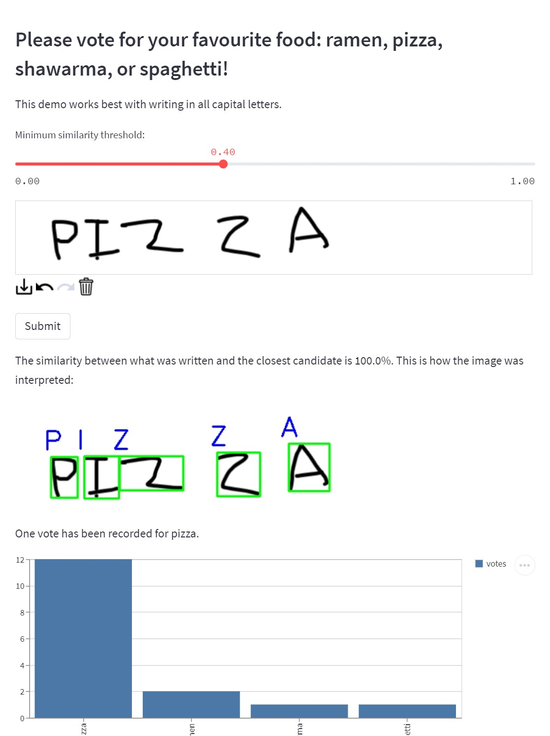
A Technology Demo is available at:
https://bit.ly/3nYPoTV

Slide 8
Thanks!
Matthew John Coffey
github.com/monolith1
linkedin.com/in/matthewjohncoffey
matthewjohncoffey@gmail.com

