Slide 1
Identifying Duplicate Entries via NLP
Matthew John Coffey
LHL Data Science October 25, 2021 Cohort

Slide 2
Problem Domain Overview
We are interested in the identification of duplicate Quora questions in order to achieve:
Improved user experience & quality of content
Limited duplicate assets
Applications to other challenges
Streamline customer service
Search optimization

Slide 3
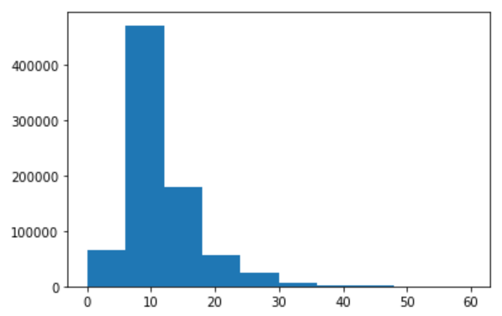
Data Exploration
Findings:
Class imbalance - 63% / 37%
Limited quality of labeling
Some questions are repeated (up to 150+ times)
Mean Character Count: 60
Mean Word Count: 11
Word Count
Frequency

Slide 4
Modeling and Feature Selection
Traditional ML
Workflow:
Preprocessing
Remove ID columns
Remove null entries
Punctuation removal
Convert to lowercase
Remove leading and trailing spaces
Remove non-alpha words
Remove stopwords
Lemmatize (nltk)
Embedding
Tf-idf Vectorization
Modelling
Logistic Regression
Multinomial Naive Bayes
XGBoost
1
Notes:
In information retrieval, tf–idf (also TF*IDF, TFIDF, TF-IDF, or Tf-idf), short for term frequency–inverse document frequency, is a numerical statistic that is intended to reflect how important a word is to a document in a collection or corpus.
The word "better" has "good" as its lemma. This link is missed by stemming, as it requires a dictionary look-up.

Slide 5
Modeling and Feature Selection
Traditional ML
Results:
Logistic Regression
74% Testing Accuracy
Multinomial Naive Bayes
75% Testing Accuracy
XGBoost
80% Testing Accuracy
1

Slide 6
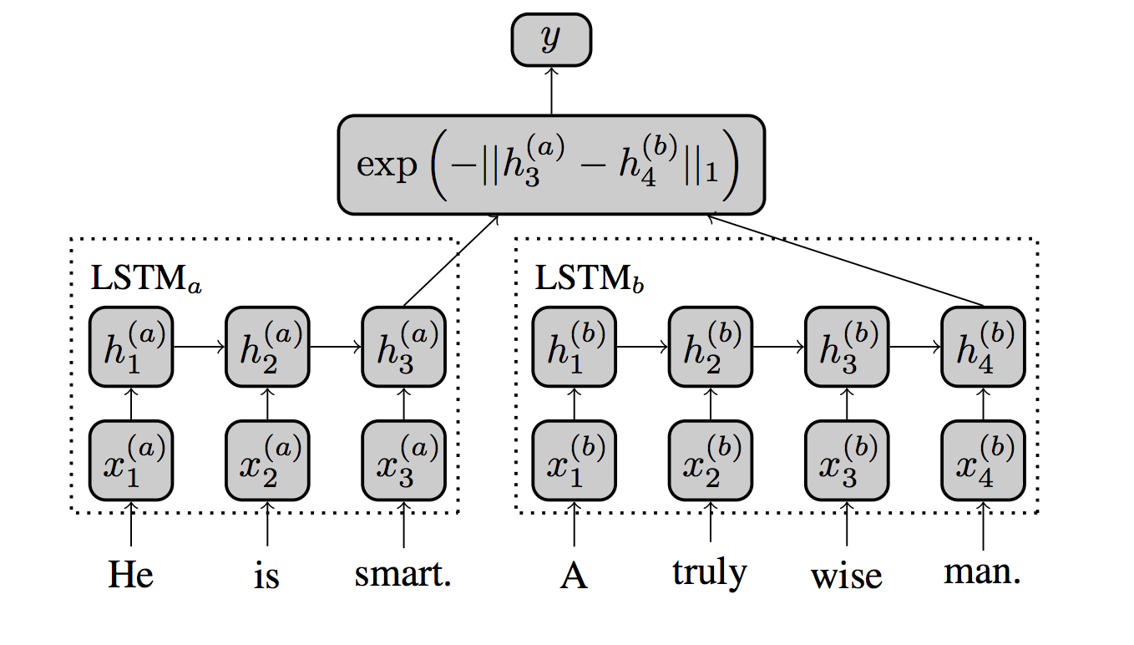
Modeling and Feature Selection
Deep Learning
Workflow:
Preprocessing
Remove ID columns
Tokenize (keras)
Padding (keras)
Sequencing (keras)
Limit sequence length
Embedding
GloVe pre-trained word embeddings (count-based)
Word2vec pre-trained word embeddings (predictive)
Modelling
Siamese LSTM
1

Slide 7
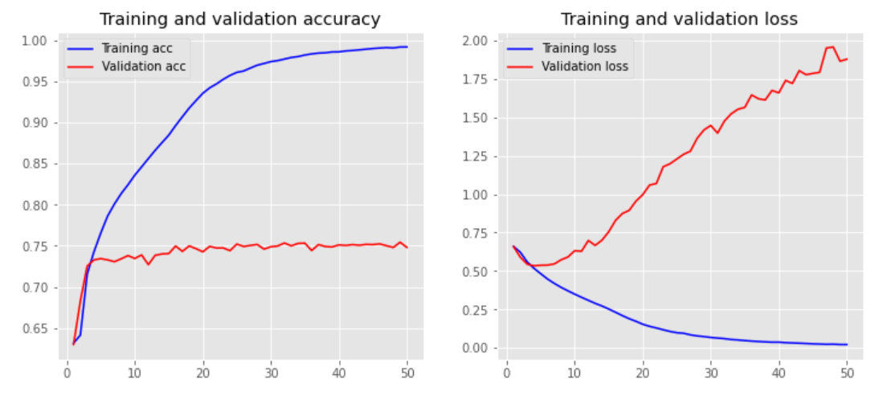
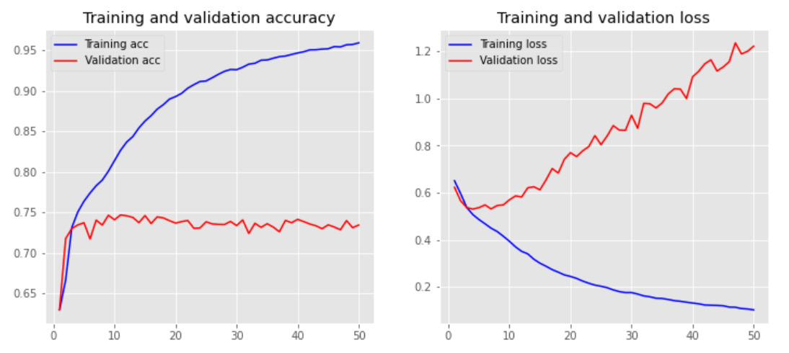
Modeling and Feature Selection
Deep Learning
Results:
Siamese LSTM with Google Word2vec
76% Testing Accuracy
Siamese LSTM with Wikipedia GloVe
75% Testing Accuracy
1

Slide 8
What next?
Revisit feature engineering
Revisit preprocessing steps (stopwords, alpha)
Tune siamese LSTM models
Fix class imbalance via oversampling
Remove sequence limitation
Try other ML models (RandomForest)

