Slide 1
Tech Use and Mental Wellbeing
COMP-3250 Data Analytics I

Slide 2
Team Members and Roles
John Rafael Diaz Cabangon (Lead Data Analyst) | Managed Power BI dashboard, data cleaning, and project scope
Howaida Nazari (ML Engineer) | Developed and optimized Python Random Forest model and methodology
Kerui Li (Scrum Master) | Facilitated Agile sprints, Hive task management, and documentation compliance
Mona Hicham Moussa (Business Analyst) | Translated data findings into actionable insights and presentation structure

Slide 3
Problem & Hypothesis
03
01
02
04
The Catalyst
The Problem
In the wake of the pandemic, society has quickly shifted toward a “always-online” digital lifestyle.
Overuse of digital devices is leading to a decline in global mental health indicators
The Question
Our Hypothesis
What is the direct link between the intensity of technology use and mental health?
Optimized technology usage can significantly reduce mental stress

Slide 4
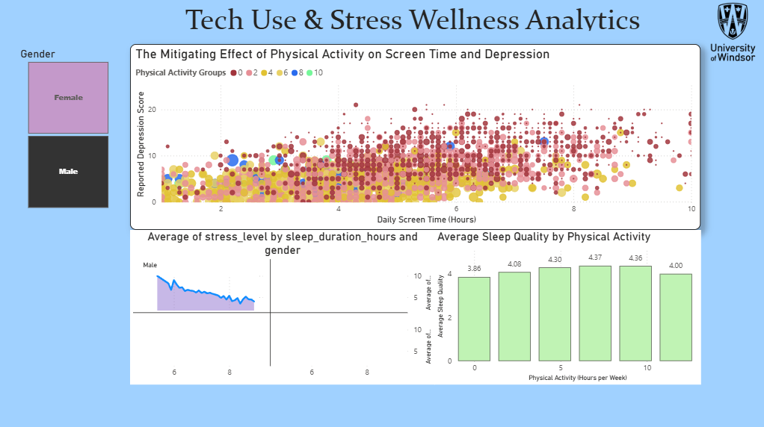
The IT Solution and Live Demo
Descriptive Analytics: Power BI
Predictive Analytics: Python Model

Slide 5
Benefits & Impact
Physical Activity
Leisure & Gaming
Mindfulness & Practice
Moderate exercise yields highest sleep quality.
Gaming and leisure act as relief
25-minute mindfulness threshold improves sleep.

Slide 6
Summary & Action Plan
01
02
03
04
Policy
Focus
Outreach
Manage technology through active offline habits.
Target specific behaviors over total time.
Promote exercise to corporate wellness programs.
Threshold
Practice mindfulness for over 25 minutes.

Slide 7

Thanks!
Do you have any questions?
References:
Hive. Hive Project Management Software. Hive, 2024, hive.com.
Microsoft. Power BI Desktop. Microsoft, 2024, powerbi.microsoft.com.
Nagpal, Prabhavalkar. Tech Use and Stress Wellness Dataset. Kaggle, 2024, www.kaggle.com/datasets/nagpalprabhavalkar/tech-use-and-stress-wellness.
Pedregosa, Fabian, et al. "Scikit-learn: Machine Learning in Python." Journal of Machine Learning Research, vol. 12, 2011, pp. 2825-2830, jmlr.csail.mit.edu/papers/v12/pedregosa11a.html.
Python Software Foundation. Python Language Reference. Python Software Foundation, 2024, www.python.org.

