Slide 1
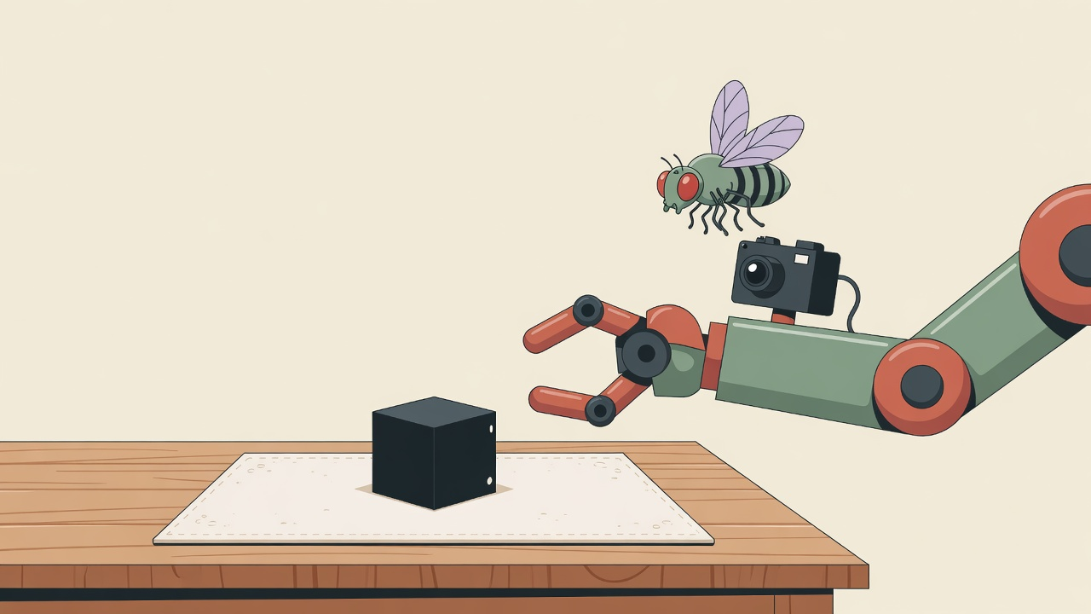
Can a tiny fly brain
pick up a cube?
A simple story about cameras, fake fly brains, and a robot arm.
Written so a 14-year-old can follow every step.

Slide 2




FLY BRAIN · CUBE PICK
THE GOAL
We want this chain to work
1. Look
2. Think
3. Move
4. Pick
A camera takes a photo of the cube on the table.
A mini copy of a fly brain turns the photo into signals.
Those signals tell the robot arm how far to go.
The cube lifts. That is the only real win.

Slide 3

FLY BRAIN · CUBE PICK
HOW IT IS SUPPOSED TO WORK
Photo in. Millimetres out.
Camera
Mini brain
Output wires
Robot math
Sees the table
About 60,000 cells
Left, right, down…
Turns that into a move
Kid translation
A real fruit fly has special output cells that say things like “go left” or “go down.” We copied a slice of that wiring into a computer. The robot is not the fly. The computer slice is. If the slice never shouts “down,” the arm will not pick the cube — no matter how smart the rest of the code looks.

Slide 4
FLY BRAIN · CUBE PICK
THE PROBLEM
The “down” shout is missing or wrong
What a human demo does
What the fly slice says
Someone already taught the same robot to pick this cube by copying human moves. In one second the arm can drop about 50 millimetres — a real reach down.
On the same photos, the fly slice mostly whispers “a bit to the side.” The “go down” wires are quiet, late, or pointed the wrong way.
−50 mm
−1 mm
down, in one second of a real pick
and sometimes the opposite of the real move

Slide 5
FLY BRAIN · CUBE PICK
WHY “TRY HARDER” BREAKS
A tug of war inside the mini brain
Wait longer
The stop alarm also wakes up
The “down” cells wake up late. If we let the fake brain run longer, they finally shout. That sounds good.
The same extra time turns on a “stop!” cell. Then we are not allowed to trust the move. We lose safety if we ignore it.
Same trap if we add the whole fly brain
The live robot must stay on a small slice (about 60,000 cells), not all 166,000. Growing the slice helps the missing wires — and makes the computer too slow to drive the arm. Win one thing, lose the other. That is the knot we have to untie, not “average it.”

Slide 6
FLY BRAIN · CUBE PICK
SET A · FIRST FIVE IDEAS
The “try harder” list
Put missing cells back
1
Add the helper cells we cut out, so the “left / down” wires have friends again.
Turn some volumes down
2
Quiet the stop-alarm cells so the late “down” cells can speak.
Two clocks
3
Read the move early, read the stop alarm later. Do not pick one waiting time.
Listen to whoever is talking
4
Use the wires that already change on pick photos. Stop pretending silent wires are joysticks.
Aim the photo better
5
Shine the picture onto the right spots in the mini brain, not as one big smear.

Slide 7
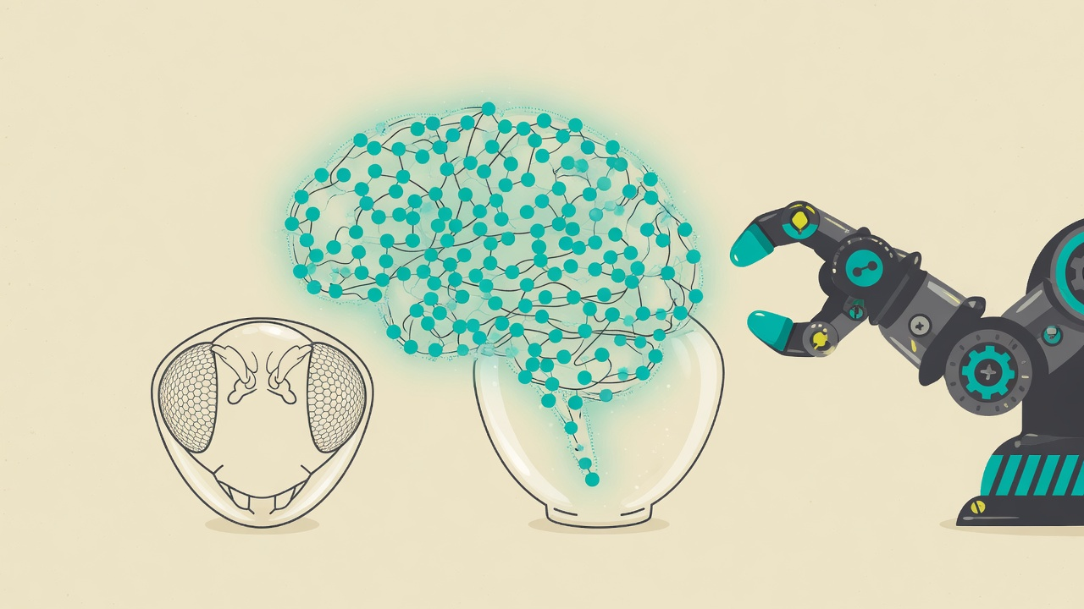
FLY BRAIN · CUBE PICK
SET A · HONEST LOOK
These ideas are mostly the same habit
If your bike chain is off, you can push harder on the pedals. You go nowhere faster.
Bigger brain, more waiting, louder volume — same chain. We already tried “a bit more waiting” and “a bit more volume.” The stop alarm got louder too.
So we asked a different question: how do you win without paying?

Slide 8
FLY BRAIN · CUBE PICK
A BETTER QUESTION
Win. Do not pay.
The knot
The dream result
The old habit
If we add missing cells, the live robot gets too slow. If we wait longer, the stop alarm screams. A middle wait is a shrug, not a fix.
The photo already knows “down.” We should not need a giant extra brain, a fake map, or a human teacher on every tick.
Keep twisting the same eight output wires. That is like tying a longer rope when the rope was the wrong tool.

Slide 9
FLY BRAIN · CUBE PICK
SET B · AFTER THAT QUESTION
Five ideas that try not to pay
Two clocks
1
Same as list A #3, but as a split: move from the middle moment, stop-alarm from the late moment. Not one average wait.
Read the map, not the wires
2
The mini brain already has a grid like a fly’s eye. Where the cube sits on that grid can mean left/right/down. The output wires can stay a diary plus a stop button.
A tiny graft
3
Do not paste the whole fly brain. Add only the missing helper types that plug into “down,” like a short extra hose, not a new ocean.
Practice big, run small
4
Offline, a bigger brain can teach a tiny cheat-sheet. Live, we still run the small slice. Not a fake map on silent wires.
Place, not volume
5
Ask which spots light up, not how loud the whole room is. Loudness wakes the stop alarm. Place can stay quiet.

Slide 10
FLY BRAIN · CUBE PICK
BOTH LISTS
Keep, drop, or merge
Two clocks
Keep. Same idea, now as a split, not a shrug.
Aim the photo / place not volume
Keep and merge. Grid location is the strong version of “aim better.”
Put the whole missing brain back
Drop for the live robot. Too slow. Maybe only as a teacher offline.
Turn the stop alarm down
Drop as the main plan. Safety is not a knob we average.
Pretend silent wires are joysticks
Drop. That would be lying about a fly pick.

Slide 11
Recommended approach
Read the map. Use two clocks.
First: from the same cube photos we already have, measure where the cube sits on the fly-eye grid. Check if that location matches the human pick (left/right/down). No robot motion for this.
Second: keep the stop alarm, but read it later than the move. Do not grow the live mini brain to 166,000 cells. Do not invent a fake “down” from silent wires.
If the grid still cannot match a real pick, we stop calling this a fly pick on the robot — not another millimetre twitch.

Slide 12


FLY BRAIN · CUBE PICK
WHAT YOU DO NOT HAVE TO DO
Nobody needs to stand by the arm for this
No more tiny robot moves to “see what happens.”
Yes: replay the old pick videos on a computer.
Yes: test the grid idea on those videos first.

