Slide 1
Introduction to Structural Equation Modeling and Its Application

Slide 2
Some very general remarks
Structural Equation Modeling is a general approach for the statistical
analysis of psychological data that highlights the use of latent variables
- An important characteristics of this approach is the focus on non-
observable random variables that represent theoretical constructs
This characteristic is incorporated in factor-analytic techniques and
methods of regression analysis

Slide 3
Outline
Some basics
A short history
The latent – manifest contrast
The priority of theory
The specificities of the model
The need to be complete
The step from the manifest to latent levels
The graphical potential

Slide 4

Some basics

Slide 5
The denotation
Modeling latent variables (also applies to the IRT and ML approaches)
Structural equation modeling
SEM (Structural equation modeling)
Confirmatory factor analysis
CFA (Confirmatory factor analysis)
Outdated denotation:
LISREL: Linear structural relationships
LISREL als program package

Slide 6
The basic concepts
a variable:
….. a place holder that can take different values or levels or states
…. is something unknown
…. must be defined (for being psychologically useful)
… in psychological applications variables are usually restricted to real numbers or integers or categories

Slide 7
The basic concepts
a variable:
….. a place holder that can take different values or levels or states
…. it is something unknown
…. it must be defined (for being useful)
…. it is often used for representing something
- a construct:
…. a theoretical concept / an idea
…. is a concept of science
…. is a concept that has been shaped as the result of conducting research
e.g. competency, extraversion, mathematical reasoning

Slide 8
The basic concepts
in research variables and constructs go together
an example:
one of many possible
mathematical structures
of y, a, b
y = a + b
variables
we can add meaning by defining variables!

Slide 9
The basic concepts
in research variables and constructs go together
an example:
one of many possible
mathematical structures
y = a + b
Using constructs adds
(psychological) meaning
reasoning ability
numeric reasoning ability
logical reasoning ability

Slide 10
Characterizations of SEM
a multivariate method for data analysis
y₁
y₂
....
y_{p}
= …

Slide 11
Characterizations of SEM
a multivariate method for data analysis
a confirmatory method (… explained in one of the following sections)

Slide 12
Characterizations of SEM
a multivariate method for data analysis
a confirmatory method
consideration of multiple indicators
e.g. construct: reasoning ability reasoning ability
indicator: ability scale score ability scale score 1 ability scale score 2

Slide 13
Characterizations of SEM
a multivariate method for data analysis
a confirmatory method
consideration of multiple indicators
consideration of errors of measurement
Observed score
Area where the true score is likely to be found!

Slide 14
A short history

Slide 15

► Spearman is credited with the idea of a latent variable

Slide 16
► In 1904 Spearman included the idea of a latent variable in
his early concept of factor analysis (FA)
Latent source
Responses to items
Factor in FA
… represents the latent source as latent variable

Slide 17
► In about 1935 Thurstone introduced common factor analysis
Latent source 1
Reflection as factors 1 and 2 in FA
Responses to items
Latent source 2
… allows no model check!

Slide 18
► In about 1935 Thurstone introduced common factor analysis
… allows no model check!
i.e. it cannot be excluded that the response is driven by another source!

Slide 19

► Confirmatory factor analysis becomes available
(Jöreskog, 1970, 1971)
In CFA an latent variable is presented as part of a model
… allows check of completeness of model (i.e. it is possible to decide whether there is good model fit or model misfit)

Slide 20
► Confirmatory factor analysis becomes available
(Jöreskog, 1970, 1971)
good model fit confirmation of hypothesis
(assumptions) incl. in model
model misfit rejection of hypothesis
(assumptions) incl. in model

Slide 21
► The further development consists in adapting the
approach to …
… specific research problems
… data types
… method effects
…
that makes it really work.

Slide 22
The Latent -
Manifest Contrast

Slide 23
The basic contrast: manifest - latent
related to: theory of observational and theoretical languages, etc.

Slide 24
The basic contrast: manifest - latent
related to: theory of observational and theoretical languages, etc.
i.e. discrimination of two types of language –
language of what is observable / language of ideas
… was developed by the so-called Vienna group
(z. B. Carnap)

Slide 25

The basic contrast: manifest - latent
What do you see now (give a name)?
:::::::::::::::::::::::::::::::::::::::::::::::::::::::::::::::::::::::::::::::::::::::
:
:
:
:
:
:
:
:
:
:
:
:
:
:
:
:
:::::::::::::::::::::::::::::::::::::::::::::::::::::::::::::::::::::::::::::::::::::::

Slide 26
The basic contrast: manifest - latent
What do you see now (give a name)?
What kind of experience do you have with it?
…
- Is it manifest or latent?

Slide 27

The basic contrast: manifest - latent
related to: discrimination of two types of language …
What is the manifest level? What does it include?

Slide 28

The basic contrast: manifest - latent
related to: discrimination of two types of language …
What is the manifest level? What does it include?
What is the latent level? What does it include?

Slide 29
The basic contrast: manifest - latent
related to: discrimination of two types of language …
What is the manifest level? …
What is the latent level? …
How are the levels related to each other?

Slide 30
The basic contrast: manifest - latent
related to: discrimination of two types of language …
What is the manifest level? …
What is the latent level? …
How are the levels related to each other?

Slide 31

The basic contrast: manifest - latent
Incorporation
… there is a specific person
(a real burgler)
When we talk about it, we use the concept of a person
(a burgler)
… because the concept is more general.

Slide 32
The basic contrast: manifest - latent
How is it reflected in psychological statistics?
(related statistical concepts)
A something of the manifest level is? manifest variable
A something of the latent level is? latent variable

Slide 33
The basic contrast: manifest - latent
How is it reflected in psychological statistics?
(related statistical concepts)
A something of the manifest level is? manifest variable
A something of the latent level is? latent variable
How are these levels related to each other?
…by the model of measurement

Slide 34
The basic contrast: manifest - latent
The model of measurement :
it explains a manifest variable (e.g., X) by means of several latent variables (e.g., τ, .. and ε)
X = τ + …. + ε
(mostly by assuming linear relationships among the latent variables but other relationships are also possible)

Slide 35
The basic contrast: manifest - latent
The model of measurement :
it explains a manifest variable (e.g., X) by means of several latent variables (e.g., τ, .. and ε)
X = τ + …. + ε
manifest latent
part part
(mostly by assuming linear relationships among the latent variables)

Slide 36
The priority

Slide 37
The priority of theory
- research starts with a theory or detailed construct
- data collection is designed according to theory
- data analysis is conducted according to theory

Slide 38
The priority of theory
- research starts with a theory or detailed construct
- data collection is designed according to theory
- data analysis is conducted according to theory
Confirmatory approach of research

Slide 39
The priority of theory
- Confirmatory approach of research
means the checking of hypotheses (…) regarding ...

Slide 40

The priority of theory
- Confirmatory approach of research
means the checking of hypotheses (…) regarding ...
… e.g. food of parrots

Slide 41
The priority of theory
- Confirmatory approach of research
means the checking of hypotheses (…) regarding ...
The beak suggests that parrots eat nuts! … e

Slide 42

The priority of theory
- Confirmatory approach of research
means the checking of hypotheses regarding ...
Hypothesis: parrots
eat nuts!
Search for supporting information

Slide 43
The priority of theory
- Confirmatory approach of research
means the checking of hypotheses regarding ...
- Explorative approach of research
means searching of something new

Slide 44
The priority of theory
- Confirmatory approach of research
means the checking of hypotheses regarding ...
- Explorative approach of research
means searching of something
- Origin: Empiricism
Research without assumptions (e.g. John Lock)

Slide 45
The priority of theory
- Confirmatory approach of research
means the checking of hypotheses regarding ...
- Explorative approach of research
means searching of something
- Origin: Empiricism
Research without assumptions (e.g. John Lock)
Problems (perceptual errors, random influences, etc.)

Slide 46
The priority of theory
An important advantage of the confirmatory approach is that it is instrumental in dealing with the complexity of the empirical reality.
An example is provided to demonstrate this advantage!

Slide 47
The priority of theory
as coping with complexity

Slide 48
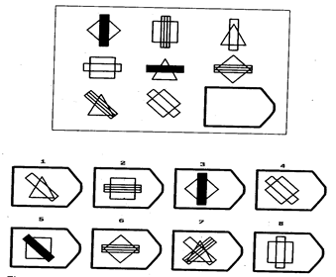
The priority of theory
as coping with complexity
Example: investigation of the validity of a scale - APM
Figure: APM item

Slide 49
The priority of theory
as coping with complexity
Example: investigation of the validity of a scale, APM
- ... is id valid as scale of fluid reasoning?
- ... is id valid as scale of spatial ability

Slide 50
The priority of theory
as coping with complexity
Example: investigation of the validity of a scale, APM
A popular way of investigating validity is to relate the scale to be
validated (APM) to other scales that are expected to measure the same
construct.
This means that APM is to be related to
- a scale measuring fluid reasoning
- a scale measuring spatial ability

Slide 51
The priority of theory
as coping with complexity
Example: investigation of the validity of a scale, APM
APM
Mentale Rotation (mR)
Visualization (V)
Closure (C)
Numerical reasoning (nR)
Scales used to collect the available data

Slide 52
The priority of theory
as coping with complexity
Example: investigation of the validity of a scale, APM
Mentale Rotation (mR)
Visualization (V)
Closure (C)
Numerical reasoning (nR)
(APM)
Spatial ability
Reasoning

Slide 53
The priority of theory
as coping with complexity
Example: investigation of the validity of a scale, APM
Mentale Rotation (mR)
Visualization (V)
Closure (C)
Numerical reasoning (nR)
(APM)
Spatial ability
Reasoning

Slide 54
The priority of theory
as coping with complexity
Example: investigation of the validity of a scale, APM
Next step: statistical investigation using ….
● explorative approach: estimation of the weights w
● confirmatory approach: use of already available
knowledge for theory-guided estimation
the weights w

Slide 55
The priority of theory
as coping with complexity
Example: investigation of the validity of a scale, APM
Next step using the …
● explorative approach: estimation of the weights w
Explorativ: Y_{APM} = k + wX_{mR}+ wX_{V} + wX_{C} + wX_{nR} + e
The estimates of the weights have to show
which scale contributes to the scale that is to be validated !

Slide 56
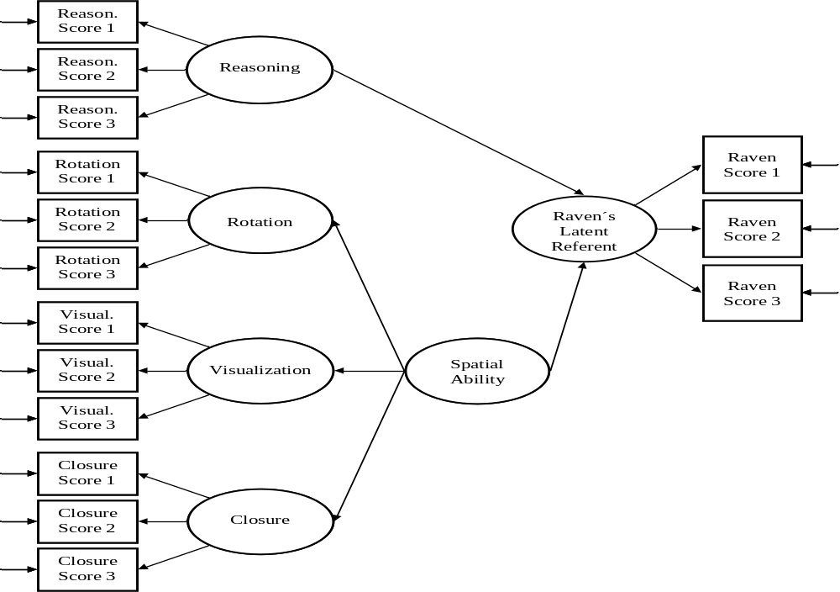
The priority of theory
as coping with complexity
.32
.83
The sample included 224 university students.
.49
.72
.75
.68*
.44
.64*
.11
.95
.74
.45
.27*
.21
.89
APM
.779
.40
.10
.95
.64
.75
.34*
.43
.29
.84
.06
.11
.94
.61
Conclusion: the scale does not represent fluid reasoning well because there are relationships with scales representing spacial ability
.91
.24*
.18
.32
.83
.59
.42
.76
.37
.79

Slide 57
The priority of theory
as coping with complexity
Example: investigation of the validity of a scale, APM
Next step using the …
● confirmatory approach: use of already available
knowledge for theory-guided estimation
the weights w
What we know is that mental rotation (mR),
visualization (V) and closure (C) are integrated
into spacial ability!

Slide 58
The priority of theory
as coping with complexity
Example: investigation of the validity of a scale, APM
Next step using the .....
● confirmatory approach: use of already available
knowledge for theory-guided estimation
the weights w
Therefore, wX_{mR}+ wX_{V} + wX_{C} needs to be
integrated into one component: wX_{V_mR_C}
so that Y_{APM} = k + wX_{V_mR_Ra} + wX_{nR} + e

Slide 59
The priority of theory
as coping with complexity
.32
.83
The sample included 224 university students.
.49
.72
.44
.75
.64*
.11
.95
.74
.45
.21
.89
APM
.779
.40
.10
.95
.64
.75
.43
.29
.84
.06
.11
.94
.61
.18
.91
.32
.83
.59
.42
.76
.37
.79

Slide 60
The priority of theory
as coping with complexity
.32
.83
The sample included 224 university students.
.49
.72
.44
.75
.64*
.11
.95
.74
.45
.21
.89
APM
.779
.40
.10
.95
.64
.75
.43
.29
.84
.06
.11
.94
.61
.18
.91
Conclusion: the scale represents fluid reasoning
.32
.83
.59
.42
.76
.37
.79

Slide 61
The Specificities

Slide 62

.... of the model

Slide 63
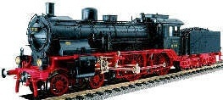
.... of the model

Slide 64
.... of the model
The train-engine theory

Slide 65
.... of the model
The train-engine theory
The train-engine model

Slide 66
The model
.... is a construction that serves the picturing of reality.
.... is to a small degree an abstraction of reality.
The theory
.... is also a construction.
.... is focused on what is essential of the construct.

Slide 67
A major differerence: specificity
● a model is usually rather specific
e.g. it may say „the train engine
has eight wheels for rails“
● a theory is usually rather general
e.g. it may say „the train engine
has wheels“

Slide 68
A major differerence: consequences of specificity
- there is one theory (e.g. of the train engine)
- there are various models (e.g. of specific train engines)
- but both of them refer to the same reality

Slide 69
A major differerence: consequences of specificity
Advantages of models:
♦ they are so specific that they can fail when related to observations
♦ different models can be compared with each other with respect to observations
♦ the best model can be identified
All this means that models are especially useful for investigating properties of …!

Slide 70
A major differerence: consequences of specificity
Disadvantage of theory:
♦ they can hardly fail (some researchers argue that it is not possible to disprove
a theory)
♦ progress in science is not possible

Slide 71
A major differerence: consequences of specificity
Models for investigating properties: an example from cognitive load theory
♦ Theory of cognitive load says … a too large load in cognitive processing
leads to errors!
… it implies that increasing the difficulty of arithmetic tasks leads to
more errors.

Slide 72
A major differerence: consequences of specificity
Models for investigating properties: an example from cognitive load theory
♦ Theory of cognitive load says … a too large load in cognitive processing
leads to errors!
♦ However, cognitive theory is imprecise regarding the relationship
- it only suggests: the more rules (that means a higher
load), the more errors.
… it implies that increasing the difficulty of arithmetic tasks leads to
more errors (e.g. more rules – more errors)

Slide 73
A major differerence: consequences of specificity
Models for investigating properties: an example from cognitive load theory
Ways of modeling ……. „the more rules (...), the more errors „ can mean …….
Courses of increase
Number of errors
All courses are correct
according to theory!
(Low load) 1 2 3 ………………………………..……… p (High load)
Low..
Number of rules (Load)

Slide 74
A major differerence: consequences of specificity
Models for investigating properties: an example from cognitive load theory
…….
Models must be specific!
e.g. model 1: assumes a linear increase
e.g. model 2: assumes a quadratic increase
e.g. model 3: assumes an increase within a specific range
This way models are likely to improve our knowledge

Slide 75
The model – final comment
♦ There is general agreement that all models are wrong but useful.
♦ Models account for observed data to a larger or lesser degree.
♦ Research aims at constructing models that provide a very good
account of reality.

Slide 76
The Need
to be complete

Slide 77
The need to be complete
- The statistical evaluation of models is conducted by means of
Goodness-of-fit tests
i.e. it is checked whether the data in general are explained by the model
(… implying that model misfit is indicated if something
important is missing).

Slide 78
The need to be complete
An example:
The investigation of the structural/factorial validity of a reasoning scale
i.e. it is to be investigated whether the items of the scale - are homogeneous
- are unidimensional

Slide 79
The need to be complete
An specific example:
.... Data collection by a personality scale (e.g. extraversion (EV))
.... Investigation of the data by the following model :
Factor capturing Latent source of EV
Responses to EV items
If there is no other source of responding, this model is likely to indicate good model fit

Slide 80
The need to be complete
An example:
For demonstrating the „need to be complete“, we assumed that
something went wrong in data collection:
… the participants did not get enough time to complete all items.
The consequence: the statistical investigation indicates model misfit.

Slide 81
The need to be complete
An example:
…..
The consequence: the statistical investigation indicates model misfit.
What does this mean?
The model is wrong!
In many cases it is simply incomplete; i.e. an important process may be missing.

Slide 82
The need to be complete
An example:
… „the participants did not get enough time to complete all items“ ...
means that the participants‘ processing speed influenced results.
There were two sources of responding instead of one. Therefore, the model must consider two sources in order to account for the data.

Slide 83
The need to be complete
An example:
… „the participants did not get enough time to complete all items“ ...
means that the participants‘ processing speed influenced results.
Factor capturing Latent source of EV
Factor capturing processing speed
Responses to EV items

Slide 84
The need to be complete
In sum
The need to be complete creates the following situation: all important sources of performance must be integrated into the model that is investigated .... to achieve good model fit.
..... although the researcher may be interested in only one of them.

Slide 85
The need to be complete
In sum
.....
If the model is incomplete, it is likely to fail! (… although the investigated hypothesis may be correct)

Slide 86
The M-L step

Slide 87
The step from the manifest to latent levels
…. This section is on the consequences of latent variable modeling for the results of investigating the relationship between two constructs!
It demonstrates an advantage of modeling latent variables because the statistical investigation is conducted at the latent level (not the manifest level)

Slide 88
The step from the manifest to latent levels
► customary investigations are conducted at the manifest level
► investigations using modeling latent variables are conducted
at the latent level.

Slide 89
The step from the manifest to latent levels
An example: the relationship between intelligence and
natural-science competency
(n-competency)
The data:
Intelligence data: APM, WAIS
N-competency data: chemestry and physics grades

Slide 90
The step from the manifest to latent levels
An example: the relationship between intelligence and n-competency
Empirical results for estimating the relationship from student sample:
- correlation APM – chemistry grade: .3
- correlation APM – physics grade: .4
- correlation WAIS – chemistry grade: .3
- correlation WAIS – physics grade: .2
What is an estimate of the true relationship?

Slide 91

The step from the manifest to latent levels
An example: the relationship between intelligence and n-competency
Result of averaging: correlation intelligence Ø – grade Ø : .3

Slide 92
The step from the manifest to latent levels
An example: the relationship between intelligence and n-competency
with the transfer to the latent level
The idea is:
the correlation at the manifest level is impaired by the influence of error.
Therefore, the elimination of error means the transfer to the latent level
The transfer is accomplished by a correction procedure that eliminates the influence of error

Slide 93
The step from the manifest to latent levels
An example: the relationship between intelligence and n-competency
with the transfer to the latent level
Latent level
Natural-science competency
Intelligence
Correction!
Manifest level
Scales
Grades

Slide 94
The step from the manifest to latent levels
An example: the relationship between intelligence and n-competency
with the transfer to the latent level
The outset:
covarianz on manifest level
correlation = ----------------------------------
SDs
Note. SD means standard deviation

Slide 95
The step from the manifest to latent levels
An example: the relationship between intelligence and n-competency
with the transfer to the latent level
A correction procedure eliminates the influence of error!
covarianz on manifest level
correlation _{intelligence-nc…} = ----------------------------------
true part of SDs
Note. SD means standard deviation

Slide 96
The step from the manifest to latent levels
An example: the relationship between intelligence and n-competency
with the transfer to the latent level
Correlations of the indicators of the same construct serve as auxiliary estimates of the relative amount of true variation included in the standard deviation!
- Correlation WAIS – APM : .77
- correlation chemistry grade – physics grade: .77
(+ assumption of equal standard deviation)
= c_{true part}
(Reliability)

Slide 97
The step from the manifest to latent levels
An example: the relationship between intelligence and n-competency
with the transfer to the latent level
A correction procedure eliminates the influence of error!
covarianz on manifest level
correlation _{intelligence - n-c…} = ----------------------------------
true part of SDs

Slide 98
The step from the manifest to latent levels
An example: the relationship between intelligence and n-competency
with the transfer to the latent level
A correction procedure eliminates the influence of error!
covarianz on manifest level
correlation _{intelligence-nc…} = --------------------------------------------
c_{true_intelligence}SD_{intelligence} × c_{true_n-competency}SD_{n-competency}

Slide 99
The step from the manifest to latent levels
An example: the relationship between intelligence and n-competency
with the transfer to the latent level
A correction procedure eliminates the influence of error!
covarianz on manifest level
correlation _{intelligence-nc…} = ---------------------------------
c_{true}² SD_{intelligence} × SD_{n-competency}
… for c_{true_intelligence} = c_{true_n-competency}: c_{true}

Slide 100
The step from the manifest to latent levels
An example: the relationship between intelligence and n-competency
with the transfer to the latent level
A correction procedure eliminates the influence of error!
correlation × SD_{intelligence} × SD_{n-competency}
correlation _{intelligence-nc…} = ---------------------------------
c_{true}² SD_{intelligence} × SD_{n-competency}

Slide 101
The step from the manifest to latent levels
An example: the relationship between intelligence and n-competency
with the transfer to the latent level
A correction procedure eliminates the influence of error!
correlation
correlation _{intelligence-nc…} = --------------
c_{true}²

Slide 102
The step from the manifest to latent levels
An example: the relationship between intelligence and n-competency
with the transfer to the latent level
A correction procedure eliminates the influence of error!
correlation .30
correlation _{intelligence-nc…} = -------------- = --------------
c_{true}² .77²
Average correlation on manifest level
Average proportion of true variance

Slide 103
The step from the manifest to latent levels
An example: the relationship between intelligence and n-competency
with the transfer to the latent level
A correction procedure eliminates the influence of error!
correlation .30
correlation _{intelligence-nc…} = -------------- = -------------- = .506
c_{true}² .77²

Slide 104
The step from the manifest to latent levels
An example: the relationship between intelligence and n-competency
with the transfer to the latent level
.5
Latent level
Natural-science competency
Intelligence
Manifest level
.3
Scales
Grades

Slide 105

Practice

Slide 106
The step from the manifest to latent levels
Investigate the relationship between optimismus and extraversion on the latent level when you have only data from the manifest level!

Slide 107
The step from the manifest to latent levels
The data:
Optimism data: RS (Rosenberg scale), PO (POSO scale)
Extraversion data: E-EPI, E-BF (Big FIVE questionnaire)
The correlations:
RS – E-EPI: .25 RS – PO (c_{true}): .8
RS – E-BF: .4
PO – E-EPI: .2 E-EPI – E-BF (c_{true}): .6
PO – E-BF: .35
The Formula:
correlation × SD × SD
correlation _{optimism-extraversion} = ---------------------------------
c_{true} × c_{true}× SD × SD

Slide 108
The step from the manifest to latent levels
The data:
Optimism data: RS (Rosenberg scale), PO (POSO scale)
Extraversion data: E-EPI, E-BF (Big FIVE questionnaire)
The correlations:
RS – E-EPI: .25 RS – PO (c_{true}): .8
RS – E-BF: .4
PO – E-EPI: .2 E-EPI – E-BF (c_{true}): .6
PO – E-BF: .35
The Formula:
correlation × SD × SD
correlation _{optimism-extraversion} = ---------------------------------
c_{true} × c_{true}× SD × SD

Slide 109
The step from the manifest to latent levels
The data:
Optimism data: RS (Rosenberg scale), PO (POSO scale)
Extraversion data: E-EPI, E-BF (Big FIVE questionnaire)
The correlations:
RS – E-EPI: .25 RS – PO (c_{true}): .8
RS – E-BF: .4
PO – E-EPI: .2 E-EPI – E-BF (c_{true}): .6
PO – E-BF: .35
The Formula:
.30 × SD × SD
correlation _{optimism-extraversion} = ---------------------------------
c_{true} × c_{true}× SD × SD

Slide 110
The step from the manifest to latent levels
What is the result?
- .450
- .506
- .625
- .705

Slide 111
The step from the manifest to latent levels
Supplement: abuse in IQ research !
How can there be abused?
* using unreliable tests

Slide 112
The step from the manifest to latent levels
Supplement: abuse in IQ research !
Previous example: Reliability Improvement in correlation
.77 .30 .50

Slide 113
The step from the manifest to latent levels
Supplement: abuse in IQ research !
Previous example: Reliability Improvement in correlation
.77 .30 .50
Other
example: .60 .30 .83

Slide 114
The step from the manifest to latent levels
Consequently:
The worse the reliability of the scale is, the larger the improvement due to correction.
Not good – leads to results that are not replicable

Slide 115
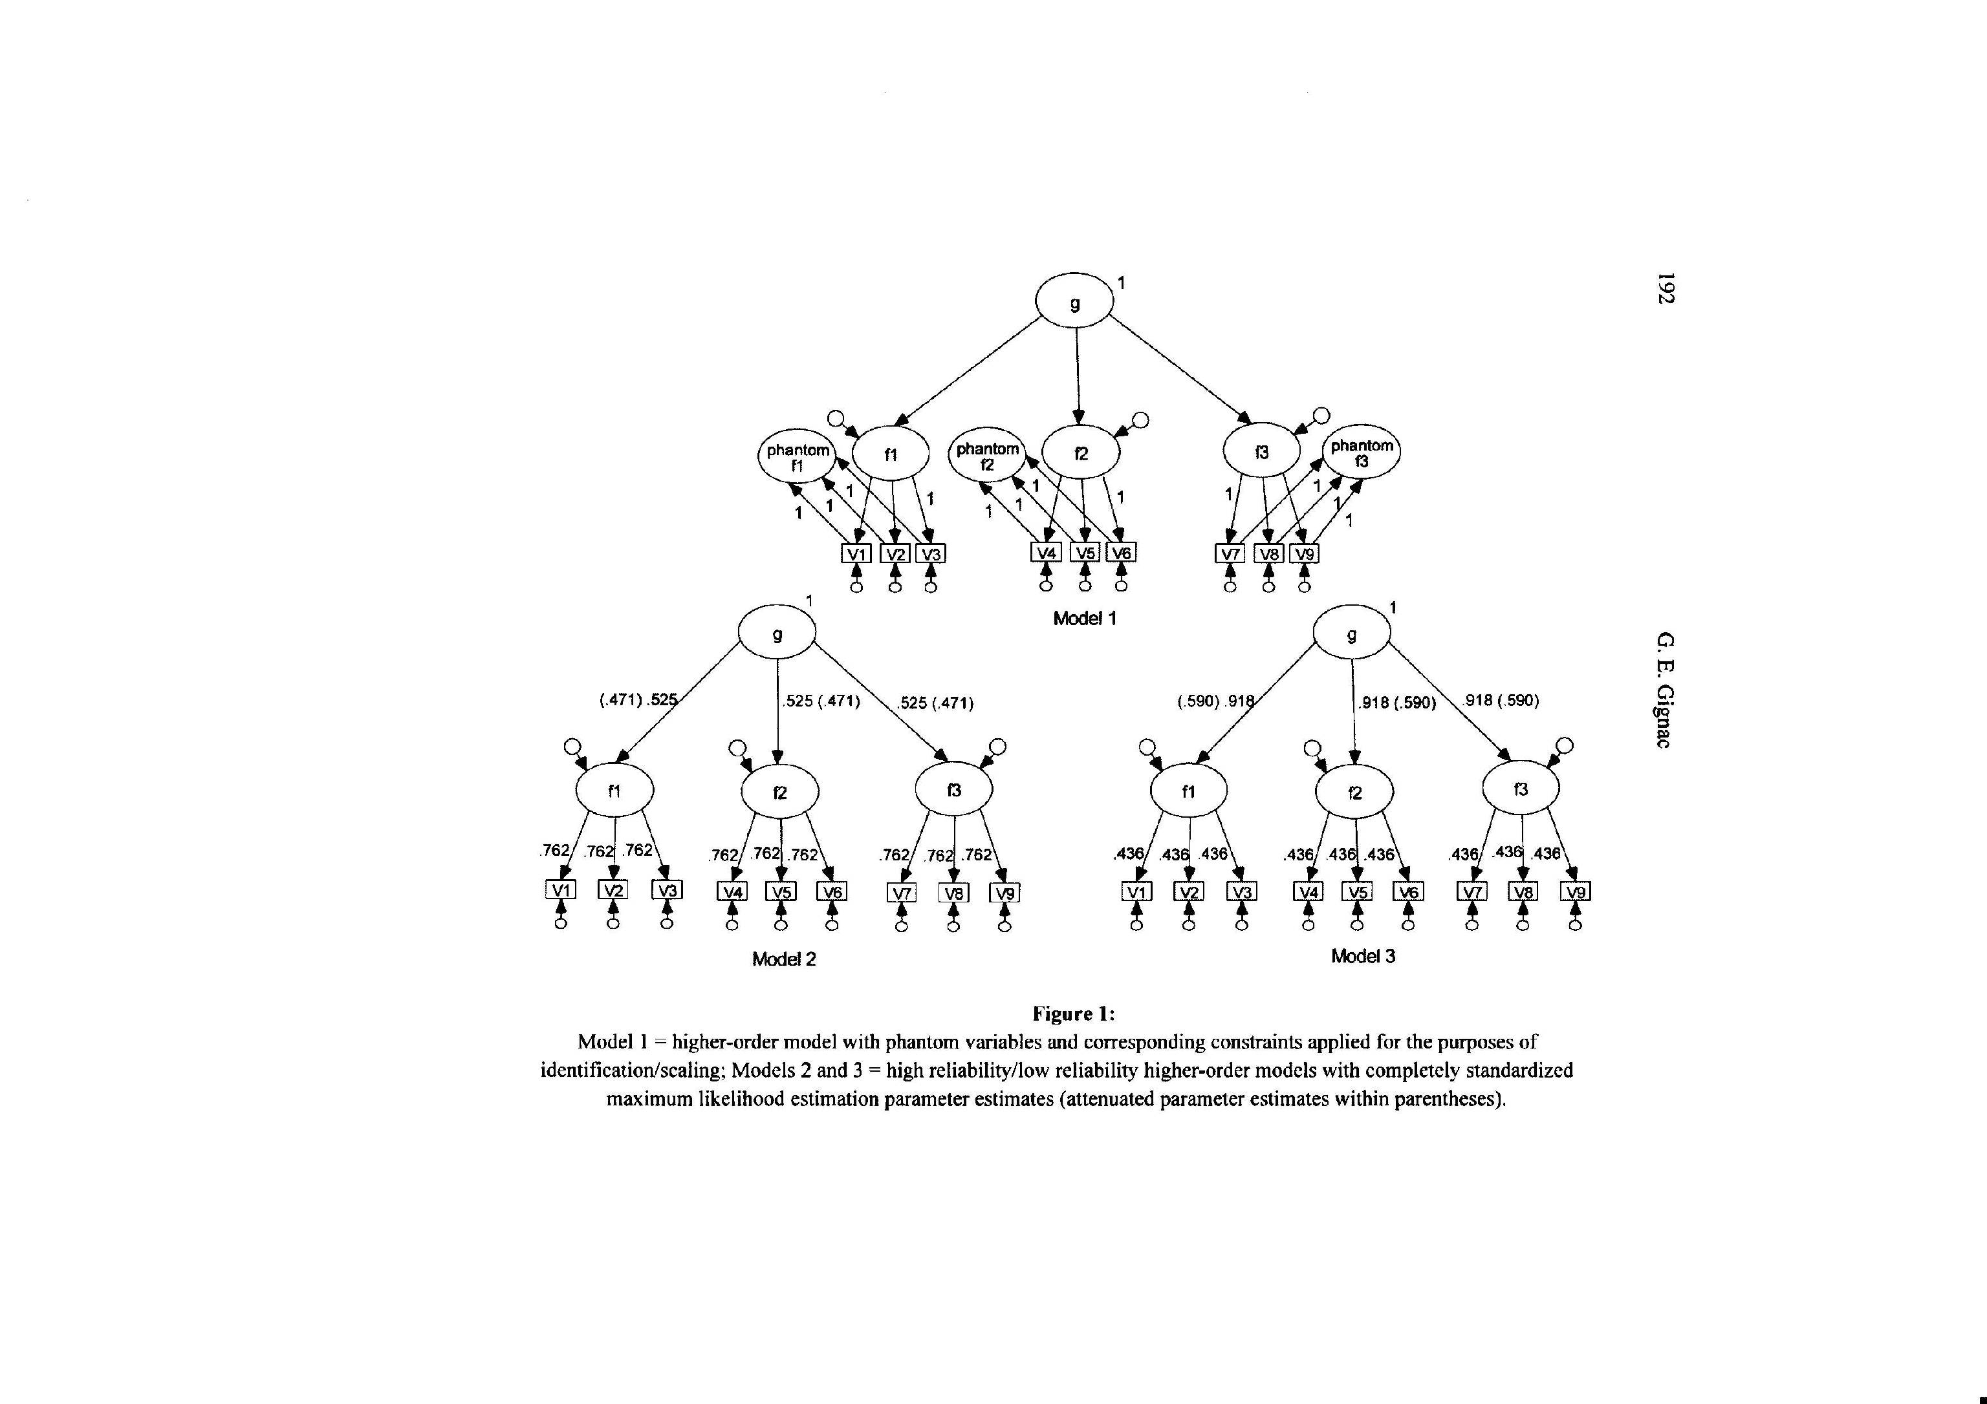
Der Schritt von der manifesten zur latenten Ebene
Beispiel mit künstliche Daten von Gignac:
- Linkes Beispiel: reliable Indicatoren
- Rechtes Beispiel: unreliable Indicatoren
Demonstration of abuse due to unreliability by Gignac using artificial data
Nachtrag : Missbrauch im Bereich der IQ-Forschung !
Reliable scores!
Unreliable scores!

Slide 116
The graphical potential

Slide 117
The graphical potential
latent variable modeling within the factor-analytic approach heavily uses graphical illustration
● for communicating structural features of models
● for communicating important results

Slide 118
The graphical potential
latent variable modeling within the factor-analytic approach heavily uses graphical illustration
● for communicating structural features of models
● for communicating important results
Advantage:
● it uses the high capacity for processing visual informantion

Slide 119
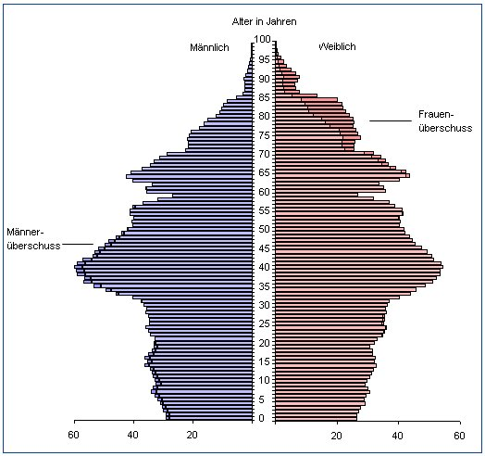
The graphical potential
Age in years
Male
Female

Slide 120
The graphical potential
latent variable
manifest variable
directed relationship
non-directed relationship / correlation

Slide 121
The graphical potential
An example: the graphical representation of a model of measurement
Latent variable
Manifest variable
Manifest variable
Manifest variable

Slide 122
The graphical potential
An example: the graphical representation of a model of measurement
Latent variable
Factor loading
Manifest variable
Manifest variable
Manifest variable
Error component

Slide 123
The graphical potential
An example: the graphical representation of a model of measurement
Latent variable
Manifest variable
Manifest variable
Manifest variable

Slide 124
The graphical potential
An example: the graphical representation of a model of measurement
Latent variable
Manifest variable
Manifest variable
Manifest variable
Error
variable
Error
variable
Error
variable

Slide 125
Summary and brush up:
What is a variable / a construct ?
Some basics
A short history
The latent – manifest contrast
The priority of theory
The specificities of the model
The need to be complete
The step from the manifest to latent levels
The graphical potential
… a placeholder / a scientifically elaborated idea
-
… observable / not observable
… it is a confirmatory approach
… models are more detailed than theories
… testing extends to the whole model
The gain due to LVM?
… estimates free of error
… use of figures and diagrams

Slide 126
Summary and brush up:
Some basics
A short history
The latent – manifest contrast
The priority of theory
The specificities of the model
The need to be complete
The step from the manifest to latent levels
The graphical potential
The gain due to LVM?
… estimates free of error
… use of figures and diagrams

Slide 127
Questions regarding the first unit:
What is a construct?
What distinguishes manifest from latent?
What is the meaning of confirmatory?

Slide 128
End

