Slide 1
The data and their properties: covariances and correlations

Slide 2
Outline
1. The procedure
2. The requirements regarding data
3. The characteristic properties of real data
4. The typical data problems
5. Covariances and correlations as input

Slide 3
Outline
1. The procedure
2. The requirements regarding data
3. The characteristic properties of data
4. The typical data problems
5. Covariances and correlations as input

Slide 4
The PROCEDURE
CFA and SEM combine features of different statistical approaches for investigating the structur of data.
One of these approaches has grown out of the analysis of the covariance matrix (AoC) (Jöreskog, 1970)

Slide 5
The PROCEDURE
Analysis of the covariance matrix (AoC) (Jöreskog, 1970) amounts to contrasting …
… the empirical covariance matrix (S) - and -
… the model-implied matrix (Σ)

Slide 6
The PROCEDURE
Analysis of the covariance matrix (AoC) (Jöreskog, 1970) amounts to contrasting …
… the empirical covariance matrix (S) - and -
… the model-implied matrix (Σ)
… for the purpose of this comparison the parameters included in Σ must be specified; the whole of them is represented by θ
… so that Σ ( θ )

Slide 7
The PROCEDURE
Analysis of the covariance matrix (AoC) (Jöreskog, 1970) amounts to contrasting …
… the empirical covariance matrix (S) - and -
… the model-implied matrix (Σ)
… the difference d(S,Σ ( θ )) is determined
… it has to be as small as possible

Slide 8
The PROCEDURE
•Analysis of the covariance matrix (AoC) (Jöreskog, 1970)
amounts to contrasting …
This means that the input to AoC is …
… a covariance matrix (CM) - or -
… a correlation matrix (KM) - or –
… the matrix including the raw data (in this case the
computer mostly transforms the data in CM or KM)

Slide 9
Outline
1. The procedure
2. The requirements regarding data
3. The characteristic properties of data
4. The typical data problems
5. Covariances and correlations as input

Slide 10
The requirements regarding data
The requirements regarding data are determined by the model of measurement: …. that is what we know
X = μ + Λξ + δ respectively Y = μ + Λη + ε
continuous, continuous,
normally distributed normally distributed
… assures a high degree of accuracy
… is a useful statistical assumption

Slide 11
The requirements regarding data
The requirements regarding data are determined by the model of measurement:
X = μ + Λξ + δ respectively Y = μ + Λη + ε
? continuous, ? continuous,
normally distributed normally distributed
i.e. X and Y must be continuous and normally distributed!

Slide 12
The requirements regarding data: SUPPLEMENT
Why is it necessary that there is correspondence
Answer: the estimation of the parameters included in Σ is based on
assumptions; there are the assumptions that x and y are continuous and
normally distributed

Slide 13
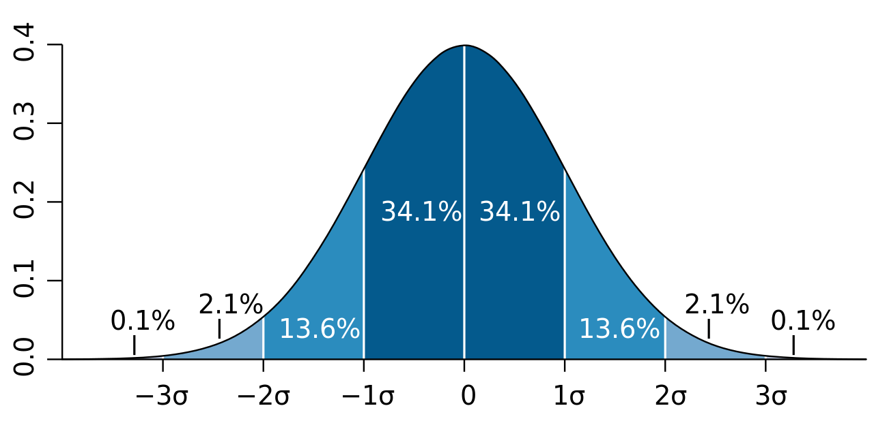
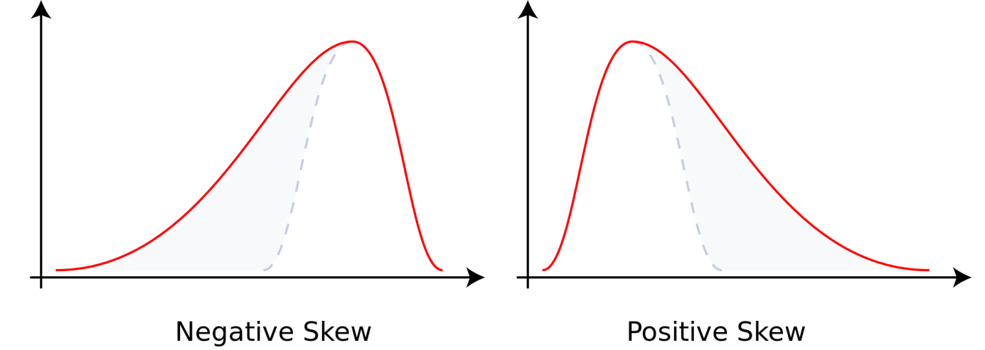
The requirements regarding data
What means a violation of these assumptions?
An example
Assume that x is skewed instead of normally distributed.
Normal distribution

Slide 14
The requirements regarding data
What means a violation of these assumptions?
An example
Assume that x is skewed instead of normally distributed.
Variance
Normal distribution
… skewness diminishes the variance!!!

Slide 15
The requirements regarding data
What means a violation of these assumptions?
An example
Assume that x shows to be platykurdic (= it is broader than normel)
… now the variance of the variable is larger than otherwise!!!

Slide 16
The requirements regarding data
What are the consequences of a violation of assumptions?
An example regarding consequences
- assume a set of items measuring the same construct but …
• some data show skewness, some the normal distribution, some are platykurdic
- the data are investigated by the same latent variable of the same model
- as a consequence, the true variance of some items is …
• underestimated
• overestimated
- the reproduction of parts of the covariance matrix may be flawed:
cov(x_{i},x_{j}) may deviate from σ_{ij} = λ_{i} x λ_{j}

Slide 17
The requirements regarding data
What are the consequences of a violation of assumptions?
… a number of method studies show that violations of the distributional assumptions lead to problems regarding model fit and correctness of parameter estimation
… e.g. :
Lai, K. (2018). Estimating standardized SEM parameters given nonnormal data and incorrect model: methods and comparisons. Structural Equation Modeling, 25(4), 1-21. doi: 10.1080/10705511.2017.1392248
West, S. G., Finch, J. F., & Curran, P.J. (1995). Structural equation models with non-normal variables: problems and remedies. In R. Hoyle (Ed.), Structural Equation Modeling: Concepts, Issues, and Applications (pp. 56-75). SAGE.

Slide 18
The requirements regarding data
Deviations from the requirements are likely to lead to …
- problems in reproducing the empirical covariance matrix
- problems in parameter estimation

Slide 19
Outline
1. The procedure
2. The requirements regarding data
3. The characteristic properties of data
4. The typical data problems
5. Covariances and correlations as input

Slide 20
The characteristic properties of data: scale
In psychological research data are typically …
- binary data
- dichotomous data
- categorical data
- ordered categorical data
- ordinal Data
- frequencies
- (rarely) data showing intervall scale

Slide 21
The characteristic properties of data: scale
Search for one example for each type of data, i.e. for …
- binary data ?
- dichotomous data ?
- categorical data ?
- ordered categorical data ?
- ordinal Data ?
- frequencies ?
- (rarely) data showing intervall scale ?

Slide 22
The characteristic properties of data: scale - Examples
Search for one example for each type of data, i.e. for …
- binary data male / female
- dichotomous data poor / rich
- categorical data apples / pears / oranges
- ordered-categorical data (Likert data) ratings like „agree fully“ …
- ordinal Data grades
- frequencies hours on computer
- (rarely) data showing intervall scale age

Slide 23
The characteristic properties of data: scale
In psychological research data are typically …
- binary data
- dichotomous data
- ordered categorical data (Likert data)
- ordinal Data
- frequencies
- (rarely) data showing intervall scale
Only these types get usually accepted as continuous!

Slide 24
The characteristic properties of data: distribution
In psychological research, data typically show …
- (rarely) a normal distribution 正态分布
- a distribution that is similar to the normal
distribution (e.g. a skewed distribution 偏态分布 )
the binomial distribution (二项分布)
not clearly identifiable distribution
fits to the requirements!
… can be modified
to fit requirement
Yes no
responses

Slide 25
Outline
1. The procedure
2. The requirements regarding data
3. The characteristic properties of data
4. The typical data problems
5. Covariances and correlations as input

Slide 26
The typical data problems
Necessary mathematical operations that are not really allowed
computation of variances方差 and covariances协方差
e.g. gender data have to be investigated (this means binary data) – the
researcher computes the arithmetic mean 算术平均数!
Wrong! The arithmetic mean is only appropriate for continuous data!

Slide 27
The typical data problems
Variances and covariances are computed using mathematical operations that are not appropriate
The observed variances and covariances may deviate from the expected variances and covariances because of …
- … characteristic dependencies (e.g. there may be a
dependency of variances (and covariances) on the
item difficulties 难度 [mean]as in binary data )
variance
easy difficult

Slide 28
The typical data problems
Variances and covariances are computed using mathematical operations that are not really appropriate
The observed variances and covariances deviate from the expected variances and covariances because of …
- … characteristic dependencies (e.g. there may be a
dependency of variances and covariances on the
item difficulties as in binary data )
- … skewness of the distribution (or another distributional irregularity
e.g. kurtosis, more than one peak)
Skewness 偏态 distorted variances 方差减小

Slide 29
Outline
1. The procedure
2. The requirements regarding data
3. The characteristic properties of data
4. The typical data problems
5. Covariances and correlations as input

Slide 30
Covariances and correlations as input
Covariances and Pearson correlations based on the products of moments usually are expected as input
- the pre-condition is that they are computed from continuous and
normally distributed data
… in order to overcome restrictions regarding scale and distribution, special coefficients have been developed!

Slide 31
Covariances and correlations as input: the scale
Covariances and Pearson correlations based on the products of moments usually are expected as input
- Problem: the data are binary / dichotomous
● Compute tetrachoric correlations 四分相关
- Problem: the data are ordered-categorical (or ordinal)
● Compute polychoric correlations 多分相关

Slide 32
Covariances and correlations as input: the scale
Covariances and Pearson correlations based on the products of moments usually are expected as input
- Problem: the data are binary
● Compute tetrachoric correlations
- Problem: the data are ordered-categorical (or ordinal)
● Compute polychoric correlations
- Problem: the data are ordered-categorical (or ordinal) with more than 6 categories
● Treat the data as continuous

Slide 33
Covariances and correlations as input: the scale
A supplement
The computation of tetrachoric and polychoric correlations
includes the computation of thresholds 临界值 (that is necessary for the transformation into the normal distribution) :
i.e. the thresholds establish the relationship to continuous and normally distributed parameters

Slide 34
Covariances and correlations as input: the scale
A supplement
The computation of tetrachoric and polychoric correlations
includes the computation of thresholds (that is necessary for the adaptation to the normal distribution) :
i.e. the thresholds establish the relationship to continuous and normally distributed parameters. They serve as basis for the computation of correlations that are in line with the requirements of the model of measurement!

Slide 35
Covariances and correlations as input: the scale
A supplement
The computation of tetrachoric and polychoric correlations
includes the computation of thresholds with respect to the normal distribution …
There is a major disadvantage:
in the marginal areas of the normal distribution the thresholds are usually not very accurate (i.e. in data obtained by very easy or very difficult items. Therefore, very large samples are necessary for achieving accurate estimates)
•A consequence is that in very easy or very difficult items very high correlations can be observed
(that is bad because the other correlations may be low)!
• Another consequence is that the input matrix may not be positive definite 正定的.

Slide 36
Covariances and correlations as input: the scale
A supplement
Covariances based on product moments and Pearson correlations usually are expected / used as input
- Problem: the data are binary
● Compute tetrachoric correlations
● Alternatively: compute probability-based covariances 概率协方差
(Schweizer, Ren, & Wang, 2015)
(… additionally needs a link transformation)

Slide 37
Covariances and correlations as input: the scale
A supplement
The formula for computing the probability-based covariance:
cov(X_{i},X_{j}) = Pr(X_{i}=1 ˄ X_{j}=1) – Pr(X_{i}=1)×Pr(X_{j}=1)
with X_{i} und X_{j} as binary variables.

Slide 38
Covariances and correlations as input: the scale
A supplement: an example
The probability-based covariance of handedness and arts interest:
Handedness Arts interest cov(X_{i},X_{j}) = Pr(X_{i}=1 ˄ X_{j}=1) – Pr(X_{i}=1)Pr(X_{j}=1)
right yes
left no Pr(handedness=right) = 4/7 = 0.571
left no Pr(arts interest=yes) = 3/7 = 0.428
right no Pr((handedness=right) and (arts interest=yes)) = 3/7 = 0.428
right yes
left no cov(handeness,arts interest) = 0.428 – 0.244 = 0.184
right yes r = 0.184 / (0.493 x 0.493 ) = 0.417

Slide 39
Covariances and correlations as input: the scale
A supplement
.....................
Computing the probability-based covariance performs only
the step from binary to continuous.
A link transformation is additionally necessary (… is described in another course unit)
Link transformations are used for relating variables
showing different distributions to each other.

Slide 40
Covariances and correlations as input: the scale
Covariances based on product moments and Pearson correlations
…………………………………………………………………………..
- further options
● …. what ever correlation together with robust WLS estimation
WLS is a correction method 修正方法 (that means that it is not a real solution to the problem)

Slide 41
Covariances and correlations as input: the DISTRIBUTION
If the data show skewness, it is necessary to select a special way of parameter estimation
Robust estimation according to Satorra-Bentler
DWLS estimation

Slide 42
Summary and brush up:
… remember: the method amounts to the comparison of empirical and model-based covariance matrices
1. The foundations
2. The requirements regarding data
3. The characteristic properties of data
4. The typical data problems
5. Covariances and correlations as input
… remember: manifest and latent variables must show the same properties
… remember: important properties are scale and distribution
… remember: data frequently do not show the desirable properties so that special adaptation may be required
… remember: the selection of special types of input and estimation method helps to overcome the problems

Slide 43
Questions regarding course unit 3
Which data properties are desirable in CFA and SEM?
Which correlation type should be selected for investigating binary data?
What data type requires the use of polychoric correlations?
Which data type can be used for representing males and females?

Slide 44
Literature
Basic:
Kline, R. b. (2011). Principles and practices of structural equation modeling (3rd edition) (Chapter 1:Introduction). New York, NY: The Guilford Press.
Schweizer, K., Ren, X., & Wang, T. (2015). A comparison of confirmatory factor analysis of binary data on the basis of tetrachoric correlations and of probability-based covariances: a simulation study. In R. E. Millsap, D. M. Bolt, L. A. van der Ark, & W.-C. Wang (Eds.), Quantitative Psychology Research (pp. 273-292). Heidelberg: Springer.

