Slide 1
Factor analysis

Slide 2
Outline
Factor analysis in general
Explorative factor analysis
  Some basics
  Fundamental theorem
  Computational steps
  Communality estimation
  Extraction methods and criteria for the number
  Methods of factor rotation
  Factor interpretation
Confirmatory factor analysis
  Some basics
  Proceeding
  Model specification

Slide 3
Factor analysis in general
Multivariate procedure
Purpose: search for structure
Purpose: data reduction
Purpose: check of assumed structure
Purpose: construction of questionnaire
...................................... .............................................................................................................................................
Two types:
  explorative factor analysis
  confirmatory factor analysis

Slide 4
Factor analysis in general
Multivariate procedure
Purpose: search for structure
e.g. The researcher is interested in learning about humor (what is the structure? ...)

Slide 5
Factor analysis in general
Multivariate procedure
Purpose: search for structure
Purpose: data reduction
e.g. The researcher likes to investigate the effect of humor on health on the basis of 50 humor items

Slide 6
Factor analysis in general
Multivariate procedure
Purpose: search for structure
Purpose: data reduction
Purpose: check of assumed structure
e.g. The researcher has an idea of the structure of humor and likes to check whether it is correct

Slide 7
Factor analysis in general
Multivariate procedure
Purpose: search for structure
Purpose: data reduction
Purpose: check of assumed structure
Purpose: construction of questionnaire
e.g. The researcher likes to construct a humor qestionnaire

Slide 8
Factor analysis in general
Multivariate procedure
Purpose: search for structure
Purpose: data reduction
Purpose: check of assumed structure
Purpose: construction of questionnaire
...................................... .............................................................................................................................................
Two types:
  explorative factor analysis
  confirmatory factor analysis

Slide 9
Explorative/exploratory factor analysis

Slide 10
Some basics
What is exploratory factor analysis?
… it is the search for one or several dimensions that are underlying data collected in using a number of different measures / items.
… it is expected to provide information on which measures / items aligns with which factor.
… there is no clear expectation as in confirmatory factor analysis
Explorative factor analysis

Slide 11
Some basics
Major outcomes of exploratory factor analysis?
… information on the number of underlying dimensions
… information regarding the grouping of measures / items
… information on participants‘ factor scores
Explorative factor analysis

Slide 12
Some basics
A remark:
Factor analysis is not one single method; it is a set of methods that are applied to data in order to achieve the final result.
It is necessary that the application of these methods follow a prescribed sequence of steps.
Explorative factor analysis

Slide 13
Some basics
A remark:
.....
It is necessary that the application of these methods follow a prescribed sequence of steps.
There are steps that require to choose between a number of alternative methods (e.g. extraction methods, rotation methods).
Explorative factor analysis

Slide 14
Fundamental theorem
This theorem formalizes basic assumptions of factor analysis.
It can be considered as a kind of precursor of the model of measurement.
Explorative factor analysis

Slide 15
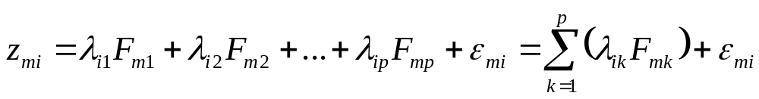
Fundamental theorem
A standardized score is described as a linear combination of factor scores, of their weights and an error component
Explanation of symbols:
m: Person
i : Item
λ: Factor loading
F: Factor score
ε: Error component
Explorative factor analysis

Slide 16
Fundamental theorem
Example:
Assume z_{mi} is the score of Tina (participant) who completed item i that is an analogy problem:
z_{Tina,item_i} = λ_{item_i,analogical reasoning}F_{Tina,analogical reasoning}+…
+λ_{item_i,figural reasoning}F_{Tina,figural reasoning}+…
+λ_{item_i,verbal reasoning}F_{Tina,verbal reasoning}+ε
analogical reasoning figural reasoning verbal reasoning
(Abilities that possibly contribute to performance)
Explorative factor analysis

Slide 17
Fundamental theorem
Example:
Assume z_{mi} is the score of Tina (participant) who completed item i that is an analogy problem:
z_{Tina,item_i} = λ_{item_i,analogical reasoning}F_{Tina,analogical reasoning}+…
+λ_{item_i,figural reasoning}F_{Tina,figural reasoning}+…
+λ_{item_i,verbal reasoning}F_{Tina,verbal reasoning}+ε
Information is regarding Tina and item!
Explorative factor analysis

Slide 18
Fundamental theorem
Example:
Assume z_{mi} is the score of Tina (participant) who completed item i that is an analogy problem:
What do we know before conducting exploratory factor analysis?
z_{Tina,item_i} = λ_{item_i,analogical reasoning}F_{Tina,analogical reasoning}+…
+λ_{item_i,figural reasoning}F_{Tina,figural reasoning}+…
+λ_{item_i,verbal reasoning}F_{Tina,verbal reasoning}+ε
Explorative factor analysis

Slide 19
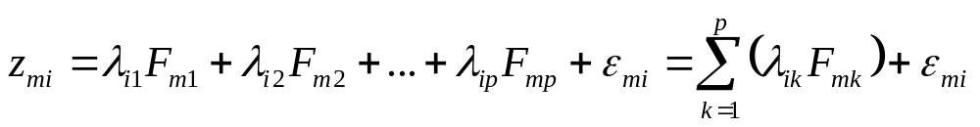
Fundamental theorem
What is achieved by factor analysis?
Explorative factor analysis

Slide 20
Fundamental theorem
What is achieved by factor analysis?
… is given
… are achieved as estimates
Explorative factor analysis

Slide 21
Fundamental theorem
What is achieved by factor analysis (from the technical perspective)?
the factor loadings
the number of substantial factors
(event.) the factor scores
(error estimates)
Explorative factor analysis

Slide 22
Procedural steps
The various methods contributing to explorative factor analysis have to be applied in successive steps.
Explorative factor analysis

Slide 23
Procedural steps
Computation of correlation matrix
Selection of extraction methode
Estimation of communalities
Factor extraction
Determination of the number of factors
Factor rotation
Factor interpretation
Explorative factor analysis

Slide 24
Procedural steps
The research problem for illustrating factor analysis
There are six items for assessing a person‘s mood …..
… but it is not known whether these items represent one attribute that is in this case mood or different attributes.
Explorative factor analysis

Slide 25
1.Computation of correlation matix
Data
An example: an item for assessing the persons‘ mood
I am very angry
really angry
angry
somewhat angry
not angry
ₒ
ₒ
ₒ
ₒ
ₒ
Explorative factor analysis

Slide 26
1.Computation of correlation matix
Data
An example: an item .... the coding
I am very angry
really angry
angry
somewhat angry
not angry
ₒ 1
ₒ 2
ₒ 3
ₒ 4
ₒ 5
The following moods are considered …
angry, nervous, grieved, determined, strong, excited
Explorative factor analysis

Slide 27
1.Computation of correlation matix
An example:
 | angry | nervous | grieved | determined | strong | excited
angry | 1.000 | .329 | .346 | .123 | -.207 | -.042
nervous | .329 | 1.000 | .405 | -.125 | -.317 | -.136
grieved | .346 | .405 | 1.000 | -.009 | -.389 | -.238
determined | .123 | -.125 | -.009 | 1.000 | .247 | .310
strong | -.207 | -.317 | -.389 | .247 | 1.000 | .372
excited | -.042 | -.136 | -.238 | .310 | .372 | 1.000
Explorative factor analysis

Slide 28
Procedural steps
Computation of correlation matrix
Selection of extraction methode
Estimation of communalities
Factor extraction
Determination of the number of factors
Factor rotation
Factor interpretation
Explorative factor analysis

Slide 29
2.Selection of extraction method
Extraction methods serve
... the identification of the factors (components) that are basic for describing / explaining the data (space)
(There is a tradition to consider the search for factors as seach for axes of a high-dimentional space)
Explorative factor analysis

Slide 30
2.Selection of extraction method
Extraction methods serve
... the identification of the factors (components) that are basic for describing / explaining the data
Illustration: spatial representation of data and factor
Data as spots in a multi-dimensional data space
Factor (dimension; axis)
Explorative factor analysis

Slide 31
2.Selection of extraction method
Extraction methods serve
... the identification of the factors / components that are basic for describing / explaining the data (space)
(There is a tradition to consider the seearch for factors as seach for as axes of a high-dimentional space)
→ The mathematical method of factor extraction searches for the of axis in the data space that enables the factor to account for as much variance as possible
→ After one or several factor(s) have been detected, the search for the next factor follows the principle that this new factor has to account for the successively largest amount of variance
Explorative factor analysis

Slide 32
2.Selection of extraction method
There are two types of basic methods for factor extraction (or component extraction):
Component analysis
observed variables are without error
theoretically the whole variance is explained
(PCA)
(actual) Factor analysis
observed variables include error
identifies latent variables (reflecting constructs)
explains only the true variance
(FA)
Explorative factor analysis

Slide 33
2.Selection of extraction method
There are two types of basic methods for factor extraction:
Only (actual) factor analysis fits with the framework of modeling latent variables
Component analysis
observed variables are without error
theoretically the whole variance is explained
(PCA)
(actual) Factor analysis
observed variable including error
identifies latent
Explorative factor analysis

Slide 34
2.Selection of extraction method
There are two types of basic methods for factor extraction:
Only (actual) factor analysis fits with the framework of modeling latent variables
This means …
• Factor extraction has to be done by (actual) factor analysis
• Component analysis is only necessary for determining the number of factors (… is explained in another section)
Explorative factor analysis

Slide 35
2.Selection of extraction method
.... it means for the user to select one of the available methods for factor extraction.
Using SPSS it means ...
Explorative factor analysis

Slide 36
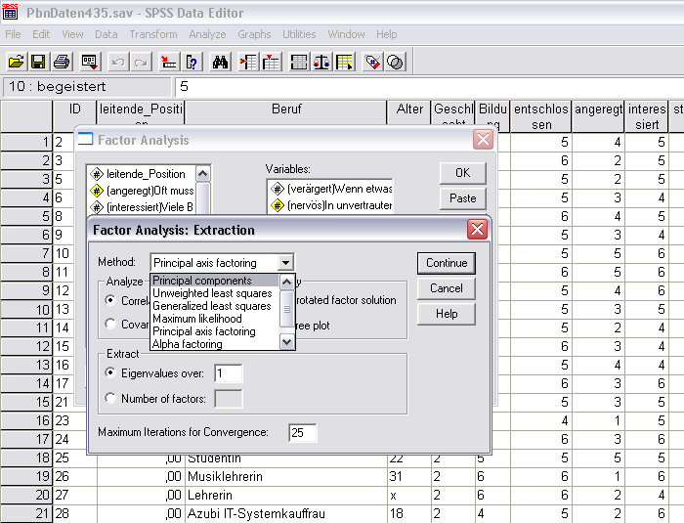
2. … SPSS
Explorative factor analysis

Slide 37
Procedural steps
Computation of correlation matrix
Selection of extraction methode
Estimation of communalities
Factor extraction
Determination of the number of factors
Factor rotation
Factor interpretation
Explorative factor analysis

Slide 38
3.Estimation of communalities
This step is necessary because the true (=systematic) variance of the items is not known!
The true variance of the item is referred to as its
communality
A number of methods for estimating communality is available
No one of them is considered perfect
Research showed that the best estimates are obtainable in a iterative way
Explorative factor analysis

Slide 39
3.Estimation of communalities
Modern methods of factor analysis estimate communality in iterative circles:
  Initial estimates start the search for communalities
  → (mostly) squared multiple correlation
  of a variable with the other variables
  serve as initial estimates
Explorative factor analysis

Slide 40
3.SPSS Output
Example
Communalities
Initial
Final
Extraction
angry
.193
,362
nervous
.242
,332
grieved
.296
,471
determined
.165
,336
strong
.287
,453
excited
.207
,348
Extraction Method: Principal Axis Factoring.
Explorative factor analysis

Slide 41
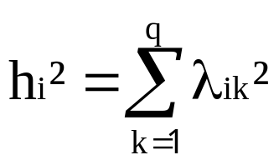
3.Estimation of communalities
A post-hoc definition of communalities is given by …
- disadvantage: this formula is only applicable after
the estimation of the factor loadings
h_{i}² : communality of item i
λ_{ik} : factor loading of item i on factor k
q : number of factors
Explorative factor analysis

Slide 42
3.Estimation of communalities
An example of using the equation:
Item number Factor loading Squared Loading h²
(variable) F₁ F₂ F₁ F₂
1 .30 .10 .09 .01 .10
2 .45 .05 .2025 .0025 .205
.. ……
Explorative factor analysis

Slide 43
3.Estimation of communalities
Practice
Find the communalities for
Item number Factor loading h²
F₁ F₂
1 .43 .09
2 .39 .05
3 .61 .13
4 .00 .35
5 .18 .41
.1848 + .0081 = .1929
.1521 + .0025 = .1546
.3721 + .0169 = .3890
……………………………
Explorative factor analysis

Slide 44
3.Estimation of communalities
A post-hoc definition of communalities is given by …
- disadvantage: this formula is only applicable after
the estimation of the factor loadings
• changes of factor loadings can lead to changes of communalities
• a search process including the modification of factor loadings can lead to larger communalities
• the aim of search is the largest possible communalities
h_{i}² : communality of item i
λ_{ik} : factor loading of item i on factor k
q : number of factors
Explorative factor analysis

Slide 45
Procedural steps
Computation of correlation matrix
Selection of extraction methode
Estimation of communalities
Factor extraction
Determination of the number of factors
Factor rotation
Factor interpretation
Explorative factor analysis

Slide 46
4.Factor extraction
Factor extraction is a complex process
- it includes
( > the maximization of the communalities )
> the estimation of factor loadings
(> the determination of the number of factors )
Explorative factor analysis

Slide 47
4.Factor extraction
Factor extraction is a complex process
- it includes
(> the maximization of the communalities )
> the estimation of factor loadings
(> the determination of the number of factors )
It occurs iteratively (with the exception of the last one)
Explorative factor analysis

Slide 48
4. … SPSS
Starting the program after the method selection means parameter estimation
Explorative factor analysis

Slide 49
4.Factor extraction
Factor extraction is designed as …
.. search for estimates of the parameters that are suited for reproducing the correlation matrix R
i.e. the parameters included in Λ (the factor loadings) have to be estimated
i.e. reproduction means the calculation of the product of the factor loading matrix Λ (Λ Λ‘) (plus the diagonal matrix of error components Θ) so that it is equal to the correlation matrix R
R = ΛΛ^{T} + Θ
Explorative factor analysis

Slide 50
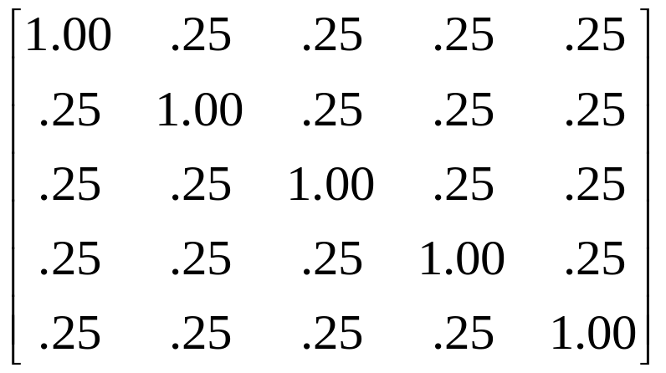
4.Factor extraction
Factor extraction is designed as …
.. reproduction of the correlation matrix
e.g. assume the given correlation matrix:
R=
Explorative factor analysis

Slide 51
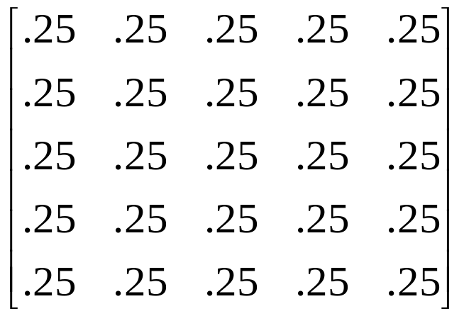
4.Factor extraction
Factor extraction is designed as …
.. reproduction of the correlation matrix
e.g. assume that 0.25 as communality replaces the diagonal elements
R_{h}=
Explorative factor analysis

Slide 52
4.Factor extraction
Factor extraction is designed as …
.. reproduction of the correlation matrix
... requires a vector λ or a matrix Λ so that ...
or
(one factor case) (case of several factors)
R_{h}= λ λ^{T}
R_{h}= Λ Λ^{T}
T means transpose
Explorative factor analysis

Slide 53

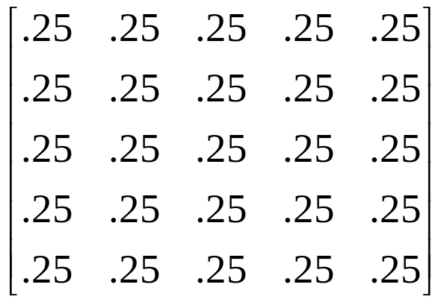
4.Factor extraction
Factor extraction is designed as …
.. reproduction of the correlation matrix
e.g. reproduces
λ=
R_{h}=
Explorative factor analysis

Slide 54
4.Factor extraction
Factor extraction is designed as …
.. reproduction of the correlation matrix
It is achieved by cross-multiplication:
[ .5 .5 .5 .5 .5 ]
=λ^{T}
X
λ=
.25
Explorative factor analysis

Slide 55
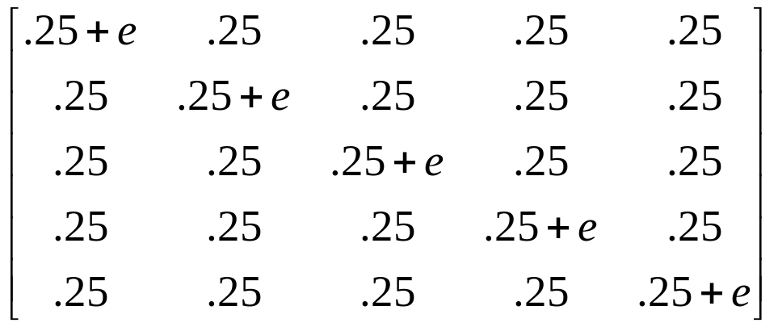
4.Factor extraction
Factor extraction is designed as …
.. reproduction of the correlation matrix
e.g. Communality Remainder
λ=
R =
Explorative factor analysis

Slide 56
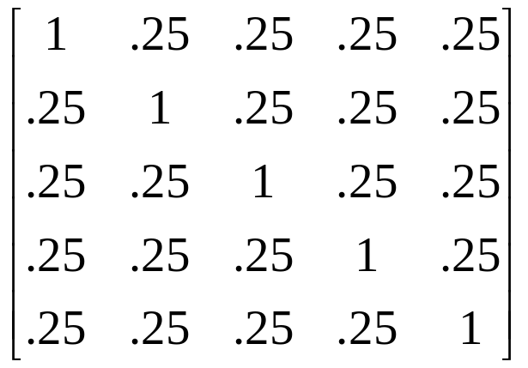
4.Factor extraction
Factor extraction is designed as …
.. reproduction of the correlation matrix
e.g. … for e=.75 (remainder):
λ=
R =
Explorative factor analysis

Slide 57
4.Factor extraction
Factor extraction is designed as …
.. reproduction of the correlation matrix
It is achieved by cross-multiplication:
[ .5 .5 .5 .5 .5 ]
=λ^{T}
X
λ=
.25
Explorative factor analysis

Slide 58
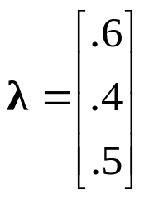
4.Factor extraction
Practice
Find the matrix that is reproduced by the following vector of factor loadings:
It is achieved by cross-multiplication:
Explorative factor analysis

Slide 59
4.Factor extraction
Practice
Find the matrix that is repreduced by the following vector of factor loadings:
It is achieved by cross-multiplication:
λ^{T} = [.6 .4 .5]
.36 .. ..
.. .. ..
.. .. ..
Explorative factor analysis

Slide 60
4.Factor extraction
Practice
Find the matrix that is repreduced by the following vector of factor loadings:
Compute the missing numbers:
λ^{T} = [.6 .4 .5]
.36 .. ..
.. .. ..
.. .. ..
Explorative factor analysis

Slide 61
4.Factor extraction
Factor extraction is designed as …
... reproduction of the correlation matrix
... with the re-estimation of communalities (and factor loadings) in an iterative way
Explorative factor analysis

Slide 62
4.Factor extraction
Factor extraction is designed as …
... reproduction of the correlation matrix
... with the re-estimation of communalities (and factor loadings) in an iterative way
... repeated reproduction of the correlation matrix using modified parameters
until a convergence criterion is reached.
Explorative factor analysis

Slide 63
4.Factor extraction
Factor extraction is designed as …
...
A note.
- only in the case of several factors the communality shows major changes during iteration (see example with two factors).
Explorative factor analysis

Slide 64
4.SPSS Output
Communalities
Initial
Final
Extraction
angry
Before starting the iteration
.193
.362
After the end of the iteration
nervous
.242
.332
grieved
.296
.471
Enlargement of communality
determined
.165
.336
strong
.287
.453
excited
.207
.348
Extraction Method: Principal Axis Factoring.
Explorative factor analysis

Slide 65
4. Factor extraction
The final outcome of the factor extraction is the factor matrix
(here in the case of
two factors):
a
Factor Matrix
Factor
1
2
angry
.426
.425
nervous
.553
.162
grieved
.649
.224
determined
-.256
.520
strong
-.651
.172
excited
-.454
.377
Extraction Method: Principal Axis Factoring.
a.
Explorative factor analysis
2 factors extracted. 10 iterations required.

Slide 66
4.SPSS Output
The matrix of factor loadings λ achieved in the end of factor extraction
a
Factor Matrix
Factor
1
2
angry
.426
.425
High loadings
nervous
.553
.162
High loadings
grieved
.649
.224
determined
-.256
.520
strong
-.651
.172
excited
-.454
.377
Extraction Method: Principal Axis Factoring.
a.
2 factors extracted. 10 iterations required.
Explorative factor analysis

Slide 67
Procedural steps
Computation of correlation matrix
Selection of extraction methode
Estimation of communalities
Factor extraction
Determination of the number of factors
Factor rotation
Factor interpretation
Explorative factor analysis

Slide 68
5. Determination of …
Number of factors
Determination of the number of factors to be extracted
The 3 most important methods
  Kaiser-Guttman criterion
  Scree test
  Parallel analysis
Explorative factor analysis

Slide 69
5. Determination of …
Number of factors
...........
Note.
eigen values play a major role;
“eigen value“ is a term that is
used to describe the amount of
variance explained by a factor
Explorative factor analysis

Slide 70
5. Determination of …
Number of factors
...........
Note.
we distinguish between “relevant eigen value“ and “eigen value due to chance“
Explorative factor analysis

Slide 71
5. Determination of …
Kaiser-Guttman criterion
All factors with eigen values (amount of explained variance) larger 1 are retained
If eigen value >1, then the corresponding factor explains more variance than a single variable
Problem:
Frequent over-estimation of number
Factors at random can have eigen values >1
Explorative factor analysis

Slide 72
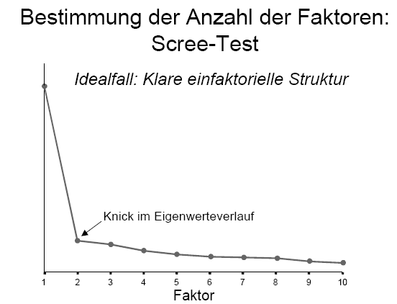
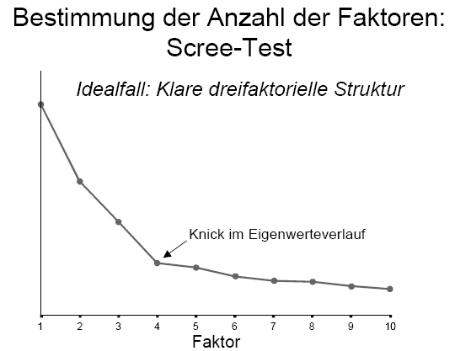
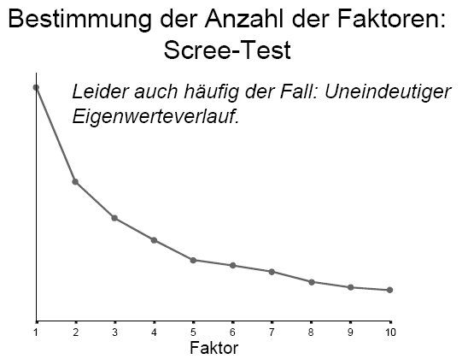
5. Determination of …
Scree test
Sorting of factors according to eigen values
Entry of eigenvalues in a diagram
Relevant are all factors before the „bend“ point
Ideal case
Clear case
Unclear case
no real bend
Bend
Bend
Explorative factor analysis

Slide 73
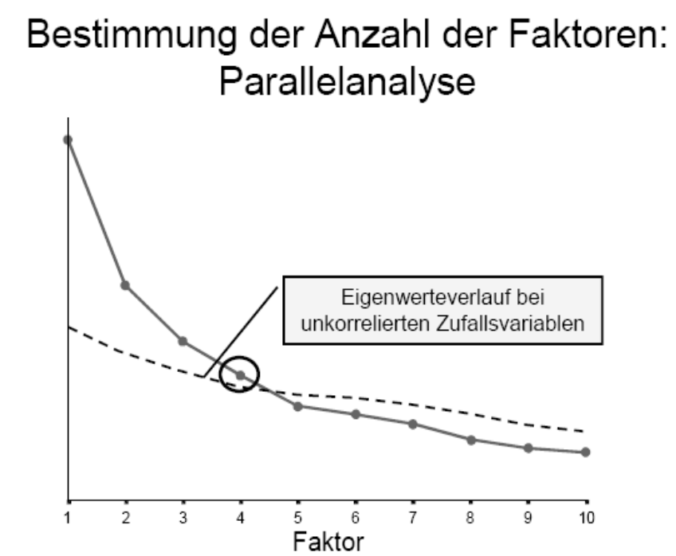
5. Determination of …
Parallel analysis
Best detection of eigen values due to chance
(1) computation of eigen values at random, (2) entry into the diagram besides the observed eigen values
Determination of the number of factors: parallel analysis
Curve of eigen values at random
Explorative factor analysis

Slide 74
Procedural steps
Computation of correlation matrix
Selection of extraction methode
Estimation of communalities
Factor extraction
Determination of the number of factors
Factor rotation
Factor interpretation
Explorative factor analysis

Slide 75
5.Rotation methods
Why is rotation necessary?
The results of factor extraction usually leads to a bad interpretation
The literal aim of rotation is the achievment of factors that enable a „good“ interpretation
Explorative factor analysis

Slide 76
5.Rotation methods
Note. If there are two or more factors virtually always the reproduction of the correlation matrix is possible by means of different patterns of factor loadings
Rotation of factors in the factor space means transformation of factor loadings
Explorative factor analysis

Slide 77
5.Rotation methods
Note. If there are two or more factors virtually always the reproduction of the correlation matrix is possible by means of different patterns of factor loadings
Rotation of factors in the factor space means transformation of factor loadings
Formal goal of factor rotation (criterion)
simple structure
of the pattern of factor loadings
Explorative factor analysis

Slide 78
5.Rotation methods
Principle of simple structure
… includes rules:
each variable should show a large loading on one factor only and small loading on the other factors
each factor should have several high loadings
Explorative factor analysis

Slide 79
5.Rotation methods
Principle of simple structure
This means .... (e.g.) F1 F2 F3
XX XX XX
XX XX XX
XX XX XX
XX XX XX
XX XX XX
XX XX XX
XX XX XX
XX XX XX
XX XX XX
XX XX XX
Explorative factor analysis

Slide 80
5.Rotation methods
An example: illustration of how factor rotation changes the factors as axes of a two-dimensional space
Explorative factor analysis

Slide 81
5.Rotation methods
Situation after factor extraction
Factor 2
Faktor 2
Factor 1
Faktor 1
Each factor explains as much variance as possible.
Explorative factor analysis

Slide 82
5.Rotation methods
Situation after factor rotation
Factor 2
Faktor 2
rFactor 2
rFactor 1
Faktor 2
Faktor 1
Factor 1
Faktor 1
Explorative factor analysis

Slide 83
5.Rotation methods
Orthogonal rotation procedures
Uncorrelated original factors
Rotated factors are uncorrelated with each other
Varimax rotation (prominent example)
Sum of the squared factor loadings λ² within each factor is maximized
Explorative factor analysis

Slide 84
5.Rotation methods
Situation after factor rotation
rFactor 2
rFactor 1
Faktor 2
Faktor 1
90º
Explorative factor analysis

Slide 85
5.Rotation methods
Oblique rotation procedure
After rotation factors are no more uncorrelated
Oblimin rotation (prominent example)
Simultaneous optimization of an orthogonal and an oblique rotation criterion
The influences of the two criteria can be modified by selecting weights; they influence the resulting correlation of factors
Explorative factor analysis

Slide 86
5.Rotation methods
Situation after factor rotation
(Version 1)
rFactor 2
rFactor 1
Faktor 2
Faktor 1
≠ 90º
Explorative factor analysis

Slide 87
5.Rotation methods
Situation after factor rotation
(Version 1)
rFactor 2
rFactor 1
Faktor 2
Faktor 1
≠ 90º
Explorative factor analysis

Slide 88
5.Rotation methods
Situation after factor rotation
(Version 1)
rFactor 2
rFactor 1
Faktor 2
Faktor 1
≠ 90º
Explorative factor analysis

Slide 89
5.Rotation methods
Situation after factor rotation
(Version 2)
rFactor 1
Faktor 1
90º
Explorative factor analysis

Slide 90
5.Rotation methods
Situation after factor rotation
(Version 2)
rFactor 2
rFactor 1
Faktor 2
Faktor 1
90º
Explorative factor analysis

Slide 91
5.SPSS Output
Evaluation regarding cross-loadings:
a
Factor Matrix
a
Rotated Factor Matrix
Factor
Factor
1
2
1
2
angry
angry
.426
.425
.590
.115
nervous
nervous
.553
.162
.550
-.173
grieved
grieved
.649
.224
.663
-.175
determined
determined
-.256
.520
.077
.574
strong
strong
-.445
.505
-.651
.172
excited
excited
-.167
.566
-.454
.377
Extraction Method: Principal Axis Factoring.
Extraction Method: Principal Axis Factoring.
Rotation Method: Varimax with Kaiser Normalization.
a.
2 factors extracted. 10 iterations required.
a.
Rotation converged in 3 iterations.
Explorative factor analysis

Slide 92
5.SPSS Output
Evaluation regarding highest loadings:
a
Factor Matrix
a
Rotated Factor Matrix
Factor
Factor
1
2
1
2
angry
angry
.426
.425
.590
.115
nervous
nervous
.553
.162
.550
-.173
grieved
grieved
.649
.224
.663
-.175
determined
determined
-.256
.520
.077
.574
strong
strong
-.445
.505
-.651
.172
excited
excited
-.167
.566
-.454
.377
Extraction Method: Principal Axis Factoring.
Extraction Method: Principal Axis Factoring.
Rotation Method: Varimax with Kaiser Normalization.
a.
2 factors extracted. 10 iterations required.
a.
Rotation converged in 3 iterations.
Explorative factor analysis

Slide 93
Procedural steps
Computation of correlation matrix
Selection of extraction methode
Estimation of communalities
Factor extraction
Determination of the number of factors
Factor rotation
Factor interpretation
Explorative factor analysis

Slide 94
6.Factor interpretation
Assigning meaning to factors
Interpretion of the items sets
A interpretation has to be based on the meanings of the items showing large loading on the factor
Explorative factor analysis

Slide 95
6.SPSS Output
a
Rotated Factor Matrix
Factor
1
2
angry
.590
.115
nervous
?
?
.550
-.173
+
grieved
.663
-.175
determined
.077
.574
strong
-.445
.505
excited
-.167
.566
Extraction Method: Principal Axis Factoring.
Rotation Method: Varimax with Kaiser Normalization.
a.
Rotation converged in 3 iterations.
Explorative factor analysis

Slide 96
6.Factor interpretation
Factor 1:
- angry
- nervous
- grieved
- weak (= - strong)
Factor 2:
- determined
- strong
- excited
What are the common categories?
Explorative factor analysis

Slide 97
6.Factor interpretation
Factor 1:
- angry
- nervous
- grieved
- weak (= - strong)
Factor 2:
- determined
- strong
- excited
Emotionality (?)
Self-confidence (?)
Explorative factor analysis

Slide 98
A note.
A standardized score is described as a linear combination of factor scores, of their weights and an error component
Explanation of symbols:
m: Person
i : Item
λ: Factor loading
F: Factor score
ε: Error component
Explorative factor analysis

Slide 99
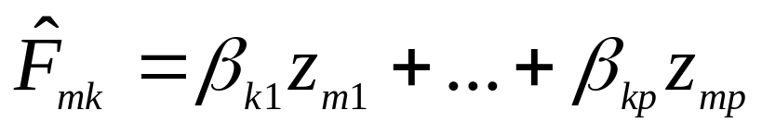
A note
Furthermore, after the factors are identified there is the possibility to compute the factor scores of the participants (see fundamental equation).
Explanation of symbols:
F: Factor score
m: Person
k : Ability/Trait (Factor)
β: Regression weight
ε: Error component
z: Standardized score
Explorative factor analysis

Slide 100
"I'm not sure what is here and there are too many measures to make sense of, so let's do a factor analysis and reduce the measures to a more restricted set of variables and see what emerges"
A humorous characterization
of what a researcher does when he/she has no idea of what to do with many correlations between scales
Explorative factor analysis

Slide 101
Summary and brush up:
Explorative factor analysis
  Some basics
  Fundamental theorem
  Computational steps
  Communality estimation
  Extraction methods
  Determination of number of factors
  Method of factor rotation
  Factor interpretation
What is the basic idea of explorative factor analysis?
… search for underlying dimensions
… formal representation of assumptions
… communality estimation , factor extraction, rotation, etc.
... estimation of explained variance
… methods employed identifying factors
… criteria for finding the number of to be extracted factors
…orthogonal and oblique rotation methods, simple structure principle
… find the common categories for factors

Slide 102
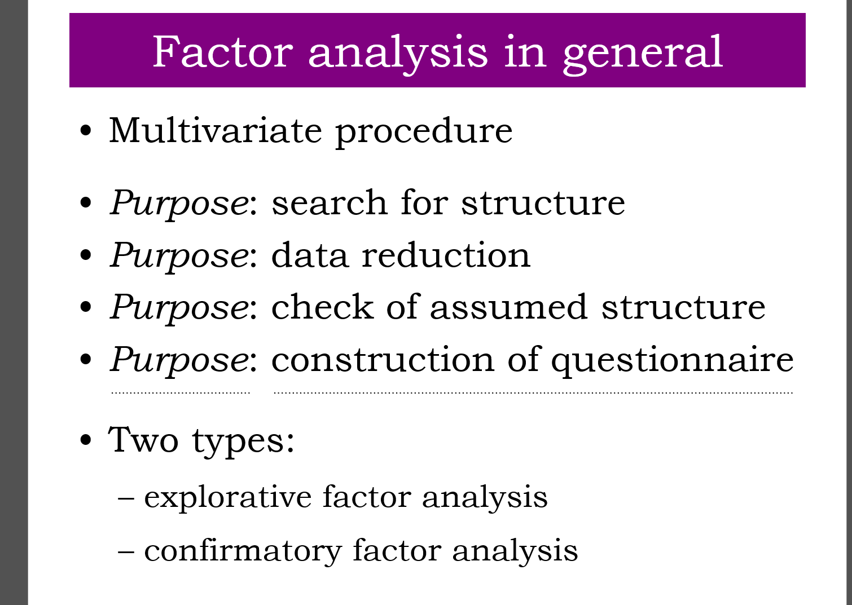
QUESTIONS REGARDING COURSE UNIT 4
What are the purposes for selecting FA?
What type of variance is represented by the communality?
Why is factor rotation conducted?
What is the principle of factor rotation?
Explorative factor analysis

Slide 103
Literature
Brown, T. A. (2006) Confirmatory factor analysis (S. 1-11, 40-76). New York, NJ: The Guilford Press

