Slide 1
CORRELATION
PARTIAL CORRELATION
MULTIPLE REGRESSION
Modeling latent variables

Slide 2

Outline
1. Introduction
2. Correlation
3. Partial correlation
  Definition
  Example
4. Multiple Regression
  Introduction
  Partial regression
  Example
5. The causality problem
  Definition
  Example

Slide 3
1. Introduction
This course unit is focused on modeling the relationships between latent variables at the latent level.

Slide 4
1. Introduction
Structural model
Measurement model of exogenous variable
Measurement model of endogenous variable
ζ₁
δ₁
x₁
λ₁₁
λ₁₁
y₁
ε₁
γ₁₁
η₁
ξ₁
δ₂
x₂
λ₂₁
y₂
λ₂₁
ε₂
Indicators
Indicators
Latent variables

Slide 5
1. Introduction
Structural model
Measurement model of exogenous variable
Measurement model of endogenous variable
ζ₁
δ₁
x₁
λ₁₁
λ₁₁
y₁
ε₁
γ₁₁
η₁
ξ₁
δ₂
x₂
λ₂₁
y₂
λ₂₁
ε₂
Indicators
Indicators
Latent variables

Slide 6
1. Introduction
Methods telling us something about the structure are presented
  Correlation
  Partial correlation
  Regression / multiple regression

Slide 7
1. Introduction
In the following methods are discussed that are in use for investigating relationships between variables.

Slide 8
2. Correlation

Slide 9
2. The correlation
The correlation serves the description of relationships between variables
  It provides information on the degree of the relationship
  It provides no information on the direction of the relationship (same direction vs contrary)

Slide 10
2. The correlation
There are different types of correlation:
  Pearson correlation / PM correlation
  tetrachoric correlation
  polychoric correlation
  biserial correlation
  Phi coefficient
  rank correlation
  point-biserial correlation
Data scales:
interval – interval
binary – binary
ordered cat. – ord. cat.
binary – ordinal
dichotomous – dich.
ordinal – ordinal
binary - interval

Slide 11
2. The correlation
There are different types of correlation:
  Pearson correlation / PM correlation
  tetrachoric correlation
  polychoric correlation
  biserial correlation
  Phi coefficient
  rank correlation
  point-biserial correlation
… of importance:

Slide 12
2. The correlation
An example: the correlation of „logical thinking“ and „creativity“:
  There is information on the size of the correlation but not on the direction of an influence
.3

Slide 13
2. The correlation
Note. Correlation coefficients typically assume that there is a linear relationship
Variable A
(Regression line)
Variable B
… it can enables basic prediction:
X*
X

Slide 14
2. The correlation
Note. Correlation coefficients typically assume that there is a linear relationship
  But there may be a non-linear relationship or different relationships in sub-groups
Variable A
Variable B
Variable A
Variable A
Variable B
Variable B

Slide 15
2. The correlation
Note. Correlation coefficients typically assume that there is a linear relationship
  But there may be a non-linear relationship or different relationships in sub-groups
  … such cases should be avoided; search for reasons.

Slide 16
2. The correlation
Note. Correlation coefficients typically assume that there is a linear relationship
How to find out? Use the scatterplot
Variable A
Variable B

Slide 17
2. The correlation
Note. Correlation coefficients typically assume that there is a linear relationship
It also helps to detect outliers!
Variable A
outlier
Variable B

Slide 18
2. The correlation
The correlation is important because it can provide the basis for investigating hypotheses
  … it can be assumed to include several effects
  … it can provide the basis for estimating effects

Slide 19
3. Partial correlation

Slide 20
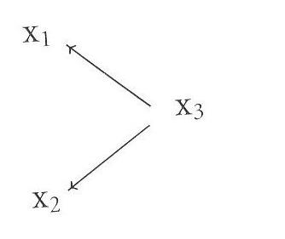
3. Partial correlation: aspects
Idea: The correlation may not reflect the assumed latent structure
Possibility: x1 and x2 are influenced by x3 // x3 brings about the correlation between x1 and x2
A high correlation between x1 and x2 may be a fake correlation

Slide 21
3. Partial correlation: aspects
„fake correlation“ = correlation between two variables that is actually due to another variable
  an example from southern Sweden
  … allegedly the return of storks from their Winter journey coincides with an increase of house burns
  i.e. there is an observable correlation
… the presumably true reason is spring with all kinds of spring activities!

Slide 22
3. Partial correlation: aspects
„fake correlation“ = correlation between two variables that is actually due to another variable
Basic idea of partial correlation:
  There is a correlation between x1 and x2 that is due to x3
  Variables x1 and x2 must be „cleaned“ from the influence of x3 → the influence of x3 must be partialed out
  Correlation „cleaned“ of influence of x₃ on x1 and x2
  → partial correlation

Slide 23
3. Partial correlation: definition
Formula:
computation requires 3 product-moment correlations between x1, x2 and x3
partial correlation is zero? → Indication that the correlation is actually a fake correlation
rx1,x2 - rx1,x3 * rx2,x3
rx1x2 ∙ x3 =
√1-r²x1,x3 * √1-r²x2,x3

Slide 24
3. Partial correlation: example
Example: 2 traits (x2, x₃) plus age (x1) are correlated (r12 =.8; r13 =.7; r23=.6)
Research question: is the relationship of creativity and thinking a „fake correlation“?
x2
Creativity
Age
x1
x3
Thinking

Slide 25
3. Partial correlation: example
Preparation for the application of the formula:
• re-assignment of subscripts
age – creativity (r₁₂) [ r₂₃ ]
age – thinking (r₁₃) [ r₁₃ ]
creativity – thinking (r₂₃) [ r₁₂ ]

Slide 26

3. Partial correlation: example
Result:
Is the influence of the variable age eliminated from the variables creativity and thinking by partialling out, the remaining partial correlation is virtually zero!
In sum: the relationship of x2 and x3 is almost completely due to the influence of x1
Original assignment
r23∙1= r23 - r12 ∙ r13 =
√1-r²12 ∙ √1-r²13
= 0.09

Slide 27
3. Partial correlation: practice
Find out whether the positive correlation between performance in school and intelligence (.4) is due private lessens
x2
Performance in school
(r=.65)
Private lessons
x1
(r=.4)
x3
Intelligence
(r=.2)

Slide 28
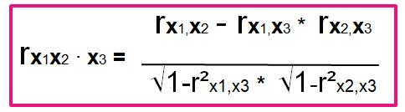
3. Partial correlation: practice
x2
Performance in school
(r=.65)
Private lessons
x1
(r=.4)
x3
Intelligence
(r=.2)
r23∙1= r23 - r12 ∙ r13
√1-r²12 ∙ √1-r²13

Slide 29
3. Partial correlation: practice
Find out whether the positive correlation between performance in school and intelligence (.4) is due private lessens
Possible Results:
.09 / .21 / .28 / .36 / .41
x2
Performance in school
(r=.65)
Private lessons
x1
(r=.4)
x3
Intelligence
(r=.2)

Slide 30
3. Partial correlation
A comment: the partial correlation
… made apparent – probably for the first time – that a correlation can originate from different sources
… is a coefficient for evaluating a hypothesis
(the hypothesis is that variable X₁ is the true source ....)

Slide 31
3. Partial correlation
The idea of the partial correlation is related to the idea of the models of measurement with one latent variable:
… it is variable that establishes the relation of and x₁ and x₂:
x1
r_{X1X2}
x2

Slide 32
4. Multiple regression

Slide 33
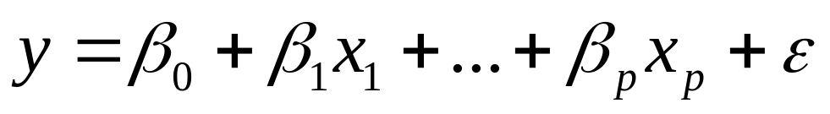
4. Multiple regression: introduction
multiple regression = prediction of a criterion variable (y) using a linear equation model including several predictors (x)
criterion predictor regression weight error component

Slide 34
4. Multiple regression: introduction
multiple regression = prediction of a criterion variable (y) using a linear equation model including several predictors (x)
criterion predictor regression weight error component

Slide 35
4. Multiple regression: introduction
multiple regression = prediction of a criterion variable (y) using a linear equation model including several predictors
one aim of multiple regression: estimation of β weights
β (instead of b) weights are also addressed as standard partial regression coefficients

Slide 36
4. Multiple regression: introduction
... serves the estimation of the effects of several predictors on the criterion
… estimation of β respectively b is conducted according to the ordinary least-square (OLS) criterion:
min = ε'ε
… the estimation method:
b = (X'X)⁻¹ X'y

Slide 37
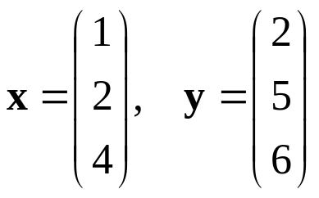
4. Multiple regression: introduction
An example regarding OLS
min = ε'ε
… the estimation method:
b = (X'X)⁻¹ X'y

Slide 38
4. Multiple regression: introduction
An example regarding OLS
min = ε'ε
… the estimation method for one predictor:
b = (x‚x)⁻¹ x'y
x'x = 21
(x'x)⁻¹=1/21
x'y=36
b = 36/21 = 1.71

Slide 39
4. Multiple regression: introduction
... serves the estimation of the effects of several predictors on the criterion
Problem:
... takes the correlations among the predictors into consideration because ...
... overlapping predictions are a major problem:

Slide 40
4. Multiple regression: introduction
… two predictor variables (x1, x2) predict a criterion variable (y)
… no overlap!
x1
x2
The ellipses represent variance of variables
y

Slide 41
4. Multiple regression: introduction
… two predictor variables (x1, x2) predict a criterion variable (y)
x1
x2
The ellipses represent variance of variables
y

Slide 42
4. Multiple regression: introduction
… two predictor variables (x1, x2) predict a criterion variable (y)
Area predicted by both predictors
x1
x2
Formula for the standard partial regression coefficient takes the overlap into consideration
y

Slide 43
4. Multiple regression: example
an example: overlapping predictors
Predictors
Criterion
Age
x1
r=0.7
rx1,x2 =.8
rx1,y = .7
rx2,y = .6
r=0.8
y
Thinking
r=0.6
Creativity
x2
Question: do the correlations reflect the influences of the predictors correctly?

Slide 44
4. The alternative: partial regression
There is an alternative way of estimating regressions weights
… if correlations are available
.. the partial regression coefficient

Slide 45
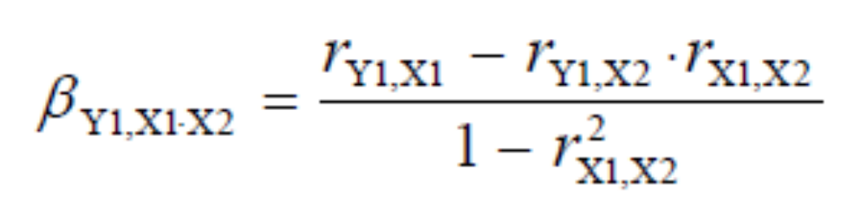
4. Partial regression
The formula for the computation of the standard partial regression coefficient β is ...
Criterion variable
Predictor 1
Predictor 2 (= additionally considered predictor)

Slide 46
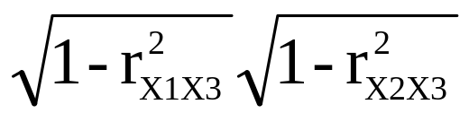
4. Partial regression
The formula for the computation of the standard partial regression coefficient β is ...
… compare denominator of partial correlation:

Slide 47
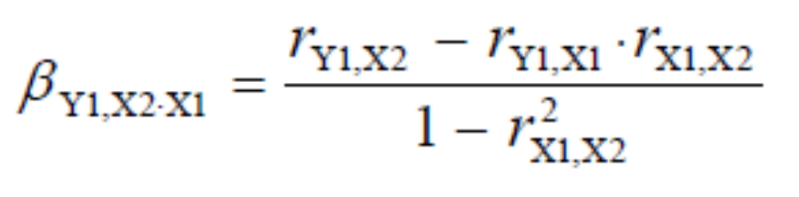
4. Partial regression: example
Formulas:
Criterion: thinking Predictor: age
Criterion: thinking Predictor: creativity

Slide 48

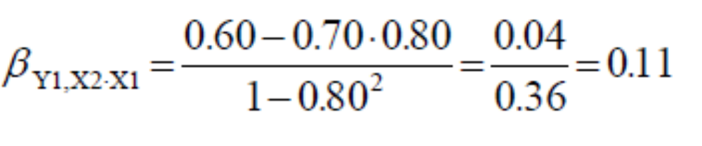
4. Partial regression: example
Equations:
Results:
Predictor: age
Predictor: creativity
Age
Thinking
Creativity
Thinking

Slide 49
4. Partial regression: example
partial regression coefficients:
the criterion thinking is influenced to a higher degree by age than by creativity
the correlation of creativity & thinking: it appears to be to a high degree due to the correlation of the predictors that means due to an indirect effect.
Age
x1
.61 (.7)
r=0,8
y
Thinking
Creativity
x2
.11 (.6)

Slide 50
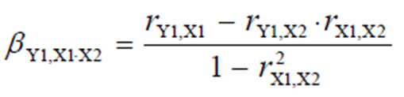
4. Partial regression: practice
Find out how strong the effect of private lessons on performance in school is when taking intelligence into
consideration!
Private lessons
x1
(r=.65)
(r=.2)
x2
Performance in school
x3
(r=.4)
Intelligence

Slide 51
4. Partial regression: practice
Find out whether ….
Private lessons
x1
(r=.65)
(r=.2)
x2
Performance in school
x3
(r=.4)
Intelligence
Possible results: β_{Private lessons} = .51 / .59 / .61 / .64

Slide 52
4. Partial regression: practice
Find out how strong the effect of intelligence on performance in school is in taking private lessons into consideration!
Private lessons
x1
(r=.65)
(r=.2)
x2
Performance in school
x3
(r=.4)
Intelligence

Slide 53
4. Partial regression: practice
Find out …
Private lessons
x1
(r=.65)
(r=.2)
x2
Performance in school
x3
(r=.4)
Intelligence
Possible results: β_{Intellgience} = .00 / .13 / .19 / .28

Slide 54
4. Partial regression: a note
in multiple regression the regression weights are computed on the basis of raw data and the computation is conducted according to another principle.

Slide 55
4. Partial regression: a note
in multiple regression the regression weights are computed on the basis of raw data and the computation is conducted according to another principle.
There are two way of determing regression coefficients:
- computation using formulas
- estimation using estimation methods
• ordinary least square estimation
• maximum likelihood estimation

Slide 56
4. Multiple regression: an analogy
Given the correlations between the latent variables ξ₁, ξ₂ and η, it is possible to compute the standardized partial regression coefficient for the following structural model:
  … with γ₁₁ as β₁ and γ₁₂ as β₂
γ12
ξ2

Slide 57
4. Multiple regression: in sum
multiple regression can be used for investigating effects of several predictors on a criterion
under appropriate preconditions the standard partial regression coefficient can be used for estimating the influences of predictors in the the structural model
it can be conducted on the basis of correlations

Slide 58
5. The causality problem

Slide 59
5. The causality problem
The „causality“ problem of SEM
  There is disagreement among SEM researchers regrading the status of the outcome of SEM:
  Does it tell us something about a causal consequence
  or an effect / an influence?

Slide 60
5. The causality problem
Problem „causality“
  The terms „causality“ and „causal“ are occasionally used for the relationships at the latent level
  … they are used because it can be argued that in the absence of
  error or other influences
  the only source of effect that remains is the exogeneous
  variable

Slide 61
5. The causality problem
Problem „causality“
  The terms „causality“ and „causal“ are occasionally used for the relationships at the latent level
  … but what does causality mean?
  e.g. does turning the switch for the light „cause“ the light
  bulb to illuminate the room?
It is correct, that the „turning of the switch“ causes this specific event!
But taking a general perspective minimizes the importance of the „turning of the switch“
… because it would not work if there were no electricity

Slide 62
5. The causality problem
Problem „causality“
  The terms „causality“ and „causal“ are occasionally used for the relationships at the latent level
  … but what does causality mean?
e.g. it may be argued: „the cause for student X to solve an
arithmetic task is (a high degree of) intelligence“
But taking a general perspective minimizes the importance of „intelligence “
… because solving the task is not possible without reading ability

Slide 63
5. The causality problem
Problem „causality“
  The terms „causality“ and „causal“ are occasionally used for the relationships at the latent level
  In sience there is the established opinion that experimentation is necessary in order to justify the assumption of causality
• experimentation marked the beginning of scientific psychology
• experimentation must include …
- the manipulation of the phenomenon
- several treatment level
- the control of error variables

Slide 64
5. The causality problem
Problem „causality“
  The terms „causality“ and „causal“ are occasionally used for the relationships at the latent level
  Since there is usually no perfect relationship between predictor and criterion variables, the denotation as „directional influence“ or „effect“ is much more appropriate and recommended instead.

Slide 65
5. The causality problem
Further problems in SEM
  The direction of the influence may not even be reflected by the regression weight correctly (regarding the question which variable influences the other variable)

Slide 66
5. The causality problem
Structural model
X measurement model
Y measurement model
ζ₁
δ₁
x₁
λ₁₁
λ₁₁
y₁
ε₁
γ₁₁
η₁
ξ₁
δ₂
x₂
λ₂₁
y₂
λ₂₁
ε₂
Indicators
Indicators
Latent variables

Slide 67
5. The causality problem
Further problems in SEM
  In some cases there is even the situation that
  and
  i.e. both models lead to the same parameter estimates
  and model fit:
Part X:
γ_{Α}
Part Y:
ξ
η
γ_{Β}
η
ξ
γ_{Α} = γ_{Β}

Slide 68

Summary and brush up:
CORRELATION
PARTIAL CORRELATION
MULTIPLE REGRESSION
1. ……
2. Correlation
3. Partial correlation
4. Multiple Regression
… measure of the closeness of the relationship / but there may be a linearity problem
… signifies what remains after removing the effect of another variable from the correlation
… prediction of criterion variable by means of several predictor variables

Slide 69
QUESTIONS REGARDING COURSE UNIT 6
What is a fake correlation?
What is a standardized partial regression coefficient?
What is an indirect effect?
Which correlations are suitable for CFA, SEM?
Explorative factor analysis

Slide 70
Literature
Kline, R. B. (2011). Principles and practices of structural equation modeling (3rd edition) (Chapter 2: Basic statistical concepts: correlations and regression, Chapter 5: Introduction to path analysis). New York, NJ: The Guilford Press.
Cohen, J., Cohen, P., West, S. G. & Aiken, L. S. (2003). Applied multiple regression/correlation analysis for the behavioral sciences (Partial regression, partial correlation, direct and indirect effects: S. 64-79). Mahwah, N.J.: Lawerence Erlbaum.

