Slide 1
PATH ANALYSIS
Modeling latent variables

Slide 2

Outline
  Introduction
  Definition
  Basic assumptions
  Decomposition
  Path coefficients
  Effects
  Application

Slide 3
Path analysis: introduction
Statistical procedure for analysing the structure using directly observable variables
Introduced in 1934 by Sewall Wright (american genetic scientist)
In the 60s-70s very popular in sociology
... is important because principles of path analysis also apply to structural models

Slide 4
Path analysis
... is a method for investigating an a priori postulated path model
A path model is an explanation of why x and y are related to each other
... is conducted on the basis of (observed) covariances and correlations
Major characteristic: estimation of directional and non-directional effects

Slide 5
Path analysis
Specificities of path analysis:
  ... is for observable variables
  ... requires one indicator only (actually no indicator!)
  ... implicitly assums that there is no error of measurement

Slide 6
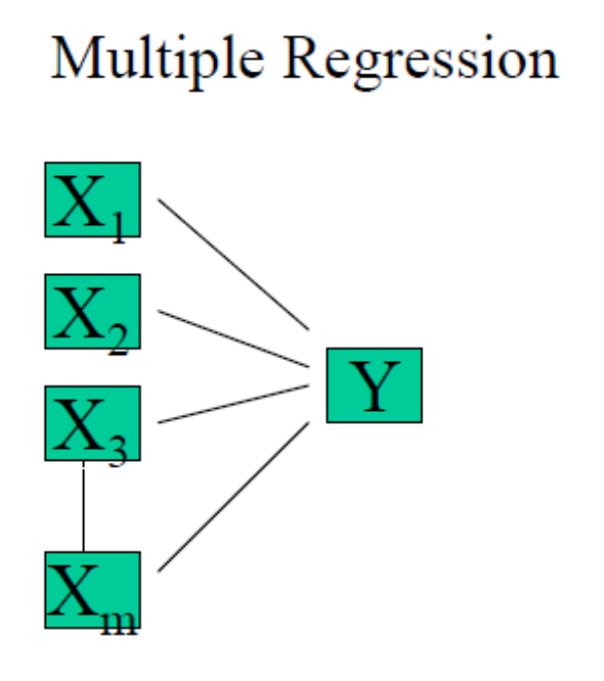
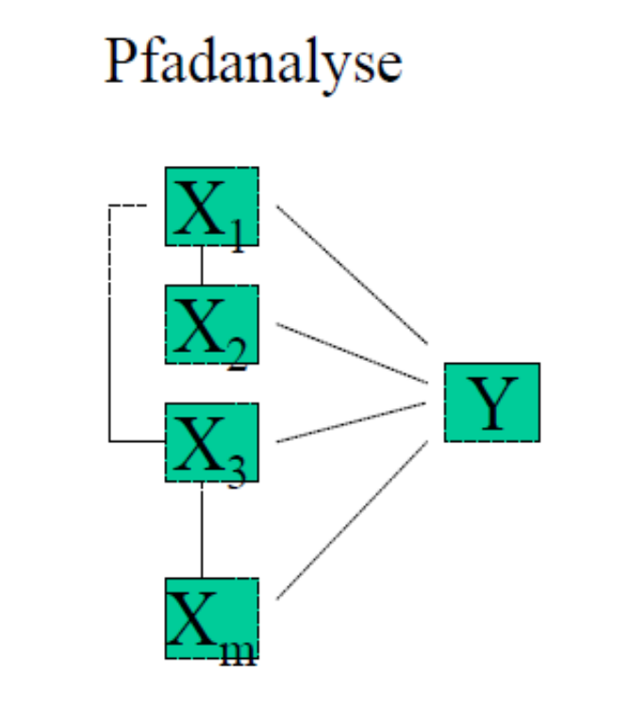

Path analysis
A comparison of path analysis and multiple regression
Multiple regression Path analysis
i. e. X3 can influence Y using different paths

Slide 7
Path analysis
A comparison ...
Multiple regression Path analysis
i. e. X3 can influence Y using different paths (see red lines)

Slide 8
Path analysis: basic assumption
A correlation can comprise several directional and non-directional effects
Path analysis decomposes a correlation (or covariance) in directional and non-directional components
→ „decomposition of correlations into effects“

Slide 9
Path analysis
Decomposition of effects:
CORRELATION
Directional effect
Non-directional
relationship
Direct
Indirect
Non-explained effect
Fake association
X Y
X Y1 Y2
X ∩ D

Slide 10
Path analysis
Simple path model with
  two independent variables X₁ and X₂, a mediator variable Y₁ and a dependent variable Y₂
  … the variables give rise to six correlations
X1
py2,x1
py1,x1
py2y1
rx1,x2
Y1
Y2
py1,x2
py2x2
X2

Slide 11
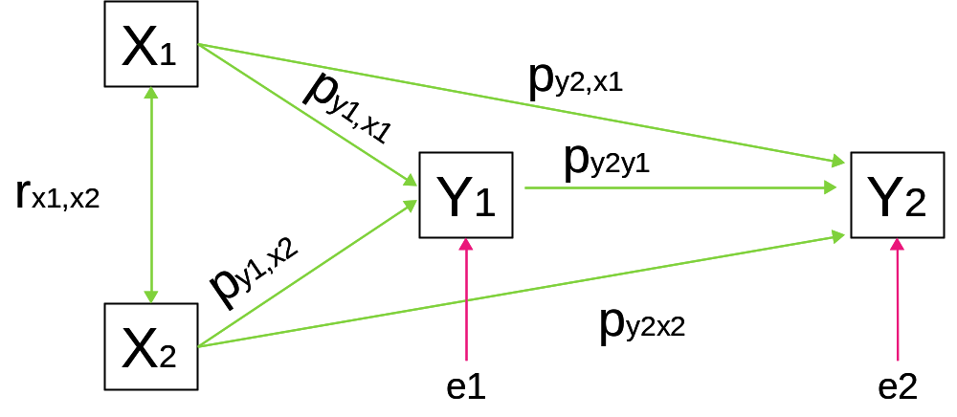
Path analysis: decomposition
Decomposition the correlation rx1,y2.
DE = Direct effect
IE = Indirect effect
NE = by the model not explained effect
rx1,y2 = py2,x1 + ….
(DE) +
To be estimated parameters of a path model:
  [ Product-moment Korrelations (r) ]
  Path coefficients (p)

Slide 12
Path analysis
Decomposition the correlation rx1,y2.
DE = Direct effect
IE = Indirect effect
NE = by the model not explained effect
rx1,y2 = py2,x1 + (py1,x1)∙(py2,y1) + (rx1,x2)∙(py2,x2) + …
(DE) + (IE) + (NE) +
To be estimated parameters of a path model:
  [ Product-moment Korrelations (r) ]
  Path coefficients (p)

Slide 13
Path analysis
Decomposition the correlation rx1,y2.
DE = Direct effect
IE = Indirect effect
NE = by the model not explained effect
rx1,y2 = py2,x1 + (py1,x1)∙(py2,y1) + (rx1,x2)∙(py2,x2) + (rx1,x2)∙(py1,x2)∙(py2,y1)
(DE) + (IE) + (NE) + (NE)
To be estimated parameters of a path model:
  [ Product-moment Korrelations (r) ]
  Path coefficients (p)

Slide 14
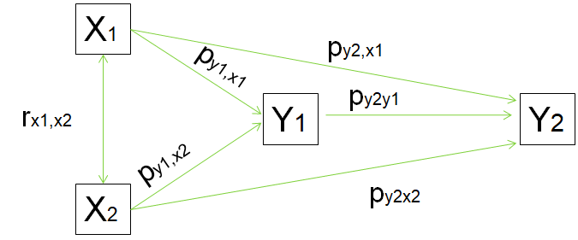
Path analysis
Decomposition:
rx1y1 = py1x1 + (rx1x2)∙(py1x2)
rx2y1 = py1x2 + (rx1x2)∙(py1x1)
rx1y2 = py2x1+(py1x1)∙(py2y1)+(rx1x2)∙(py2x2)+(rx1x2)∙(py1x2)∙(py2y1)
.......

Slide 15
Path analysis: practice
Decomposition:
rx1y1 = py1x1 + (rx1x2)∙(py1x2)
rx2y1 = py1x2 + (rx1x2)∙(py1x1)
rx1y2 = py2x1+(py1x1)∙(py2y1)+(rx1x2)∙(py2x2)+(rx1x2)∙(py1x2)∙(py2y1)
Complete the list of equations:
rx2y2 = ....
ry1y2 = ....

Slide 16
Path analysis
Decomposition:
rx1y1 = py1x1 + (rx1x2)∙(py1x2)
rx2y1 = py1x2 + (rx1x2)∙(py1x1)
rx1y2 = py2x1+(py1x1)∙(py2y1)+(rx1x2)∙(py2x2)+(rx1x2)∙(py1x2)∙(py2y1)
rx2y2 = py2x2+(py1x2)∙(py2y1)+(rx1x2)∙(py2x1)+(rx1x2)∙(py1x1)∙(py1y2)
ry1y2 = py2y1
…..

Slide 17
Path analysis
The new parts of the structure model
X1
py2,x1
py1,x1
py2y1
rx1,x2
Y1
Y2
py1,x2
py2x2
X2

Slide 18
Path analysis
Example
Age (X1) ; creativity (X2)
Thinking (Y1) ; problem solving ability (Y2)
Age
py2,x1
py1,x1
rx1,x2
Thinking
py2y1
Ability
py1,x2
py2x2
Creativity

Slide 19
Path analysis
Decomposition for example:
1 rx1x2 = (age & creativity)
rx1x2
2 rx1y1 = (age & thinking)
  py1x1 + (rx1x2)∙(py1x2)
3 rx2y1 = (creativity & thinking)
  py1x2 + (rx1x2)∙(py1x1)

Slide 20
Path analysis
4 r_{x1y2} = (age & problem solving ability)
  p_{y2x1} +
      + (p_{y1x1})∙(p_{y2y1})
      + (r_{x1x2})∙(p_{y2x2})
        + (r_{x1x2})∙(p_{y1x2})∙(p_{y2y1})
5 r_{x2y2} = (creativity & problem solving ability)
  py2x2 + (py1x2)∙(py2y1)
      + (rx1x2)∙(py2x1)
      + (rx1x2)∙(py1x1)∙(py1y2)

Slide 21
Path analysis
6 ry1y2 = (thinking & problem solving ability) py2y1

Slide 22
Path analysis: the unkowns
Decomposition:
rx1y1 = py1x1 + (rx1x2)∙(py1x2)
rx2y1 = py1x2 + (rx1x2)∙(py1x1)
rx1y2 = py2x1+(py1x1)∙(py2y1)+(rx1x2)∙(py2x2)+(rx1x2)∙(py1x2)∙(py2y1)
rx2y2 = py2x2+(py1x2)∙(py2y1)+(rx1x2)∙(py2x1)+(rx1x2)∙(py1x1)∙(py1y2)
…..
→ Series of linear equations

Slide 23
Path analysis: path coefficients
Decomposition:
rx1y1 = py1x1 + (rx1x2)∙(py1x2)
rx2y1 = py1x2 + (rx1x2)∙(py1x1)
rx1y2 = py2x1+(py1x1)∙(py2y1)+(rx1x2)∙(py2x2)+(rx1x2)∙(py1x2)∙(py2y1)
rx2y2 = py2x2+(py1x2)∙(py2y1)+(rx1x2)∙(py2x1)+(rx1x2)∙(py1x1)∙(py1y2)
…..
→ Series of linear equations
- with path coefficients as unknowns
- the path coefficients can be determined if their number corresponds to
the number of equations
- the path coefficients can be estimated if their number is smaller than the
number of equations

Slide 24
Path analysis
Demonstration of how to find estimates of the path coefficients
Given are r_{x1y1} , r_{x2y1} and r_{x1x2} and the following
decompositions:
rx1y1 = py1x1 + (rx1x2)∙(py1x2) (1)
rx2y1 = py1x2 + (rx1x2)∙(py1x1) (2)
(1) -> (3) - p_{y1x1} = - r_{x1y1} + r_{x1x2} × p_{y1x2}
(3) -> (4) p_{y1x1} = r_{x1y1} - r_{x1x2} × p_{y1x2}
(2) -> (5) r_{x2y1} = p_{y1x2} + r_{x1x2} × (r_{x1y1} - r_{x1x2} × p_{y1x2})
(5) -> (6) r_{x2y1} = p_{y1x2} + r_{x1x2} × r_{x1y1} - r_{x1x2} × r_{x1x2} × p_{y1x2}

Slide 25
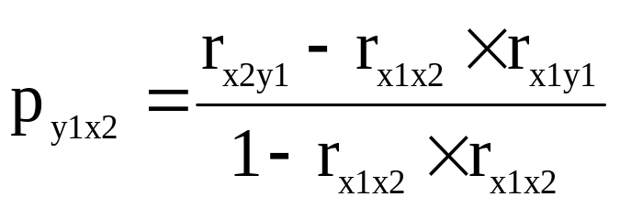
Path analysis
Demonstration of how to find estimates of the path coefficients
…..
(2) -> (5) r_{x2y1} = p_{y1x2} + r_{x1x2} × (r_{x1y1} - r_{x1x2} × p_{y1x2})
(5) -> (6) r_{x2y1} = p_{y1x2} + r_{x1x2} × r_{x1y1} - r_{x1x2} × r_{x1x2} × p_{y1x2}
(6) -> (7) r_{x2y1} = p_{y1x2} × (1 - r_{x1x2} × r_{x1x2}) + r_{x1x2} × r_{x1y1}
(7) -> (8) p_{y1x2} × (1 - r_{x1x2} × r_{x1x2}) = r_{x2y1} - r_{x1x2} × r_{x1y1}
(8) -> (9)

Slide 26
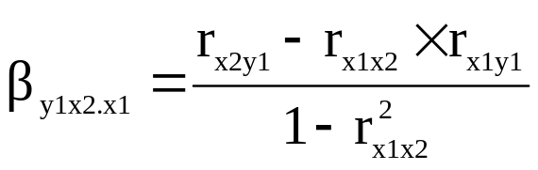
Path analysis
Demonstration of how to find estimates of the path coefficients
…..
... it corresponds to the standardized partial regression coefficent:
(7) -> (8)

Slide 27
Path analysis
Demonstration of how to find estimates of the path coefficients
…..
rx1y1 = py1x1 + (rx1x2)∙(py1x2) (1)
rx2y1 = py1x2 + (rx1x2)∙(py1x1) (2)
... it corresponds to the standardized partial regression coefficent:
(1) -> (3*) - p_{y1x1} = (r_{x1x2})∙(p_{y1x2}) – r_{x1y1}
(3*) -> (4*) p_{y1x1} = r_{x1y1} - (r_{x1x2})∙(p_{y1x2})

Slide 28
Path analysis
Application to the example of regression analysis
Predictors
Criterion
x1
Estimate by p_{yx1} ?
.61
Age
r=0.7
rx1,x2 =.8
rx1,y = .7
rx2,y = .6
r=0.8
y
Thinking
r=0.6
Creativity
x2
Estimate by p_{yx2} ?
.11

Slide 29
Path analysis
Note 1:
In simple structural models multiple regression and path
analysis do equally well.
A complex path model can includes structural unites that
are not possible in a structural model showing the basic
structure of a multiple regression model.

Slide 30
Path analysis
Note 2:
Because of path analysis new parameters become
available: these are measures of direct and indirect
effects.
• new information is available
• but note that the outcome depends on the model (i.e. another
model may lead to another result

Slide 31
Path analysis: effects
Effect estimation :
Direct effects correspond to path coefficients
Indirect effects are estimated by multiplying path coefficients
X1
.60
.70
rx1,x2
Y1
.30
Y2
py1,x2
py2x2
X2

Slide 32
Path analysis
Example with path coefficients added:
Age (X1) ; creativity (X2)
Thinking (Y1) ; problem solving ability (Y2)
Age
.60
.70
rx1,x2
Thinking
.30
Ability
py1,x2
py2x2
Creativity

Slide 33
Path analysis
Example with path coefficients added:
Age (X1) ; creativity (X2)
Thinking (Y1) ; problem solving ability (Y2)
Direct effect (age – ability): .60
Indirect effect (age – ability): .70×.30 = .21
Age
.60
.70
rx1,x2
Thinking
.30
Ability
py1,x2
py2x2
Creativity

Slide 34
Path analysis practice
Example with path coefficients added:
Age (X1) ; memory (X2)
Thinking (Y1) ; problem solving ability (Y2)
Determine the indirect effect of age on ability via memory and thinking !
Age
.194 .288 .421 .502
.60
.70
.8
Thinking
.40
Ability
.9
.3
Memory

Slide 35
Path analysis
Consequences for parameter estimation:
Parameter estimation can be realized as search for the solution(s) of a system of linear equations (i.e. in a somewhat different way as in regression analysis)
Even in complex structures parameter estimation can be conducted on the basis of correlations

Slide 36
Path analysis: application
Frequently the focus is on parts of the complete simple path model:
X1
py2,x1
py1,x1
py2y1
rx1,x2
Y1
Y2
py1,x2
py2x2
X2

Slide 37
Path analysis: application
Frequently the focus is on parts of the complete simple path model:
Model for testing the hierachy of predictors

Slide 38
Path analysis: application
Frequently the focus is on parts of the complete simple path model:
e.g.
.50
Attention
Working memory
.36
.54
Fluid intelligence
Direct effect: 36
Indirect effect: .27

Slide 39
Path analysis: application
Frequently the focus is on parts of the complete simple path model:
X1
py2,x1
py1,x1
py2y1
rx1,x2
Y1
Y2
py1,x2
py2x2
X2

Slide 40
Path analysis: application
Frequently the focus is on parts of the complete simple path model:
Developmental model

Slide 41
In sum
The path analysis brings about new structural feature …..
… increases the complexity of models that can
possibly be investigated
.... enable investigations on the basis of
covariances and correlations

Slide 42

Summary and brush up:
CORRELATION
PARTIAL CORRELATION
MULTIPLE REGRESSION
PATH ANALYSIS
1. ……
2. Path
3. Mediation
4. Decomposition
5. Effect
… an assumed way of influence
… indirect influence
… subdivision into components
… influence

Slide 43
QUESTIONS REGARDING COURSE UNIT 6
What is a path coefficient?
What is a mediation variable?
What kinds of effects are considered in path analysis?
How many indicators are required in path analysis?

Slide 44
Literature
Kline, R. B. (2011). Principles and practices of structural equation modeling (3rd edition) (Chapter 2: Basic statistical concepts: correlations and regression, Chapter 5: Introduction to path analysis). New York, NJ: The Guilford Press.
Cohen, J., Cohen, P., West, S. G. & Aiken, L. S. (2003). Applied multiple regression/correlation analysis for the behavioral sciences (Partial regression, partial correlation, direct and indirect effects: S. 64-79). Mahwah, N.J.: Lawerence Erlbaum.

