Slide 1
Structural Equation Modeling
(SEM)

Slide 2
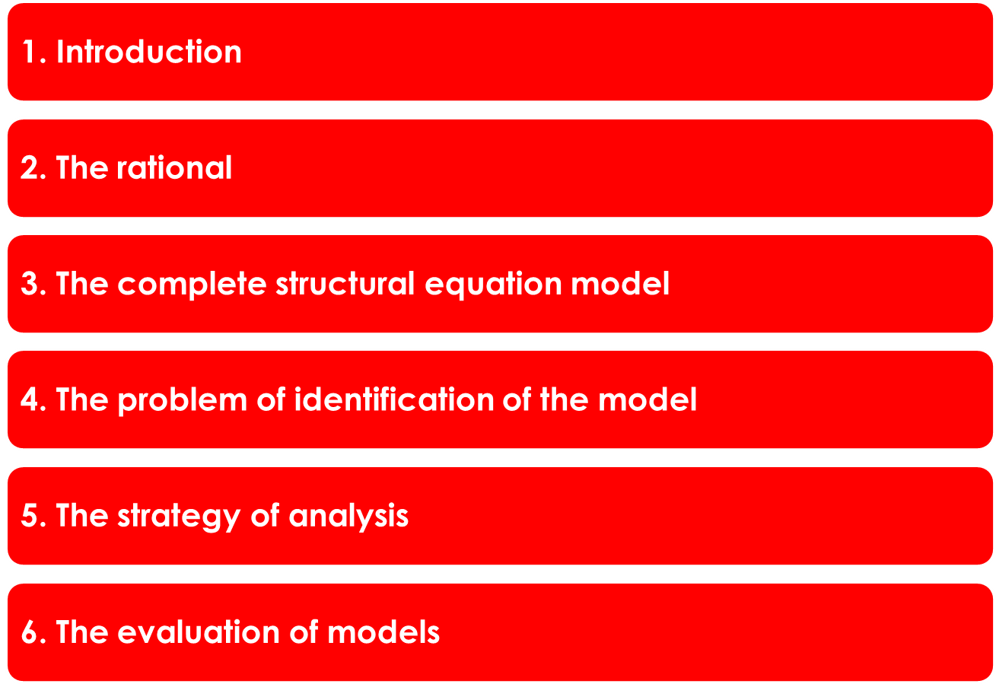
Outline

Slide 3
Introduction
• Structural equation modeling (SEM) is a procedure for conducting structural investigations on the latent level.
• The separation of error from the true component of measurement implies the switch from the manifest to the latent level.
• There are consequences for the relationships of the latent variables!

Slide 4
Slide from the first course unit
The step from the manifest to latent levels
An example: the relationship between intelligence and n-competency with the transfer to the latent level
Obtained by a simple correction method
.5
Latent level
Natural-science competency
Intelligence
Manifest level
.3
Scales
Grades

Slide 5
Introduction
An example
The model
Latent
variable
ξ₁
Latent
variable
ξ₂
λ₁₁
λ₂₁
λ₃₁
λ₄₁
λ₅₁
λ₆₂
λ₇₂
x₁
x₂
x₃
x₄
x₅
x₆
x₇
δ₁
δ₂
δ₃
δ₄
δ₅
δ₆
δ₇
Confirmatory factor analysis

Slide 6
Introduction
An example
Correlations on the manifest level
Latent
variable
ξ₁
Latent
variable
ξ₂
λ₁₁
λ₂₁
λ₃₁
λ₄₁
λ₅₁
λ₆₂
λ₇₂
x₁
x₂
x₃
x₄
x₅
x₆
x₇
r=.04
r=.05
r=.04
r=.05
mean r=.042
r=.03
Confirmatory factor analysis

Slide 7
Introduction
An example
Correlations on the manifest level
Latent
variable
ξ₁
Latent
variable
ξ₂
λ₁₁
λ₂₁
λ₃₁
λ₄₁
λ₅₁
λ₆₂
λ₇₂
x₁
x₂
x₃
x₄
x₅
x₆
x₇
r=.035
r=.04
r=.045
r=.04
mean r=.038
r=.03
Confirmatory factor analysis

Slide 8
Introduction
An example
Correlations on the latent level
.519
Latent
variable
ξ₁
Latent
variable
ξ₂
λ₁₁
λ₂₁
λ₃₁
λ₄₁
λ₅₁
λ₆₂
λ₇₂
x₁
x₂
x₃
x₄
x₅
x₆
x₇
δ₁
δ₂
δ₃
δ₄
δ₅
δ₆
δ₇
mean r=.040
Confirmatory factor analysis

Slide 9
Introduction
• SEM combines several methods; the application of these methods is not apparent to the user.
• Since there is hardly any influence on these methods, SEM teaching is usually focused on explaining how to do structural equation modeling
• Nevertheless, it is good to have an idea of how the results are achieved.

Slide 10
Outline

Slide 11
The rationale
(„Rationale“ means „basic idea* of something or is a (rough) explanation of how it works basically)
In this section structural equation modeling is described by means of different approaches / methods for providing an idea of how it works.
Four perspectives are taken!

Slide 12
The rationale
The perspectives …
Input-output rational … considering the input and output of
a sequence of stages
CFI/MR/PA rationale … doing it as CFI followed by multiple regression or path analysis
EFA/MR rationale … doing it as EFA followed by MR
SEM algorithm-based rationale … doing it be standard SEM software

Slide 13


The rationale
.....
Input-output rational: the explanation concentrating on input and output of the steps
• It starts with the data matrix M (input 1) and leads to the covariance matrix S (output 1):

Slide 14

The rationale
.....
The rationale concentrating on input and output of the steps
• ... the covariance matrix S (input 2) is used for obtaining the matrix of correlations of factors φ (output 2):

Slide 15
The rationale
.....
The rationale concentrating on input and output of the steps
• ... the matrix of correlations of factors φ (input 3) is used for obtaining the matrix of gamma coefficients (partial regression weights / path coefficients) Γ (output 3):
...

Slide 16
The rationale
.....
The rationale concentrating on input and output of the steps
• ... all parameter estimates (input of various steps) are used for the estimation of model fit (final output):
... Σ so that
Fit estimation
(indices of model fit)
is possible

Slide 17
The rationale
.....
2. CFI/MR/PA rationale: explanation concentrating on contributions of CFI and MR/PA (the methods) to investigating the data
The procedure starts with the computation covariances:

Slide 18
The rationale
.....
2. The rationale concentrating on CFI and MR/PA (the methods) for investigating the data
It moves on with confirmatory factor analysis for obtaining correlations between the latent variables:

Slide 19
This diagram illustrates a two-factor model of measurement that yields the correlation φ ₂₁ between two latent variables
φ ₂₁ = r/cov
φ ₁₁
LV 1
ξ₁/η₁
LV 2
ξ₂/η₂
φ ₂₂
λ₁₁
λ₂₁
λ₃₁
λ₄₂
λ₅₂
λ₆₂
x_{1/}y₁
x_{2/}y₂
x_{3/}y₃
x_{4/}y₄
x_{5/}y₅
x_{6/}y₆
θ₁₁
θ₂₂
θ₃₃
θ₄₄
θ₅₅
θ₆₆
δ₁
δ₂
δ₃
δ₄
δ₅
δ₆₁
Confirmatory factor analysis

Slide 20
The rationale
.....
The rationale concentrating on CFI and MR/PA (the methods) for investigating the data
The latent correlations can be used for computing gamma coefficients (standardized partial regression coefficients (MR) / path coefficients (PA)) :
Matrix of gamma parameters

Slide 21
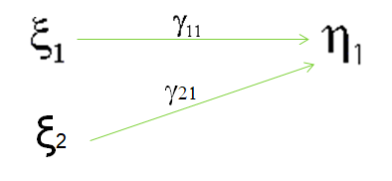
The rationale
......
An illustration:
Standardized partial regression coefficient / path coefficient as gamma coefficients

Slide 22
The rationale
.....
The following matrices can be made available this way directly or indirectly: Λ, θ, Φ, Γ, Ψ Σ
What remains is the investigation of model fit.

Slide 23

The rationale
.....
3. EFA/MR rationale: the explanation concentrating on EFA and MR as methods for investigating the data
The more basic way is conducting EFA:
- it yields factors and factor scores
- correlating the factor scores yield factor correlations

Slide 24

The rationale
.....
3. The rationale concentrating on EFA and MR as methods for investigating the data
The factor scores of EFA can be used as basis for conducting multiple regression (MR). MR yields regression weights.
......

Slide 25
The rationale
......
An illustration:
Standardized partial regression coefficients as gamma coefficients
EFA factors

Slide 26
The rationale
.....
The parameters of the following matrices can be made available this way: Λ, (θ), Φ, Γ, (Ψ) Σ
What remains is the investigation of model fit.

Slide 27
The rationale
2./3. Finally, the various estimated parameters are included into the model-implied covariance matrix Σ [ Σ(θ) ] ...
.... for reproducing the empirical covarince matrix S
- and -
.... for estimating the fit indices that are necessary for evaluating model fit
But, there are no easily available procedures for doing it outside of SEM software.

Slide 28
The rationale
.....
4. SEM algorithm-based rationale: the explanation concentrates on an algorithm that performs simultaneous parameter estimation for the whole model
i.e. at first the structure of Σ is specified according to the information provided by the path diagram and afterwards all the parameters are estimated simultaneously

Slide 29
The rationale
The matrices Σ and S are considered as the input to the fit function F( ) :
F( Σ ( θ ), S ) min
that is minimized. It is minimized by modifying the values of the parameters included in θ (Note. This is not the θ representing error variance; instead it includes the parameter estimates).

Slide 30
The rationale
It is an iterative algorithm starting with starting values assigned to θ.
In some software the user can/could provide starting values.
The reached minimum is transformed into a χ² statistic.
In the ideal case of a perfect reproduction,
χ² = 0.

Slide 31
The rationale
Information on model fit is provided!

Slide 32
The rationale: a demonstration
… from cognitive psychology. It is investigated whether (visual) working memory and executive processes (shifting) explain reasoning.
… using EFA and MR

Slide 33
The rationale: a demonstration
… from cognitive psychology. It is investigated whether (visual) working memory and executive processes (shifting) explain reasoning.
The available data ( manifest variables):
three reasoning scores
six (visual) working memory scores
four executive processes (shifting) scores

Slide 34
The rationale: a demonstration
… from cognitive psychology. It is investigated whether (visual) working memory and executive processes (shifting) explain reasoning.
< the parameters were estimates by EFA and MR using SPSS >

Slide 35
The rationale: a demonstration
… from cognitive psychology. It is investigated whether (visual) working memory and executive processes (shifting) explain reasoning.
The outcome obtained by SPSS:
Working memory
-.39 Reasoning
Executive processes
.30
-.04

Slide 36
The rationale: a demonstration
… from cognitive psychology. It is investigated whether (visual) working memory and executive processes (shifting) explain reasoning.
The outcome obtained by SPSS (SEM procedure in parentheses):
Working memory
-.39 (-.40) Reasoning
Executive processes
.30 (.36)
-.04 (-.09)

Slide 37
The rationale: a demonstration
… from cognitive psychology. It is investigated whether (visual) working memory and executive processes (shifting) explain reasoning.
SEM output additionall signifies that the model fit is not good because of inhomogeneity of the working memory scores.
(this information is not available from SPSS)

Slide 38
Outline

Slide 39
The complete structural equation model
The complete structural equation model combines models of measurement with a structural model:

Slide 40
The complete structural equation model: simple case
Structural model
Measurement model of exogenous variables
Measurement model of endogenous variables
ζ₁
δ₁
x₁
λ₁₁
λ₁₁
y₁
ε₁
γ₁₁
η₁
ξ₁
δ₂
x₂
λ₂₁
y₂
λ₂₁
ε₂
Indicators
Indicators
Latent variables
Notes:
Latente endogene Variablen = AV
Latente exogene Variablen = UV
Enthalten empirische Indikatoren für latente Größen
Indikatorvariablen x1, x2, y1 ermöglichen Berechnung von:
Korrelationen zw. den Indikatorvariablen
Beziehung zw. latenten Variablen und ihren Indikatorvariablen
Beziehung zw. latenten exogenen und latenten endogenen Variablen
Kovarianzstrukturanalyse: Beziehung zw. hypothetischen Konstrukten wird aus Kovarianzen errechnet.

Slide 41
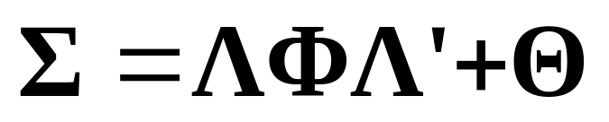
The complete structural equation model
In preparing the path diagram both parts (measurement and structural models) have to be considered.
Furthermore, the diagram must be prepared for being transformed into the corresponding model of the covariance matrix:
(part for one model of measurement)
……

Slide 42
The complete structural equation model : simple case
What is available!
Structural model
Measurement model of exogenous variables
Measurement model of endogenous variables
ζ₁
δ₁
x₁
λ₁₁
λ₁₁
y₁
ε₁
γ₁₁
η₁
ξ₁
δ₂
x₂
λ₂₁
y₂
λ₂₁
ε₂
Indicators
Indicators
Latent variables
Notes:
Latente endogene Variablen = AV
Latente exogene Variablen = UV
Enthalten empirische Indikatoren für latente Größen
Indikatorvariablen x1, x2, y1 ermöglichen Berechnung von:
Korrelationen zw. den Indikatorvariablen
Beziehung zw. latenten Variablen und ihren Indikatorvariablen
Beziehung zw. latenten exogenen und latenten endogenen Variablen
Kovarianzstrukturanalyse: Beziehung zw. hypothetischen Konstrukten wird aus Kovarianzen errechnet.

Slide 43
The complete structural equation model : simple case
What is needed additionally!
Structural model
Measurement model of exogenous variables
Measurement model of endogenous variables
ψ₁₁
Θ_{11(δ)}
φ ₁₁
ζ₁
Θ_{11(ε)}
δ₁
x₁
λ₁₁
λ₁₁
y₁
ε₁
γ₁₁
η₁
ξ₁
δ₂
x₂
λ₂₁
y₂
λ₂₁
ε₂
Θ_{22(δ)}
Θ_{22(ε)}
Indicators
Indicators
Latent variables
Notes:
Latente endogene Variablen = AV
Latente exogene Variablen = UV
Enthalten empirische Indikatoren für latente Größen
Indikatorvariablen x1, x2, y1 ermöglichen Berechnung von:
Korrelationen zw. den Indikatorvariablen
Beziehung zw. latenten Variablen und ihren Indikatorvariablen
Beziehung zw. latenten exogenen und latenten endogenen Variablen
Kovarianzstrukturanalyse: Beziehung zw. hypothetischen Konstrukten wird aus Kovarianzen errechnet.

Slide 44
The complete structural equation model : complex case
Measurement models of exogenous variables
Measurement models of endogenous variables
Structural model
ζ₁
Position(y₁)
ε₁
λ₁₁=1
δ₁
NEO-FFI (x₁)
λ₁₁=1
γ₁₁
Professional success(η₁)
λ₂₁
Wage (y₂)
ε₂
Conscientious-ness (ξ₁)
δ₂
FB 2 (x₂)
λ₂₁
γ₁₂
λ₃₁
Promotions (y₃)
ε₃
γ₂₁
β₂₁
δ₃
Self eval. (x₃)
λ₃₂=1
Work moti-vation (ξ₂)
γ₂₂
Professional reputation (η₂)
λ₄₂=1
Colleague
opinion (y₄)
ε₄
δ₄
Concentra-tion test (x₄)
λ₄₂
ζ₂
Indikators
Indikators
Latent variables

Slide 45
The complete structural equation model : complex case
What is needed additionally!
Measurement models of exogenous variables
Measurement models of endogenous variables
Struktural model
ζ₁
θ₁₁
θ₁₁
ψ₁₁
Position(y₁)
ε₁
φ₁₁
λ₁₁=1
δ₁
NEO-FFI (x₁)
λ₁₁=1
γ₁₁
Professional success(η₁)
λ₂₁
Wage (y₂)
ε₂
θ₂₂
Conscientious-ness (ξ₁)
θ₂₂
δ₂
FB 2 (x₂)
λ₂₁
γ₁₂
λ₃₁
Promotions (y₃)
θ₃₃
ε₃
φ₂₁
β₂₁
θ₃₃
γ₂₁
δ₃
Self eval. (x₃)
λ₃₂=1
θ₁₁=0
Work moti-vation (ξ₂)
γ₂₂
Professional reputation (η₂)
λ₄₂=1
Colleague
opinion (y₄)
ε₄
θ₄₄
δ₄
Concentra-tion test (x₄)
λ₄₂
φ₂₂
ψ₂₂
ζ₂
Indikators
Indikators
Latent variables

Slide 46
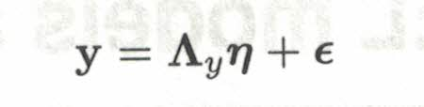
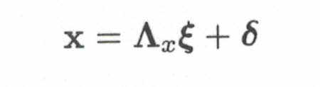
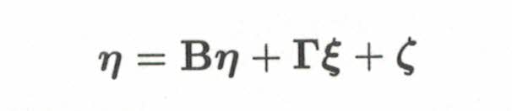
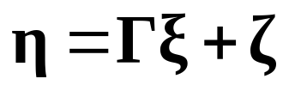
The formal representation of the simple case
• The endogenous model of measurement
• The exogenous model of measurement
• The structural model

Slide 47
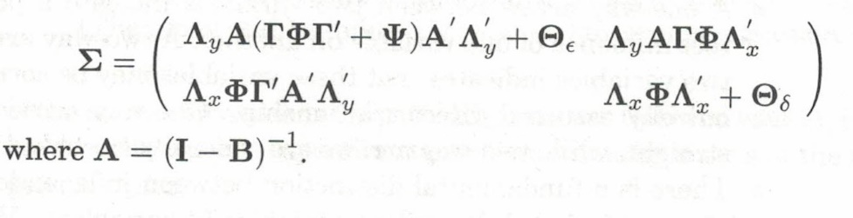
The model of the covariance matrix: the simple case
• The … …..
• The complete covariance model

Slide 48
The model of the covariance matrix: the simple case
• The … …..
• The complete covariance model

Slide 49
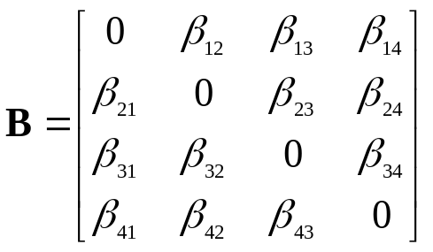
The formal representation of the complex case
• The endogenous model of measurement
• The exogenous model of measurement
• The structural model

Slide 50
The model of the covariance matrix: the complex case
• The … …..
• The complete covariance model

Slide 51
The model of the covariance matrix: the complex case
• The … …..
• The complete covariance model

Slide 52
The complete structural equation model
The correct preparation of the path diagram is very important !!!
.... and is controlled by the user !!!

Slide 53
The complete structural equation model: some types
In the following some types of complete structural equation models are discussed.

Slide 54
The complete structural equation model: some types
There are types of complete structural equation models that apply to a number of different research questions
These types just need to be specified differently!

Slide 55
The complete structural equation model: some types
The linear prediction model

Slide 56
The complete structural equation model: some types
Basic model structure:
Linear prediction model
(see multiple regression)
Structural model
ζ₁
ξ₁
η₁
ξ₂
Latent variables
Notes:
Bsp. aus Backhaus: Welche Auswirkungen besitzen Familie und Schule auf die Schulleistungen eines Kindes?
Welche sind die exogenen und welche die endogenen Variablen?
Latente Variablen:
exo: Familie + Schule
endo: Schulleistung
Indikatoren:
Familie: Beruf des Vaters bzw. seine Schulbildung + Schulbildung der Mutter
Schule: Ausmaß der Nachhilfe + Ausbildungsniveau des Lehrers
Schulleistung: Wissenstest + Interessentest

Slide 57
The complete structural equation model: application
Research question:
How do family and school (the teacher, teaching style, etc.) influence the child‘s performance in school?
Hypothesis 1
Family influences the child‘s performance in school
Hypothesis 2
School influences the child‘s performance in school
(Hypothesis 3
Family and school depend on each other)

Slide 58
Path diagram for example
Structural model
ζ₁
Family (ξ₁)
Performance in school (η₁)
School (ξ₂)
Research question: how do family and the properties of school influence the child‘s performance in school?
Indikatoren
Latent variables
Notes:
Bsp. aus Backhaus: Welche Auswirkungen besitzen Familie und Schule auf die Schulleistungen eines Kindes?
Welche sind die exogenen und welche die endogenen Variablen?
Latente Variablen:
exo: Familie + Schule
endo: Schulleistung
Indikatoren:
Familie: Beruf des Vaters bzw. seine Schulbildung + Schulbildung der Mutter
Schule: Ausmaß der Nachhilfe + Ausbildungsniveau des Lehrers
Schulleistung: Wissenstest + Interessentest

Slide 59
Path diagram for example
Structural model
Measurement model of exogenous variables
ζ₁
δ₁
Occupation father (x₁)
Family (ξ₁)
Performance in school (η₁)
δ₂
Education Mother (x₂)
δ₃
Extent of coaching (x₃)
School (ξ₂)
Research question: how do family and the properties of school influence the child‘s performance in school?
δ₄
Education teacher (x₄)
Indicators
Indikatoren
Latent variables
Notes:
Bsp. aus Backhaus: Welche Auswirkungen besitzen Familie und Schule auf die Schulleistungen eines Kindes?
Welche sind die exogenen und welche die endogenen Variablen?
Latente Variablen:
exo: Familie + Schule
endo: Schulleistung
Indikatoren:
Familie: Beruf des Vaters bzw. seine Schulbildung + Schulbildung der Mutter
Schule: Ausmaß der Nachhilfe + Ausbildungsniveau des Lehrers
Schulleistung: Wissenstest + Interessentest

Slide 60
Path diagram for example
Structural model
Measurement model of exogenous variables
Measurement model of endogenous variables
ζ₁
Knowledge test (y₁)
ε₁
δ₁
Occupation father (x₁)
Family (ξ₁)
Performance in school (η₁)
Interest test (y₂)
ε₂
δ₂
Education Mother (x₂)
δ₃
Extent of coaching (x₃)
School (ξ₂)
Research question: how do family and the properties of school influence the child‘s performance in school?
δ₄
Education teacher (x₄)
Indicators
Indikatoren
Latent variables
Notes:
Bsp. aus Backhaus: Welche Auswirkungen besitzen Familie und Schule auf die Schulleistungen eines Kindes?
Welche sind die exogenen und welche die endogenen Variablen?
Latente Variablen:
exo: Familie + Schule
endo: Schulleistung
Indikatoren:
Familie: Beruf des Vaters bzw. seine Schulbildung + Schulbildung der Mutter
Schule: Ausmaß der Nachhilfe + Ausbildungsniveau des Lehrers
Schulleistung: Wissenstest + Interessentest

Slide 61
The complete structural equation model: some types
The mediation model (in combination with the linear prediction model)

Slide 62
The complete structural equation model: some types
Basic model structure:
Mediation model
(see path analysis)
Structural model
ζ₁
ξ₁
η₁
ζ₂
η₂
Latent variables
Notes:
Bsp. aus Backhaus: Welche Auswirkungen besitzen Familie und Schule auf die Schulleistungen eines Kindes?
Welche sind die exogenen und welche die endogenen Variablen?
Latente Variablen:
exo: Familie + Schule
endo: Schulleistung
Indikatoren:
Familie: Beruf des Vaters bzw. seine Schulbildung + Schulbildung der Mutter
Schule: Ausmaß der Nachhilfe + Ausbildungsniveau des Lehrers
Schulleistung: Wissenstest + Interessentest

Slide 63
The complete structural equation model: some types
Basic model structure:
Mediation model
(see path analysis)
mostly in combination with
Linear prediction model
Structural model
ζ₁
This enlarged model is selected to find out whether η₁ is really important!
ξ₁
η₁
ζ₂
η₂
Latent variables
Notes:
Bsp. aus Backhaus: Welche Auswirkungen besitzen Familie und Schule auf die Schulleistungen eines Kindes?
Welche sind die exogenen und welche die endogenen Variablen?
Latente Variablen:
exo: Familie + Schule
endo: Schulleistung
Indikatoren:
Familie: Beruf des Vaters bzw. seine Schulbildung + Schulbildung der Mutter
Schule: Ausmaß der Nachhilfe + Ausbildungsniveau des Lehrers
Schulleistung: Wissenstest + Interessentest

Slide 64
The complete structural equation model: some types
Basic model structure:
Mediation model
(see path analysis)
mostly in combination with
Linear prediction model
Structural model
ζ₁
This enlarged model is selected to find out whether η₁ is really important!
If yes
ξ₁
η₁
ζ₂
η₂
Latent variables
Notes:
Bsp. aus Backhaus: Welche Auswirkungen besitzen Familie und Schule auf die Schulleistungen eines Kindes?
Welche sind die exogenen und welche die endogenen Variablen?
Latente Variablen:
exo: Familie + Schule
endo: Schulleistung
Indikatoren:
Familie: Beruf des Vaters bzw. seine Schulbildung + Schulbildung der Mutter
Schule: Ausmaß der Nachhilfe + Ausbildungsniveau des Lehrers
Schulleistung: Wissenstest + Interessentest

Slide 65
The complete structural equation model: some types
Basic model structure:
Mediation model
(see path analysis)
mostly in combination with
Linear prediction model
Structural model
ζ₁
This enlarged model is selected to find out whether η₁ is really important!
If no
ξ₁
η₁
ζ₂
η₂
Latent variables
Notes:
Bsp. aus Backhaus: Welche Auswirkungen besitzen Familie und Schule auf die Schulleistungen eines Kindes?
Welche sind die exogenen und welche die endogenen Variablen?
Latente Variablen:
exo: Familie + Schule
endo: Schulleistung
Indikatoren:
Familie: Beruf des Vaters bzw. seine Schulbildung + Schulbildung der Mutter
Schule: Ausmaß der Nachhilfe + Ausbildungsniveau des Lehrers
Schulleistung: Wissenstest + Interessentest

Slide 66
The complete structural equation model: application
Research question:
Does executive control predict performance in problem solving directly or indirectly via working memory?
Hypothesis
Working memory mediates the effect of executive control on problem solving
Alternative Hypothesis
Working memory influences problem solving directly

Slide 67
The complete structural equation model: application
Research question:
Does executive control predict performance in problem solving directly or indirectly via working memory?
EC
WM
PS

Slide 68
The complete structural equation model: some types
Basic model structure:
Mediation model
(see path analysis)
mostly in combination with
Linear prediction model
Structural model
ζ₁
EC (ξ₁)
WM (η₁)
ζ₂
PS (η₂)
Research question: Does executive control predict performance in problem solving directly or indirectly via working memory?
Indikatoren
Latent variables
Notes:
Bsp. aus Backhaus: Welche Auswirkungen besitzen Familie und Schule auf die Schulleistungen eines Kindes?
Welche sind die exogenen und welche die endogenen Variablen?
Latente Variablen:
exo: Familie + Schule
endo: Schulleistung
Indikatoren:
Familie: Beruf des Vaters bzw. seine Schulbildung + Schulbildung der Mutter
Schule: Ausmaß der Nachhilfe + Ausbildungsniveau des Lehrers
Schulleistung: Wissenstest + Interessentest

Slide 69
The complete structural equation model: some types
The developmental model (as extended mediation model)

Slide 70
The complete structural equation model: some types
Basic model structure:
Developmental model
Structural model
ζ₁
ζ₂
ζ₃
ξ₁
η₁
η₂
η₃
… with check for direct effect
Latent variables
Notes:
Bsp. aus Backhaus: Welche Auswirkungen besitzen Familie und Schule auf die Schulleistungen eines Kindes?
Welche sind die exogenen und welche die endogenen Variablen?
Latente Variablen:
exo: Familie + Schule
endo: Schulleistung
Indikatoren:
Familie: Beruf des Vaters bzw. seine Schulbildung + Schulbildung der Mutter
Schule: Ausmaß der Nachhilfe + Ausbildungsniveau des Lehrers
Schulleistung: Wissenstest + Interessentest

Slide 71
The complete structural equation model: application
Research question:
Is there cognitive development from speed to executive processes to working memory to cognitive ability?
Hypothesis 1
Processing speed influences executive control
Hypothesis 2
Executive control influences working memory
Hypothesis 3
Working memory influences cognitive ability

Slide 72
The complete structural equation model: some types
Basic model structure:
Developmental model
Structural model
ζ₁
ζ₂
ζ₃
Cognitive speed (ξ₁)
Executive processes (η₁)
Working memory (η₂)
Cognitive ability (η₃)
… with check for direct effect
Research question: Is there development from speed to executive processes to working memory to cognitive ability?
Latent variables
Notes:
Bsp. aus Backhaus: Welche Auswirkungen besitzen Familie und Schule auf die Schulleistungen eines Kindes?
Welche sind die exogenen und welche die endogenen Variablen?
Latente Variablen:
exo: Familie + Schule
endo: Schulleistung
Indikatoren:
Familie: Beruf des Vaters bzw. seine Schulbildung + Schulbildung der Mutter
Schule: Ausmaß der Nachhilfe + Ausbildungsniveau des Lehrers
Schulleistung: Wissenstest + Interessentest

Slide 73
The complete structural equation model: some types
The hierarchical linear prediction model
… for dealing with many predictors

Slide 74
The complete structural equation model: some types
Structural model
Basic model structure:
Linear prediction model
ξ₁
ζ₁
ξ₂
η₁
ξ₃
The problem
…….
Latent variables
Notes:
Bsp. aus Backhaus: Welche Auswirkungen besitzen Familie und Schule auf die Schulleistungen eines Kindes?
Welche sind die exogenen und welche die endogenen Variablen?
Latente Variablen:
exo: Familie + Schule
endo: Schulleistung
Indikatoren:
Familie: Beruf des Vaters bzw. seine Schulbildung + Schulbildung der Mutter
Schule: Ausmaß der Nachhilfe + Ausbildungsniveau des Lehrers
Schulleistung: Wissenstest + Interessentest

Slide 75
The complete structural equation model: application
Research question:
Does attention (focal attention, concentration, sustained attention, vigilance, etc.) predict cognitive ability?
Hypothesis
Attention predicts cognitive ability

Slide 76
The complete structural equation model: application
Model 1 (attention types as predictors)
Focal attention
Prediction model!
……………
Cognitive ability
……………
……………

Slide 77
The complete structural equation model: application
Model 1 (attention types as predictors)
Focal attention
Prediction model!
*
……………
*
Cognitive ability
ns
……………
ns
Likely disadvantage: only some types contribute substantially (*)
……………

Slide 78
The complete structural equation model: some types
Structural model
Basic model structure:
Linear prection model
Attention 1 (ξ₁)
ζ₁
Attention 2 (ξ₂)
Cognitive ability (η₁)
Attention 3 (ξ₃)
Disadvantages: (1) only some predictors predict
…….
Latent variables
Notes:
Bsp. aus Backhaus: Welche Auswirkungen besitzen Familie und Schule auf die Schulleistungen eines Kindes?
Welche sind die exogenen und welche die endogenen Variablen?
Latente Variablen:
exo: Familie + Schule
endo: Schulleistung
Indikatoren:
Familie: Beruf des Vaters bzw. seine Schulbildung + Schulbildung der Mutter
Schule: Ausmaß der Nachhilfe + Ausbildungsniveau des Lehrers
Schulleistung: Wissenstest + Interessentest

Slide 79
The complete structural equation model: some types
Structural model
Basic model structure:
Linear prection model with mediation
- or -
Hierarchical linear prection model
A1
A2
B
A3
A…
B has to summarize the effects o A1, …
Latent variables
Notes:
Bsp. aus Backhaus: Welche Auswirkungen besitzen Familie und Schule auf die Schulleistungen eines Kindes?
Welche sind die exogenen und welche die endogenen Variablen?
Latente Variablen:
exo: Familie + Schule
endo: Schulleistung
Indikatoren:
Familie: Beruf des Vaters bzw. seine Schulbildung + Schulbildung der Mutter
Schule: Ausmaß der Nachhilfe + Ausbildungsniveau des Lehrers
Schulleistung: Wissenstest + Interessentest

Slide 80
The complete structural equation model: some types
Structural model
Basic model structure:
Linear prection model with mediation
ξ₁
ζ₁
ζ₂
ξ₂
η₁
η₂
ξ₃
…….
Latent variables
Notes:
Bsp. aus Backhaus: Welche Auswirkungen besitzen Familie und Schule auf die Schulleistungen eines Kindes?
Welche sind die exogenen und welche die endogenen Variablen?
Latente Variablen:
exo: Familie + Schule
endo: Schulleistung
Indikatoren:
Familie: Beruf des Vaters bzw. seine Schulbildung + Schulbildung der Mutter
Schule: Ausmaß der Nachhilfe + Ausbildungsniveau des Lehrers
Schulleistung: Wissenstest + Interessentest

Slide 81
The complete structural equation model: application
Research question:
Does attention based on attention types (focal attention, concentration, sustained attention, vigilance, etc.) predict cognitive ability?
Hypothesis
Attention predicted by all attention types (…) predicts cognitive ability

Slide 82
The complete structural equation model: application
Model 2
Focal attention
……………
Cognitive ability
Attention
……………
……………

Slide 83
The complete structural equation model: application
Model 2 (attention types as predictors)
Focal attention
Prediction model!
*
……………
*
Cognitive ability
Attention
ns
……………
ns
Possible disadvantage: only some types contribute substantially (*)
……………

Slide 84
The complete structural equation model: some types
Structural model
Basic model structure:
Linear prection model with mediation
Attention 1 (ξ₁)
ζ₁
ζ₂
Attention 2 (ξ₂)
Attention (η₁)
CA (η₂)
Attention 3 (ξ₃)
Disadvantages: (1) only some predictors predict and (2) the hierarchical structure of attention is not considered!
Disadvantages: (1) only some predictors predict
…….
Latent variables
Notes:
Bsp. aus Backhaus: Welche Auswirkungen besitzen Familie und Schule auf die Schulleistungen eines Kindes?
Welche sind die exogenen und welche die endogenen Variablen?
Latente Variablen:
exo: Familie + Schule
endo: Schulleistung
Indikatoren:
Familie: Beruf des Vaters bzw. seine Schulbildung + Schulbildung der Mutter
Schule: Ausmaß der Nachhilfe + Ausbildungsniveau des Lehrers
Schulleistung: Wissenstest + Interessentest

Slide 85
The complete structural equation model: some types
ζ₁
Structural model
ζ₁
Basic model structure:
Hierachical linear prection model
(see hierachical model of measurement and linear prediction model)
η₁
ζ₂
ζ_{p}
η₂
ζ₃
ξ ₁
η_{p}
η₃
ζ...
…….
Latent variables
Notes:
Bsp. aus Backhaus: Welche Auswirkungen besitzen Familie und Schule auf die Schulleistungen eines Kindes?
Welche sind die exogenen und welche die endogenen Variablen?
Latente Variablen:
exo: Familie + Schule
endo: Schulleistung
Indikatoren:
Familie: Beruf des Vaters bzw. seine Schulbildung + Schulbildung der Mutter
Schule: Ausmaß der Nachhilfe + Ausbildungsniveau des Lehrers
Schulleistung: Wissenstest + Interessentest

Slide 86
The complete structural equation model: application
Research question:
Does attention based on attention types (focal attention, concentration, sustained attention, vigilance, etc.) as upper-level latent variable predict cognitive ability?
Hypothesis
Attention including all attention types (…) predicts cognitive ability

Slide 87
The complete structural equation model: application
Model 3
… treated like factor loadings
Focal attention
……………
Cognitive ability
Attention
……………
……………

Slide 88
ζ₁
Structural model
Attention 1 (n₁)
ζ₂
ζ_{q}
Attention 2 (η₂)
Research question: Does attention based on attention types (focal attention, concentration, sustained attention, vigilance, etc.) as upper-level latent variable predict cognitive ability?
ζ₃
Attention (ξ₁)
CA (η_{q})
Attention 3 (η₃)
…….
Indikatoren
Latent variables
Notes:
Bsp. aus Backhaus: Welche Auswirkungen besitzen Familie und Schule auf die Schulleistungen eines Kindes?
Welche sind die exogenen und welche die endogenen Variablen?
Latente Variablen:
exo: Familie + Schule
endo: Schulleistung
Indikatoren:
Familie: Beruf des Vaters bzw. seine Schulbildung + Schulbildung der Mutter
Schule: Ausmaß der Nachhilfe + Ausbildungsniveau des Lehrers
Schulleistung: Wissenstest + Interessentest

Slide 89
Outline

Slide 90
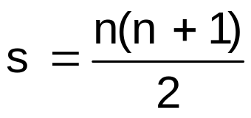
Identification of model
In n indicator variables:
= number of the empirical
information (variances and covariances)
t = number of to be estimated parameters
Degree of freedom (df) = s - t
Notes:
Gleichungssystem muss eindeutig lösbar sein.
Parameter)
Bei d.f. < 0 → Modell ist nicht identifiziert
Bei d.f. = 0 → Gleichungssystem ist eindeutig lösbar, aber Modellstruktur nicht überprüfbar
Bei d.f. > 0 → Lösbarkeit des Strukturgleichungsmodells

Slide 91
Identification of model
Although the overall structure may be identified, there can be problems regarding the sub-structures!
- measurement models may not be identified
Notes:
Gleichungssystem muss eindeutig lösbar sein.
Parameter)
Bei d.f. < 0 → Modell ist nicht identifiziert
Bei d.f. = 0 → Gleichungssystem ist eindeutig lösbar, aber Modellstruktur nicht überprüfbar
Bei d.f. > 0 → Lösbarkeit des Strukturgleichungsmodells

Slide 92
Identification of model
Although the overall structure is identified, there may be problems regarding the sub-structures!
- measurement models may not be identified
● What – if there is only one indicator?
Var(η)
Professional reputation (η)
λ
Colleague‘s
opinion (y₄)
ε
Notes:
Gleichungssystem muss eindeutig lösbar sein.
Parameter)
Bei d.f. < 0 → Modell ist nicht identifiziert
Bei d.f. = 0 → Gleichungssystem ist eindeutig lösbar, aber Modellstruktur nicht überprüfbar
Bei d.f. > 0 → Lösbarkeit des Strukturgleichungsmodells

Slide 93
Identification of model
Although the overall structure is identified, there may be problems regarding the sub-structures!
- measurement models may not be identified
What can be done if there are two or
three indicators?
Notes:
Gleichungssystem muss eindeutig lösbar sein.
Parameter)
Bei d.f. < 0 → Modell ist nicht identifiziert
Bei d.f. = 0 → Gleichungssystem ist eindeutig lösbar, aber Modellstruktur nicht überprüfbar
Bei d.f. > 0 → Lösbarkeit des Strukturgleichungsmodells

Slide 94
Example
Struktural model
Measurement models of exogenous variables
Measurement models of endogenous variables
ζ₁
θ₁₁
θ₁₁
ψ₁₁
Position(y₁)
ε₁
φ₁₁
λ₁₁=1
δ₁
NEO-FFI (x₁)
λ₁₁=1
γ₁₁
Professional success(η₁)
λ₂₁
Wage (y₂)
ε₂
θ₂₂
Conscientious-ness (ξ₁)
θ₂₂
δ₂
FB 2 (x₂)
λ₂₁
γ₁₂
λ₃₁
Promotions (y₃)
θ₃₃
ε₃
φ₂₁
β₂₁
θ₃₃
γ₂₁
δ₃
Self eval. (x₃)
λ₃₂=1
θ₁₁=0
Work moti-vation (ξ₂)
γ₂₂
Professional reputation (η₂)
λ₄₂=1
Colleague
opinion (y₄)
ε₄
θ₄₄
δ₄
Concentra-tion test (x₄)
λ₄₂
φ₂₂
ψ₂₂
ζ₂
Indikators
Indikators
Latent variables

Slide 95
Identifikation of model
Although the overall structure is identified, there may be problems regarding the sub-structures!
- measurement models may not be identified
● Note: each model of measurement
must be (just) identified independently of all
the other models
Therefore, do separated investigations for
the individual models of measurement!
Notes:
Gleichungssystem muss eindeutig lösbar sein.
Parameter)
Bei d.f. < 0 → Modell ist nicht identifiziert
Bei d.f. = 0 → Gleichungssystem ist eindeutig lösbar, aber Modellstruktur nicht überprüfbar
Bei d.f. > 0 → Lösbarkeit des Strukturgleichungsmodells

Slide 96
Outline

Slide 97
The strategy of analysis
The strategy of analysis refers to the successive steps in data analysis and the decisions to be made
Notes:
Gleichungssystem muss eindeutig lösbar sein.
Parameter)
Bei d.f. < 0 → Modell ist nicht identifiziert
Bei d.f. = 0 → Gleichungssystem ist eindeutig lösbar, aber Modellstruktur nicht überprüfbar
Bei d.f. > 0 → Lösbarkeit des Strukturgleichungsmodells

Slide 98
The to-be-investigated model
Structural model
Measurement model of exogenous variables
Measurement model of endogenous variables
ζ₁
Knowledge test (y₁)
ε₁
δ₁
Occupation father (x₁)
Family (ξ₁)
Performance in school (η₁)
Interest test (y₂)
ε₂
δ₂
Education Mother (x₂)
δ₃
Extent of coaching (x₃)
School (ξ₂)
δ₄
Education teacher (x₄)
Indicators
Indicators
Latente variables
Notes:
Bsp. aus Backhaus: Welche Auswirkungen besitzen Familie und Schule auf die Schulleistungen eines Kindes?
Welche sind die exogenen und welche die endogenen Variablen?
Latente Variablen:
exo: Familie + Schule
endo: Schulleistung
Indikatoren:
Familie: Beruf des Vaters bzw. seine Schulbildung + Schulbildung der Mutter
Schule: Ausmaß der Nachhilfe + Ausbildungsniveau des Lehrers
Schulleistung: Wissenstest + Interessentest

Slide 99
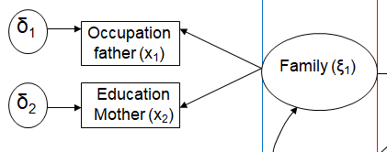
The strategy of analysis
At first model fit of each model of measurement of each latent variable is investigated
e.g.
Notes:
Gleichungssystem muss eindeutig lösbar sein.
Parameter)
Bei d.f. < 0 → Modell ist nicht identifiziert
Bei d.f. = 0 → Gleichungssystem ist eindeutig lösbar, aber Modellstruktur nicht überprüfbar
Bei d.f. > 0 → Lösbarkeit des Strukturgleichungsmodells

Slide 100
The strategy of analysis
At first model fit of each model of measurement of each latent variable is investigated
If one of these models of measurement does not fit, the whole process is terminated
… if there is no way out!
Notes:
Gleichungssystem muss eindeutig lösbar sein.
Parameter)
Bei d.f. < 0 → Modell ist nicht identifiziert
Bei d.f. = 0 → Gleichungssystem ist eindeutig lösbar, aber Modellstruktur nicht überprüfbar
Bei d.f. > 0 → Lösbarkeit des Strukturgleichungsmodells

Slide 101
The strategy of analysis
….
If one of these models of measurement does not fit, the whole process is terminated
… a possible way out for a new start
could be combining indicators.
… another possible way out is the
consideration of alternative models of
measurement.
Notes:
Gleichungssystem muss eindeutig lösbar sein.
Parameter)
Bei d.f. < 0 → Modell ist nicht identifiziert
Bei d.f. = 0 → Gleichungssystem ist eindeutig lösbar, aber Modellstruktur nicht überprüfbar
Bei d.f. > 0 → Lösbarkeit des Strukturgleichungsmodells

Slide 102
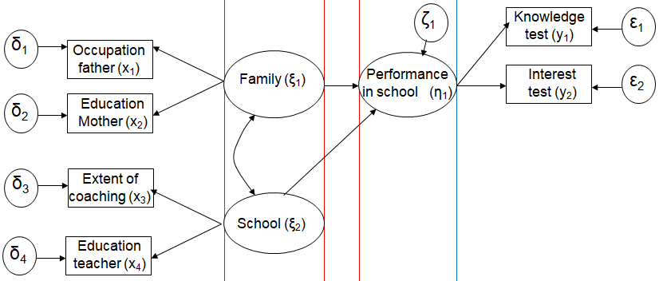
The strategy of analysis
If all models of measurement show sufficient model fit, the complete model is investigated, e.g.
Notes:
Gleichungssystem muss eindeutig lösbar sein.
Parameter)
Bei d.f. < 0 → Modell ist nicht identifiziert
Bei d.f. = 0 → Gleichungssystem ist eindeutig lösbar, aber Modellstruktur nicht überprüfbar
Bei d.f. > 0 → Lösbarkeit des Strukturgleichungsmodells

Slide 103
The strategy of analysis
If all models of measurement show sufficient model fit, the complete model is investigated
• The strategy requiring the investigation
of alternative models does not apply to
the complete model
l
• The complete model represents a
hypothesis that requires …
… either confirmation or rejection
Notes:
Gleichungssystem muss eindeutig lösbar sein.
Parameter)
Bei d.f. < 0 → Modell ist nicht identifiziert
Bei d.f. = 0 → Gleichungssystem ist eindeutig lösbar, aber Modellstruktur nicht überprüfbar
Bei d.f. > 0 → Lösbarkeit des Strukturgleichungsmodells

Slide 104
The strategy of analysis
Comments regarding measurement models:
Formerly in the case of misfit modifications based on modification indices were recommended
Today modifications are considered as inadmissible manipulations since the confirmatory character of the approach is lost
… if the hypothesis is modified.
Notes:
Gleichungssystem muss eindeutig lösbar sein.
Parameter)
Bei d.f. < 0 → Modell ist nicht identifiziert
Bei d.f. = 0 → Gleichungssystem ist eindeutig lösbar, aber Modellstruktur nicht überprüfbar
Bei d.f. > 0 → Lösbarkeit des Strukturgleichungsmodells

Slide 105
Outline

Slide 106
The evaluation of models
After conducting the statistical analysis by means of a software program (that simply has to be started after the specification of the model) an output becomes available that includes two types of information:
- parameter estimates
- fit information
Notes:
ein iteratives Schätzverfahren: d. h.. Parameter werden mit Hilfe von Algorithmen so lange modifiziert, bis ein Minimum gefunden ist

Slide 107
The evaluation of models
Fit information:
… is used for evaluating whether
there is a good degree of model fit
(or at least an acceptable one).
… if there is model misfit instead:
the model is given up!
Notes:
ein iteratives Schätzverfahren: d. h.. Parameter werden mit Hilfe von Algorithmen so lange modifiziert, bis ein Minimum gefunden ist

Slide 108
The evaluation of models
Fit information:
… is used for evaluating whether
there is a good degree of model fit
(or at least an acceptable one).
… in the positive case: the evaluation
proceeds to what is the meaning for
the research question / hypothesis
Notes:
ein iteratives Schätzverfahren: d. h.. Parameter werden mit Hilfe von Algorithmen so lange modifiziert, bis ein Minimum gefunden ist

Slide 109
The evaluation of models
Example:
χ2: 209.5
RMSEA: .048 (=<.06)
SRMR: .075 (=<.08)
CFI: .96 (>=.95)
NNFI: .95 (>=.95)
AIC: 310.5
Notes:
ein iteratives Schätzverfahren: d. h.. Parameter werden mit Hilfe von Algorithmen so lange modifiziert, bis ein Minimum gefunden ist

Slide 110
The evaluation of models
… in the positive case: the evaluation
proceeds to what is the meaning for
the research question / hypothesis
● Parameter information:
The parameter estimates are used for
providing an answer to the research
question / for evaluating the
hypothesis.
Notes:
ein iteratives Schätzverfahren: d. h.. Parameter werden mit Hilfe von Algorithmen so lange modifiziert, bis ein Minimum gefunden ist

Slide 111
Remember the following example
Structural model
Measurement model of exogenous variables
Measurement model of endogenous variables
ζ₁
Knowledge test (y₁)
ε₁
δ₁
Occupation father (x₁)
Family (ξ₁)
Performance in school (η₁)
Interest test (y₂)
ε₂
δ₂
Education Mother (x₂)
Research question: how do family and the properties of school influence the child‘s performance in school?
δ₃
Extent of coaching (x₃)
School (ξ₂)
δ₄
Education teacher (x₄)
Indicators
Indikatoren
Latent variables
Notes:
Bsp. aus Backhaus: Welche Auswirkungen besitzen Familie und Schule auf die Schulleistungen eines Kindes?
Welche sind die exogenen und welche die endogenen Variablen?
Latente Variablen:
exo: Familie + Schule
endo: Schulleistung
Indikatoren:
Familie: Beruf des Vaters bzw. seine Schulbildung + Schulbildung der Mutter
Schule: Ausmaß der Nachhilfe + Ausbildungsniveau des Lehrers
Schulleistung: Wissenstest + Interessentest

Slide 112
Remember the following example
Structural model
Measurement model of exogenous variables
Measurement model of endogenous variables
ζ₁
Knowledge test (y₁)
ε₁
δ₁
Occupation father (x₁)
.15ns
Family (ξ₁)
Performance in school (η₁)
Interest test (y₂)
ε₂
δ₂
Education Mother (x₂)
.35*
δ₃
Extent of coaching (x₃)
School (ξ₂)
δ₄
Education teacher (x₄)
Indicators
Indicators
Latent variables
Notes:
Bsp. aus Backhaus: Welche Auswirkungen besitzen Familie und Schule auf die Schulleistungen eines Kindes?
Welche sind die exogenen und welche die endogenen Variablen?
Latente Variablen:
exo: Familie + Schule
endo: Schulleistung
Indikatoren:
Familie: Beruf des Vaters bzw. seine Schulbildung + Schulbildung der Mutter
Schule: Ausmaß der Nachhilfe + Ausbildungsniveau des Lehrers
Schulleistung: Wissenstest + Interessentest

Slide 113
The evaluation …
The example
The gamma parameters indicate that
the family has no influence on the
childrens‘s school performance
whereas the school has one.
In the case of no support of a hypothesis: What are possible reasons?
Notes:
ein iteratives Schätzverfahren: d. h.. Parameter werden mit Hilfe von Algorithmen so lange modifiziert, bis ein Minimum gefunden ist

Slide 114
The evaluation …
The example
The gamma parameters indicate that
the family has no influence on the
childrens‘s school performance
whereas the school has one.
Possible reasons can eventually be
found in the selection of indicators
for family …
Notes:
ein iteratives Schätzverfahren: d. h.. Parameter werden mit Hilfe von Algorithmen so lange modifiziert, bis ein Minimum gefunden ist

Slide 115
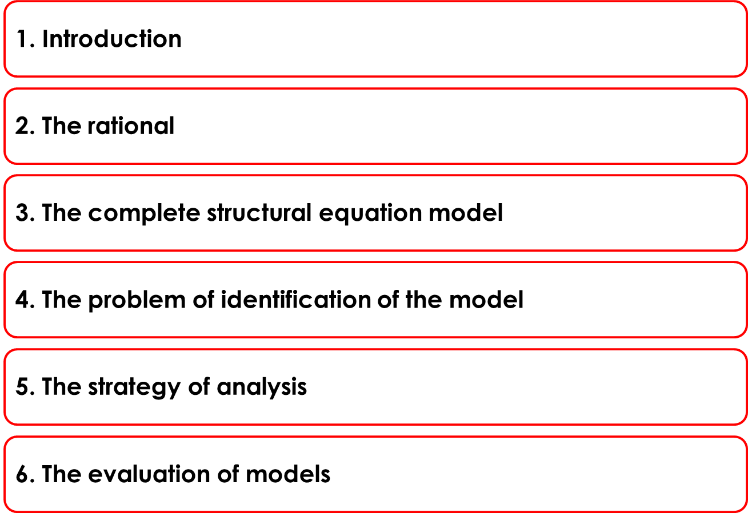
Summary and brush up:
… confirmation that the elimination of error influences parameter estimates on the latent level
… SEM can be perceived as combination of FA and MR / Path Analysis
… gives rise to a
complex model of the covariance matrix
… check whether
all subsections are (just) identified
… proceed from the check of model fit to evaluating parameter
… compare observed fit statistics and cutoffs

Slide 116
QUESTIONS REGARDING COURSE UNIT 7
Why are model modifications not acceptable for achieving good model fit?
What has to be done if one model of measurement indicates bad model fit?
Explorative factor analysis

Slide 117
Literature
Kline, R. B. (2011). Principles and practices of structural equation modeling (3rd edition) (Chapter 1: Introduction). New York, NY: The Guilford Press.

