Slide 1
Preconditions and
Check of Preconditions

Slide 2
Introduction
This course unit concentrates on the preconditions for the statistical investigations; these are preconditions that must be given for achieving valid results.
Violations of preconditions lead to the termination of the computations in some cases; but sometimes the program does not detect a violation.
Some violations of preconditions lead to results that signify very bad model fit although the model is good.
In such a case the computed statistics are not correct / invalid

Slide 3
Outline
The model
    1.1 The model: identification of complete model
    1.2 The model: identification of model of measurement
    1.3 The model: fixations
    1.4 The model: specification of relationships
The data
    2.1 Properties of ideal data
    2.2 Typical problems
3. The check of preconditions

Slide 4
1. The model
1.1 The model: identification of complete model
The degree of freedom provided by the progam corresponds to what is achieved by using the formula listed below.
Formula:
d.f. = s – t
s = [n (n+1) ] / 2
The degree of freedom must be larger than zero!

Slide 5
1. The model
1.2 The model: identification of model of measurement
In this case the user must compute the degree of freedom.
Formula:
d.f. = s – t
s = [n (n+1) ] / 2
The degree of freedom must be at least zero!
Larger than zero is better!

Slide 6
1. The model
1.3 The model: fixations
Are the fixations correct?
- variance of a latent variable: 1 (but not zero)
- factor loadings: 1 or equal sizes
(or zero)
(other values)
- error variances: 0 or equal sizes

Slide 7
1. The model
1.3 The model: specification of relationships
Is the to-be-investigated relationship specified correctly?
- is the relationships a correlation?
… correlate the corresponding latent variables:
ξ₁
ξ₂

Slide 8
1. The model
1.3 The model: specification of relationships
Is the to-be-investigated relationship specified correctly?
- is a directional effect?
… define the latent variables as independent (exogenous) and dependent (endogenous) latent variables:
… and check whether the corresponding ψ parameter is free for estimation.
ξ₁
η₁

Slide 9
2. The data
2.1 The properties of ideal data
● They show continuous scale (interval level)
● There is a sample of sufficient size
The required size varies as a function of
- the relationship of the numbers of participants and manifest variables
- the selected estimation method
- the type of input
In many studies (e.g. studies using cognitive data) N ≥ 200 is sufficient.

Slide 10
2. The data
2.1 The properties of ideal data
● They show continuous scale (interval level)
● There is a sample of sufficient size
● Each random variable follows a normal distribution

Slide 11
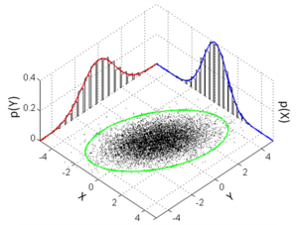
2. The data
2.1 The properties of ideal data
● They show continuous scale (interval level)
● There is a sample of sufficient size
● Each random variable follows a normal distribution
● There is multivariate normal distribution
e.g. a bivariate ....

Slide 12
2. The data
2.1 The properties of ideal data
● They show continuous scale (interval level)
● There is a sample of sufficient size
● Each random variable follows a normal distribution
● There is multivariate normal distribution
● The input matrix is positive definite
M: matrix
v: any vector
v^{T} M v > 0

Slide 13
2. The data
2.1 The properties of ideal data
● They show continuous scale (interval level)
● There is a sample of sufficient size
● Each random variable follows a normal distribution
● There is multivariate normal distribution
● The input matrix is positive definite
● The variables do show linear relationships

Slide 14
2. The data
2.2 Typical problems
● The scale differs from what is expected (see course unit on data).
In psychological research data are typically …
- binary data
- dichotomous data
- ordered categorical data (Likert data)
- ordinal Data
- frequencies
- (rarely) data showing intervall scale
No problem

Slide 15
2. The data
2.2 Typical problems
● The scale differs from what is expected (see course unit on data).
In psychological research data are typically …
- binary data
- dichotomous data
- ordered categorical data (Likert data)
- ordinal Data
Use ¹ tetrachoric correlation or probability-based covariances
Use ² polychoric correlation
¹
²

Slide 16
2. The data
2.2 Typical problems
● The scale differs from what is expected (see course unit on data).
In psychological research data are typically …
- binary data
- dichotomous data
- ordered categorical data (Likert data)
- ordinal Data
³ if there are six or more than six categories / six different values, ...
treat the data as if they were continuous data
¹
^{2,3}

Slide 17
2. The data
2.2 Typical problems
● The scale differs from what is expected (see course unit on data).
● The sample is too small
... increase sample size
... switch to another less demanding
method (e.g. regression analysis)

Slide 18
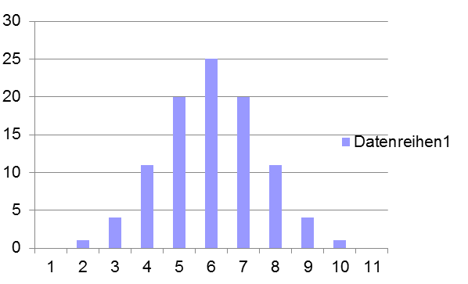
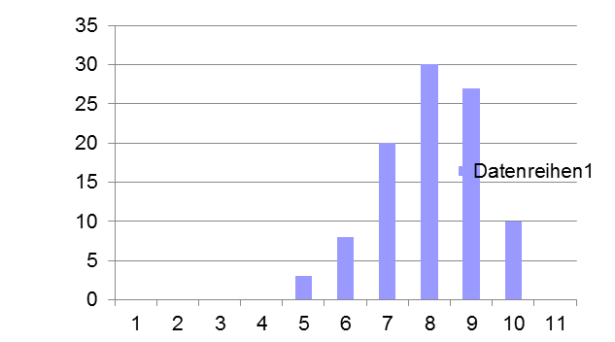
2. The data
2.2 Typical problems
● No normal distribution. Big problem!
Nomal distribution Distorted normal distribution
Skewness=0.017 Skewness=-0.378
The variance becomes smaller!

Slide 19
2. The data
2.2 Typical problems
● No normal distribution. Big problem!
Nomal distribution Distorted normal distribution
Mean: 6 Variance: 2.4 Mean: 8 Variance: 1.5

Slide 20
2. The data
2.2 Typical problems
● No normal distribution. Big problem!
Transformationen of distribution is no more recommended!
Instead select an estimation method that compensates for the deviation
from normality (see next course unit)
(Finney, DiStefano, & Kopp, 2016)
... so-called robust estimation methods need to be selected
(e.g. the Satorra-Bentler corrected maximum likelihood estimation method)

Slide 21
2. The data
2.2 Typical problems
● The scale differs from the ideal (see course unit on data).
● The sample is too small
● The data do not follow the normal distribution
● There is no multivariate normal distribution
.... try robust estimation

Slide 22
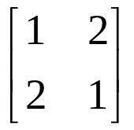
2. The data
2.2 Typical problems
● Matrix is not positive definite.
i.e. there is multi-collinearity
(... eventually it is overcome by the program using the so-called ridge
procedure)
e.g.
… is not positive definite (e.g. not >0)

Slide 23

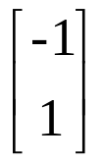

2. The data
2.2 Typical problems
● Matrix is not positive definite.
Demonstration:
e.g.
… is not positive definite
X
=
X
= -2 < 0

Slide 24
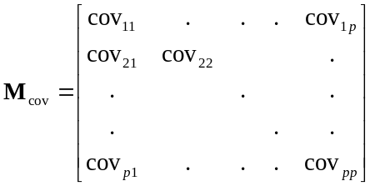
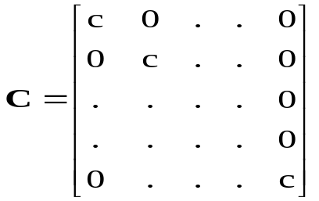
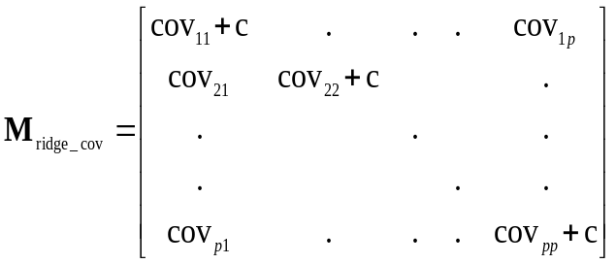
2. The data
2.2 Typical problems
● Matrix is not positive definite. Use Ridge Procedure: an example
… the correlation matrix
the ridge matrix
the ridge-adjusted matrix

Slide 25
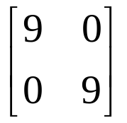
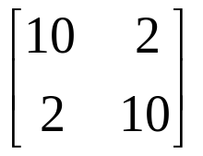
2. The data
2.2 Typical problems
● Matrix is not positive definite.
Demonstration:
e.g.
=
+
X
X
= -2
X
X
= 16 ( > 0)

Slide 26
2. The data
2.2 Typical problems
● Matrix is not positive definite.
● Variables do not show linear relationships.
…. reject the model
or
…. check whether the consideration of a moderator variable solves
the problem

Slide 27
3. The check of preconditions
● It is to be checked whether the preconditions of 1.1, 1.2 and 2.1 are
given (i.e. regarding the model and regarding obvious data
characteritics)
It remains to check characteristics that are not obvious!

Slide 28
3. The check of preconditions
● It is to be checked whether the preconditions regarding normality are
given
● Especially the shape of distribution needs to be checked …
…. skewness statistic
- z test for finding out whether the distribution of individual variables
is symmetric
- Kolmogorov-Smirnov test (for individual variables)
…. Mardia test (for a set of variables / a matrix;
sometimes it is demanded)

Slide 29
3. The check of preconditions
● It is to be checked whether the preconditions regarding normality are
given
● Especially the shape of distribution needs to be checked …
… there may be several several peaks
(suggesting a mixture of subsample showing different distributions)
… subsample should be investigated separately

Slide 30
3. The check of preconditions
● It is to be checked whether the preconditions regarding normality are
given
● Especially the shape of distribution needs to be checked …
… there is an indication of a binary scale

Slide 31
3. The check of preconditions
● It is to be checked whether the preconditions regarding normality are
given
● Especially the shape of distribution needs to be checked …
… there may be an indication of a Poisson distribution
… is not suited for the computation of correlations or covariances

Slide 32
QUESTIONS REGARDING COURSE UNIT 9
If the data are ordered-categorical, what is the minimum number of categories for treating these data as continuous?
Which estimation method has to be selected if the data do not follow the normal distribution?
What has to be done, if the sample size is too small?
What means „not positive definite“?
Explorative factor analysis

