Slide 1

Persuasive Messages
An Unexpected Presentation

Slide 2
What the heck is it
Persuasive messaging is an effort to influence others to change their thoughts and behaviors towards something

Slide 3
Common Uses of Persuasive Messaging
Education
Sales and Marketing
Politics
Customer Service
Leadership Roles
Social Activism
Job Interviews
Debates
Dating
Working in a Team

Slide 4
Delivery

Slide 5
Three Types of Persuasion
Ethos (credibility)
Pathos (Emotional)
Logos (Rationality)
Proof of credentials
Use of reputable sources
Must come across as trustworthy
Often presented in a very professional way
Use of examples and anecdotes that evoke emotion
Use of emotionally charged language
Very deliberate word choices
Use of facts and statistics
Explanation of why exactly their idea is correct
Must avoid logical fallacies
Destroy them with facts and logic

Slide 6

Call to Action
A message that pushes the audience to take action
Leaves no room for questions like “okay but how am I supposed to do this”
Best to use at the end of the message
Short and direct
please give me bonus points for using a picture of ping pong balls

Slide 7
Counterarguments
Think up potential objections that your audience might have
Acknowledge these doubts and provide counterarguments
This shows that you have considered other views, which gains credibility

Slide 8
Know your audience
Being able to put yourself in the shoes of others helps develop better appeals
There are many ways to learn about your audience, such as socializing, surveys or researching the demographics
Learn as much as you can about their opinions, beliefs, interests, etc.
Try to figure out if they would prefer intrinsic gain, such as personal growth, or extrinsic gain, such as gifts

Slide 9

Scenario Painting
Build a story that puts the reader in a hypothetical situation where they can see how they would benefit
Be very descriptive so that it paints a vivid picture for the audience

Slide 10
Some more general tips
Remain clear and concise (avoid unnecessarily articulate language)
When writing, use correct spelling and grammar
Don't talk down to your audience
Make it easy to comply
Finish the message with a reminder of what is appealing to the reader
Some forms of bribery are legal

Slide 11

Why it works

Slide 12
It just does
People often look to others for guidance
The word of authoritative individuals carries a lot of weight
Messages make people feel as though the presenter can relate to them
The idea that the reader/listener is getting something out of it
People like to feel like they’re part of something bigger
Doesn’t require infiltration of their dreams
Or a dream within a dream
Or a dream within a dream within a dream
Or a dream within a dream within a dream within a dream
Or a dream within a dream within a dream within a dream within a dream
Or a dream within a dream within a dream within a dream within a dream within a dream

Slide 13
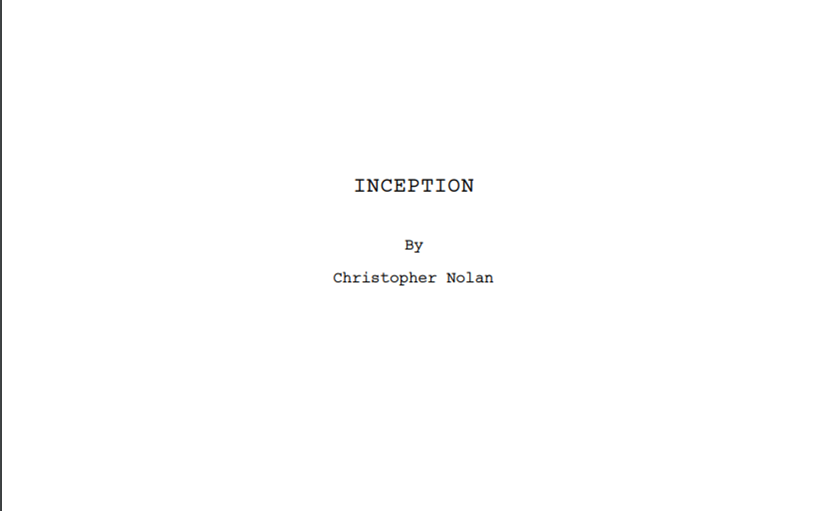

Slide 14
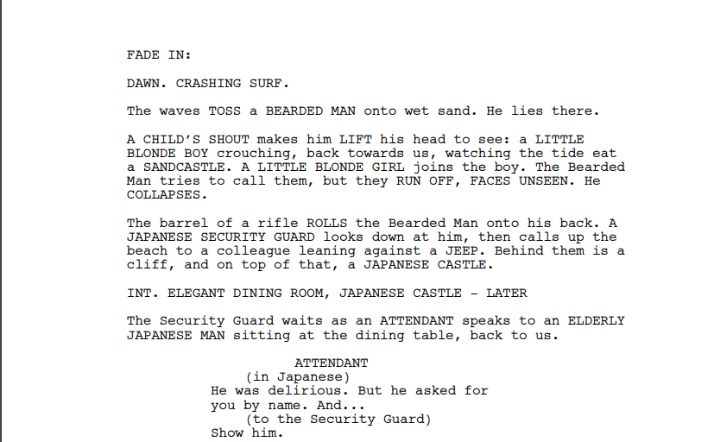

Slide 15
Ways that you (the student) might use persuasive messaging
Requesting an extension of an assignment's deadline
Scholarship applications
Internship interviews
Asking for the help of another student
Tutoring

Slide 16
In Summary
Persuasive messaging aims to change the thoughts and beliefs of others
It is used in many areas of everyday life
Effective persuasion involves using credibility, logic, emotions, and an audience’s understanding
It works because of trust, emotion, and perceived value

Slide 17
el fin

