Slide 1

Automation using Selenium

Slide 2

Content of Selenium
Test - Automation Introduction
Test-Automation Strategy
Overview of Selenium Components
Selenium IDE & RC
Selenium Web driver
Selenium Grid
Object Identification
XPATH, Object Locators
HTML,XML,CSS
TestNG - Framework

Slide 3
Approach & Importance in Test-Automation
Record & Play back it’s not a Complete Automation Testing.
Automation Strategy & Framework is important in Test-Automation Projects.
Our Automation Training Provided by Test- Architect.

Slide 4

Automation Introduction
Automation is the integration of testing tools into the test environment in such a manner that the test execution, logging, and comparison of results are done with little human intervention.
A testing tool is a software application which helps automate the testing process. But the testing tool is not the complete answer for automation.

Slide 5

Process of Automation
Unstable software: If the software is still under development and undergoing many changes automation testing will not be that effective.
Once in a blue moon test scripts: Do not automate test scripts which will be run once in a while.
Code and document review: Do not try to automate code and document reviews; they will just cause trouble.

Slide 6

Features of Automation
Testing workbenches provide a range of tools to reduce the time required and total testing costs.
Systems such as Junit/TestNG support the automatic execution of tests.
Most testing workbenches are open systems because testing needs are organization-specific.
They are sometimes difficult to integrate with closed design and analysis workbenches.

Slide 7

Advantages of Automation Testing
Automated testing is cheaper.
Automated testing is faster.
Automated testing is more reliable.
Automated testing reduces human and technical risks.
Automated testing is more powerful and versatile.

Slide 8

Overview of Supported Technologies
Java
JavaScript
HTML
CSS
Ant
XML
Locators

Slide 9
Java Features
Java has some interesting features:
automatic type checking,
automatic garbage collection,
simplifies pointers; no directly accessible pointer to memory,
simplified network access,
multi-threading!

Slide 10
Java Advantages
Portable - Write Once, Run Anywhere
Security has been well thought through
Robust memory management
Designed for network programming
Multi-threaded (multiple simultaneous tasks)
Dynamic & extensible (loads of libraries)
Classes stored in separate files
Loaded only when needed

Slide 11

Selenium Introduction
Test tool for web applications
Runs in any mainstream browser
Supports tests in many languages
Selenium(pure HTML, no backend required)
Java, C#, PHP, Perl, Python, Ruby
Record/playback (Selenium IDE)
Open Source with corporate backing
Lives at selenium.openqa.org

Slide 12

What is Selenium?
Selenium automates browsers. Selenium has the support of some of the largest browser vendors who have taken (or are taking) steps to make Selenium a native part of their browser.
It is also the core technology in countless other browser automation tools, APIs and frameworks.

Slide 13

Why selenium?
Selenium is probably the best option for automated testing of Websites today.
It is becoming increasingly popular and it is the first choice of automation testers as well as organizations for automating the testing of Web-based applications for both the GUI as well as the functionality.
Selenium can also be used as a unit testing tool for JavaScript

Slide 14
You can use open source.Selenium tool selenium IDE is a plugin to firefox to record and playback tests (like WinRunner, QTP).
You can then export the recorded test in most language e.g. html, Java , .net , perl , ruby etc. The exported test can be run in any browser and any platform using “selenium remote control”.

Slide 15
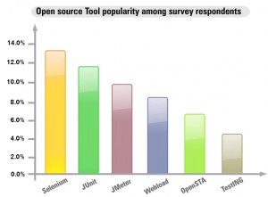
The following graph shows the popularity of Selenium along with other open source automation testing tools.

Slide 16
Advantages of Selenium
Free!
Can test across multiple browsers
Mimics actual user experience
Ajax / CSS support
Use language of choice
Large user community

Slide 17
Overview of Selenium Components
Selenium IDE - Plugin to Firefox/Chrome to record and play test in firefox/Chrome and also export tests in different languages.
Selenium RC- Allows playing of exported test in different platform/OS.
Selenium Grid -Allows to control lots of selenium machines.
Selenium Web driver -Driving a browser natively as a user would either locally or on a remote machine using the Selenium Server it marks a leap forward in terms of browser automation.

Slide 18
Selenium IDE
Easy record and playback.
Intelligent field selection will use IDs, names, or XPath as needed.
Autocomplete for all common Selenium commands.
Walk through tests.
Debug and set breakpoints.
Save tests as HTML, Ruby scripts, or any other format. Support for Selenium user-extensions.js file.
Option to automatically assert the title of every page.

Slide 19
Selenium Web driver
Selenium Web Driver is the successor to Selenium RC.
Selenium Web Driver accepts commands (sent in Selenese, or via a Client API) and sends them to a browser.
This is implemented through a browser-specific browser driver, which sends commands to a browser, and retrieves results.
Most browser drivers actually launch and access a browser application (such as Firefox or Internet Explorer); there is also an HtmlUnit browser driver, which simulates a browser using HtmlUnit.

Slide 20
Selenium IDE | Selenium RC | Webdriver
Works on Mozilla/Chrome | Works on almost all browsers.Does not work on latest version of firefox/IE | Works on latest versions of almost all browsers - Firefox, IE(6,7,8), OPera, Chrome
Record and run tool | No Record and run | No Record and run
No server required to start | Server is required to start | No server required to start
Core engine is Javascript based | Core engine is Javascript based | Interacts natively with browser application
Very simple to use. | Its a simple and small API | Complex and a bit large API as compared to RC
Not at all object oriented | Less Object orinted API | Purely Object oriented API
Cannot move mouse with it | Cannot move mouse with it | Can move mouse cursor
Full xpaths have to be appended with 'xapth=\\' syntax | Full xpaths have to be appended with 'xapth=\\' syntax | No need to append 'xpath=\\'

Slide 21
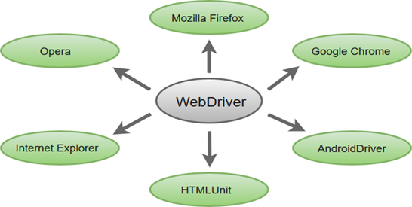
Multiple Browser Support
: Selenium WebDriver supports a diverse range of web browsers such as Firefox, Chrome, Internet Explorer, Opera and many more. It also supports some of the non-conventional or rare browsers like HTMLUnit.
WebDriver driver = new FirefoxDriver(); (Firefox browser ) WebDriver driver = new ChromeDriver(); (Chrome browser) WebDriver driver = new InternetExplorerDriver(); (Internet Explorer browser)

Slide 22
Object Identification
To identify the objects such as Links, Buttons, Edit boxes, Drop downs, etc on the application Selenium uses a concept called “Locators”.
There are around 8 different types of locators.
Every Web Page will be having some HTML Source code. This can be viewed using Inspect.

Slide 23
Locators
Element Locators
i. ID
ii. Name
iii. Class Name
iv. Tag Name
v. Link Text & Partial Link Text
vi. CSS Selector
vii. XPath

Slide 24
Locators
ID Locator:
ID’s are unique for each element so it is common way to locate elements using ID Locator. As per W3C, ID’s are supposed to be unique on a page and it makes ID’s are the most reliable locator. ID locators are the fastest and safest locators out of all locators.
findElement(By.id("IdName"));
Name Locator:
We sometimes use Name locator to identify the elements on our webpage. Locating elements using Name is same as locating elements using ID locator.
These are not unique on a page. If there are multiple elements with the same Name locator then the first element on the page is selected. Test may fail, if another element with the same Name locator is present on the web page or added by the developers in the later stages.
findElement(By.name("Name"));

Slide 25
Locators
Class Name Locator:
Class Name locator gives the element which matches the values specified in the attribute name “class”.
findElement(By.className("Element Class"));
Tag Name Locator:
Tag Name locator is used to find the elements matching the specified Tag Name. It is very helpful when we want to extract the content within a Tag.
findElement(By.tagName("HTML Tag Name"));
Link Text Locator:
If there are multiple elements with the same link text then the first one will be selected. This Link Text locator works only on links (hyperlinks) so it is called as Link Text locator.
findElement(By.linkText("LinkText"));

Slide 26
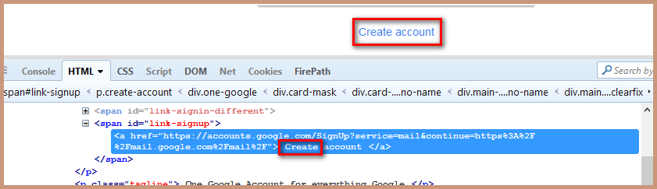
Locators
Partial Link Text:
In some situations, we may need to find links by a portion of the text in a Link Text element. it contains. In such situations, we use Partial Link Text to locate elements. findElement(By.partialLinkText("partialLinkText"));
findElement(By.partialLinkText("Create"))

Slide 27
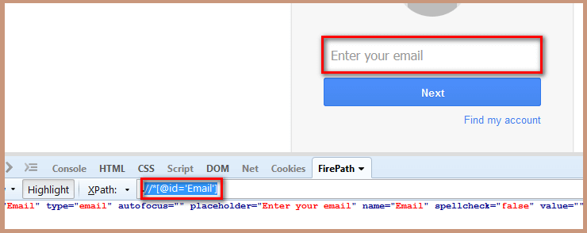
Locators
XPath Locator:
XPath is designed to allow the navigation of XML documents, with the purpose of selecting individual elements, attributes, or some other part of an XML document for specific processing. XPath produces reliable locators but in performance wise it is slower (especially in IE older versions) compared to CSS Selector.
findElement(By.xpath("XPath"))
findElement(By.xpath("//*[@id='Email']"))

Slide 28
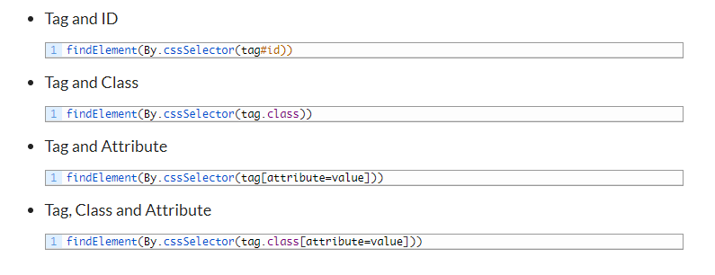
Locators
CSS Selector Locator:
There is a debate on the performance between CSS Locator and XPath locator and the debate on the performance of CSS and XPath locator. Most of the automation testers believe that using CSS selector makes the execution of script faster compared to XPath locator. This locator is always the best way to locate elements on the page.
Following are the some of the mainly used formats of CSS Selectors.

Slide 29
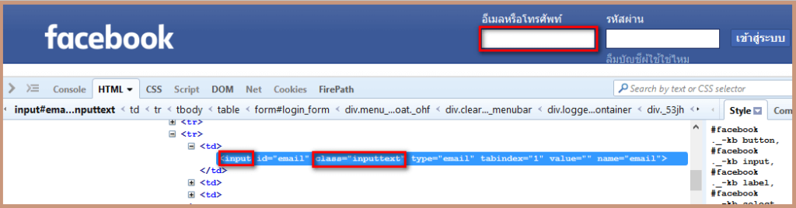
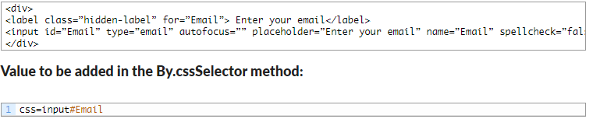
Locators
driver.findElement(By.cssSelector("input#Email"))
driver.findElement(By.cssSelector("input.inputtext"))
driver.findElement(By.cssSelector("input[name=Email]"))
driver.findElement(By.cssSelector("input.inputtext[name=email]"))

Slide 30
Selenium WebDriver Commands
driver.close();
Before we write any code to use the Selenium WebDriver commands, you must know how to create a Webdriver’s instance.
// Creating Firefox driver object.
System.setProperty("webdriver.gecko.driver","C:\<ChromeDriverPath>\chromedriver.exe");
WebDriver driver = new FirefoxDriver();
// Creating Chrome driver object.
System.setProperty("webdriver.chrome.driver","C:\<ChromeDriverPath>\chromedriver.exe");
WebDriver driver = new ChromeDriver();
// Creating IE driver object.
System.setProperty("webdriver.ie.driver","C:\<IEDriverPath>\IEDriverServer.exe");
WebDriver driver = new InternetExplorerDriver();
void close() – This method kills the current window which the WebDriver has the control over. It doesn’t allow any parameter and its return type is void.
Command – driver.close();
It’ll terminate the browser if it’s the only window currently open.

Slide 31
Selenium WebDriver Commands
void quit() – This method Closes all windows opened by the WebDriver. It doesn’t allow any parameter and its return type is void.
It’ll automatically close all of the opened windows and terminate the browser.
driver.quit();
Get Command.
void get(String arg0) – This method launches a new web page in the browser window. It allows String as a parameter and returns a void.
Where siteUrl is the website address to launch. It is the best practice to pass a fully qualified address.
driver.get(“http://hotel.kaabatech.com/”);
Get Title Command.
String getTitle() – This method returns the title string of the current page in the browser. It doesn’t allow any parameter and its return type is a String.
Since it returns a String value, it’s appropriate to save it in a String object/variable.
String strTitle = driver.getTitle();

Slide 32
Selenium WebDriver Commands
Get Current URL Command.
String getCurrentUrl() – This method returns the string containing the URL currently opened in the browser window. It doesn’t allow any parameter and its return type is a String. It’s one of the rarely used Selenium WebDriver commands, but sometimes it is helpful to use for logging purpose.
Since it returns a String value, it’s appropriate to store it in a String object/variable.
String strUrl = driver.getCurrentUrl();
Get Page Source Command.
String getPageSource() – This method retrieves the Source Code of a web page. It doesn’t allow any parameter and its return value is a String.
Since it returns a String value, you must save it to String object/variable.
String strSource = driver.getPageSource();
These Selenium Webdriver commands are very useful and allow you to control the navigation flows in the web browser.
void to(String arg0) – This method launches a new web page in the browser window. It allows to a pass a String parameter, and its return type is a void.
It is almost similar to the driver.get(siteUrl) method. Here siteUrl is the website URL to open. It is the best practice to use a fully qualified string address.
driver.navigate().to("http://hotel.kaabatech.com/");

Slide 33
Selenium WebDriver Commands
Forward Command.
void forward() – This method simulates the browser’s forward button action. It doesn’t allow any parameter and its return type is a void.
It moves you forward by a single page into the browser’s history data.
driver.navigate().forward();
Back Command.
void back() – This method simulates the browser’s back button action. It doesn’t allow any parameter and its return type is a void.
It moves you back by a single page into the browser’s history data.
driver.navigate().back();
Refresh Command.
void refresh() – This method simulates the browser’s refresh button action. It doesn’t allow any parameter and its return type is a void.
It triggers the same action as does the F5 shortcut in the browser.
driver.navigate().refresh();

Slide 34
Selenium WebDriver Commands
Clear Command.
void clear( ) – This method will clear the value of any text type element. It doesn’t allow any parameter and its return type is also void.
This method doesn’t impact any HTML element other than the field of text type. Example – INPUT and TEXTAREA elements.
WebElement user = driver.findElement(By.id("User"));
user.clear();
//Or use the following code.
driver.findElement(By.id("User")).clear();
SendKeys Command.
void sendKeys(CharSequence… keysToSend ) – This method types in the values passed in the argument into the associated web element object. It allows a CharSequence as a parameter, and its return type is void.
This method supports elements like INPUT and TEXTAREA elements.
WebElement user = driver.findElement(By.id("User"));
user.sendKeys("TechBeamers");
//Or follow the below coding style.
driver.findElement(By.id("User")).sendKeys("TechBeamers");

Slide 35
Selenium WebDriver Commands
Click Command.
void click( ) – This method performs the click action at the web element. It doesn’t accept any parameter, and its return type is void.
It is one of the most common methods which interacts with web elements like links, checkboxes, buttons, etc.
WebElement link = driver.findElement(By.linkText("TechBeamers"));
link.click();
//Or try to use the below code.
driver.findElement(By.linkText("TechBeamers")).click();
IsDisplayed Command.
boolean isDisplayed( ) – This method checks the visibility of a web element. It doesn’t allow any parameters but its return type is a boolean value.
This method will return true if the element is present and visible on the page. It’ll throw a NoSuchElementFound exception if the element is not available. If it is available but kept as hidden, then the method will return false.
WebElement user = driver.findElement(By.id("User"));
boolean is_displayed = user.isDisplayed();

Slide 36
Selenium WebDriver Commands
Submit Command.
void submit( ) – This method initiates the submission of an HTML form. It doesn’t allow any parameter and its return type is void.
If the method is leading the current page to change, then it would wait until the new page gets loaded.
WebElement submit_form = driver.findElement(By.id("Submit"));
submit_form.submit();
GetText Command.
String getText( ) – This method will give you the innerText value of the element. You must note that the innerText property is CSS aware and the getText() method would return a blank if the text is hidden.
This method provides the innerText of the associated element. The output includes the sub-elements and leaves any leading or trailing whitespace aside.
WebElement link = driver.findElement(By.xpath("MyLink"));
String strlink = link.getText();

Slide 37
Selenium WebDriver Commands
GetSize Command.
Dimension getSize( ) – This method returns the height and width of the given element. It doesn’t allow to pass any parameter, but its return type is the Dimension object.
This methods provides the size of the element on the web page.
WebElement user = driver.findElement(By.id("User"));
Dimension dim = user.getSize();
dim.height ;
dim.width;
GetLocation Command.
Point getLocation( ) – This method locates the location of the element on the page. It doesn’t allow to pass any parameter, but its return type is the Point object.
This method provides the Point class object. You can easily read the X and Y coordinates of a specific element.
WebElement name = driver.findElement(By.id("Name"));
Point point = name.getLocation();
System.out.println("X cordinate# " + point.x + "<==>" + "Y cordinate# " + point.y);

Slide 38
Selenium WebDriver Commands
CheckBox Selection:
You can use the ID attribute to select a Radio Button or a CheckBox. We’ve provided the Webdriver command to click which you can apply to both types of elements.
WebElement target = driver.findElement(By.id("checkbox1"));
target.click();
IsSelected() To Check The State:
If you’ve selected/deselected a Checkbox/Radio Button and you want to check its final state. Then, you can use the <IsSelected> command to know the correct status of the element.
List list = driver.findElements(By.name("radioButton"));
Boolean is_selected = list.get(0).isSelected();
if (is_selected == true) {
list.get(1).click();
}
else{
list.get(0).click();
}
When there is a group of Radio Buttons/Check Boxes on the page then, it is possible that their names are same, but values are different. That’s why we’ve used the Webdriver findElements command to get the list of web elements.

Slide 39
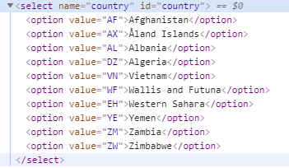
Selenium WebDriver Commands
Handling DropDown And Multiple Select in WebDriver
It is the Webdriver class which provides the implementation of the HTML SELECT tag. It exposes several “Select By” and “Deselect By” type methods. You can apply these methods to manipulate the selection in the DropDown and Multiple Select object. This class is the part of the Selenium’s <org.openqa.selenium.support.ui.Select> package. Apart from its unique capability, the Select class acts normally. You can define it using the <new> keyword following the standard syntax.
Select select = new Select(<WebElement object>);
WebElement dropdown = driver.findElement(By.id("country"));
Select select = new Select(dropdown);
Different Select Methods:
selectByVisibleText Method.
selectByIndex Method.
selectByValue Method.
select.selectByVisibleText("Albania");
select.selectByIndex(2);
select.selectByValue("AL");

Slide 40
Selenium WebDriver Commands
Handling DropDown And Multiple Select in WebDriver
DeselectByIndex Method.
Command Syntax: select.deselectByIndex(<Index>);
Use it when you want to deselect any option via its index. It accepts the index as argument.
DeselectByValue Method.
Command Syntax: select.deselectByValue(<Value>);
Use it when you wish to deselect all options using a value that matches the value in the dropdown options.
DeselectByVisibleText Method.
Comand Syntax: select.deselectByVisibleText(<Text>);
Use it to deselect all options by supplying the input text that matches the text in the dropdown options.
DeselectAll Method.
Command Syntax: select.deselectAll( );
Usage: Use it to turn off all the selected entries at once. But you can use this method if the <Select> tag has <multiple> attribute enabled in the Html. Otherwise, it’ll throw the <NotImplemented> exception. Hence, it’s compulsory to have an attribute like <multiple=”multiple”> while defining the <Select> tag.
Select select = new Select(<WebElement object>);
WebElement dropdown = driver.findElement(By.id("country"));
Select select = new Select(dropdown);
select.deselectByVisibleText("Albania");
select.deselectByIndex(2);
select.deselectByValue("AL");
select.deselectAll();

Slide 41
Selenium WebDriver Commands
Handling DropDown And Multiple Select in WebDriver
getOptions Method:
List<WebElement> –This gets the all options belonging to the Select tag. It takes no parameter and returns List<WebElements>.
Command – select.getOptions();
Sometimes you may like to count the element in the dropdown and multiple select box, so that you can use the loop on Select element.
Select select = new Select(<WebElement object>);
WebElement dropdown = driver.findElement(By.id("country"));
Select select = new Select(dropdown);
List <WebElement> elementCount = select.getOptions();
System.out.println(elementCount.size());
isMultiple Method:
isMultiple( ) : boolean – This tells whether the SELECT element support multiple selecting options at the same time or not. This accepts nothing but returns boolean value(true/false).
Command – select.isMultiple();
This is done by checking the value of the “multiple” attribute.

Slide 42
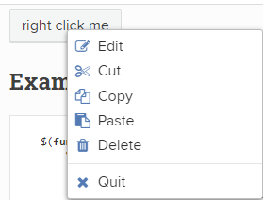
Selenium WebDriver Commands
Actions Class in Selenium
How to Right click ?
In many cases, automation test scripts need to perform similar action i.e. right click on some element on the web page and then selecting an option from the displayed context menu. To perform the right-click action through a Selenium script, WebDriver API does not have the capability for right-click command like other Action commands: click, sendKeys.
Actions actions = new Actions(driver);
WebElement btnElement = driver.findElement(By.id("rightClickBtn"));
actions.contextClick(btnElement).perform();
WebElement elementOpen = driver.findElement(By.xpath(".//div[@id='rightclickItem']/div[1]"));
elementOpen.click();

Slide 43
Selenium WebDriver Commands
Actions Class in Selenium
How to Double Click?
Double-click on webpage is not a very common user action. Sometime webpage, there might be some elements that require a double click to invoke an action on them. Similar to Right Click, in Selenium there is no WebDriver API command which has the capability to double click the webelement.
Actions actions = new Actions(driver);
WebElement btnElement = driver.findElement(By.id("doubleClickBtn"));
actions.doubleClick(btnElement).perform();
What is Drag and Drop Action?
This is an action performed with a mouse when a user moves (drags) a web element and then places (drops) it into an alternate area.
Here are the methods Actions class provides for Drag-Drop action:
dragAndDrop(WebElementsource, WebElement target)
dragAndDropBy(WebElementsource, int xOffset, int yOffset)
//Actions class method to drag and drop
Actions builder = new Actions(driver);
WebElement from = driver.findElement(By.id("draggable"));
WebElement to = driver.findElement(By.id("droppable"));
//Perform drag and drop
builder.dragAndDrop(from, to).perform();

Slide 44
Selenium WebDriver Commands
Actions Class in Selenium
What happens internally when invoke the perform() method above:
Click And Hold Action: dragAndDrop() method first performs click-and-hold at the location of the source element
Move Mouse Action: Then source element gets moved to the location of the target element
Button Release Action: Finally, it releases the mouse
Build: build() method is used to generate a composite action containing all actions. But if you observe, we have not invoked it in our above command. The build is executed in the perform method internally
Perform: perform() method performs the actions we have specified. But before that, it internally invokes build() method first. After the build, the action is performed
DragAndDropBy action in Selenium using OffSets
Actions builder = new Actions(driver);
WebElement from = driver.findElement(By.id("draggable"));
WebElement to = driver.findElement(By.id("droppable"));
//First, get x and y offset for from object
int xOffset1 = from.getLocation().getX();
int yOffset1 = from.getLocation().getY();
//Secondly, get x and y offset for to object
int xOffset = to.getLocation().getX();
int yOffset = to.getLocation().getY();
//Find the xOffset and yOffset difference to find x and y offset needed in which from object required to dragged and dropped
xOffset =(xOffset-xOffset1)+10;
yOffset=(yOffset-yOffset1)+20;
builder.dragAndDropBy(from, xOffset,yOffset).perform();

Slide 45
Selenium WebDriver Commands
Actions Class in Selenium
Mouse Hover Action:
A mouse hover is also called as hover. Mouse hover action is basically an action where a user places a mouse over a designated area like a hyperlink. It can cause some event to get triggered.
Moving the mouse over an element on web page displays some pop-up windows or maybe description boxes.
In automation also, many times it is required to perform some action on the element which gets visible only on mouse hover on some other element. For this, mouse cursor needs to be placed over an element.
Actions actions = new Actions(driver);
WebElement menuOption = driver.findElement(By.xpath(".//div[contains(text(),'Music')]"));
//Mouse hover menuOption
actions.moveToElement(menuOption).perform();

Slide 46
Selenium WebDriver Commands
Actions Class in Selenium
Keyboard Events in Selenium:
Firstly, in most of the Web Applications, features functionalities are available on the press of Shortcut keys. For instance, the most commonly used feature of most widely used text editor software like Word document is Copy & Paste. Shortcut keys CTRL+C and CTRL+V, respectively, perform this function. In other words, the combination of Control and C or Control and V is tested to check such shortcut keys functionality. The sendKeys() method is unable to perform this action of multiple key combinations.
Secondly, sometimes, some instances require interaction with Desktop components & type text into it. For instance, to upload any file as an email attachment, we have to enter the file name on Windows Dialog. sendKeys() method is unable to perform this action as Selenium WebDriver works with the web. Therefore, it’s unable to identify the Windows dialog box.
keyboard events Key Down, Key Up, and Send Keys along with their overloaded methods :
keyDown(CharSequence key): Performs a modifier key press.
keyDown(WebElement target, CharSequence key): Performs a modifier key press after focusing on an element.
keyUp(CharSequence key): Performs a modifier key release.
keyUp(WebElement target, CharSequence key): Performs a modifier key release after focusing on an element.
sendKeys(CharSequence keys): Sends keys to the active element.
sendKeys(WebElement target, .CharSequence keys) : Equivalent to calling: Actions.click(element).sendKeys(keysToSend)
For example we have to copy and paste address. To build the same sequence of steps, follow the steps below:
Press the CTRL key and along with that send key ‘c’ which will mimic CTRL + c
actions.keyDown(Keys.CONTROL).sendKeys(“c”);
To release the CTRL key press, let’s use the keyUp(), which performs a modifier key release after focusing on an element.
actions.keyUp(Keys.CONTROL);
So the complete actions sequence for Action Two would be as below:
actions.keyDown(Keys.CONTROL).sendKeys(“c”).keyUp(Keys.CONTROL).perform();

Slide 47
Selenium WebDriver Commands
Actions Class in Selenium
Keyboard Events in Selenium
//Find web elements
WebElement userName = driver.findElement(By.id("userName"));
WebElement currAddr = driver.findElement(By.id("currentAddress"));
WebElement perAddr = driver.findElement(By.id("permanentAddress"));
WebElement submitButton = driver.findElement(By.id("submit"));
//Instantiate Actions class
Actions actions = new Actions(driver);
actions.sendKeys(userName,"Mr.Jones").perform();
//Enter current address
actions.click(currAddr).sendKeys("1205 OAK STREET,OLD FORGE,NEW YORK,11240").perform();
//Copy current address
actions.keyDown(currAddr,Keys.CONTROL).sendKeys("a").keyUp(Keys.CONTROL).perform();
actions.keyDown(Keys.CONTROL).sendKeys("c").keyUp(perAddr,Keys.CONTROL).perform();
//Paste current address in permanant adderss text field
actions.keyDown(Keys.CONTROL).sendKeys("v").keyUp(Keys.CONTROL).perform();

Slide 48
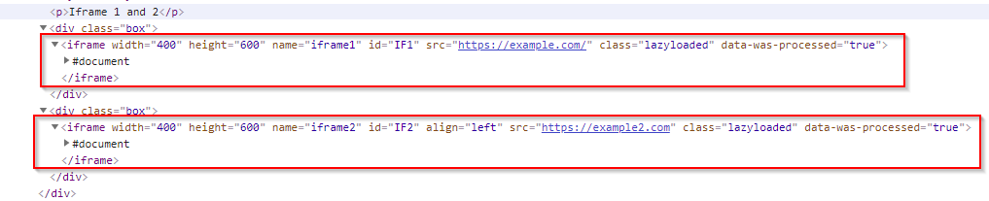
Selenium WebDriver Commands
iFrame in Selenium
iFrame is a HTML document embedded inside an HTML document. iFrame is defined by an <iframe></iframe> tag in HTML. With this tag, you can identify an iFrame while inspecting the HTML tree.
Before starting we have to understand that to work with different iFrames on a page we have to switch between these iFrames. To Switch between iFrames we have to use the driver’s switchTo().frame command. We can use the switchTo().frame() in three ways:
switchTo.frame(int frameNumber): Pass the frame index and driver will switch to that frame.
switchTo.frame(string frameNameOrId): Pass the frame element Name or ID and driver will switch to that frame.
switchTo.frame(WebElement frameElement): Pass the frame web element and driver will switch to that frame.
//First find the element using any of locator stratedgy
WebElement iframeElement = driver.findElement(By.id("IF1"));
//now use the switch command
driver.switchTo().frame(iframeElement);
//Switch back to the main window
driver.switchTo().defaultContent();

Slide 50
TestNG
Automated testing framework
NG = Next Generation
Similar to JUnit (especially JUnit 4)
Not a JUnit extension (but inspired by JUnit)
Designed to be better than JUnit, especially when testing integrated classes
Created by Dr. Cédric Beust (of Google)
Open source (http://testng.org)

Slide 51
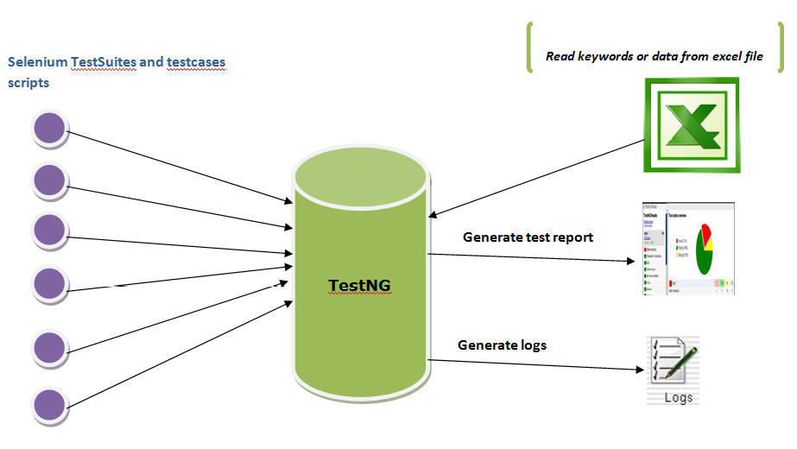

Slide 52
Selenium Commands - Hybrid Automation Framework
Selenium framework is a code structure for making code maintenance simpler, and code readability better. A framework involves breaking the entire code into smaller pieces of code, which test a particular functionality.
The code is structured such that, the “data set” is separated from the actual “test case” which will test the functionality of the web application. It can also be structured in a way wherein, the test cases which need to be executed are called (invoked) from an external application (like an Excel).
Hybrid framework is a technique wherein we can make the best use of both Data Driven & Modular Drivena Selenium framework (s). We will be focusing on the following staff for Hybrid framework :
1) Page Object Model
2) Object Repository
3) Modular Driven Technique
4) Function Parameters
5) Constant Variables
6) Data Driven Technique
7) TestNG Unit testing Framework
8) Extent Report

Slide 53
Selenium Commands - Hybrid Automation Framework
Page Object Model: Page Object Model is a Design Pattern which has become popular in Selenium Test Automation. It is widely used design pattern in Selenium for enhancing test maintenance and reducing code duplication. Page object model (POM) can be used in any kind of framework such as modular, data-driven, keyword driven, hybrid framework etc.
The disadvantage of duplicated code is that the project is less maintainable. If some locator will change, you have to walk through the whole test code to adjust locators where necessary. By using the page object model we can make non-brittle test code and reduce or eliminate duplicate test code.
Instead of keeping WebElements in Java Action Class file we will be creating separate Package call “PageObjects”. So, Action Class will be invoking these classes.

Slide 54
Selenium Commands - TestNG
TestNG is a testing framework inspired from JUnit and NUnit but introducing some new functionality that make it more powerful and easier to use.
It is an open source automated testing framework; where NG means Next Generation. TestNG is similar to JUnit but it is much more powerful than JUnit.
TestNG eliminates most of the limitations of the older framework and gives the developer the ability to write more flexible and powerful tests with help of easy annotations, grouping, sequencing & parametrizing. Features of TestNG Framework:
Support for parameters.
Supports dependent methods testing.
Test configuration flexible.
Supports powerful execution model.
TestNG has a more elegant way of handling parameterized tests with the data-provider concept.
For the same test class TestNG support for multiple instances.
Supported different Annotations like @BeforeSuite, @AfterSuite, @BeforeClass, @AfterClass, @BeforeTest, @AfterTest, @BeforeGroups, @AfterGroups, @BeforeMethod, @AfterMethod, @DataProvider, @Factory, @Listeners, @Parameters, @Test.

Slide 55
Selenium Commands - TestNG
Advantages of TestNG over Junit:
In TestNG Annotations are easy to understand over JUnit.
In TestNG there is no constraint like you have to declare @BeforeClass and @AfterClass, which is present in JUnit.
As method name constraint is present in JUnit, such method name constraint is not present in TestNG and you can specify any test method names.
In TestNG enable you to grouping of test cases easily which is not possible in JUnit.
TestNG supports following three 3 additional setUp/tearDown level: @Before/AfterSuite, @Before/AfterTest and @Before/AfterGroup.
TestNG do not require extend any class.
TestNG allows us to define the dependent test cases each test case is independent to other test case.
TestNG allows us to execute of test cases based on group. Let’s take a scenario where we have created two set of groups “Regression” & “Sanity”. If we want to execute the test cases under Sanity group then it is possible in TestNG framework.
Parallel execution of Selenium test cases is possible in TestNG.

Slide 56
Selenium Commands - TestNG
What are the different Annotations are present in TestNG?
@BeforeSuite: The annotated method will be run before all tests in this suite have run.
@AfterSuite: The annotated method will be run after all tests in this suite have run.
@BeforeTest: The annotated method will be run before any test method belonging to the classes inside the tag is run.
@AfterTest: The annotated method will be run after all the test methods belonging to the classes inside the tag have run.
@BeforeGroups: The list of groups that this configuration method will run before. This method is guaranteed to run shortly before the first test method that belongs to any of these groups is invoked.
@AfterGroups: The list of groups that this configuration method will run after. This method is guaranteed to run shortly after the last test method that belongs to any of these groups is invoked.
@BeforeClass: The annotated method will be run before the first test method in the current class is invoked.
@AfterClass: The annotated method will be run after all the test methods in the current class have been run.
@BeforeMethod: The annotated method will be run before each test method.
@AfterMethod: The annotated method will be run after each test method.
@Test: The annotated method is a part of a test case.

Slide 57
Selenium Commands - TestNG
Now create an ne Package TestClass. Right click on this package and create a new TestNG class “Login.java”

Slide 58
Selenium Commands - TestNG Test Suite
In TestNG framework, we need to create testng.xml file to create and handle multiple test classes. This is the xml file where you will configure your test run, set test dependency, include or exclude any test, method, class or package and set priority etc.

Slide 59
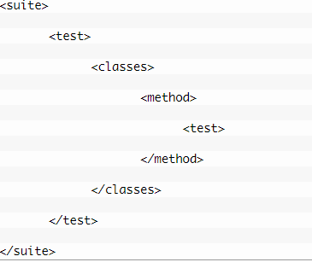
Selenium Commands - TestNG Annotations
Annotations hierarchy or Annotations levels in TestNG.
It says that @Test is the smallest annotation here. @Method will be executed first, before and after the execution of @Test. The same way @Class will be executed first, before and after the execution of @Method and so on.
Now with the below example it will be clear to you easily.

Slide 60
Selenium Commands - TestNG Annotations
public class TestNGTest {
@Test
public void testCase1() {
System.out.println("This is the Test Case 1");
}
@Test
public void testCase2() {
System.out.println("This is the Test Case 2");
}
@BeforeMethod
public void beforeMethod() {
System.out.println("This will execute before every Method");
}
@AfterMethod
public void afterMethod() {
System.out.println("This will execute after every Method");
}
@BeforeClass
public void beforeClass() {
System.out.println("This will execute before the Class");
}
@AfterClass
public void afterClass() {
System.out.println("This will execute after the Class");
}
}

Slide 61
Selenium Commands - TestNG Annotations
public class TestNGTest {
@BeforeTest
public void beforeTest() {
System.out.println("This will execute before the Test");
}
@AfterTest
public void afterTest() {
System.out.println("This will execute after the Test");
}
@BeforeSuite
public void beforeSuite() {
System.out.println("This will execute before the Test Suite");
}
@AfterSuite
public void afterSuite() {
System.out.println("This will execute after the Test Suite");
}
}

Slide 62
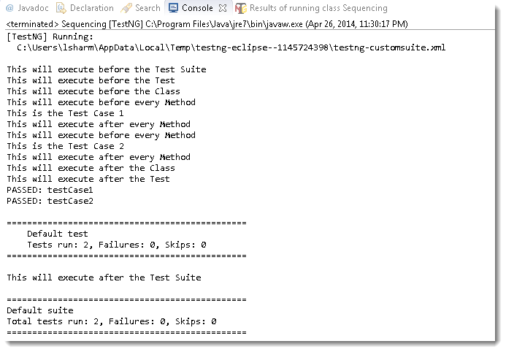
Selenium Commands - TestNG Annotations
Output would be :

Slide 63
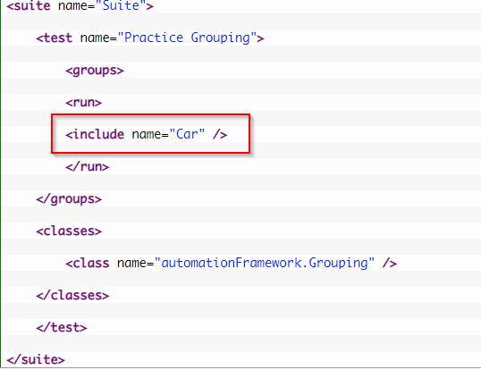
Selenium Commands - TestNG Annotations
Test Case Grouping: Groups is one more annotation of TestNG which can be used in the execution of multiple tests. Let’s say you have hundred tests of class vehicle and in it ten method of car, ten method of scooter and so on. You probably like to run all the scooter tests together in a batch. And you want all to be in a single test suite. With the help of grouping you can easily overcome this situation.
1) Create two methods for Car, two methods for Scooter and one method in conjunction with Car & Sedan Car.
2) Group them separately with
using (groups = { ” Group Name” })
3) Create a testng xml like this:

Slide 64
Selenium Commands - TestNG Annotations
public class Grouping {
@Test (groups = { "Car" })
public void Car1() {
System.out.println("Batch Car - Test car 1");
}
@Test (groups = { "Car" })
public void Car2() {
System.out.println("Batch Car - Test car 2");
}
@Test (groups = { "Scooter" })
public void Scooter1() {
System.out.println("Batch Scooter - Test scooter 1");
}
@Test (groups = { "Scooter" })
public void Scooter2() {
System.out.println("Batch Scooter - Test scooter 2");
}
@Test (groups = { "Car", "Sedan Car" })
public void Sedan1() {
System.out.println("Batch Sedan Car - Test sedan 1");
}
}

Slide 65
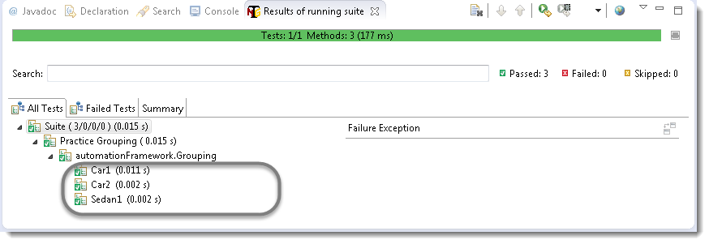
Selenium Commands - TestNG Annotations
Run the test by right click on the testng.xml file and select Run As > TestNG Suite. Output will be like this in TestNg console:

Slide 66
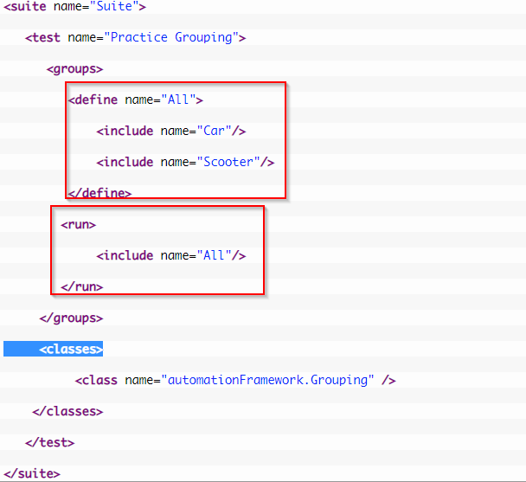
Selenium Commands - TestNG Annotations
Change the configuration like below:

Slide 67
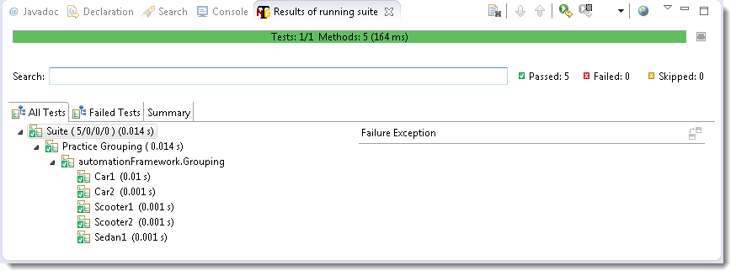
Selenium Commands - TestNG Annotations
Run the test by right click on the testng.xml file and select Run As > TestNG Suite. Output will be like this in TestNg console:

Slide 68
Selenium Commands - TestNG Dependent Test
Sometimes, you may need to invoke methods in a Test case in a particular order or you want to share some data and state between methods. This kind of dependency is supported by TestNG as it supports the declaration of explicit dependencies between test methods.
TestNG allows you to specify dependencies either with:
Using attributes dependsOnMethods in @Test annotations OR
Using attributes dependsOnGroups in @Test annotations.
public class Dependent {
@Test (dependsOnMethods = { "OpenBrowser" })
public void SignIn() {
System.out.println("This will execute second (SignIn)");
}
@Test
public void OpenBrowser() {
System.out.println("This will execute first (Open Browser)");
}
@Test (dependsOnMethods = { "SignIn" })
public void LogOut() {
System.out.println("This will execute third (Log Out)");
}
}

Slide 69
Selenium Commands - TestNG Prioritizing & Sequencing
There will be situations when you want to put number of tests under a single test class and like to run all in single shot. With the help of TestNG ‘@Test‘ annotations we can execute multiple tests in single TestNG file.
public class MultipleTest {
public WebDriver driver;
@Test
public void One() {
System.out.println("This is the Test Case number One");
}
@Test
public void Two() {
System.out.println("This is the Test Case number Two");
}
@Test
public void Three() {
System.out.println("This is the Test Case number Three");
}
@Test
public void Four() {
System.out.println("This is the Test Case number Four");
}
}

Slide 70
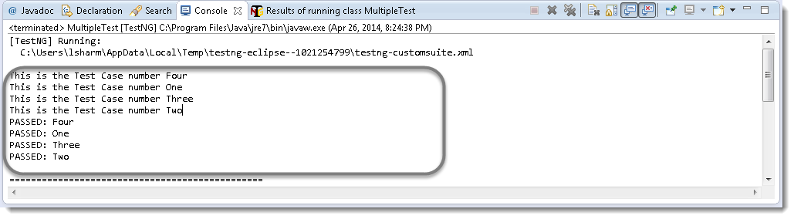
Selenium Commands - TestNG Annotations
The output would be:
By default, methods annotated by @Test are executed alphabetically.
Take a look over the next topic to see how to prioritize @Test.

Slide 71
Selenium Commands - TestNG Prioritizing & Sequencing
You need to use the ‘priority‘ parameter, if you want the methods to be executed in your order. Parameters are keywords that modify the annotation’s function.
Let’s take the same above example and execute all @Test methods in right order. Simply assign priority to all @Test methods starting from 0(Zero).
public class MultipleTest {
public WebDriver driver;
@Test(priority = 0)
public void One() {
System.out.println("This is the Test Case number One");
}
@Test(priority = 1)
public void Two() {
System.out.println("This is the Test Case number Two");
}
@Test(priority = 2)
public void Three() {
System.out.println("This is the Test Case number Three");
}
@Test(priority = 3)
public void Four() {
System.out.println("This is the Test Case number Four");
}
}

Slide 72
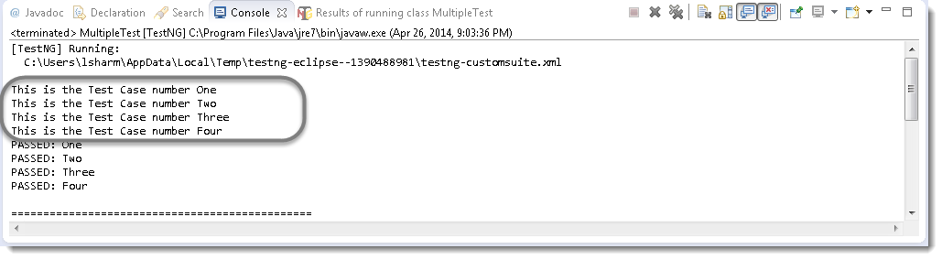
Selenium Commands - TestNG Annotations
The output would be:

Slide 73
Selenium Commands - TestNG Skipping a Test Case
Think of a situation where you are required to skip one or more @Test from your testng class. In testng, you can easily able to handle this situation by setting the ‘enabled’ parameter to ‘false’ for e.g.: @Test(enabled = false)
To use two or more parameters in a single annotation, separate them with a comma:
@Test(priority = 3, enabled = false)
public class MultipleTest {
public WebDriver driver;
@Test(priority = 0)
public void One() {
System.out.println("This is the Test Case number One");
}
@Test(priority = 1)
public void Two() {
System.out.println("This is the Test Case number Two");
}
@Test(priority = 2, enabled = false)
public void Three() {
System.out.println("This is the Test Case number Three");
}
@Test(priority = 3)
public void Four() {
System.out.println("This is the Test Case number Four");
}
}

Slide 74
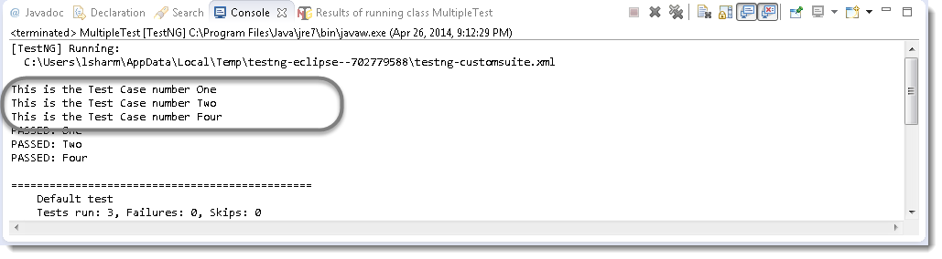
Selenium Commands - TestNG Annotations
The output would be:

Slide 75
Selenium Commands - TestNG Asserts
TestNG also gives us the power to take decisions in the middle of the test run with the help of Asserts. With this we can put various checkpoints in the test. In selenium there will be many situations in the test where you just like to check the presence of an element. All you need to do is to put an assert statement on to it to verify its existence.
Different Asserts Statements: 1) Assert.assertTrue() & Assert.assertFalse()
2. Assert.assertEquals
public class MultipleTest {
public WebDriver driver;
@Test(priority = 0)
public void One() {
WebElement myAccount = driver.findElement(By.xpath(".//*[@id='account']/a"));
Assert.assertTrue(myAccount.isDisplayed());
Assert.assertEquals(“Azad Rahman", myAccount.getText());
System.out.println("This is the Test Case number One");
}
@Test(priority = 1)
public void Two() {
System.out.println("This is the Test Case number Two");
}
}

Slide 76
Selenium Commands - TestNG Parameters
Everybody knows the importance of Parameterization in testing and in automation testing. It allows us to automatically run a test case multiple times with different input and validation values. TestNG again gives us another interesting feature called TestNG Parameters. TestNG lets you pass parameters directly to your test methods with your testng.xml.
public class MultipleTest {
public WebDriver driver;
@Test(priority = 0)
@Parameters({ "sUsername", "sPassword" })
public void Login(String sUsername, String sPassword) {
driver = new FirefoxDriver();
driver.manage().timeouts().implicitlyWait(10, TimeUnit.SECONDS);
driver.get("http://www.store.demoqa.com");
driver.findElement(By.xpath(".//*[@id='account']/a")).click();
driver.findElement(By.id("log")).sendKeys(sUsername);
driver.findElement(By.id("pwd")).sendKeys(sPassword);
driver.findElement(By.id("login")).click();
driver.findElement(By.xpath(".//*[@id='account_logout']/a")).click();
driver.quit(); }
}

Slide 77
Selenium Commands - TestNG Parameters
Everybody knows the importance of Parameterization in testing and in automation testing. It allows us to automatically run a test case multiple times with different input and validation values. TestNG again gives us another interesting feature called TestNG Parameters. TestNG lets you pass parameters directly to your test methods with your testng.xml.
<suite name="Suite">
<test name="ToolsQA">
<parameter name="sUsername" value="testuser_1"/>
<parameter name="sPassword" value="Test@123"/>
<classes>
<class name="automationFramework.TestngParameters" />
</classes>
</test>
</suite>

Slide 78
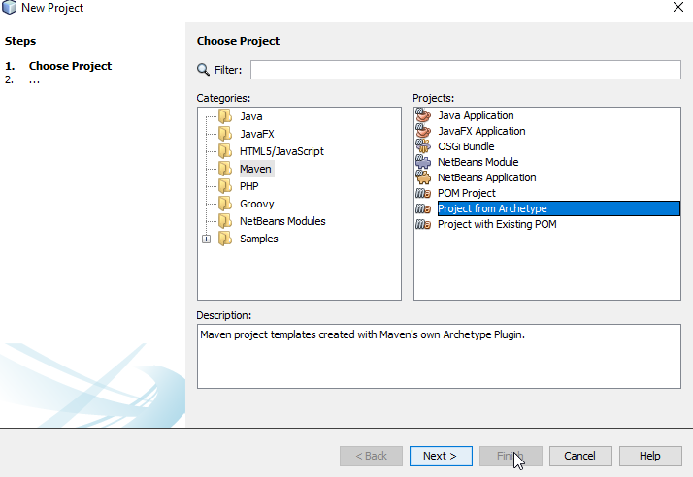
Maven Project with TestNG
Open you NetBeans IDE, create new Maven project. Select Project from Archetype.

Slide 79
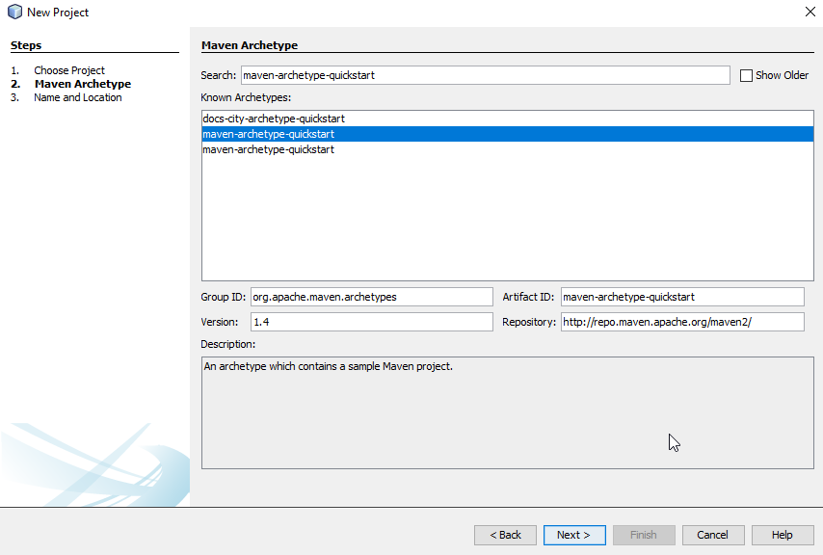
Maven Project with TestNG
Search for maven-archetype-quickstart

Slide 80
Maven Project with TestNG
Open the POM file and replace the junit dependency with TestNG also, add the selenium dependency
<dependency>
<groupId>junit</groupId>
<artifactId>junit</artifactId>
<version>4.11</version>
<scope>test</scope>
</dependency>
<dependency>
<groupId>org.testng</groupId>
<artifactId>testng</artifactId>
<version>6.8</version>
<scope>test</scope>
</dependency>
<dependency>
<groupId>org.seleniumhq.selenium</groupId>
<artifactId>selenium-java</artifactId>
<version>3.141.59</version>
</dependency>

Slide 81
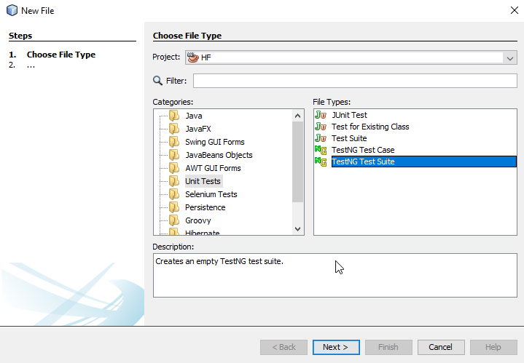
Maven Project with TestNG
Right click on project New > Other > Unit Tests > TestNGSuite
Name the XML file to “testing.xml”

Slide 82
Maven Project with TestNG
Open the POM file and add TestNG.xml dependency to POM.xml file. In order to do that we need to add plugin name “maven-surefire-plugin”
<plugin>
<groupId>org.apache.maven.plugins</groupId>
<artifactId>maven-surefire-plugin</artifactId>
<version>2.22.1</version>
<configuration>
<forkCount>0</forkCount>
<suiteXmlFiles>
<suiteXmlFile>src/test/java/testng.xml</suiteXmlFile>
</suiteXmlFiles>
</configuration>
</plugin>

Slide 83
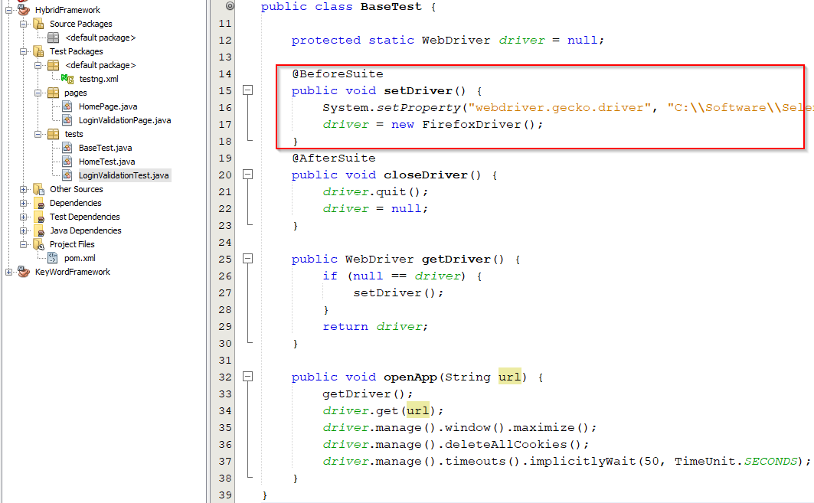
Maven Project with TestNG
Create Two Packages name “pages” and “tests”. “Pages” where web pages are represented as classes, and the various elements on the page objects are defined as variables on the class .
“Tests” where all the test cases are store as classes and PageFactory being used to initialize with initElements. Test classes are conjunction with TestNG annotation methods.
Let’s create A test class name “BaseTest” that will set and get the Driver, close the driver after suite. Open the application with desired URL and all test case extend the “BaseTest”.

Slide 84
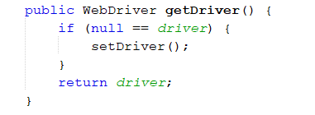
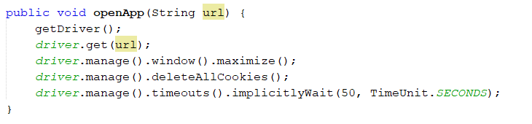
Maven Project with TestNG
As you see the from previous example, we have added setDriver() method @BeforeSuite to make sure the driver will be defined and set first before initialize anything else. You may need to close browser after every class to run test parallelly so, you may need to redefine driver so, getDriver() method will do it for you if driver is closed.

Slide 85
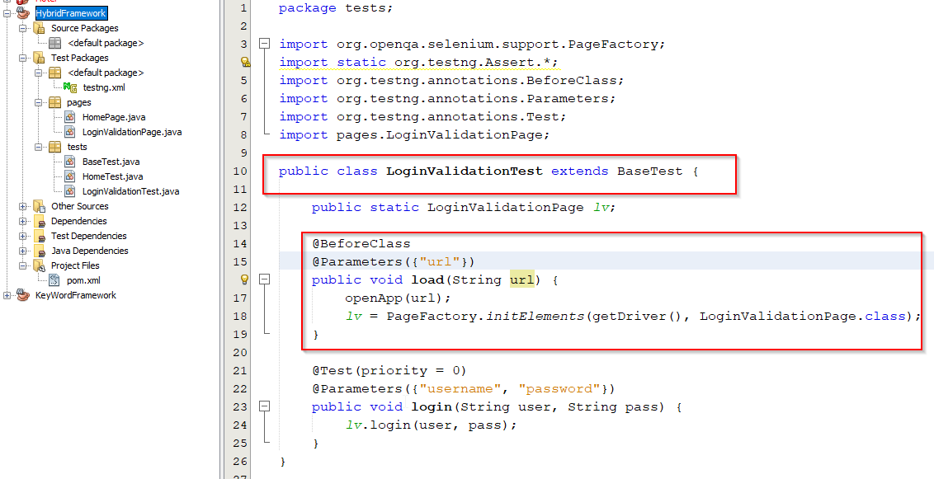
Maven Project with TestNG
Now, let’s create “LoginValidationTest.java” to begin actual test class under package “tests”
LoginValidationTest class is extending from BaseTest class. Before the class we are opening the application from reading the Paramater “url” from testing.xml file. Web page classes or Page Objects containing web elements need to be initialized using Page Factory before the web element variables can be used. This can be done simply through the use of initElements function on PageFactory.

Slide 86
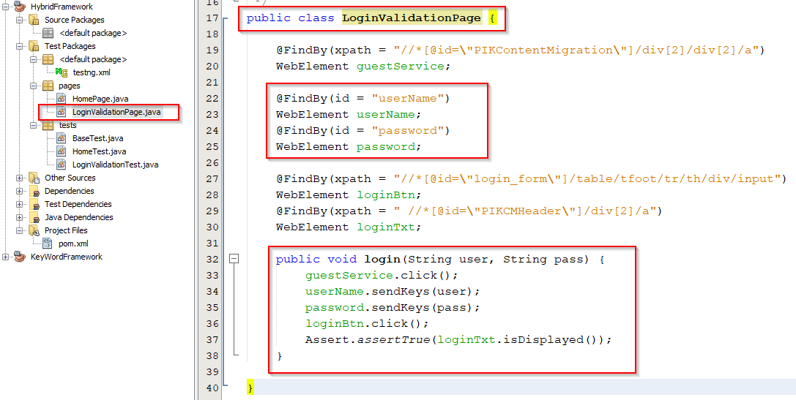
Maven Project with TestNG
Now, we need to create “LoginValidationPage.java” to store all page object under package “pages”. Page Factory will initialize every WebElement variable with a reference to a corresponding element on the actual web page based on configured “locators”. This is done through the use of @FindBy annotations. With this annotation, we can define a strategy for looking up the element, along with the necessary information for identifying it.

Slide 87
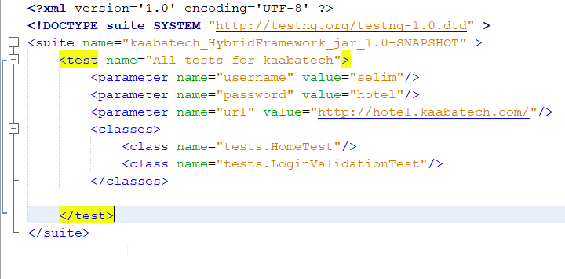
Maven Project with TestNG
We need to add classes in testng.xml in order to execute test cases. Also, we have added parameters for application url and valid credentials to login to the system.

Slide 88
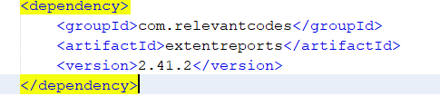
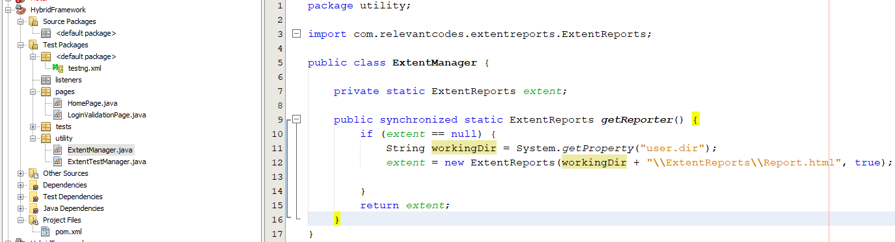
Maven Project with TestNG
This is the time to go one step up. We are now introducing logging/reporting module in our project call “ExtentReports”. First, we need to add ExtentReports Dependency to our POM file. 2nd we need to create “utility” and “listeners” package under “Test Packages”. Create two class ExtentManager and ExtentTestManager under “utility” package.
ExtentManager:
In this class, we created an ExtentReports object and it can be reachable via getReporter() method. Also, we need to set your ExtentReports report HTML file location.

Slide 89
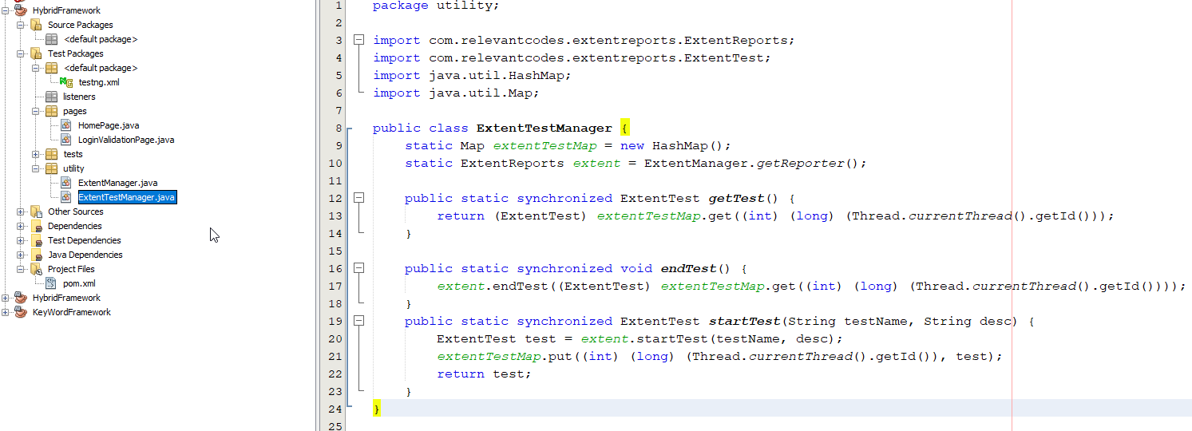
Maven Project with TestNG
ExtentTestManager Class:
An extentTestMap map is created. It holds the information of thread ids and ExtentTest instances.
ExtentReports instance is created by calling getReporter() method from ExtentManager.
At startTest() method, an instance of ExtentTest created and put into extentTestMap with current thread id.
At endTest() method, test ends and ExtentTest instance got from extentTestMap via current thread id.
At getTest() method, return ExtentTest instance in extentTestMap by using current thread id.

Slide 90
Maven Project with TestNG
Now we need to add TestListener class to “listeners” package and update testing.xml file to listen the actions.
<listeners>
<listener class-name="listeners.TestListener"/>
</listeners>
TestNG Listeners:
There are many types of listeners available in TestNG for example IAnnotationTransformer, IAnnotationTransformer2, IConfigurable, IConfigurationListener, IConfigurationListener2, IExecutionListener, IHookable, IInvokedMethodListener, IInvokedMethodListener2, IMethodInterceptor, IReporter, ISuiteListener, ITestListener.
As far as testing concern only a few can be used effectively such as :
ISuiteListener: It has two method in it onStart() & onFinish(). Whenever a class implements this listener, TestNG guarantees the end-user that it will invoke the methods onStart() and onFinish() before and after running a TestNG Suite. So before TestNG picks up your suite for execution, it first makes a call to onStart() method and runs whatever has been scripted in this method. In a similar way, it again makes a call to onFinish() method after a suite has been run.

Slide 91
Maven Project with TestNG
ITestListener: The working of this listener is also exactly the same as ISuiteListerner but the only difference is that it makes the call before and after the Test, not the Suite. It has seven methods in it.
onFinish(): Invoked after all the tests have run and all their Configuration methods have been called.
onStart(): Invoked after the test class is instantiated and before any configuration method is called.
onTestFailedButWithinSuccessPercentage(ITestResult result): Invoked each time a method fails but has been annotated with successPercentage and this failure still keeps it within the success percentage requested.
onTestFailure(ITestResult result): Invoked each time a test fails.
onTestSkipped(ITestResult result): Invoked each time a test is skipped
onTestStart(ITestResult result): Invoked each time before a test will be invoked.
onTestSuccess(ITestResult result): Invoked each time a test succeeds.

Slide 92
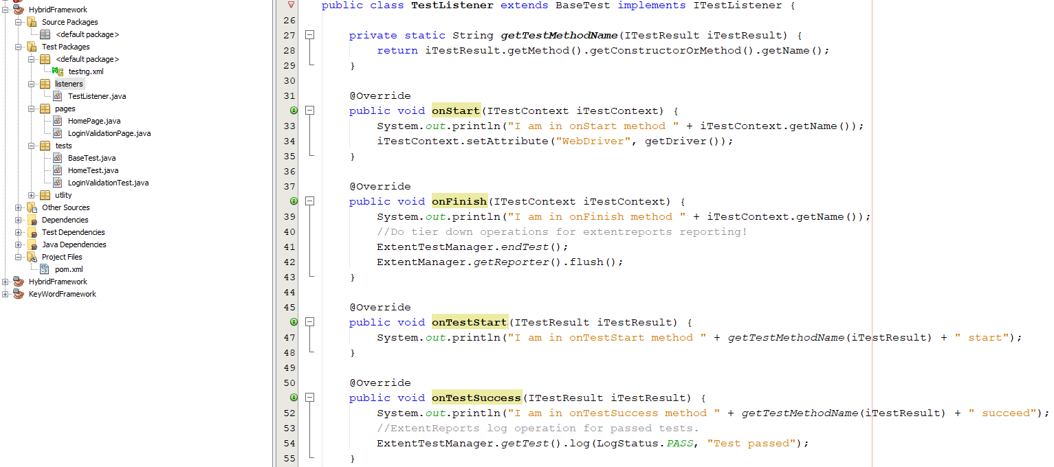
Maven Project with TestNG
IInvokedMethodListener: The working of this listener is also exactly the same as ISuiteListerner & ITestListerner and the only difference is that it makes the call before and after every Method. It has only two methods in it.
afterInvocattion(): Invoke after each method
beforeInvocation(): Invoke before each method

Slide 93
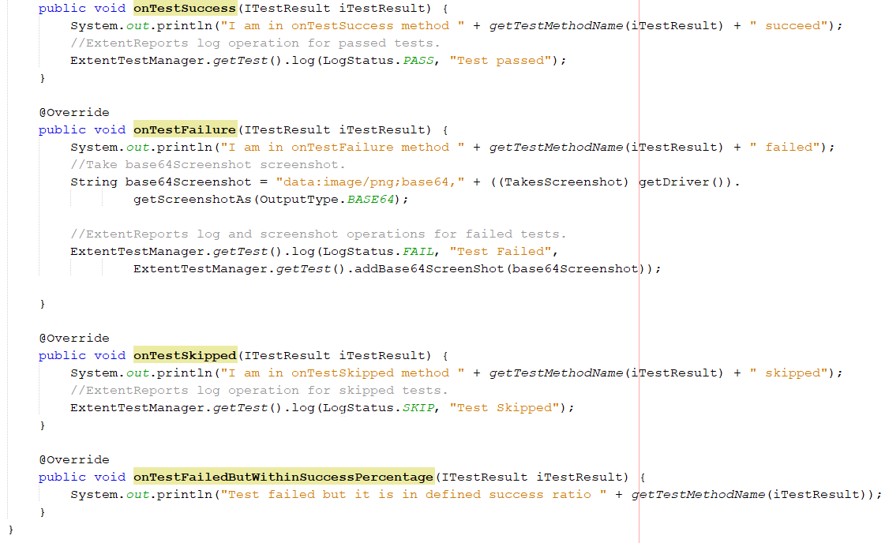
Maven Project with TestNG

Slide 94
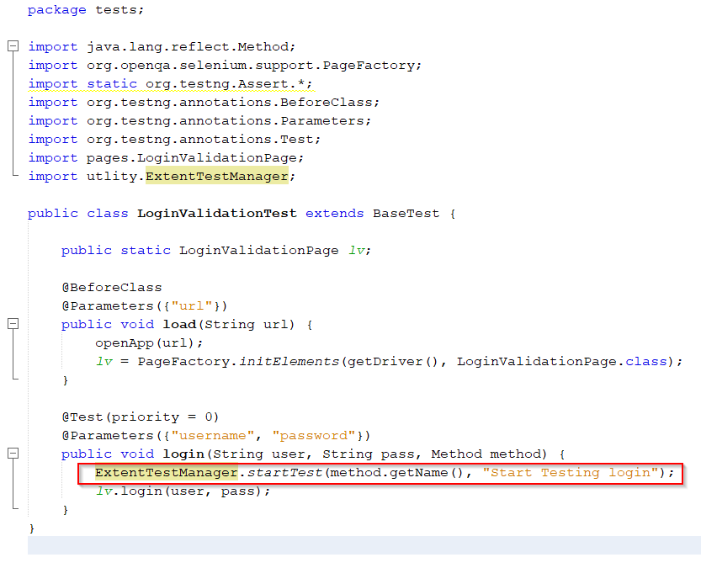
Maven Project with TestNG
We need to update the test class to start the ExtentReports logging. Let’s open class “LoginValidationTest”
Need to call ExtentTestManager static method “startTest” passing to variable method name and description of the current test.

Slide 95
Thank You

