Slide 1



Department of Computer Science specialize in Data Science
Frontend Development Course
React Riddle Website
Lecturer: Sok Piseth
Year: 2 (Term 2)
Group: CS-DS-G2
Team: 06
Member: Vann Vat, Chim Panhaprasith, Phan Panhawornd

Slide 2
Table of Contents
Introduction
Methodology
Project Timeline
Expected Outcome
Conclusion
Future Improvement
Demonstration

Slide 3

Introduction
+ React Riddles is an interactive quiz game designed to help users practice key React concepts step by step.
+ This project will give challenges for users to solve by typing the correct React code and can navigate to the different level by click the arrow icons.
+ This platform is perfect for beginner who want to learn React or for developer who want to improve their skills.

Slide 4






Methodology
Tools that we use to collaborative and communication through this whole project are:

Slide 5
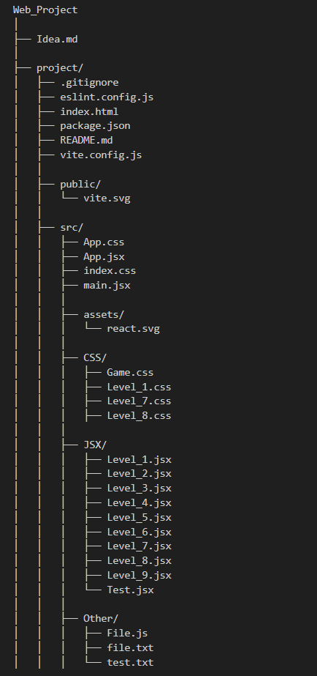
Code Structure

Slide 6
Timeline
Week 1
2
Week 3
Finding topic, idea for the project
Define all the level of the quiz
Design each level
Testing the code Debugging error
Finalize the project
Week 2
Create react project, write each level code into its file
Design style of each level
1
3

Slide 7
Expected Outcome
Interactive Learning:
Users progress through levels by solving React-based challenges.
Each level introduces a new React concept, such as JSX, props, state, event handling, conditional rendering, and forms.
Visual Feedback:
Users receive real-time feedback on their input, helping them learn React concepts effectively.
Success messages and animations provide a sense of accomplishment.
Progression System:
Users start at Level 1 and progress to the next level upon completing the current one.
After you complete the final level which is (Level 9), it will display a "Thank You for Playing!" message with a celebratory animation.

Slide 8
Conclusion
React Riddles project is a well-organized and interactive learning platform that guides users through various levels to master React concepts. Each level focuses on a specific topic, including props, state management, event handling, hooks and conditional rendering, offering an engaging, hands-on learning experience.

Slide 9
Lesson Learned
+ Github
_ know how to collaboration with the team more efficiently
_ tracking the changes of code
_ more communication with the team
+ React Library
+ Frontend Development
_ UX/UI with react
_ Function, useState()
_ Condition.....
+ import and export file

Slide 10
Future Improvement
After we have finished this project, We want to improve our project to be able to:
+ Add more level of quiz into this website
+ More improve in each level of the quiz
+ visual output
+ improve the responsive of our website

Slide 11
Demo

Slide 12
References
+ W3Schools. (n.d.). W3Schools online web tutorials. from
https://www.w3schools.com
+ Codepip. (n.d.). Flexbox Froggy - A game for learning CSS flexbox. from
https://flexboxfroggy.com/

Slide 13
THANK YOU VERY MUCH!

