Slide 1
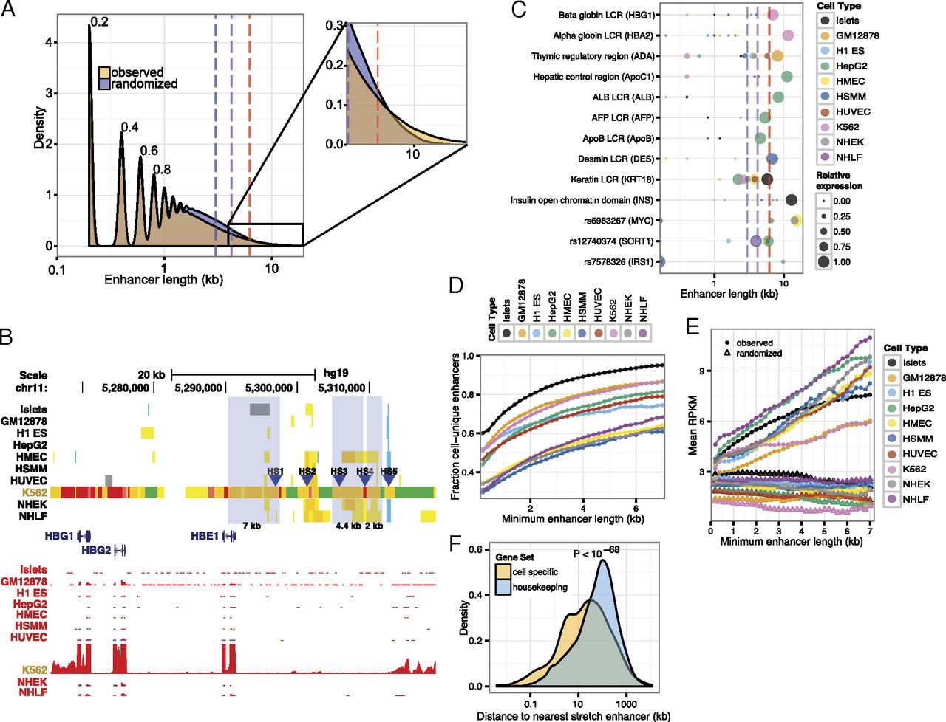

Stretch enhancer properties.
Stephen C. J. Parker et al. PNAS 2013;110:44:17921-17926
©2013 by National Academy of Sciences
Notes:
Stretch enhancer properties. (A) Enhancer states exhibit a range of length distribution. Density plot of observed (yellow) and random (blue) distribution of enhancer state lengths for all cell types combined. Distribution for each cell type is shown in SI Appendix, Fig. S6. Periodicity in the plot is a function of the 200-bp window of the ChromHMM algorithm. (Inset) Small but substantial enrichment for large enhancer states at the tail of the distribution. Enhancer sizes for the 90th (blue dashed line), 95th (purple dashed line), and 99th (red dashed line) percentile of the random distribution are indicated for reference. (B) Human β globin LCR contains multiple stretch enhancers. Chromatin states (Upper) and expression profiles (RNA-seq, red) near the β globin LCR show K562-specific chromatin states and robust HBG1/2 and HBE1 expression. Hypersensitive sites (HS) 1–3 and 5 (blue arrowheads) reside in K562-specific enhancer states (orange/yellow), two of which qualify as stretch enhancers. Chromatin states are color-coded as in Fig. 1A. (C) Celebrity enhancer regions overlap stretch enhancers. LCRs (15) and the INS/TH/IGF2 open chromatin domain (33) are contained in the top 10% of enhancer state size in relevant cell types (e.g., hepatic control region in hepatocellular carcinoma, thymic regulatory region in lymphoblastoid cell lines). Recently reported GWAS enhancer regions (18–21) also overlap stretch enhancers (see lower three rows). Colors of circles on the plot represent different cell types. Circle diameters indicate RNA-seq expression levels of the target gene relative to levels in the highest cell type, as indicated in the key. Dashed lines are the same as in A. (D) Cell type specificity of enhancer increases with length. Fraction of enhancers unique to a cell type is plotted against increasing enhancer length. (E) Nearby gene expression increases with enhancer length. Median RNA-seq expression (RPKM) of genes within 125 kb of enhancer states is plotted against increasing enhancer length. Filled circles denote observed mean expression. Empty triangles indicate mean expression levels from randomly assigned genes. (F) Cell-specific genes are close to stretch enhancers. The distance of cell-specific or housekeeping genes (Materials and Methods) to stretch enhancers in each cell type was measured and indicates that cell-specific genes are significantly closer (P < 10⁻⁶⁸; Wilcoxon rank sum test) compared with housekeeping genes.

