Slide 1
700 Tons of Code Later
When Your IDE Will Not Cut It You Need a Spoon
Alexander Shopov @TEQnation 2019

Slide 2
[ashopov@ashmac ~]$ whoami
By day: Software Engineer at Uber
By night: OSS contributor
Overall: father of 2, husband of 1
Coordinator of Bulgarian GNOME TP
Git, bash, Sentry, Jenkins speak Bulgarian
South Slavic language in Cyrillic

Slide 3
[ashopov@ashmac ~]$ whoami
Contacts:
E-mail: ash@kambanaria.org
LinkedIn: https://www.linkedin.com/in/alshopov
SlideShare: https://www.slideshare.net/al_shopov
GitHub: https://github.com/alshopov
Web: Just search “al_shopov”

Slide 4

Please Learn and Share
License: Creative Commons
Attribution 4.0 International
(CC-BY v4.0)

Slide 5
When We All Know How To Do Stuff
Files
  small or few - text editor
  big or many - sed, awk, perl
Data
  small, single table - spreadsheet
  many, interrelated, large tables - database
Explore the data
  quick check - ad hoc interactive session
  large, long, transform and change - SQL/ETL/script job

Slide 6
When We Only We Think We Do
1 module - use editor/IDE
10 modules - use editor/IDE
100 modules - use editor/IDE

Slide 7
When We Only We Think We Do
1 module - use editor/IDE
10 modules - use editor/IDE
100 modules - use editor/IDE
Really?
700 modules - use what?

Slide 8
So What Can We Do?
Don’t work on 700 modules
Curse at ℙ{IDE, CPU, memory} when trying to open 700 modules
Work, work, work
  Work in sequence - need time
  Work in parallel - need people
  Work in in sequence/parallel - need time, people and management

Slide 9
Is It Realistic?
Microservices
Growth
Monrepos

Slide 10
Lather, Rinse, Repeat
Files - put a single FS
Data - put in a single DB
Source - put in a single SCCS
Eggs - put in a single basket

Slide 11
IDEs Work Great Until They Don't
Text tools – inadequate
Lexer, parser – hard
Use good and tested solution

Slide 12

Spoon

Slide 13
Spoon At a Glance
Site: http://spoon.gforge.inria.fr
Development: https://github.com/INRIA/spoon
License: MIT/CeCILL-C
Distributed via maven, thin/fat (library/utility) versions
Started in 2005, currently at v7.4, going to v7.5
Developed at INRIA (Lille), part of OW2, used in academia and industry

Slide 14
Two Sides of The Polyhedron
Code analysis
  Static checks
  Get metrics
  Architecture
Code generation
  Annotation processing
  Instrumentation
  Reflection substitute

Slide 15
When You Do That:
Code Transformation

Slide 16
AKA Most of Programming
Refactor
Upgrade dependencies
Replace dependencies
Bug fixing
Maintenance
Most mundane things

Slide 17
Spoon’s Metamodel - AST For Java Developers
Based on the Java LANGUAGE
More complicated than bytecode
Programmers ≠ compilers, reflection
  nested classes - synthetic members
  covariant return, type erasure - bridge methods

Slide 18
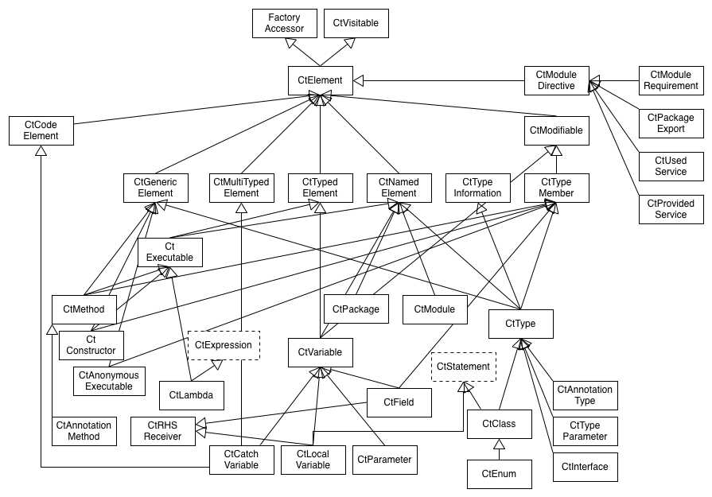
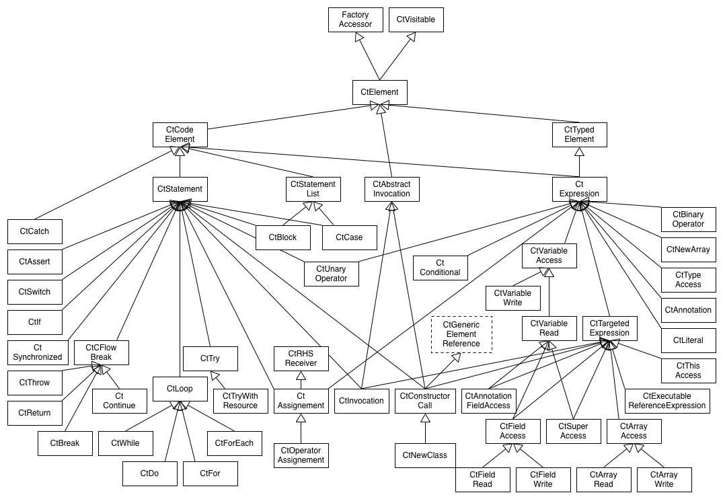
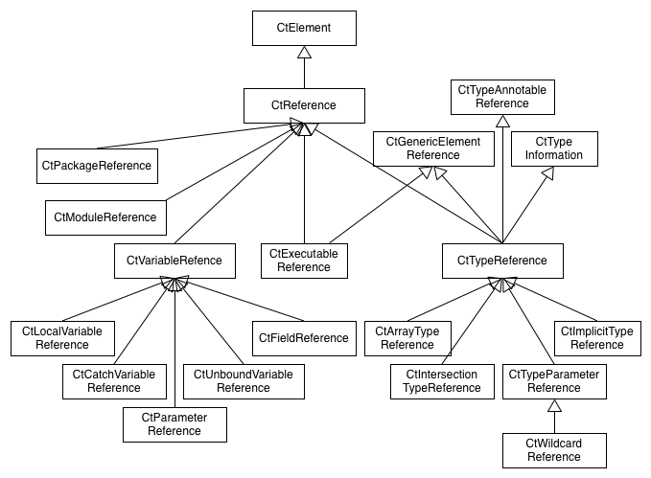
Legion
Structure (declarations, roughly what can be outside methods)
Code (executable statements and expressions, roughly inside methods)
References (names, roughly cross-references, may shortcut/terminate)

Slide 19
Everything is CtElement
Ct = Compile Time
Presents tree model on top of source (DOM for Java)
  children, parents, siblings
  queries
  paths
Instances are CtVisitable-able - accept(CtVisitor) that can visitCtSomeThing (CtSomeThing<?> thing)

Slide 20
The Fab Four
Elements are created via Factory-s
Elements are searched via Query-es
Analyses are done via Processor-s
Transformations are done via Template-s

Slide 21
Let’s Do a Realistic Example
Many modules that have lots of unit tests (hooray!) (jUnit 4.x)
For every one of the modules - introduce a common base class for unit tests
Inconsistent naming – there are TestFooBar, FooBarTest, even Bug123BeGone – whatever people liked
Some of the above names represent utility classes
Some of the test classes already extend others
There are inner classes as well

Slide 22
new
Spoonerism()
.readClasses()
.display()
.enumerateTestingClasses()
.determineBaseTestingClassPackage()
.createBaseTestingClass()
.extendTestingClasses()
.writeTransformedClasses();

Slide 23
new
Spoonerism()
.readClasses()
.display()
.enumerateTestingClasses()
.determineBaseTestingClassPackage()
.createBaseTestingClass()
.extendTestingClasses()
.writeTransformedClasses();

Slide 24
Spoonerism readClasses() {
// Command line launcher,
// others for maven,…
spoonUniverse = new Launcher();
// call it many times if needed
spoonUniverse.addInputResource(IN_DIR);
// build and wait
spoonUniverse.buildModel();
return this;
}

Slide 25
new
Spoonerism()
.readClasses()
.display()
.enumerateTestingClasses()
.determineBaseTestingClassPackage()
.createBaseTestingClass()
.extendTestingClasses()
.writeTransformedClasses();

Slide 26
Spoonerism display() {
// ↓ bad
// System.out.println(spoonUniverse);
// ↓ moderately good
SpoonModelTree tree = new SpoonModelTree(
spoonUniverse.getFactory());
/* Get the same via command line:
java -jar spoon-core-…—with-dependencies.jar -g -i DIR
*/
return this;
}

Slide 27
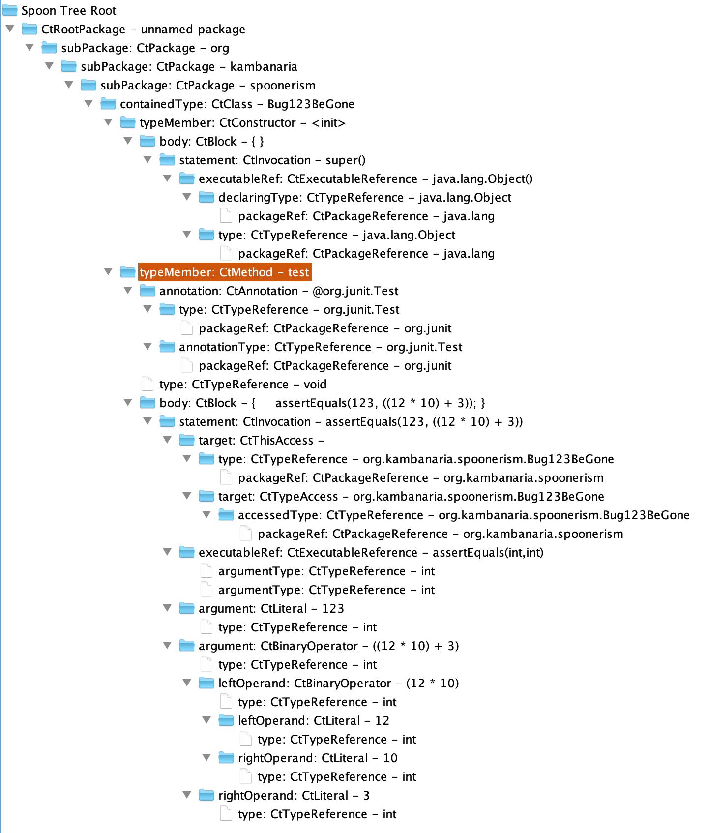
package org.kambanaria.spoonerism;
import org.junit.Test;
import static org.junit.Assert.assertEquals;
public class Bug123BeGone {
@Test
public void test() {
assertEquals(123, 12 * 10 + 3);
}
}

Slide 28
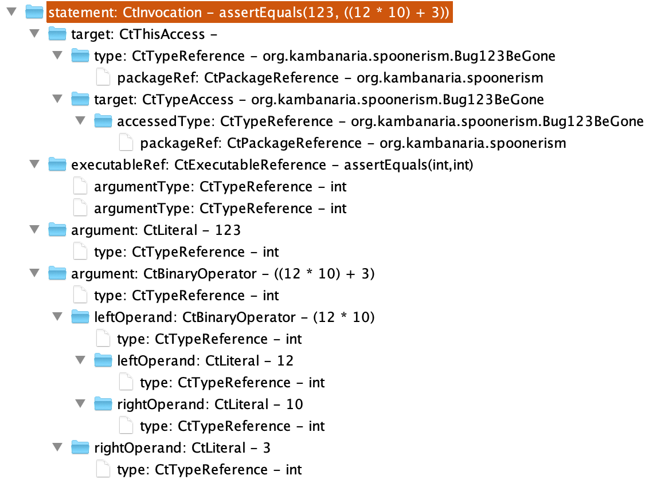
assertEquals(123, 12 * 10 + 3);

Slide 29
new
Spoonerism()
.readClasses()
.display()
.enumerateTestingClasses()
.determineBaseTestingClassPackage()
.createBaseTestingClass()
.extendTestingClasses()
.writeTransformedClasses();

Slide 30
TypeFilter<CtClass> isClass =
new TypeFilter<CtClass>(CtClass.class);

Slide 31
Factory factory = spoonUniverse.getFactory();
CtTypeReference<?> juTestRef =
factory.Type().createReference("org.junit.Test");
// can also use class literal
// factory.Type().createReference(org.junit.Test.class);
TypeFilter<CtClass> isWithTestAnnotatedMethods =
new TypeFilter<CtClass>(CtClass.class) {
@Override
public boolean matches(CtClass ctClass) {
return super.matches(ctClass) &&
!ctClass
.getMethodsAnnotatedWith(juTestRef)
.isEmpty();
}
};

Slide 32
TypeFilter<CtClass> isRealTestingClass = new TypeFilter<CtClass>(CtClass.class) {
@Override
public boolean matches(CtClass ctClass) {
if (!super.matches(ctClass)) {
return false;
}
CtTypeReference<?> current = ctClass.getReference();
do {
if (!current.getTypeDeclaration()
.getMethodsAnnotatedWith(juTestRef).isEmpty()) {
return true;
}
} while ((current = current.getSuperclass()) != null);
return false;
}
};
testingClasses = new HashSet<>(spoonUniverse.getModel().getRootPackage()
.getElements(isRealTestingClass));

Slide 33
if (!super.matches(ctClass)) {
return false;
}
CtTypeReference<?> current = ctClass.getReference();
do {
if (!current.getTypeDeclaration()
.getMethodsAnnotatedWith(juTestRef).isEmpty()) {
return true;
}
} while ((current = current.getSuperclass()) !=null);
return false;

Slide 34
new
Spoonerism()
.readClasses()
.display()
.enumerateTestingClasses()
.determineBaseTestingClassPackage()
.createBaseTestingClass()
.extendTestingClasses()
.writeTransformedClasses();

Slide 35
Spoonerism determineBaseTestingClassPackage(){
// What is the name of the new superclass? BaseTest
// What is the package of the new superclass?
CtClass firstClass = testingClasses.iterator().next();
String qualifiedName = firstClass.getPackage().getQualifiedName();
List<String> commonComponents = Arrays.asList(
qualifiedName.split("[.]"));
for (CtClass ctClass:testingClasses) {
List<String> currentComponents = Arrays.asList(
ctClass.getPackage().getQualifiedName().split("[.]"));
int max = Math.min(currentComponents.size(), commonComponents.size());
for (int i = 0; i < max; i++ ) {
if (!currentComponents.get(i).equals(commonComponents.get(i))) {
commonComponents = commonComponents.subList(0, i);
break;
}
}
}
baseTestingClassPackage = String.join(".", commonComponents);
return this;
}

Slide 36
A.B.C.D.E
A.B.F.G
A.B.H
A.B.I.J.K
A.B.L
A.B.M.N
—————————
A.B

Slide 37
new
Spoonerism()
.readClasses()
.display()
.enumerateTestingClasses()
.determineBaseTestingClassPackage()
.createBaseTestingClass()
.extendTestingClasses()
.writeTransformedClasses();

Slide 38
Spoonerism createBaseTestingClass() {
String baseClassFqn =
baseTestingClassPackage + ".BaseTest";
BaseTestingClass =
spoonUniverse.getFactory().createClass(baseClassFqn);
return this;
}

Slide 39
new
Spoonerism()
.readClasses()
.display()
.enumerateTestingClasses()
.determineBaseTestingClassPackage()
.createBaseTestingClass()
.extendTestingClasses()
.writeTransformedClasses();

Slide 40
Spoonerism extendTestingClasses() {
CtTypeReference<?> baseTestingClassRef =
baseTestingClass.getReference();
for (CtClass ctClass: testingClasses) {
CtTypeReference<?> superClass =
ctClass.getSuperclass();
if (ctClass.getSuperclass() == null) {
ctClass.setSuperclass(baseTestingClassRef);
}
}
return this;
}

Slide 41
new
Spoonerism()
.readClasses()
.display()
.enumerateTestingClasses()
.determineBaseTestingClassPackage()
.createBaseTestingClass()
.extendTestingClasses()
.writeTransformedClasses();

Slide 42
Spoonerism writeTransformedClasses () {
Environment env = spoonUniverse.getEnvironment();
env.setAutoImports(true);
env.setCommentEnabled(true);
spoonUniverse.setSourceOutputDirectory(OUT_DIR);
spoonUniverse.prettyprint();
return this;
}

Slide 43
Spoon Me Further
2016, Gérard Paligot, slides
2017, Benjamin Danglot, YouTube, slides
2018, Simon Urli, YouTube, slides

Slide 44
Fork Off
Eclipse JDT (Java Development Tools)
IntelliJ PSI (Program Structure Interface)
Try with Spoon first:
  It is for Java, based on Java and in Java
  Roots in academy yet targeting industry and practitioners

