Slide 1
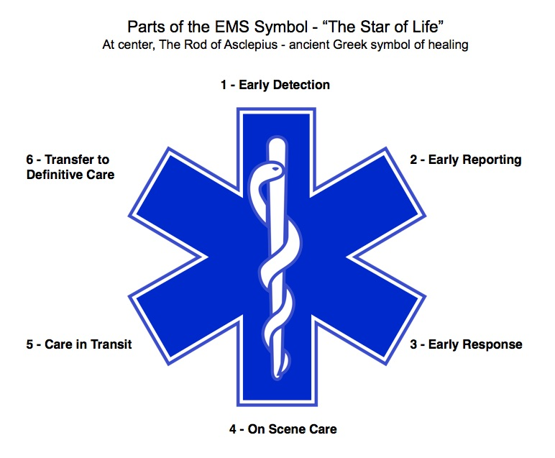
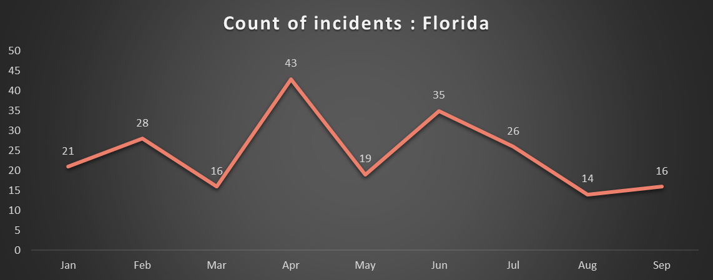
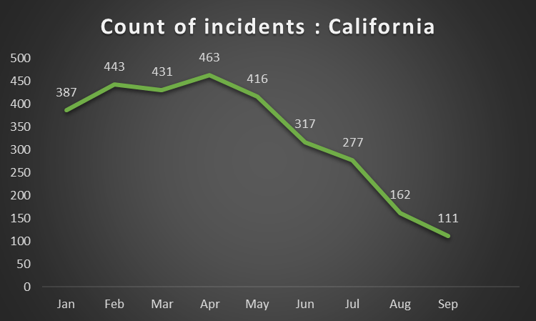
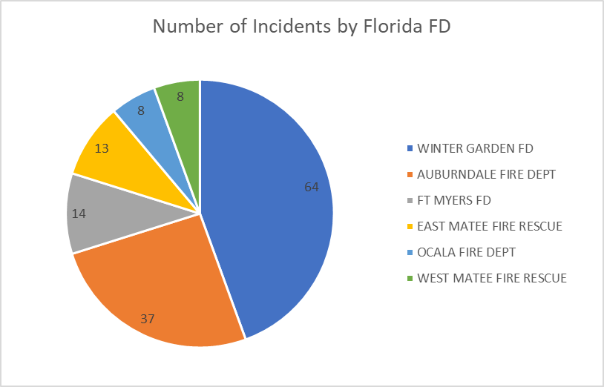
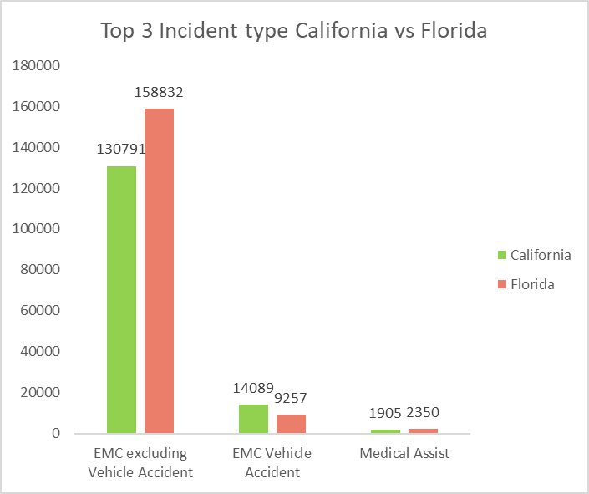
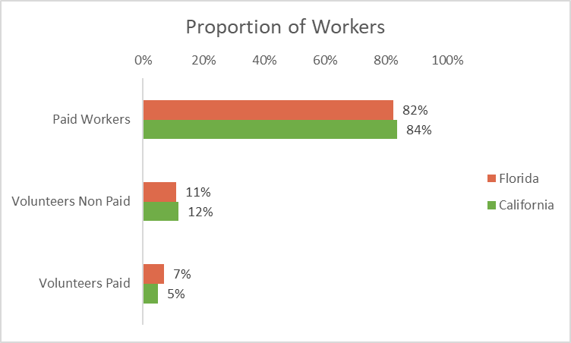
OPERATIONAL CONSIDERATIONS AND METRIC GUIDELINES FOR EMS MOTOR VEHICLE INCIDENTS
DIGITAL ACADEMIC RESEARCH POSTER TEMPLATE
Subtitle for Digital Academic Research Poster (16:9)
Your names and the names of the people who contributed to this presentation
FLORIDA
District ID | Count of Accidents | Fire Dept Name
WG2 (District 10) | 59 | WINTER GARDEN FD
1 | 27 | AUBURNDALE FIRE DEPT
2 | 11 | AUBURNDALE FIRE DEPT
CALIFORNIA
Fire Dept Name | Count of DISTRICT
LAKE WALES FIRE DEPT | 0
LEE COUNTY PORT AUTHORITY | 0
MYAKKA FIRE DIST | 0
PACE VFD | 0
Pama City Fire Dept | 0
SATELLITE BEACH FD | 0
STATION 35 | 0
WILLISTON VOL FD | 0
99%
ALS

