Slide 1
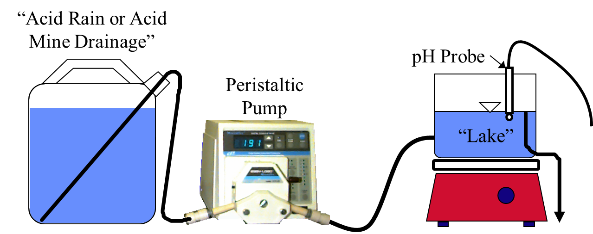
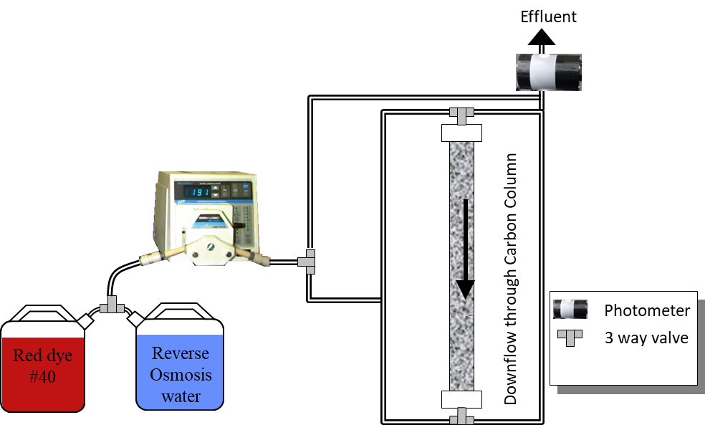
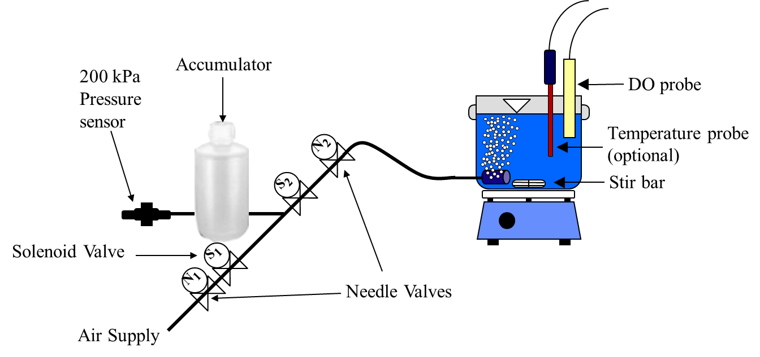
Online Intro CEE 4530
Monroe Weber-Shirk

Slide 2
Pivot (google pivot entrepreneur!)
I had this hypothesis that meeting together in the lab was the best way to teach
We got some new data (that virus) that suggested that meeting together in the lab isn’t a good strategy now
So we are pivoting
Let’s make this an awesome opportunity
We have one new constraint (can’t meet physically)
We have more institutional flexibility
We will use this opportunity to learn Onshape

Slide 3
Checking in: Random breakout room task
One thing you miss during the pandemic
A hope for the spring semester
An idea for how to build an online community of learners for 4530

Slide 4
So life is complicated right now
If your life gets complicated
Talk to me (email or phone or zoom or whatsApp or…)
I’ll respect your privacy. You don’t need to tell me why your life is complicated. Just tell me you need a break or whatever accommodation.
Due dates are suggestions. We’ll be flexible as needed.

Slide 5
Online Logistics?
Community of learners
We will need to work extra hard to get face-to-face interactions
I like meeting with you, so don’t hesitate to reach out!
We will work to create virtual face-to-face interactions in teams and as a class
I welcome suggestions!
My office hours (3 pm every weekday)
I’m learning as we go (see Canvas announcements for Monroe’s Zoom office room)
I’m also available most afternoons. Knock on my door with a calendar invite or a WhatsApp message or a Zoom meeting
Do you all have the ability to contact your team mate(s)?
One of the unintended life skills is learning how to collaborate remotely
I see this collaboration as key for making the project more fun

Slide 6
Why did I pick Onshape?
Free
Online
Collaborative
Don’t need a powerful computer
Next generation (created by former SolidWorks CEOs)
A former student, Ethan Keller, recommended it and then he went on to get a job with Onshape!

Slide 7
Onshape Project (https://github.com/monroews/CEE4530/wiki/Onshape)
Start with online tutorials (see syllabus)
Could be done individually or in teams
Onshape is designed for collaboration
Weekly check-ins where we show something we are working on
Very flexible on how you craft your project

Slide 8
Breakout into teams

Slide 9
Reflections
How is the adsorption lab going?
What concerns or questions do you have about the adsorption lab?
Did you get an invite to join Onshape?
Who has done an Onshape tutorial
Friday (or next Friday) present something you’ve drawn!

Slide 10
4-13-2020 Discussion
Move your sketches into the “first models” folder
What skills de we need to create cool models for your projects
Variables make me excited!
Parts (McMaster-carr has cad drawings of most of their merchandise) – how do we use this effectively?
How do you draw flexible tubing?
What ideas do you have for projects?

