Slide 1
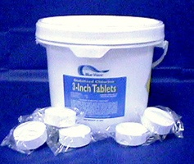
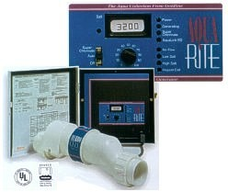
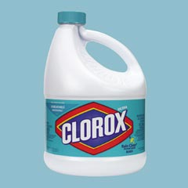
Disinfection

Slide 2
The Case for Chlorine
It kills stuff
Residual
It’s the law… But is it a good idea?
Chlorine is the only available disinfectant that provides a residual
Recontamination
Does a chlorine residual provide protection against recontamination?
How much chlorine would be required?
Regrowth
Very few pathogens multiply in drinking water

Slide 3
Chlorine Based Disinfectants
Contaminant | MRDLG¹ (mg/L)² | MRDL¹ (mg/L)² | Potential Health Effects from Ingestion of Water | Sources of Contaminant in Drinking Water
Chloramines NH₂Cl (as Cl₂) | MRDLG=4¹ | MRDL=4.0¹ | Eye/nose irritation; stomach discomfort, anemia | Water additive used to control microbes
Chlorine (as Cl₂) | MRDLG=4¹ | MRDL=4.0¹ | Eye/nose irritation; stomach discomfort | Water additive used to control microbes
Chlorine dioxide (as ClO₂) | MRDLG=0.8¹ | MRDL=0.8¹ | Anemia; infants & young children: nervous system effects | Water additive used to control microbes
Maximum Residual Disinfectant Level (MRDL) - The highest level of a disinfectant allowed in drinking water. There is convincing evidence that addition of a disinfectant is necessary for control of microbial contaminants. Maximum Residual Disinfectant Level Goal (MRDLG) - The level of a drinking water disinfectant below which there is no known or expected risk to health. MRDLGs do not reflect the benefits of the use of disinfectants to control microbial contaminants.
Notes:
http://www.epa.gov/safewater/mcl.html#mcls

Slide 4
Chlorine is highly reactive
First large-scale chlorination was in 1908 at the Boonton Reservoir of the Jersey City Water Works
Chlorine concentration is reported as Cl₂ even when in the form of HOCl or OCl-
Typical dosage at the water treatment plant (1-5 mg/L)
variable, based on the chlorine demand
goal of 0.2 mg/L residual
Trihalomethanes (EPA primary standard is 80 μg/L)1
Chlorine oxidizes organic matter
1) http://water.epa.gov/lawsregs/rulesregs/sdwa/mdbp/mdbp.cfm#trihalomethanes

Slide 5
The EPA requires a chlorine residual
Minimum free chlorine residual in a water distribution system should be 0.2 mg/L.¹
For all systems using surface water or groundwater under the influence of surface water for supply, a detectable disinfectant residual must be maintained within the distribution system in at least 95% of the samples collected (or heterotrophic bacteria counts must be less than or equal to 500 cfu/ml as an equivalent) and at least 0.2 mg/L concentration of residual disinfectant (free or combined) entering the distribution system must be maintained.²
Chloramines are also known as combined chlorine
1) http://10statesstandards.com/waterstandards.html#4.3.3
2) http://www.epa.gov/ogwdw/disinfection/tcr/pdfs/issuepaper_effectiveness.pdf

Slide 6
Chorine isn’t always required
The European Union does not require disinfection. Of the 15 original European Union member states, only Spain and Portugal require disinfection in distribution systems.¹
Amsterdam stopped chlorinating in 1983
Chlorine not required for groundwater!
1) http://www.epa.gov/ogwdw/disinfection/tcr/pdfs/issuepaper_effectiveness.pdf
Notes:
Rittmann, B. E. and P. M. Huck (1989). "Biological Treatment of Public Water Supplies." Critical Reviews in Environmental Control 19(2): 119-184.
See http://www.americanchemistry.com/s_chlorine/sec_content.asp?CID=1133&DID=4491&CTYPEID=109#chl for the cholera epidemic caused by reluctance to use chlorine story
http://chlorine.americanchemistry.com/Chlorine-Misinformation

Slide 7
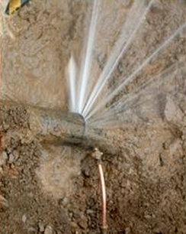
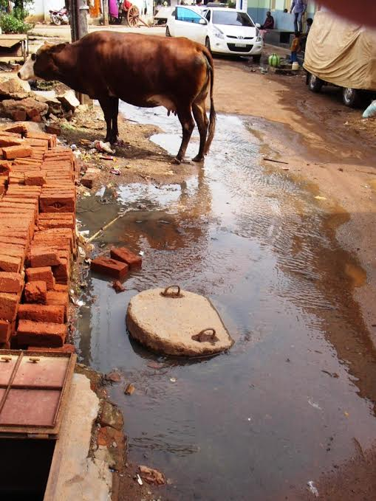
Contamination on the way from the treatment plant to your house
Necessary conditions:
Saturated contaminated soil
Leaky Pipe
Pressure outside pipe must exceed pressure inside pipe
Potential Causes:
Negative pressure transients
Booster pumps
*Photo credits
Top: http://texas-slab-leak-repair.com/water_leak
Bottom: Emily Kumple
Alicia Peters, David Gold, Weier Chen, Lucia Garcia-Iturri Gallego. Distribution System Contamination Prevention. 2014
Notes:
Alicia Peters David Gold Weier Chen Lucia Garcia-Iturri Gallego
https://docs.google.com/a/cornell.edu/presentation/d/1FbHpETKLk-6JZaqnlvxxkkQqu3iSUCvia9jvmYfr5kg/edit#slide=id.p4

Slide 8
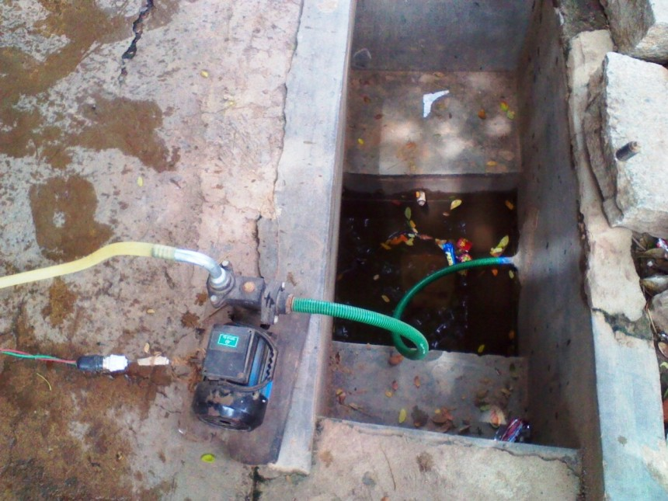
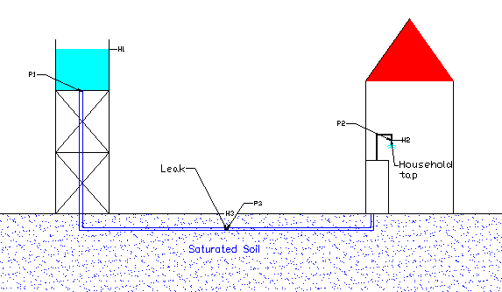
Flat terrain scenario for pipeline contamination
Alicia Peters, David Gold, Weier Chen, Lucia Garcia-Iturri Gallego. Distribution System Contamination Prevention. 2014
Notes:
Alicia Peters David Gold Weier Chen Lucia Garcia-Iturri Gallego
https://docs.google.com/a/cornell.edu/presentation/d/1FbHpETKLk-6JZaqnlvxxkkQqu3iSUCvia9jvmYfr5kg/edit#slide=id.p4

Slide 9
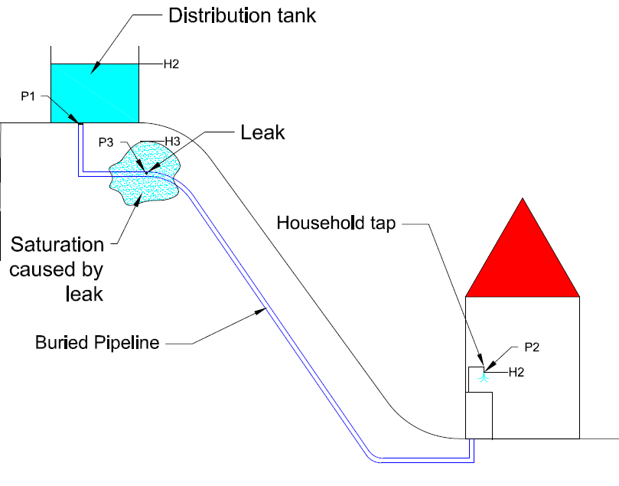

Recontamination is easy in hilly terrain with intermittent supply
Alicia Peters, David Gold, Weier Chen, Lucia Garcia-Iturri Gallego. Distribution System Contamination Prevention. 2014
Notes:
Alicia Peters David Gold Weier Chen Lucia Garcia-Iturri Gallego
https://docs.google.com/a/cornell.edu/presentation/d/1FbHpETKLk-6JZaqnlvxxkkQqu3iSUCvia9jvmYfr5kg/edit#slide=id.p4

Slide 10
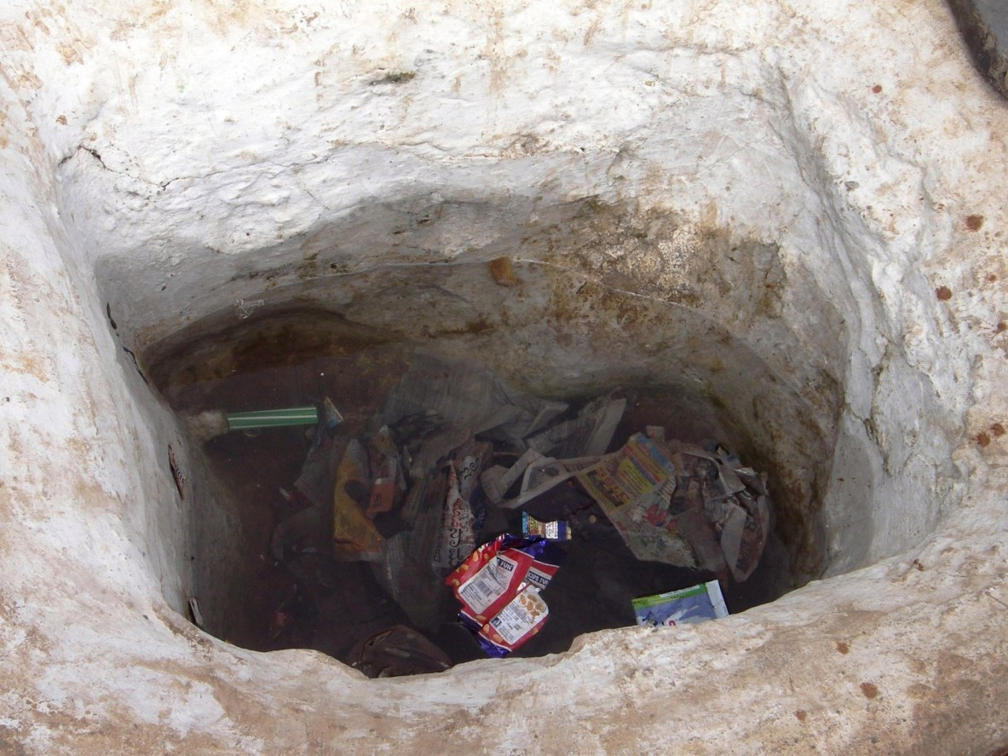
Cross Contamination is
Caused by:
Household booster pumps
Household taps at lower elevation than saturated ground
Pipeline pressure transients
Prevented by:
24/7 water supply
No household booster pumps
Float valves for household storage
Alicia Peters, David Gold, Weier Chen, Lucia Garcia-Iturri Gallego. Distribution System Contamination Prevention. 2014
Notes:
Cross-contamination takes place when a negative pressure is be generated in a distribution pipeline. These pressures may be generated by events that were described earlier including, pipeline transients, private pumps or elevation differences. This is a fairly simple mechanism to prevent in practice through proper operator training, prohibition of personal pumps, and the use of float valves or check valves on household storage units.
Alicia Peters David Gold Weier Chen Lucia Garcia-Iturri Gallego
https://docs.google.com/a/cornell.edu/presentation/d/1FbHpETKLk-6JZaqnlvxxkkQqu3iSUCvia9jvmYfr5kg/edit#slide=id.p4

Slide 11
Why is a Residual Required? Why is Chlorine the only option?
Inactivating microorganisms in the distribution system
Treatment failure
Leaking pipes, valves, and joint seals
Cross-connection and backflow
Finished water storage vessels
Improper treatment of equipment or materials before and during main repair
Intentional introduction of contaminants into distribution system
Indicating distribution system contamination (If residual chlorine is monitored continuously it might be possible to detect an increase in contamination from a decrease in chlorine.)
Controlling biofilm growth
Groundwater doesn’t require chlorine!?!?

Slide 12
Chlorine is assumed to protect against recontamination
Proponents of maintaining a disinfectant residual point to situations where residuals were not maintained and preventable waterborne disease outbreaks occurred.
Haas (1999) argues that both a 1993 Salmonella outbreak caused by animal waste introduced to a distribution system reservoir and a 1989 E. coli O157:H7 outbreak could have been prevented if distribution system chlorination had been in effect.
Both of these outbreaks were due to bacterial pathogens that are sensitive to chlorine and could have been at least partially inactivated.¹
1) http://www.epa.gov/ogwdw/disinfection/tcr/pdfs/issuepaper_effectiveness.pdf

Slide 13
Chlorine Demand vs. Total Organic Carbon
Samples were incubated in the dark for 1 h at 10°C.
0.5 mg chlorine
mg carbon
Notes:
http://www.pubmedcentral.nih.gov/picrender.fcgi?artid=243978&action=stream&blobtype=pdf
APPLIED AND ENVIRONMENTAL MICROBIOLOGY, July 1981, p. 159-167
0099-2240/81/070159-09$02.00/0
Effect of Turbidity on Chlorination Efficiency and Bacterial Persistence in Drinking Water
MARK W. LECHEVALLIER, T. M. EVANS, AND RAMON J. SEIDLER*
Department of Microbiology, Oregon State University, Corvallis, Oregon 97331
Samples were incubated in the dark for 1 h at 10°C.

Slide 14
Chlorine Protection against Recontamination?
How much sewage would residual chlorine at 0.2 to - 0.5 mg/L protect you from?
0.4 to 1.0 mg/L of organic carbon

Slide 15
How much organic matter could be treated by residual Cl₂?
Take a town of 5000 people
Flow rate per person is about 3 mL/s
Average flow rate is 15 L/s
Assume storage tank is half full when contamination event occurs
Small town storage tanks typically provides 1/3 day of storage – 432,000 L
Assume 0.2 mg/L Cl₂ residual – 0.4 mg/L carbon
173 gm of organic carbon (distributed uniformly throughout the entire storage tank…)

Slide 16
Inactivation of Shielded Pathogens
Many of the studies measuring inactivation of pathogens by disinfectants were conducted using dispersed pathogens
What happens if the pathogens are embedded in an organic particle?
Fecal contamination potentially contains pathogens embedded in protective organic matter

Slide 17
Cell Associated virus was inside fetal rhesus kidney derived cells
0.36 mg/L average free Cl₂ at pH 6
What do you conclude?
86
to get pC* of 4 is (86 min)*(0.36 mg/L)=31 (min mg/L)
Notes:
Sobsey, M., T. Fuji, et al. (1991). "Inactivation of cell associated and dispersed Hepatitis A virus in water." J Am Water Works Assoc 83: 64–67.

Slide 18
Embedded virus particles are protected from chlorine
The rate of virus deactivation dropped significantly when the virus particles were inside kidney cells
The deactivation of embedded virus particles can not be described by a single first order reaction (________________)
What is controlling the rate of virus deactivation?
Chicks Law is violated

Slide 19
Scales of the Embedded Virus
Location | Deactivation rate
Dispersed | Very fast
Inside cell with disrupted cell wall | Slow
Inside intact cell | Very slow
1000 nm
1 μm
Virus particles are about 20 nm
HOCl are about 0.2 nm

Slide 20
Mass Transport and Chlorine Protection
Chlorine must diffuse through cell contents to reach virus
Organic material inside the cell reacts with chlorine before it gets to the virus

Slide 21
Larger particle aggregates provide long term protection from chlorine
Turbid water could easily have organic particles that are 10 or even 100 μm in diameter
The amount of organic matter in a small particle and the slow diffusion would provide long term protection for embedded pathogens
10 μm

Slide 22
Two towns
Population 2000
Surface water source: 2 to 800 NTU
Full AguaClara (or conventional water treatment plant)
Population 2000
Surface water source: 0.5-3 NTU
Chlorination (could be chlorine tablets or could be AguaClara doser)
Compare these two for water quality, customer acceptance, sustainability, what happens during a treatment failure, ability to handle dissolved organics, required water tariff, etc.
Notes:
AguaClara will have higher quality water that provides better protection against pathogens.
Floc/sed/filtration will remove some organics and hence reduce chlorine demand. Thus fewer tastes and odors.
If the

Slide 23
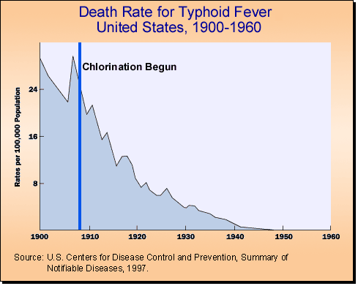
Flocculation/Sedimentation, Filtration, and Chlorine saves lives…
If you accept the “Chlorine eliminated Typhoid Myth”
Then you will likely recommend chlorination as the first line of defense in the Majority World-
But in small systems (in the Majority World)
Chlorine dose is generally not controlled based on a target residual dose
Surface water may currently be untreated and hence have high turbidity
that correlates with high chlorine demand
that contains pathogens embedded in organic particles
that produces disinfection byproducts
Notes:
https://chlorine.americanchemistry.com/Standalone-Content/PDFs/Typhoid-Fever.pdf

Slide 24
Chlorine demand is positively correlated with turbidity
If using a chlorine dose of 2 mg/L, then no residual chlorine would be maintained above 15 NTU!
Disclaimer – There is no solid connection between chlorine demand and turbidity
But – organic matter is often associated with particulate matter
Based on 6 watersheds in western Oregon
Notes:
http://www.pubmedcentral.nih.gov/picrender.fcgi?artid=243978&action=stream&blobtype=pdf

Slide 25
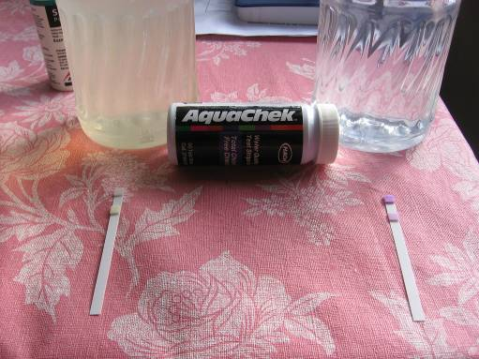
Turbidity and Chlorine
Chlorine test showing no residual after exposure to turbid tap water (left)
Notes:
Sample done in Ojojona Honduras comparing commercial bottled water with tap water.

Slide 26
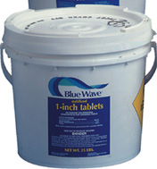
Chlorine Sources
On Site Production (electrolysis)
Chlorine gas (Cl₂)
Liquid Bleach (NaOCl)
Calcium hypochlorite (1 mg Ca(OCl)₂ is equivalent to 0.65 mg of Cl₂)
Chlorinated isocyanurates
Bleach Concentration in terms of sodium hypochlorite (NaOCl) |  |  | Bleach concentration in terms of Available Chlorine (As Cl₂) |  |  | Additional Information (estimated)
Wt. % | Trade % | Grams per liter | Wt. % | Trade % | Grams per liter | Density of the solution (lb/U.S. gal) | Specific gravity of the solution
5 | 5.4 | 53.9 | 4.8 | 5.1 | 51.4 | 9.0 | 1.08
10 | 11.6 | 115.8 | 9.5 | 11.0 | 110.4 | 9.7 | 1.16
15 | 18.6 | 185.7 | 14.3 | 17.7 | 177.0 | 10.3 | 1.24
Notes:
http://www.olinchloralkali.com/calculators/calc_table.asp
https://www.oxy.com/OurBusinesses/Chemicals/Products/Documents/isocyanurates/ACL%20Potable%20Water%20Brochure.pdf

Slide 27
How much Clorox should you add to a 5 gallon bucket or a 1L bottle?

Slide 28
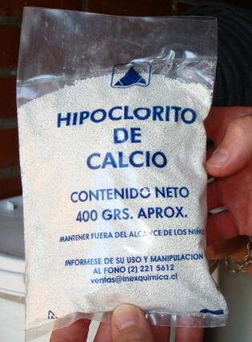
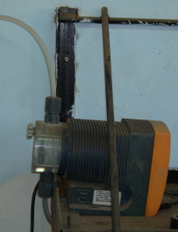
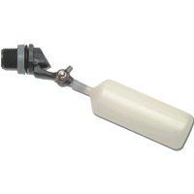
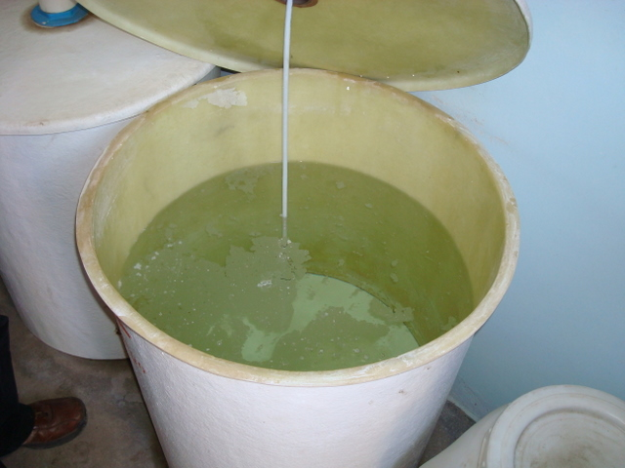
Calcium hypochlorite is cheaper to transport
Relatively inexpensive ($3 per kg)
Easy to transport (high equivalent moles of Cl₂ per unit mass)
Less dangerous than chlorine gas
High calcium concentration results in insoluble calcium carbonate from exposure to the atmospheric CO₂ or dissolved carbonates.
Clogs tubing and float valves (submerged orifice works better to avoid contact with atmospheric CO₂)

Slide 29
Chlorine Reactions
Charges
0
+1
-2
+1
-1
Cl₂ + H₂O → H⁺ + HOCl + Cl⁻
HOCl ↔ H⁺ + OCl⁻
The sum of HOCl and OCl⁻ is called the ____ ______ _______
Hypochlorous acid
Hypochlorite ion
free chlorine residual

Slide 30
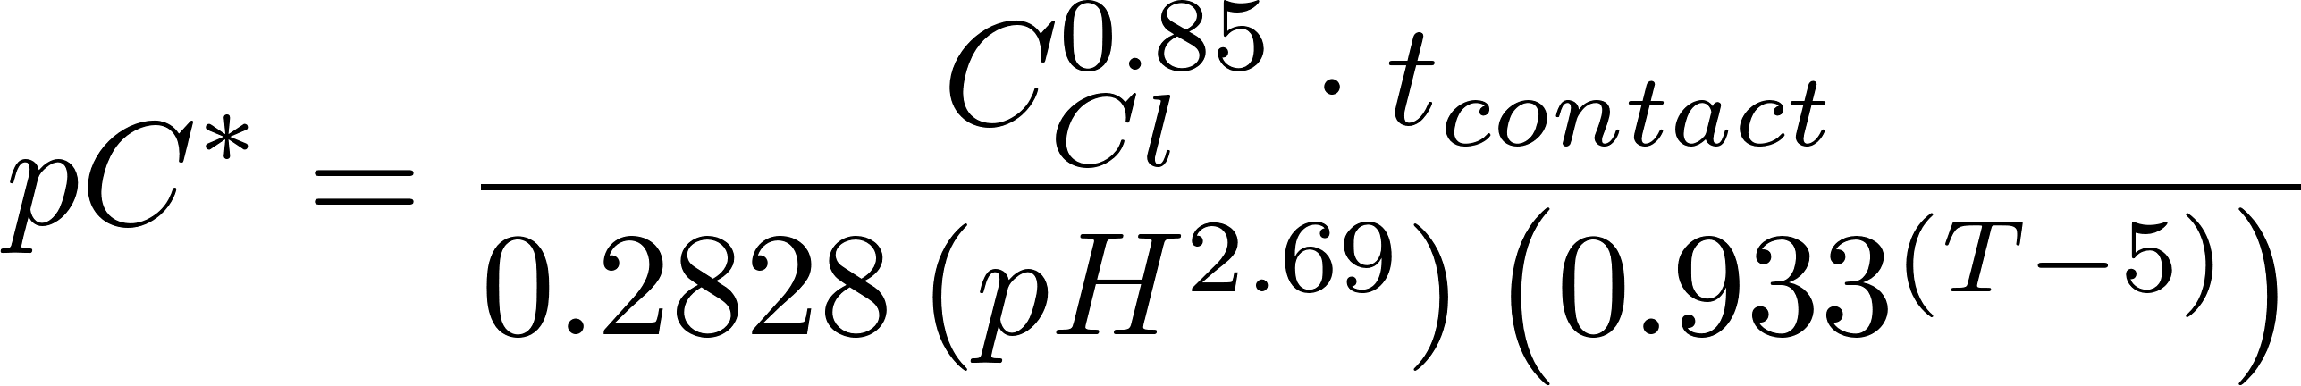
Chlorine and pH
HOCl ↔ H⁺ + OCl⁻
HOCl is the more effective disinfectant
Therefore chlorine disinfection is more effective at ________ pH
Dissociation constant is 10^{-7.5}
HOCl and OCl⁻ are in equilibrium at pH 7.5
low
pk

Slide 31
EPA Pathogen Inactivation Requirements
Safe Drinking Water Act
SDWA requires 99.9% inactivation for Giardia and 99.99% inactivation of viruses
Giardia is more difficult to kill with chlorine than viruses and thus Giardia inactivation determines the CT
Concentration x Time

Slide 32
EPA Credits for Giardia Inactivation
Treatment type Credit
Conventional Filtration 99.7%
Direct Filtration* 99%
Disinfection f(time, conc., pH, Temp.)
Flocculation/Sedimentation/Filtration
* No sedimentation tanks
What is wrong with the concept of credit for percent removal?
Notes:
Floc sed reduces raw water turbidity to about 1 NTU regardless of the starting NTU.
This approach is the best we have currently. The goal should be to reduce the particle concentration as much as possible.

Slide 33
EPA Disinfection CT Credits
To get credit for 99.9% inactivation of Giardia:
Contact time (min)
chlorine pH 6.5 pH 7.5
(mg/L) 2°C 10°C 2°C 10°C
0.5 300 178 430 254
1 159 94 228 134
Inactivation is a function of _______, ____________
______, and ___________.
time
concentration
pH
temperature
Where did these numbers (to 3 significant digits) come from?

Slide 34
CT equation for Giardia
C_{Cl} = Free Cl₂ Residual [mg/L]
t_{contact} = Time required [min]
pH = pH of water
T = Temperature, degrees C
pC* = -[Log(fraction remaining)]
Note: These equations are NOT dimensionally correct!
Notes:
http://wilkes1.wilkes.edu/~eqc/chlorinecontact.htm
This formula was provided by Peter Martin, an associate Engineer with the Contra Costa Water District, and was published in the AWWA Journal AWWA 85:12:12 Dec 1993).

Slide 35
Disinfection Byproducts
Contaminant | MCLG¹ (mg/L)² | MCL (mg/L)² | Potential Health Effects from Ingestion of Water | Sources of Contaminant in Drinking Water
Bromate | zero | 0.010 | Increased risk of cancer | Byproduct of drinking water disinfection (plants that use ozone)
Chlorite | 0.8 | 1.0 | Anemia; infants & young children: nervous system effects | Byproduct of drinking water disinfection (plants that use chlorine dioxide)
Haloacetic acids (HAA5) | n/a⁶ | 0.060 | Increased risk of cancer | Byproduct of drinking water disinfection
Total Trihalomethanes (TTHMs) | none⁷ ---------- n/a⁶ | 0.10 ---------- 0.080 | Liver, kidney or central nervous system problems; increased risk of cancer | Byproduct of drinking water disinfection
What happens to residual chlorine when you drink it?
Notes:
http://www.epa.gov/safewater/mcl.html#mcls

Slide 36
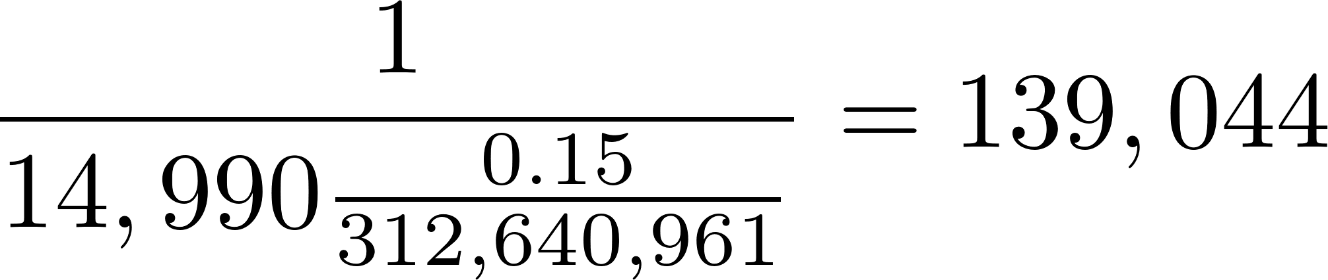
Dark side of chlorine
Bladder cancer in the US in 2011 - New cases: 69,250 - Deaths: 14,990 (http://www.cancer.gov/cancertopics/types/bladder)
15% (2248) attributable to exposure to chlorination by-products (http://www.ncbi.nlm.nih.gov/pubmed/8932920)
1/139,000 people may die from bladder cancer from exposure to chlorination by-products
6,939 deaths/yr (2017) from pathogens that can be waterborne
https://www.cdc.gov/healthywater/burden/current-data.html
Notes:
https://www.cdc.gov/healthywater/burden/current-data.html

Slide 37
Tastes and Odors: Taste Thresholds
Complaints of the chlorine taste should not be discounted
Chlorine taste may prevent some consumers from using treated water
Need to convince consumers that the chemical taste is healthy???
Notes:
Rittmann, B. E. and P. M. Huck (1989). "Biological Treatment of Public Water Supplies." Critical Reviews in Environmental Control 19(2): 119-184.

Slide 38
Getting the Right Dose: WHO on Chlorination
exposed
Chlorine compounds usually destroy _______ pathogens after 30 minutes of contact time, and free residual chlorine (0.2–0.5 mg per liter of treated water) can be maintained in the water supply to provide ongoing disinfection.
Several chlorine compounds, such as sodium hypochlorite and calcium hypochlorite, can be used domestically, but the active chlorine concentrations of such sources can be different and this should be taken into account when calculating the amount of chlorine to add to the water.
The amount of chlorine that will be needed to kill the pathogens will be affected by the quality of the untreated water and by the strength of the chlorine compound used.
If the water is excessively turbid, it should be filtered or allowed to settle before chlorinating it (___________________________)
Remove particles first!
Notes:
http://www.who.int/water_sanitation_health/hygiene/om/en/linkingchap6.pdf

Slide 39
Conclusions
Chlorine can inactivate many types of pathogens with inactivation efficiency a function of pathogen type, embedded protection, contact time, pH, dose…
Chlorination cannot replace particle and pathogen removal for surface waters
If you can see cloudiness in a glass of water it is too dirty for chlorine!
Chlorine cannot make water contaminated with feces safe to drink
Efforts to prevent contamination of treated water all the way to the consumer’s mouth are very important!

Slide 40
Confusions
The importance of chlorine residual for protection against recontamination is unclear
There are negative health effects to chlorination
Chlorine dosages should be kept as low as possible
Removal of dissolved organics is important to reduce disinfection byproduct formation
Time to investigate alternatives!

