Slide 1
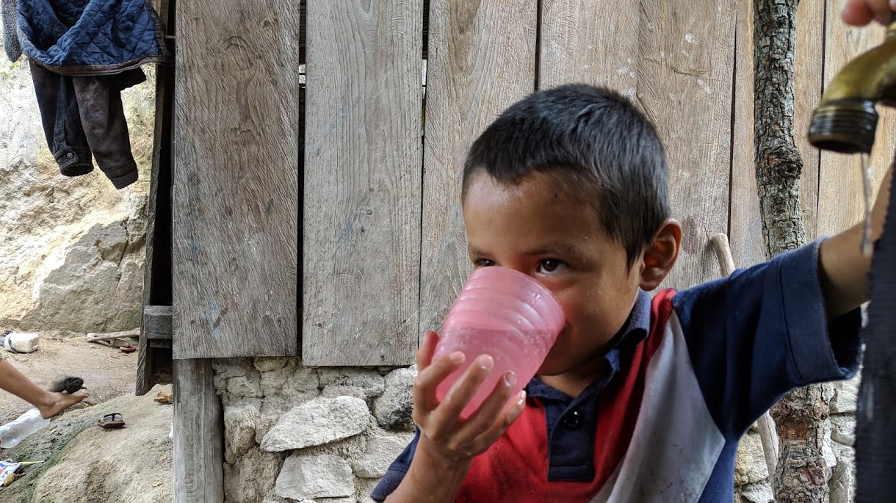
Safe Water on Tap CIVILENG 5610.02
Introduction
Monroe L. Weber-Shirk
AguaClara Reach
Notes:
Photo credit to Yitzy Rosenburg, 2019
Add expectation that student come to class!

Slide 2
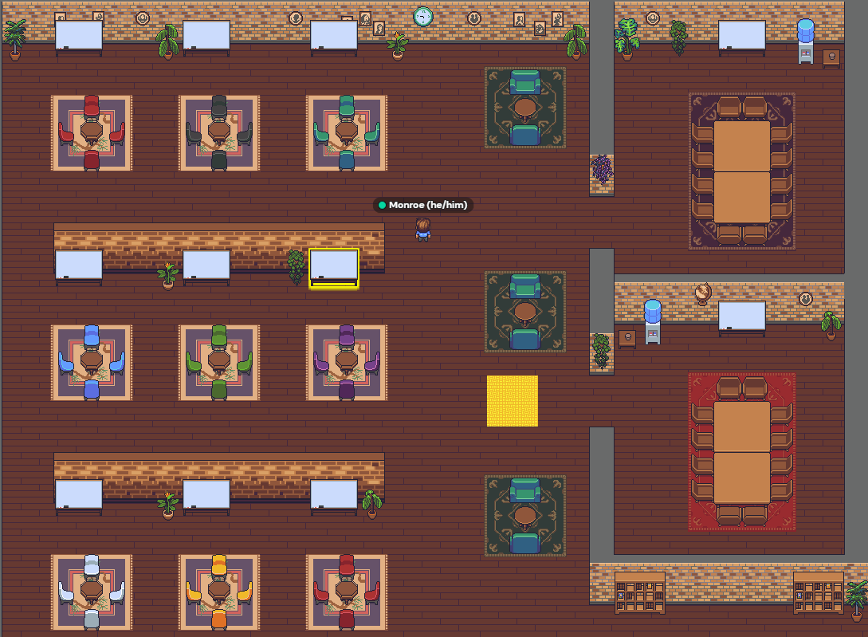
Course Organization Did you get the emails from me and Clare?
SWOT wiki on github: home to everything
https://github.com/AguaClara/SWOT/wiki/Syllabus
There is a textbook! https://aguaclara.github.io/Textbook/
Design Challenges
Some are for each Individual and some are for teams
Due on date listed on the course schedule!!!!
Final Project Ideas (see https://github.com/AguaClara/SWOT/wiki/Ideas)
Still evolving!
Office hours in a virtual office space
https://gather.town/app/Hc0kHX8CqY6qfMhl/AguaClaraReach
Notes:
Explain design challenges and due dates
Initial survey
Power point
Encouage students to work with PDF and take notes on top of my notes in class.

Slide 3
First Assignment
Learn how to use Onshape as a CAD environment by January 20!
Start TODAY! (see Part Studios Design Challenge)
https://github.com/AguaClara/SWOT/wiki/Part-Studios
Notes:
We need the steps for getting started to be defined.

