Slide 1


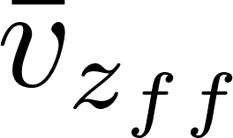
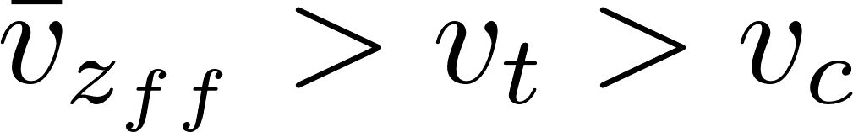
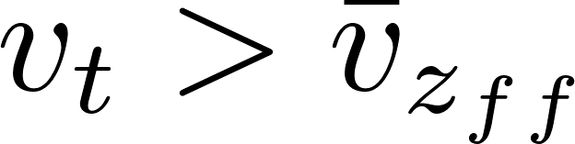
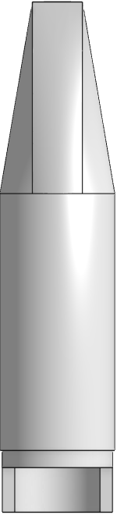
Floc Filter, Plate Settler, Floc Hopper
Effluent manifold
Plate Settlers
 | Terminal Velocity
 |  | 2
 |  | 2
 |  | 2
 |  | >2
Floc Filter
Floc Hopper
Inlet (from flocculator)
Notes:
Story
Big green flocs from flocculator form blue floc filters in the plate settler
Red flocs

