Slide 1

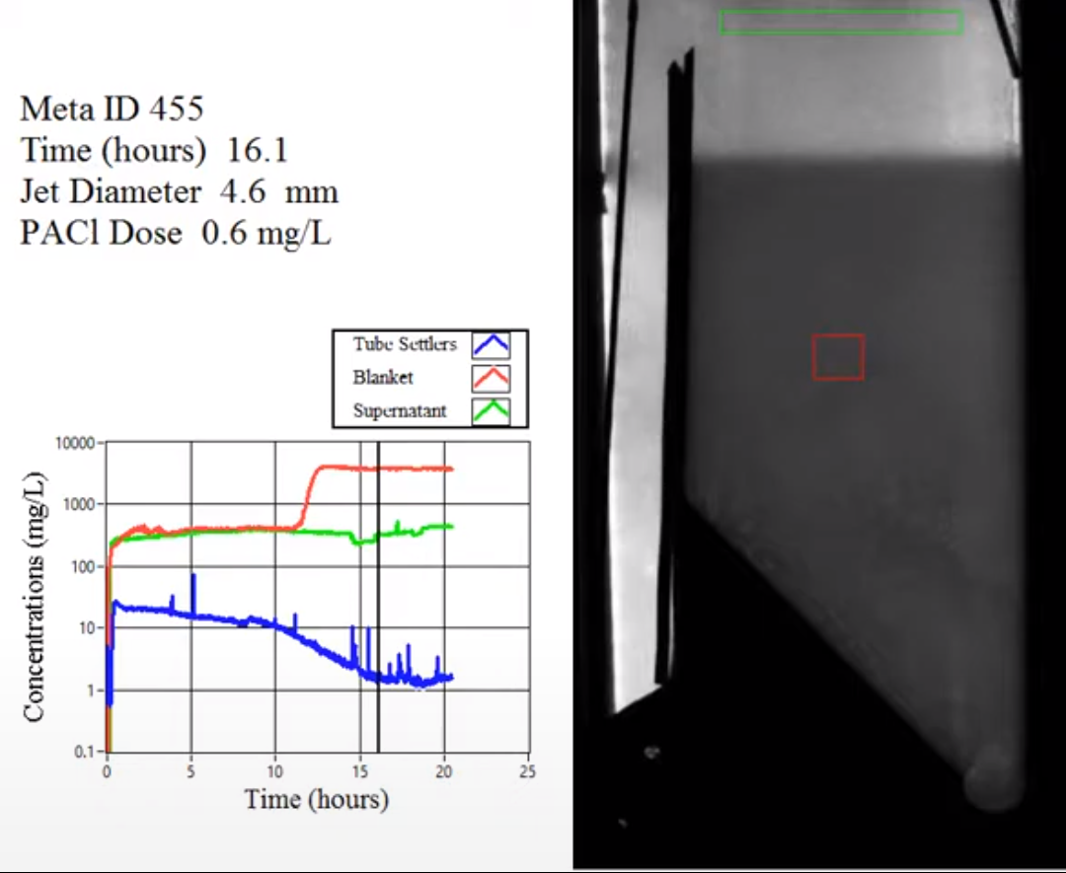
Notes:
https://www.youtube.com/watch?v=pytXC-1zWhw
<iframe width="590" height="483" src="https://www.youtube.com/embed/pytXC-1zWhw" title="YouTube video player" frameborder="0" allow="accelerometer; autoplay; clipboard-write; encrypted-media; gyroscope; picture-in-picture" allowfullscreen></iframe>
<iframe width="791" height="445" src="https://www.youtube.com/embed/pytXC-1zWhw?autoplay=1&start=285&end=360" title="YouTube video player" frameborder="0" allow="accelerometer; autoplay; clipboard-write; encrypted-media; gyroscope; picture-in-picture" allowfullscreen></iframe>
How does the floc filter remove small particles?
Are plate settlers needed after a floc filter?
What determines how fast the floc/water interface rises? 100mg/L*1mm/s = 3000 mg/L * x mm/s
Why might a floc filter reduce settled water turbidity?
How is water entering the tank?
Where do the solids eventually go?
What mechanisms could result in particle aggregation in a floc filter?

Slide 2
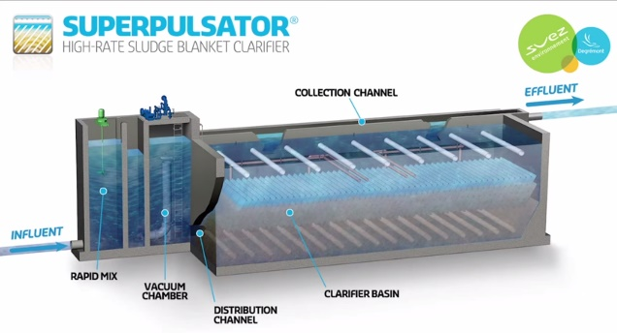
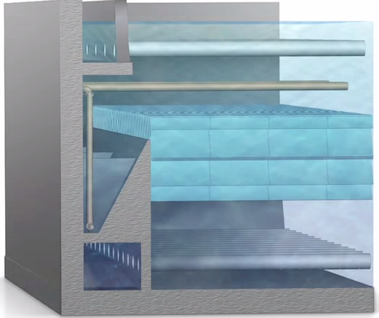
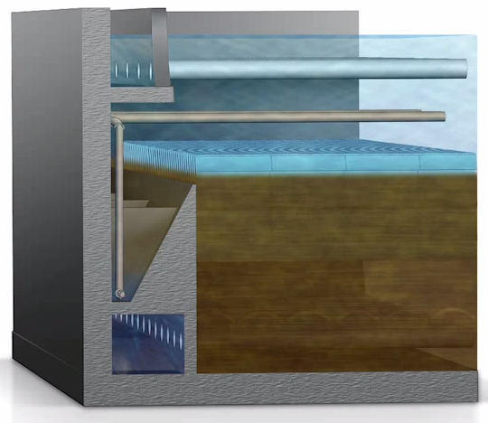
Previous state-of-the-art… SUPERPULSATOR® Clarifier
Notes:
https://www.youtube.com/watch?v=UNhygQov69Q
Why is pulsator needed?
Which end of the sed tank will have flocs rising rapidly? (two reasons)
<iframe width="640" height="360" src="https://www.youtube.com/embed/UNhygQov69Q?autoplay=1&mute=1&start=68&stop=214" title="YouTube video player" frameborder="0" allow="accelerometer; autoplay; clipboard-write; encrypted-media; gyroscope; picture-in-picture" allowfullscreen></iframe>

Slide 3
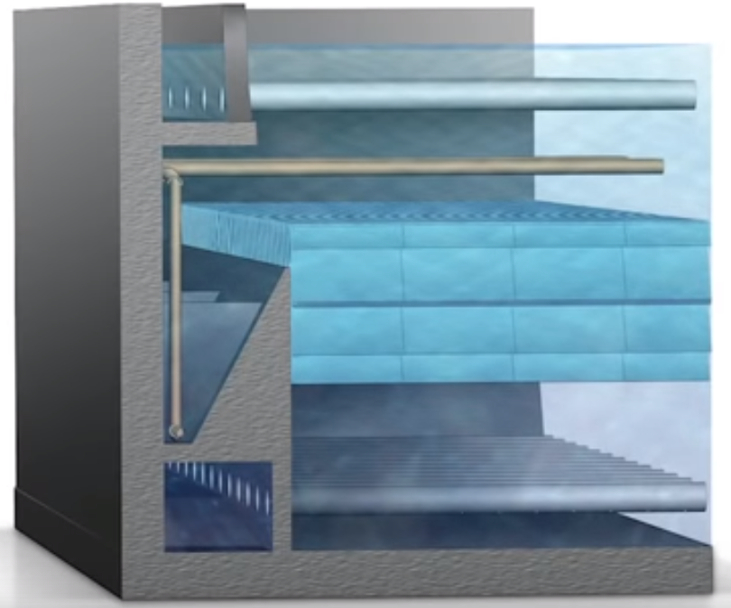
Why is there pulsing flow in a SuperPulsator?
What failed when they didn’t pulse?
What problem were they trying to solve?
Can we solve that problem a better way?
Will sludge accumulate and go anaerobic?
Notes:
Sludge slowly buries more and more of the inlet manifold system.

Slide 4
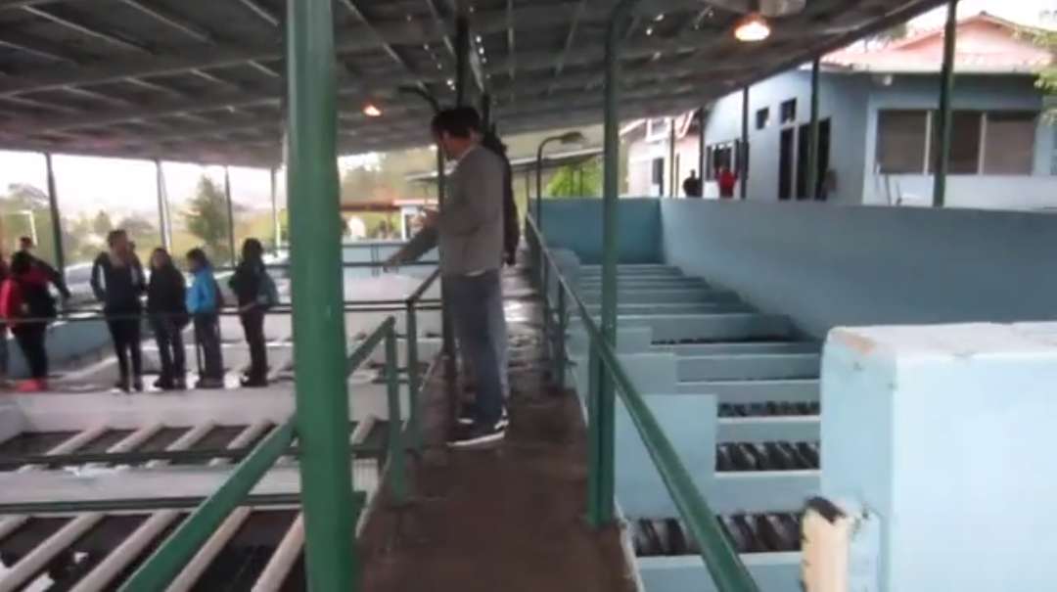
Santa Rosa de Copan: CEPIS Plant Tour
Notes:
https://www.youtube.com/watch?v=aLaCuq9PK7s
<iframe width="640" height="360" src="https://www.youtube.com/embed/aLaCuq9PK7s?autoplay=1&mute=1" title="YouTube video player" frameborder="0" allow="accelerometer; autoplay; clipboard-write; encrypted-media; gyroscope; picture-in-picture" allowfullscreen></iframe>

Slide 5
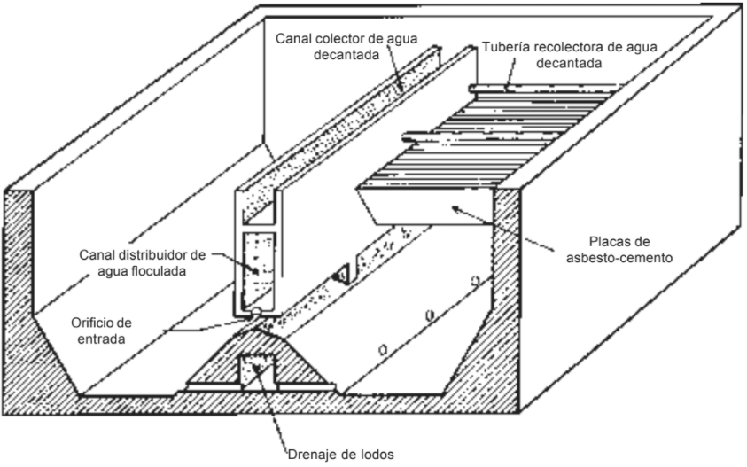
CEPIS/OPS designs – Vertical Flow
Orifice from inlet manifold
Critique this design
Notes:
What could fail?
What would be challenging for the operators when they have to clean it?

Slide 6
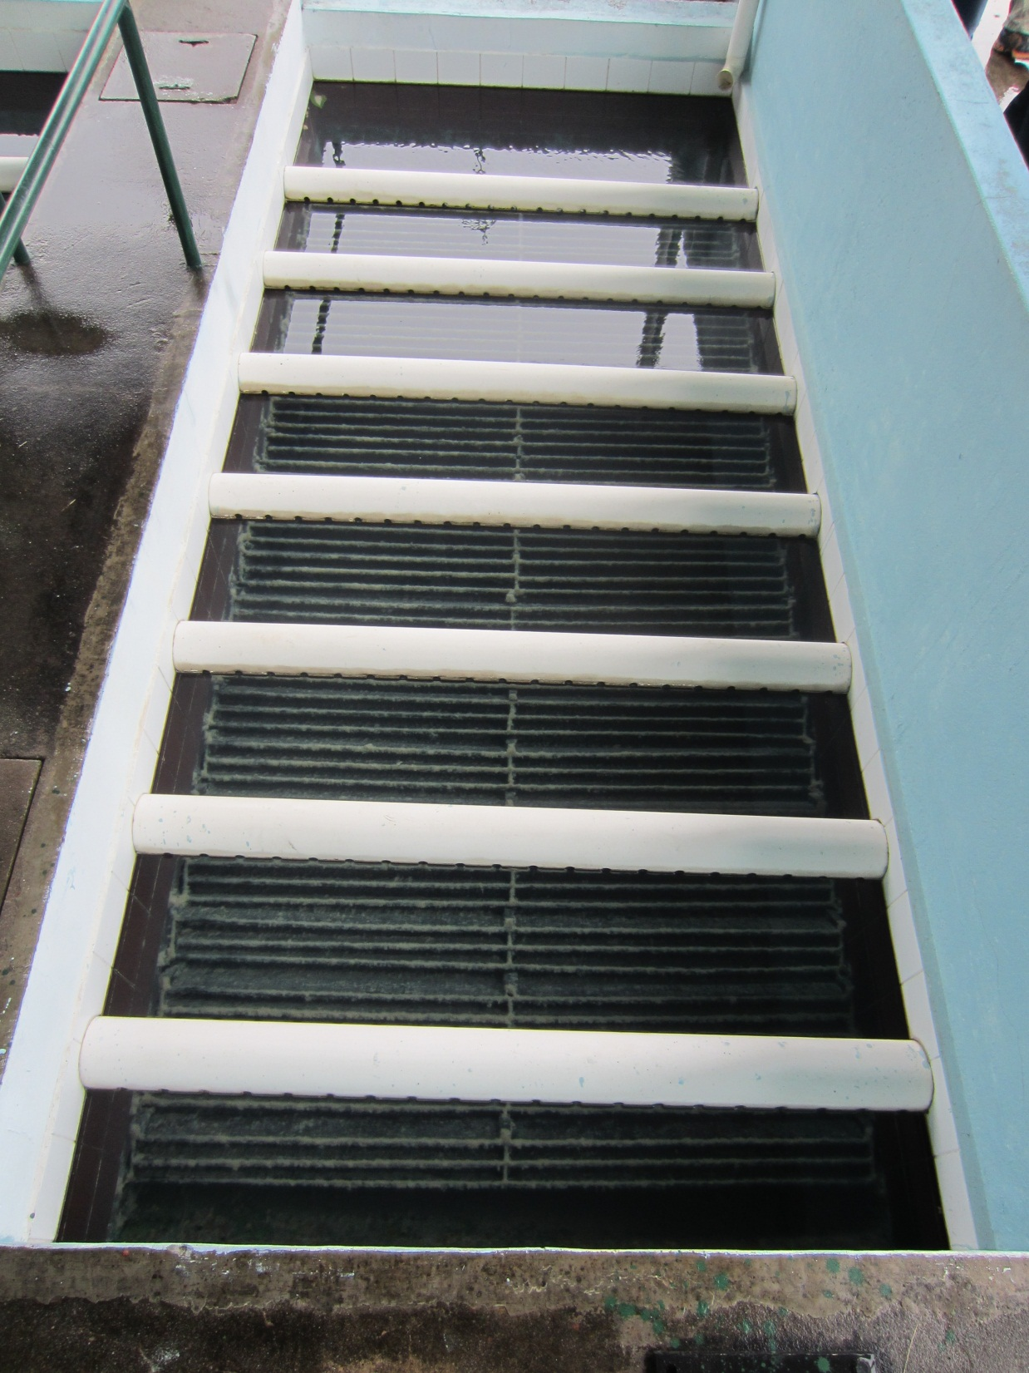
CEPIS Plate settlers and outlet manifolds
Outlet manifold orifices must be perfectly level using this system (orifice elevation sets water elevation!)
Submerged launders (used by AguaClara) are easier to build with no concern if they aren’t level
Channels for inlet and outlet

