Slide 1
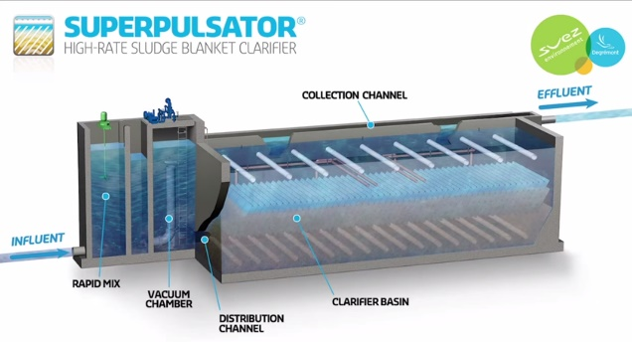
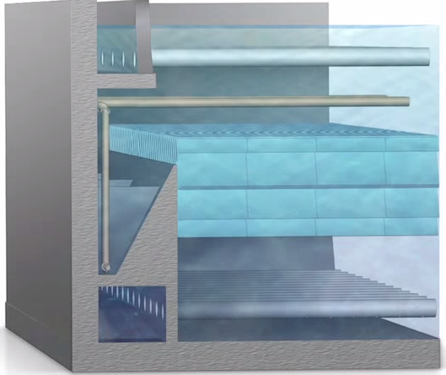

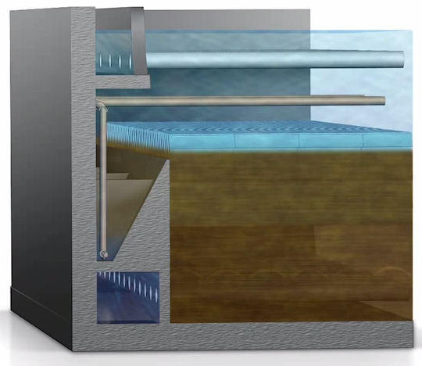
Previous state-of-the-art… SUPERPULSATOR® Clarifier
Notes:
https://www.youtube.com/watch?v=UNhygQov69Q
Why is pulsator needed?
Which end of the sed tank will have flocs rising rapidly? (two reasons)
<iframe width="640" height="360" src="https://www.youtube.com/embed/UNhygQov69Q?autoplay=1&mute=1&start=68&stop=214" title="YouTube video player" frameborder="0" allow="accelerometer; autoplay; clipboard-write; encrypted-media; gyroscope; picture-in-picture" allowfullscreen></iframe>

Slide 2
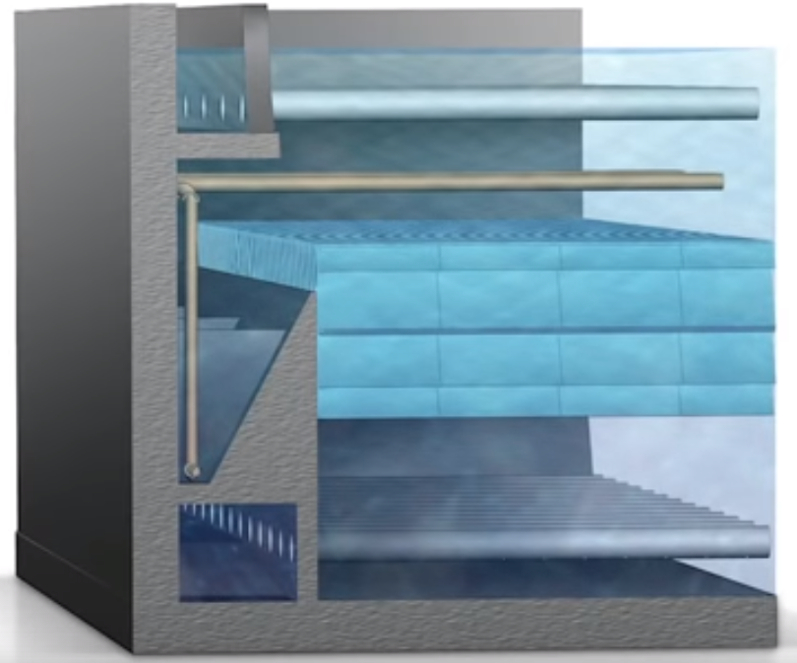
Why is there pulsing flow in a SuperPulsator?
What failed when they didn’t pulse?
What problem were they trying to solve?
Can we solve that problem a better way?
Will sludge accumulate and go anaerobic?
Notes:
Sludge slowly buries more and more of the inlet manifold system.

Slide 3
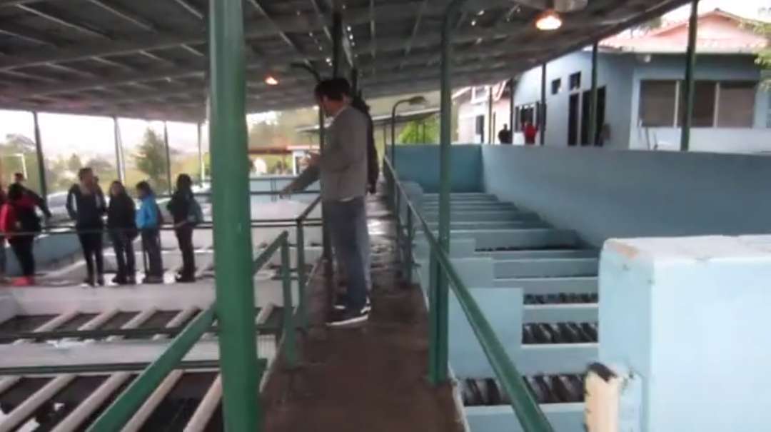
Santa Rosa de Copan: CEPIS Plant Tour
Notes:
https://www.youtube.com/watch?v=aLaCuq9PK7s
<iframe width="640" height="360" src="https://www.youtube.com/embed/aLaCuq9PK7s?autoplay=1&mute=1" title="YouTube video player" frameborder="0" allow="accelerometer; autoplay; clipboard-write; encrypted-media; gyroscope; picture-in-picture" allowfullscreen></iframe>

Slide 4
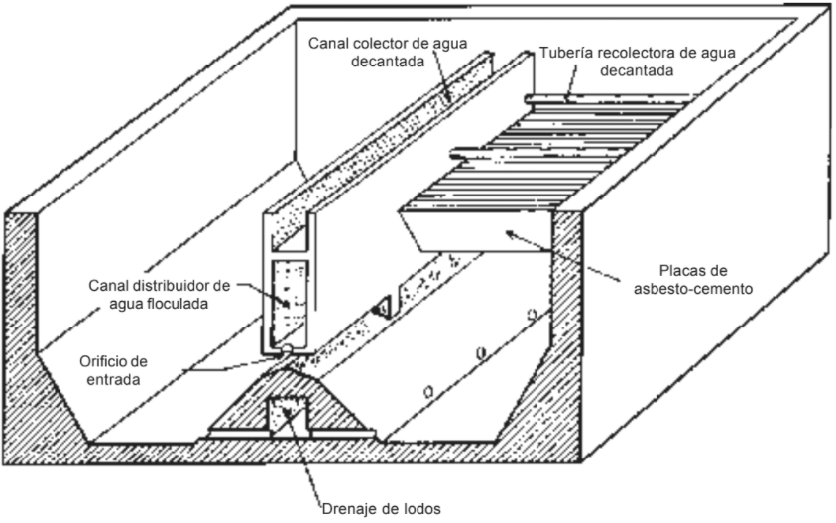
CEPIS/OPS designs – Vertical Flow
Critique this design
Sludge will accumulate on the flat tank bottom
How are plate settlers suspended?
Inaccessible channels
Access to bottom of tank?
Notes:
CAPÍTULO 4
DECANTADORES LAMINARES

Slide 5
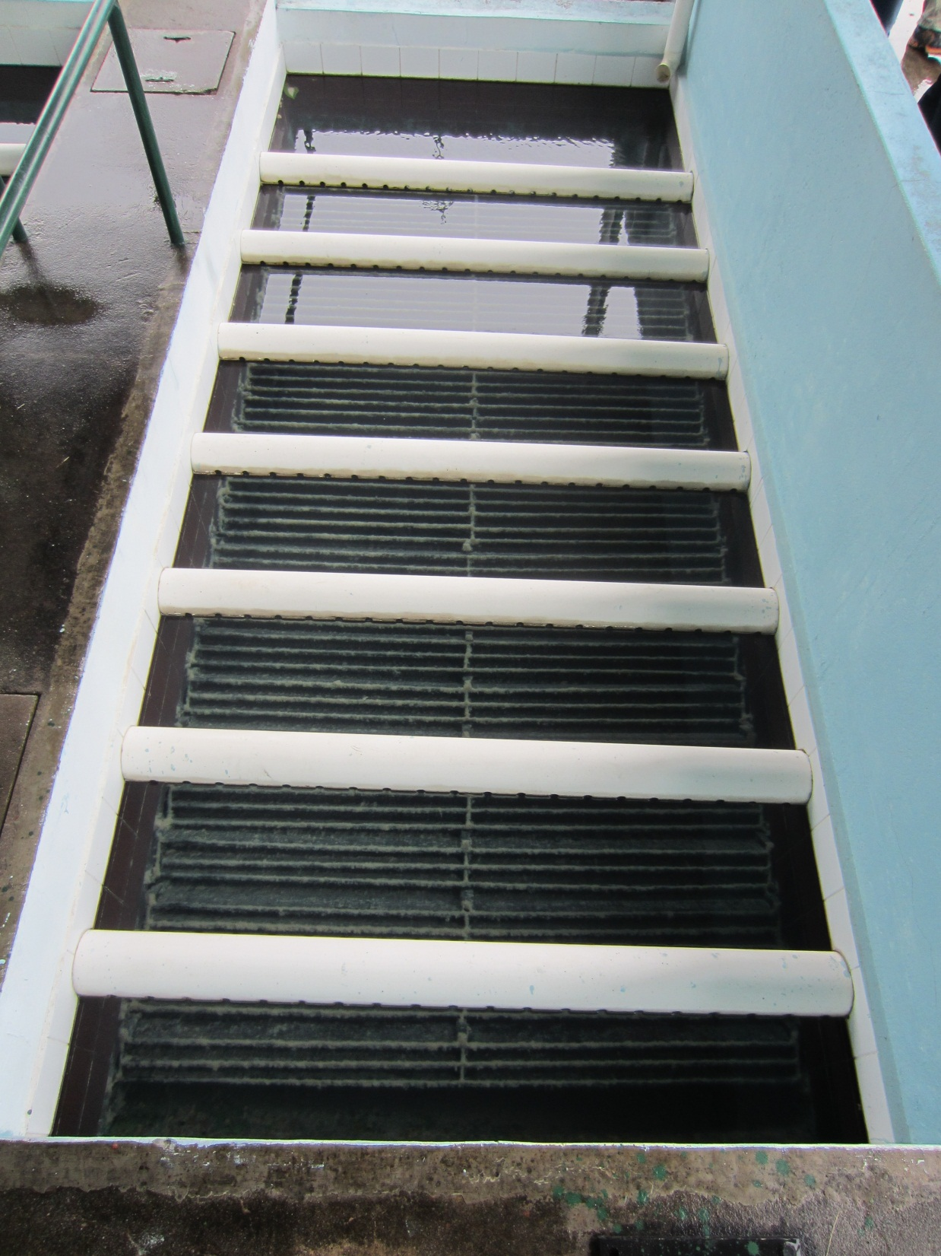
CEPIS Sed
Plate settlers and outlet manifolds
Outlet Manifolds must be perfectly level using this system (orifice elevation sets water elevation!)
Submerged launders are easier to build with no concern if they aren’t level
Channels for inlet and outlet

