Slide 1
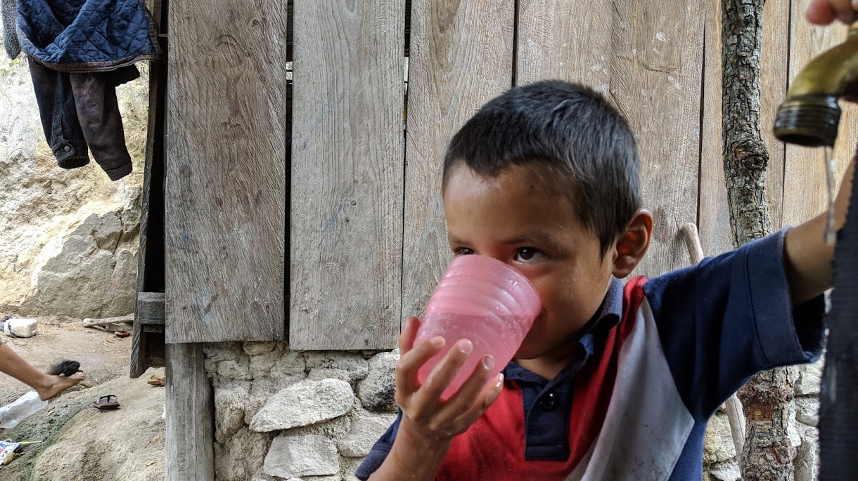
Safe Water on Tap CIVILENG 5610.02
Introduction
Monroe L. Weber-Shirk
AguaClara Reach
Notes:
Photo credit to Yitzy Rosenburg, 2019
Add expectation that student come to class!

Slide 2
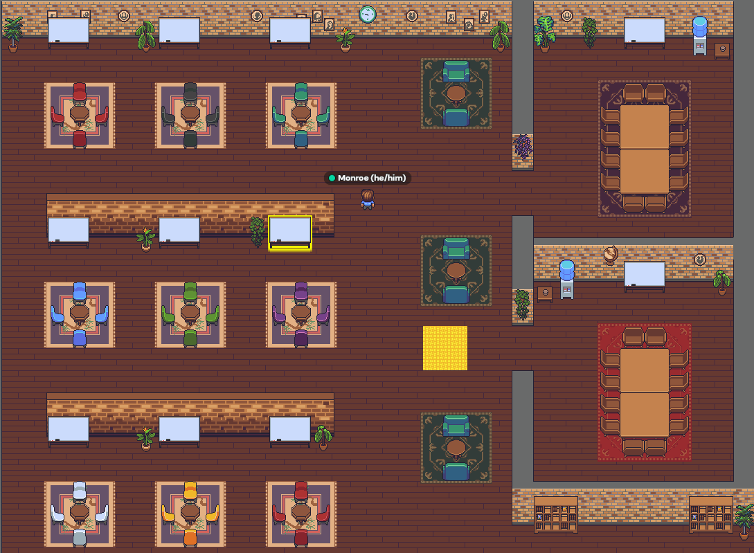
Course Organization Did you get the emails from me and Clare?
SWOT wiki on github: home to everything
https://github.com/AguaClara/SWOT/wiki/Syllabus-OSU
There is a textbook! https://aguaclara.github.io/Textbook/
View lectures and answer questions prior to class!
We will use class time for brief presentations and then work on assignments
Design Challenges
Some are for each Individual and some are for teams
Due on date listed on the course schedule/syllabus!!!!
Meetings in a virtual office space
https://gather.town/app/Hc0kHX8CqY6qfMhl/AguaClaraReach
Notes:
Explain design challenges and due dates
Initial survey
Power point
Encouage students to work with PDF and take notes on top of my notes in class.

Slide 3
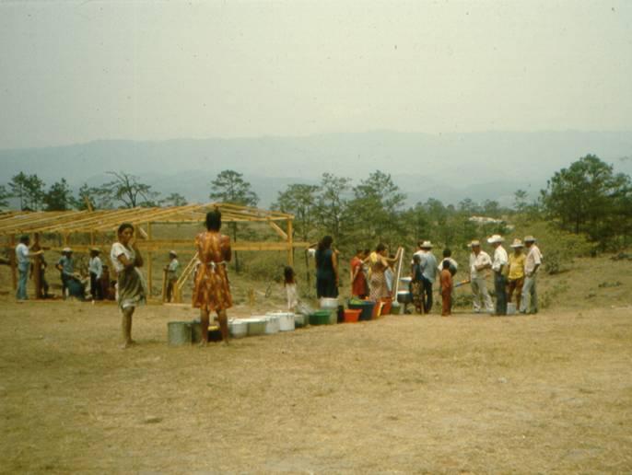
Why am I teaching this course?
Experience in refugee camps in Honduras in 1982-83
The spark of interest: What makes slow sand filters work? (no one knew!)
Invitation to begin a water project in Latin America (12/2002)
The realization that what I had been taught wasn’t up to the challenge of solving the big global challenge of providing safe drinking water on tap to communities
I’ve been teaching this course since 2004 and it changes every time!
Notes:
Realization that we were assuming that knowing how to build water treatment facilities in the US prepared students for tackling the problem anywhere on the planet.
Issues of scale and resources (human, capital)

Slide 4
Mesa Grande: Waiting for water

Slide 5
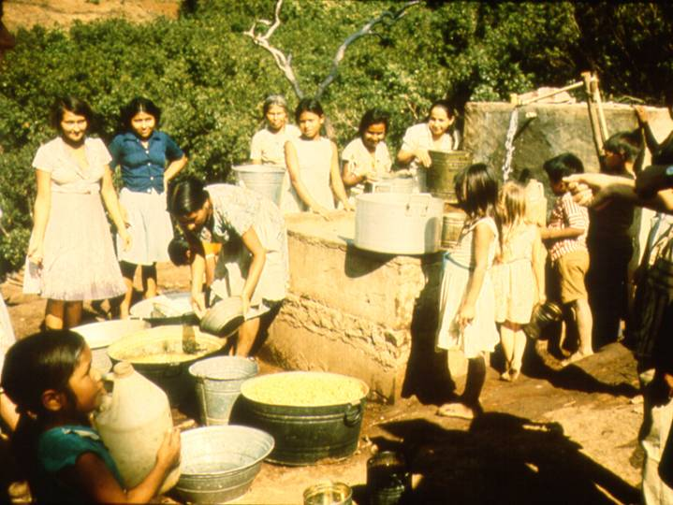
Water in Colomoncagua

Slide 6
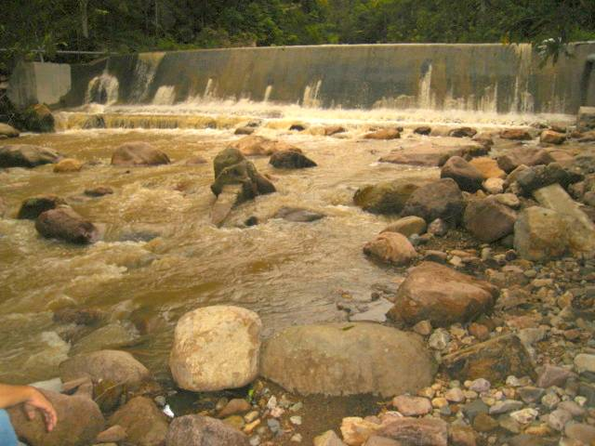

Slide 7
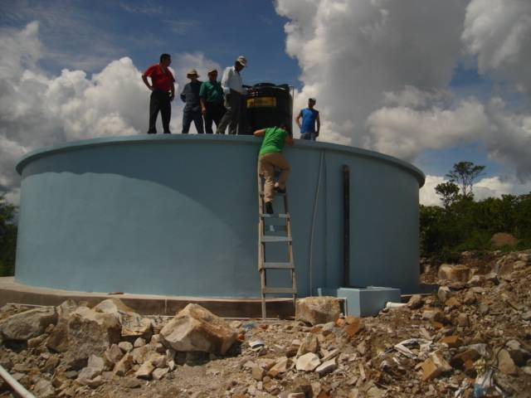

Slide 8
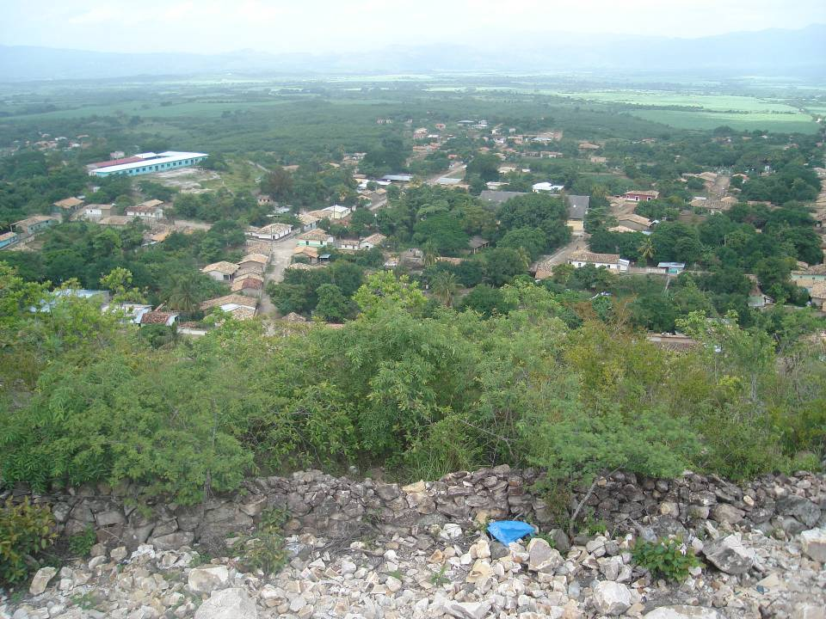

Slide 9
AguaClara
Founded in 2005
Using the scientific method to learn
Continuous learning based on laboratory research and experience designing, building, and operating AguaClara water treatment plants
Starting from the understanding that existing community scale water treatment systems weren’t good enough
Reflective, Agile, and grounded in Listening with Empathy

Slide 10
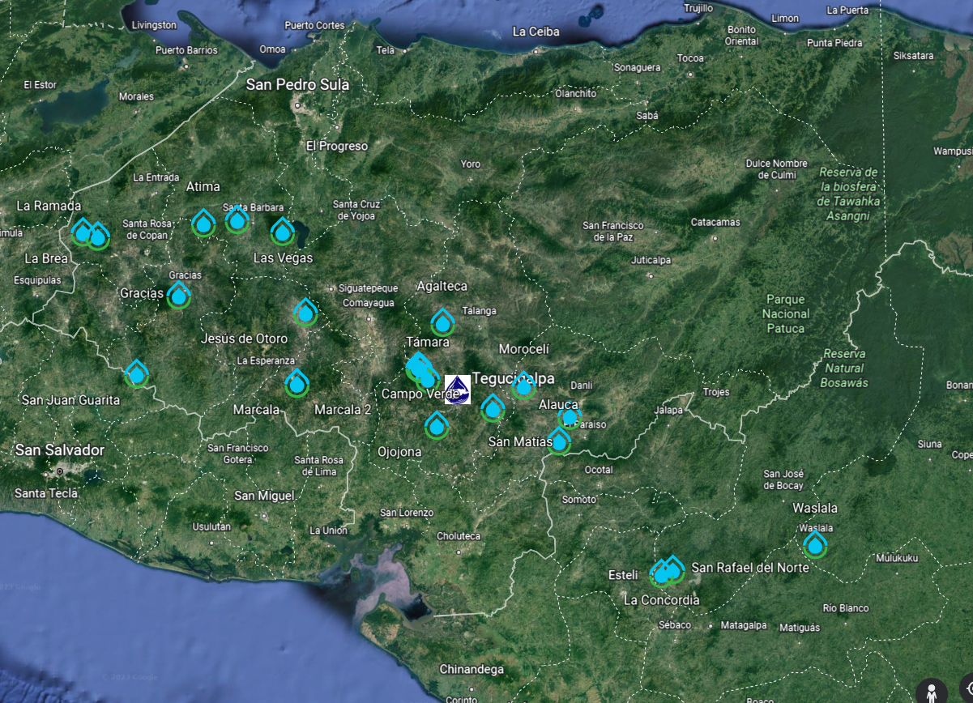

Slide 11
Today’s agenda in Gather
Gather around a table (numbered 1 to 15) with at least one other person
Begin working on Part Studios Assignment
https://github.com/AguaClara/SWOT/wiki/Part-Studios

