Slide 1
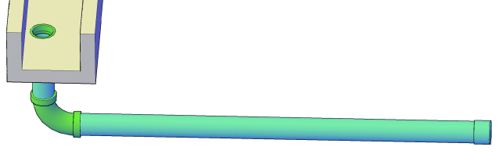
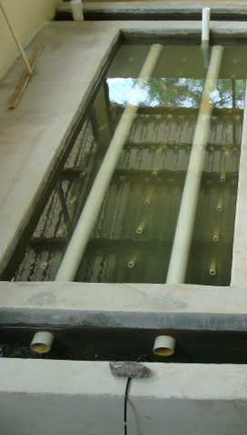
Inlet and Outlet Manifolds and Plant Hydraulics
Using direct fluid feedback (physics) rather than indirect computer feedback to control flows
In which the Change in Kinetic Energy BECOMES SIGNIFICANT
(Thanks to A.A. Milne)

Slide 2
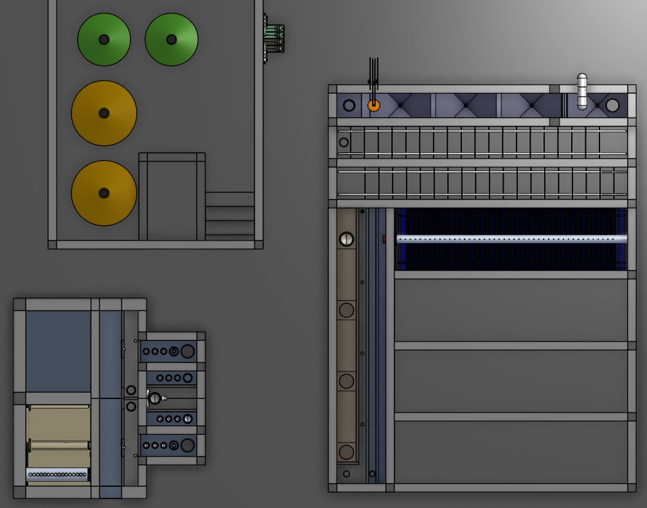
Flow in parallel: Unequal flow division is a waste of resources
There are many places in a water treatment plant where there are parallel paths
Failure mode: What if all of the water went through 1 clarifier bay?
Will the water divide equally?

Slide 3
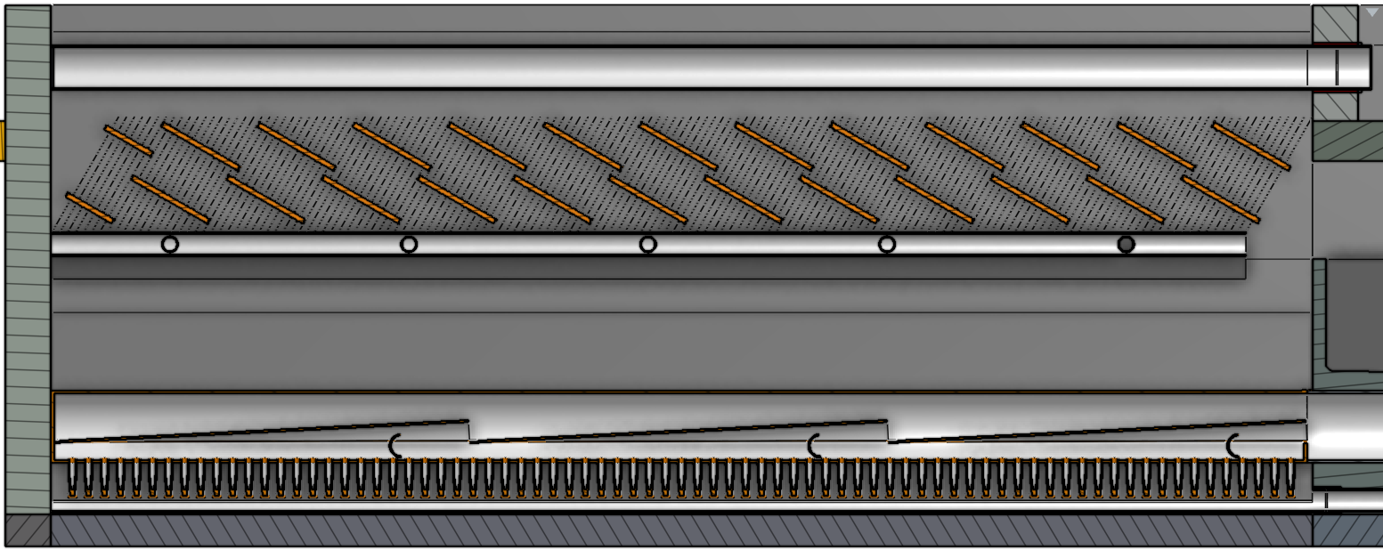
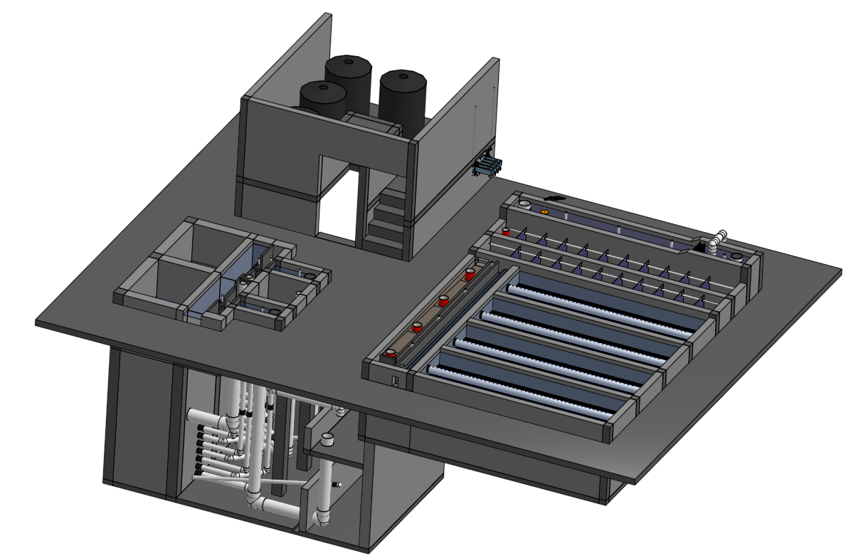
Places we’d like Equal Flow Distribution
Clarification
Between clarifier bays
Between diffusers into clarifier bay
Between plate settlers
Filtration
Between filters
Between filter layers
Between branches
Between slots in the branches
Notes:
We currently use flow restrictions in the effluent launder to divide the flow between the clarifier bays.

Slide 4
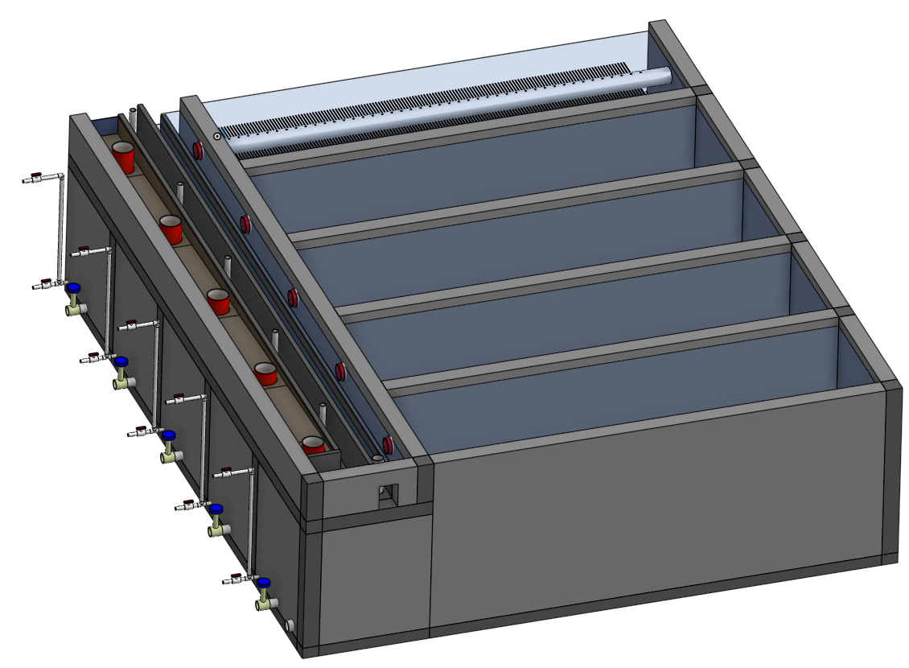
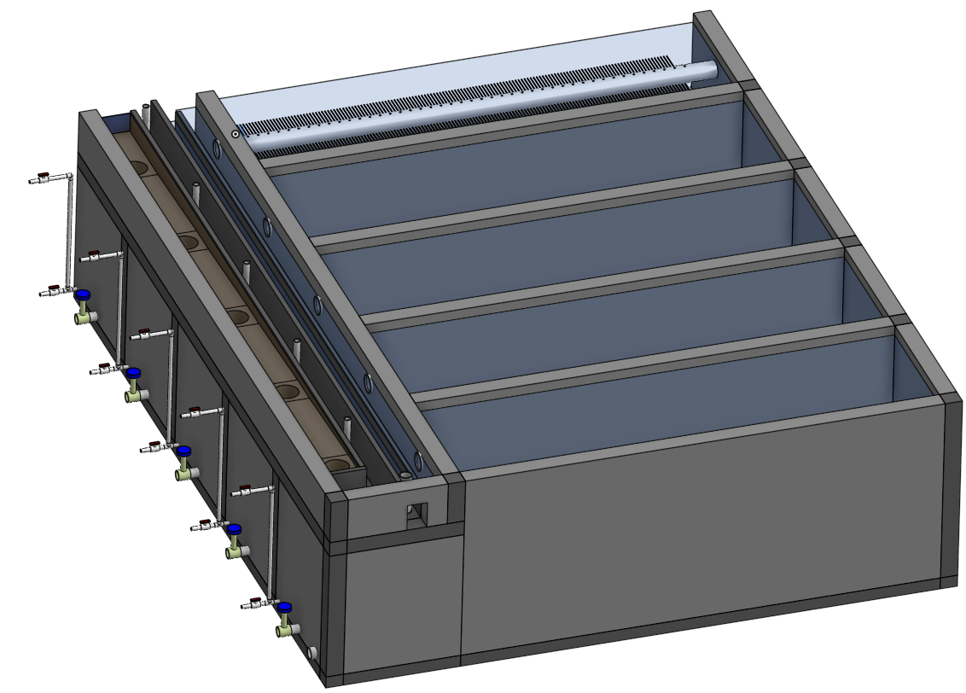
Why does water flow through the clarifier bays?
Where does the energy come from to move the water through the clarifier bays?

Slide 5
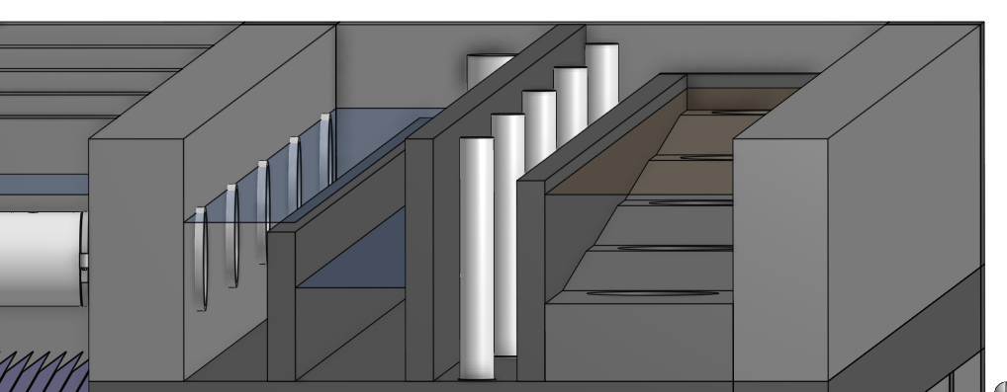
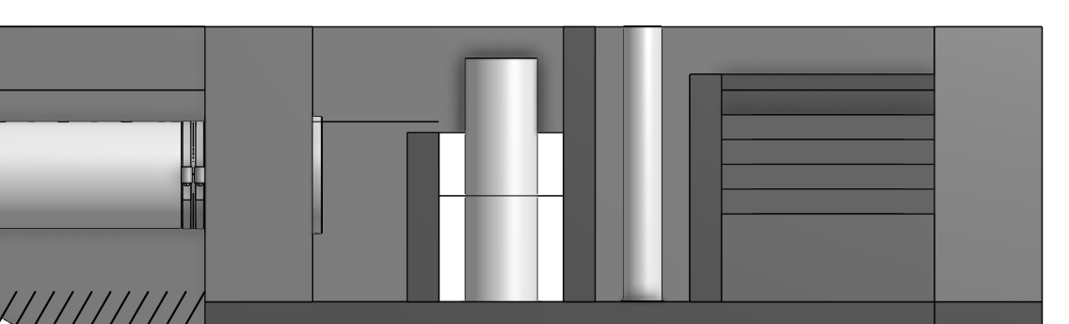
Why does water flow through the clarifier bays?
Water level in clarifier bay
Water level in exit channel
Water level in clarifier bay
Where is the majority of the head loss in a clarifier bay?
Water level in inlet channel from flocculator
Where is majority of the head loss in a clarifier bay?
5 cm of potential energy pushes the water through the bay

Slide 6
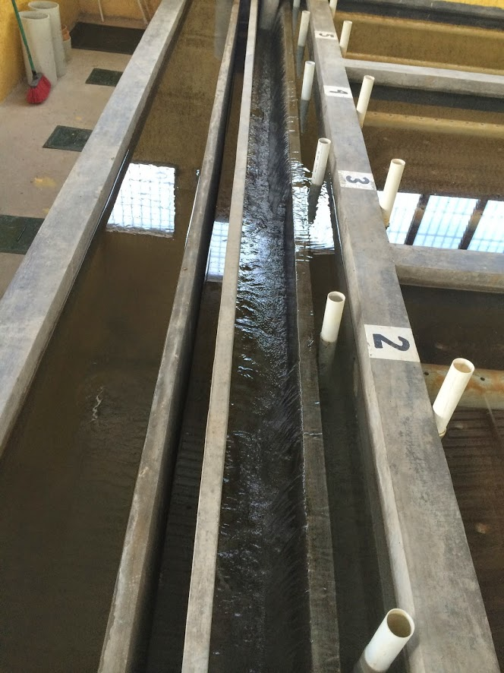
Clarifier Flow Distribution
Pipe stubs to block clarifier bay inlet manifolds
Inlet channel
Flocculated water to waste
Sensor access to floc hopper
Clarified water outlet channel
Weir that controls water level in clarifier (and flocculator)
What is different about the path of water through the clarifier bays?
How might that cause a difference in flows?
Notes:
#6 will have the highest flow rate if inlet channel has a constant cross sectional area.

Slide 7
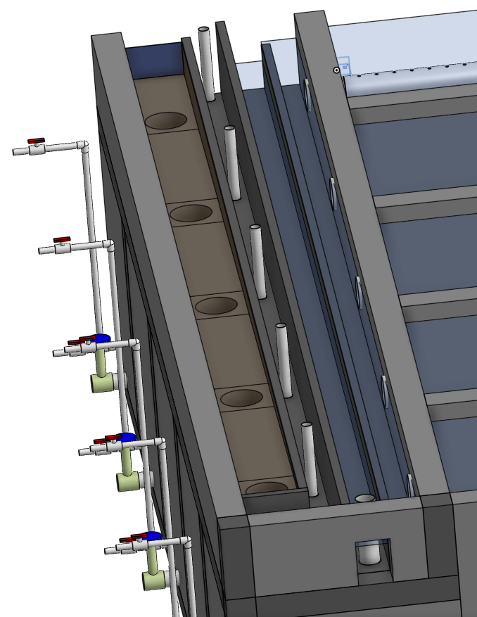

Clarifier Flow Distribution
Inlet channel
Flocculated water to waste
Sensor access to floc hopper
Pipe stub to block clarifier bay inlet manifolds
Clarified water outlet channel
Weir that controls water level in clarifier (and flocculator)

Slide 8

Flow Division in OStaRS between layers
Inlet plumbing head loss
Outlet box
Total filter head loss
What fraction of the filter flow goes through each pipe? Hmmmm….
How many layers are served by each pipe?
If we use the same size pipes which layers will get more flow?
1
2
2
2
2
2
1

Slide 9




How can we make water split equally between several paths in a manifold?
Draw a manifold with ports that you think would give unequal flow. Orifices diameters are uniform.
Draw a manifold with ports that you think would give equal flow
What do you think is important? (pressure, elevation, kinetic energy)
1
2
n-1
n
cs₁
cs_{n}
Inlet manifold
Notes:
Vertical manifold or manifold at a slant?
Draw slanted pipe in a lake and discuss what causes water to flow in a pipe
Change in pressure or elevation or energy

Slide 10
4 strategies
Make the paths identical (try this first!)
Add custom head loss to each path (complicated!)
Increase identical head loss in all paths to make differences insignificant
Clarifier bay inlet manifold diffuser pipes used to have high exit velocities
Clarifier bay effluent manifold uses orifice head loss
Reduce head loss and pressure recovery that cause differences in piezometric head
Use large diameter pipes for manifolds
Rule of thumb - exit and entrance velocities must be greater than manifold velocity!

Slide 11
How do you know which way water fill flow in a pipe?
Water flows down hill
Water flows from high pressure to lower pressure
P₁
P₂

Slide 12
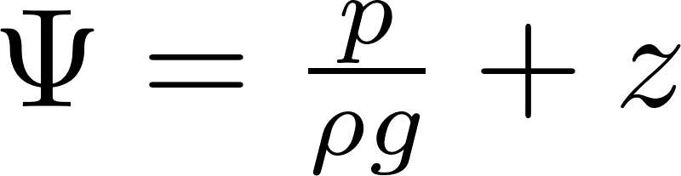
Let’s drop a pipe in a swimming pool Which way does the water flow?
From high elevation to low elevation!
From high pressure to low pressure
From high piezometric head to low piezometric head

Slide 13
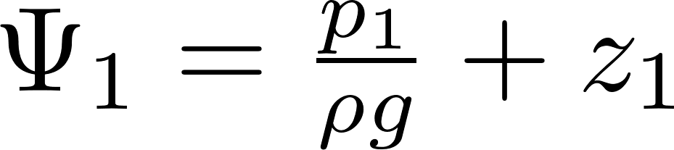
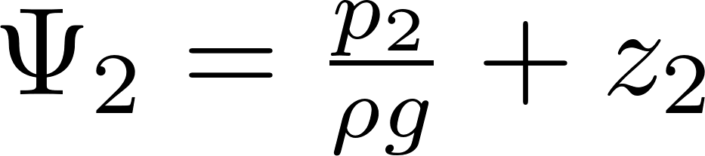
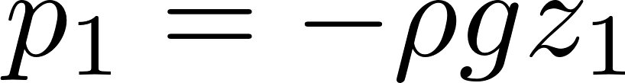
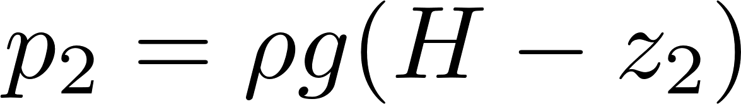
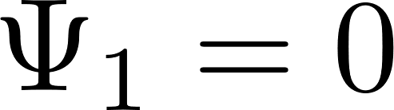
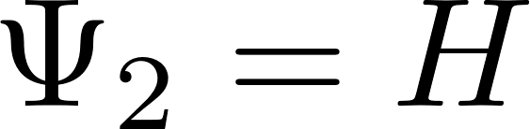
Piezometric head: no flow
H
Z=0
1
1
2
n
Notes:
Fluid goes from high piezometric head to low piezometric head (for ports exiting normal to the flow)
Draw piezometers on

Slide 14


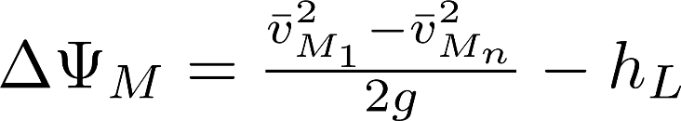
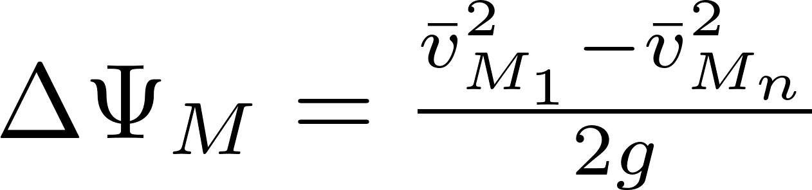
Piezometric head with flow
H
What sets H?
Flow per orifice
Orifice head loss
What sets change in piezometric head between port 1 and port n?
Z=0
1
Neglect head loss
Piezometric head in an outlet manifold increases in direction of flow!
n
Notes:
Fluid goes from high piezometric head to low piezometric head (for ports exiting normal to the flow)
Draw piezometers on

Slide 15
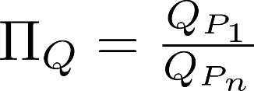
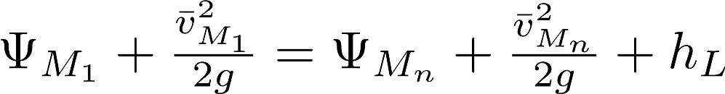
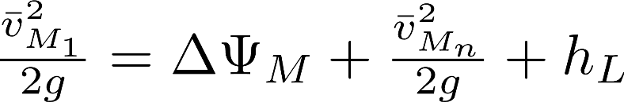
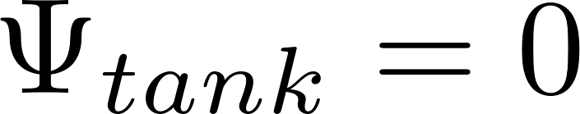
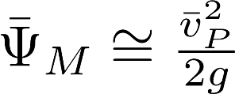
Flow distribution between ports in an inlet manifold
Which port is going to get the most flow?
There is a very gradual flow expansion!
The water is being stopped by pressure on the end cap
Where is the manifold pressure highest?
1
2
n-1
n
cs₁
cs_{n}
Inlet manifold
Notes:
Draw manifold in lake picture
Define Pi.Q= Qp1/Qpn
Define H average (=vjet^2/2g) and ΔH (vpipe^2/2g) showing manometers
Note that shape of inlet (pitot tube) matters
ΔH proportional to 1/A^2 (from orifice eq)
How do you get Pi.Q = 1?
H average > ΔH
Ajet<Apipe

Slide 16
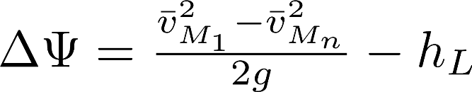
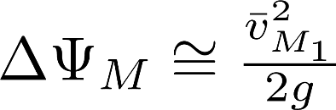
Change in piezometric head from port 1 to port n (inlet manifold)
For short (fL/d <<1), straight (K=0) inlet manifolds the change in piezometric head is equal to the initial velocity head
The same for outlet manifolds except piezometric head decreases in the direction of flow
1
2
n-1
n
cs₁
cs_{n}
Inlet manifold

Slide 17
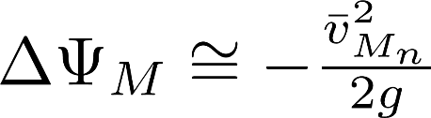
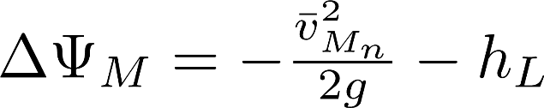
Change in piezometric head from port 1 to port n (outlet manifold)
For short (fL/d <<1), straight (K=0) outlet manifolds the change in piezometric head is equal to the negative final velocity head
n
n-1
2
1
cs_{n}
cs₁
Inlet manifold

Slide 18
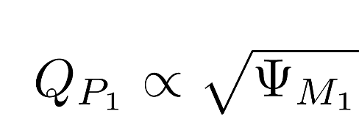

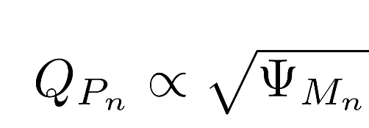

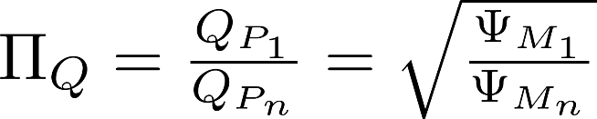

Flow Division Analysis for Inlet Manifold (with orifice outlets)
Total difference between paths 1 and n
To simplify analysis we assume equal piezometric head error on both sides of the mean piezometric head (first order linearity approximation).
Port one has mean piezometric head – ½ delta piezometric head
Engineering basis of design
Flow ratio is less than one
Last port has higher flow
We can achieve uniform flow by increasing
Notes:
Change in piezometric head is the same for both routes!
The loss coefficient is different and that means that the flows will be different too.
This is missing the effect of pressure recovery
Need a method to specify

Slide 19
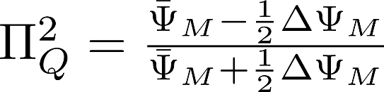

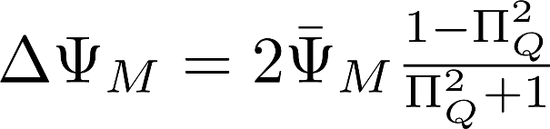
Solve for the maximum permissible change in piezometric head
Solve for
This is change in piezometric head in the manifold as a function of port flow uniformity and average piezometric head across the ports.

Slide 20
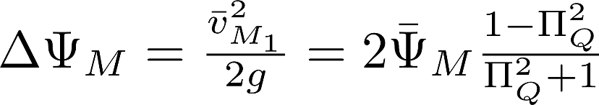
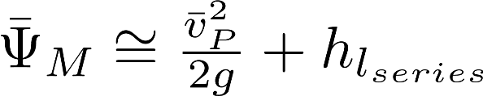
Relationship between port contracted velocity and manifold velocity
Port flow uniformity equation
Piezometric head in the manifold (energy equation)
If head loss in the manifold is small, then we have
Pressure recovery
differences in port flow
causes
is the contracted port velocity
The average manifold piezometric head sets the average port velocity

Slide 21
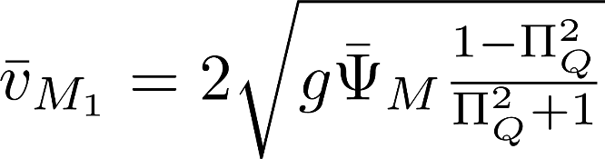
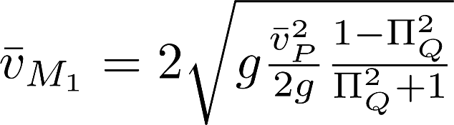
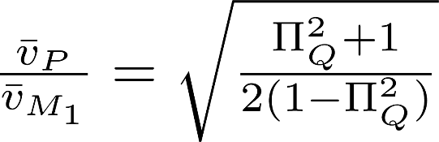
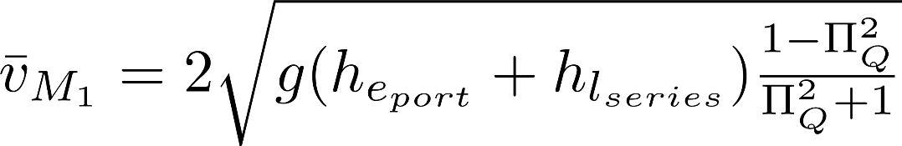
Manifold velocity
Pressure recovery =
No head loss in series
With helpful head loss in series

Slide 22

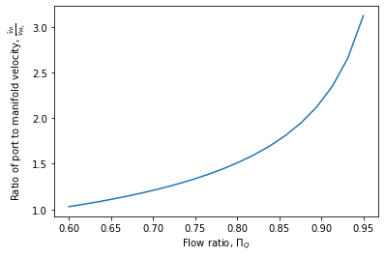
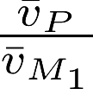
Plot port velocity over manifold velocity as a function of
Total contracted port area must be smaller than pipe (manifold) area to get reasonable flow distribution
High port velocity means high head loss
More energy required to achieve more uniform flow distribution
Notes:
Suppose I am wiling to use 5 cm of head loss in the orifices. And I want first over last to be 85%. How do I find the size of the pipe?
Use v=root(2gh) to get the constricted velocity in the port.
Then solve for manifold velocity

Slide 23
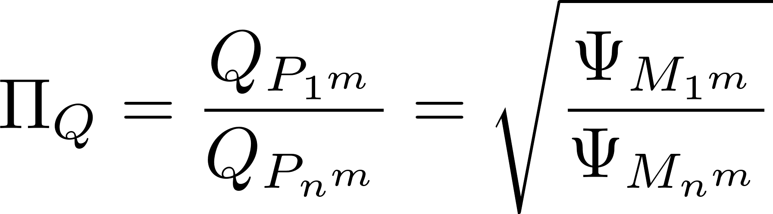
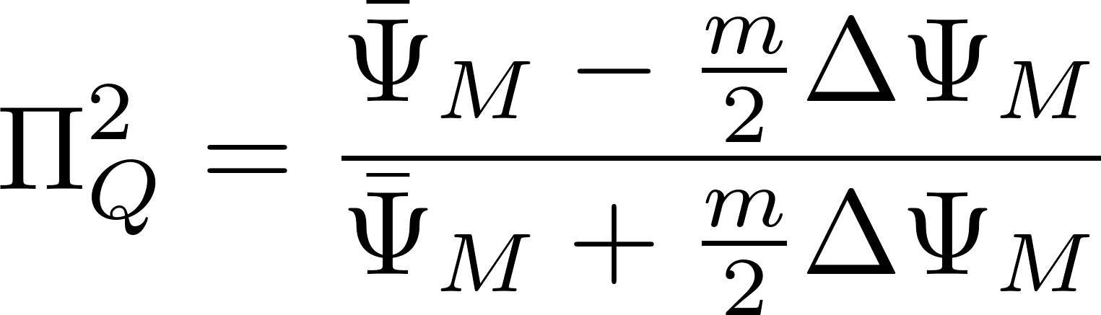
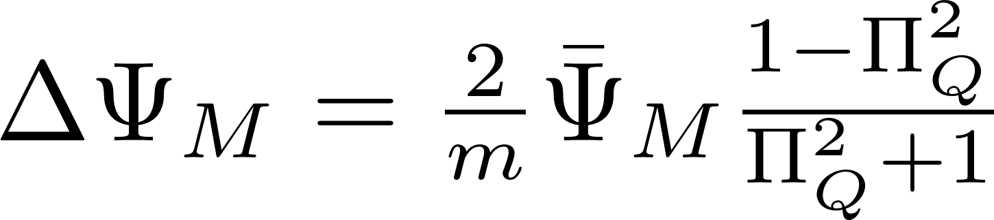
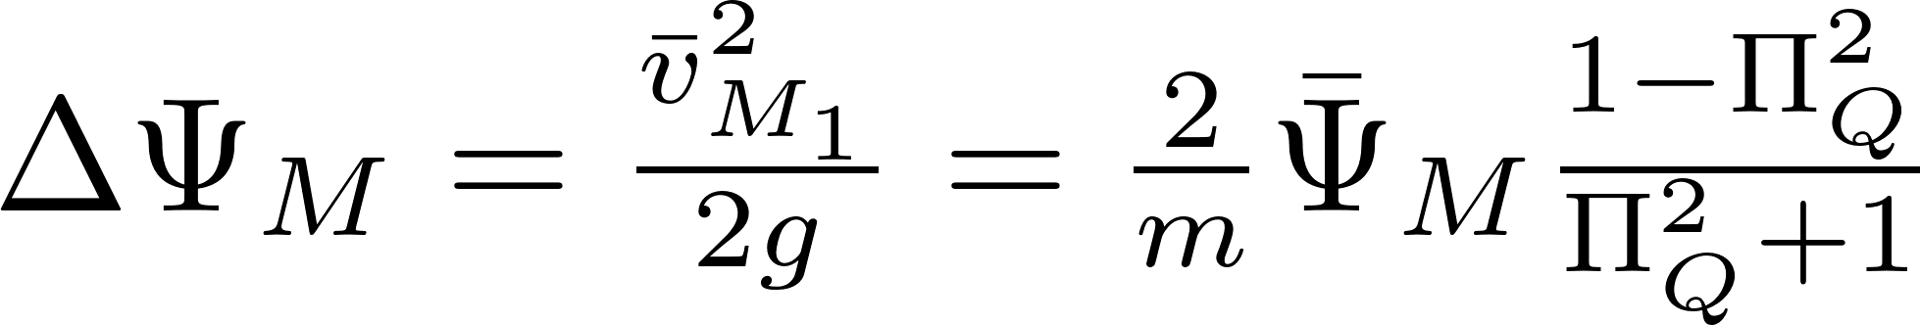
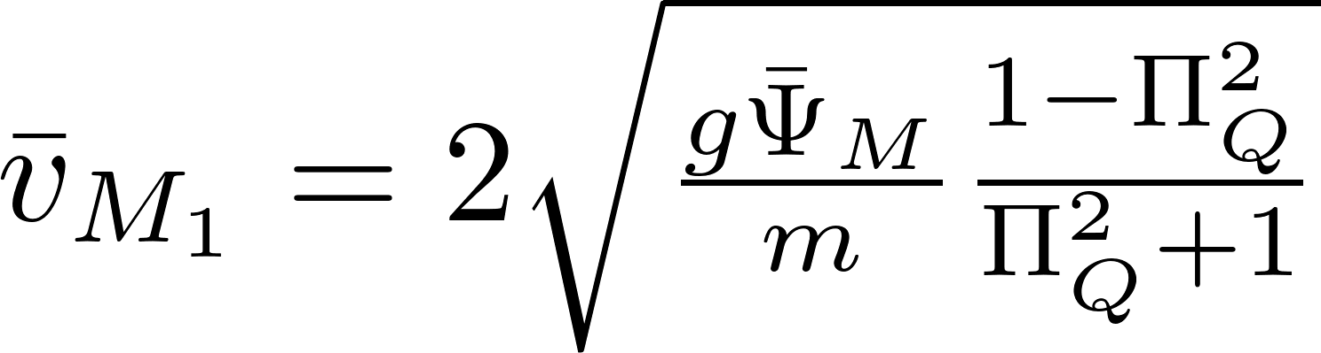
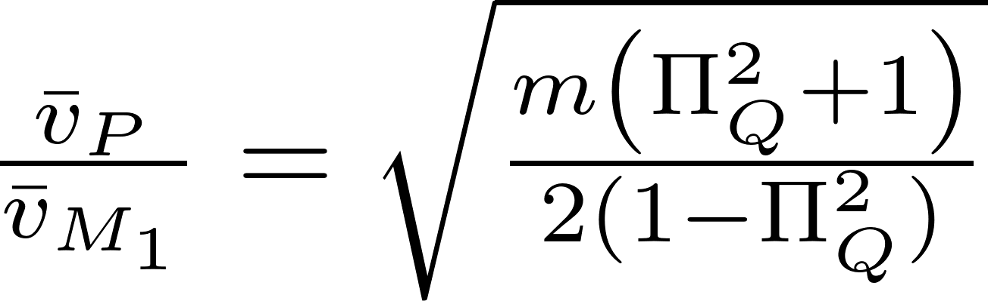
Series of m Manifolds
Where m is the number of manifolds in series
Here this nomenclature is indicating that the subscript would actually have this many repeated 1s or ns.

Slide 24
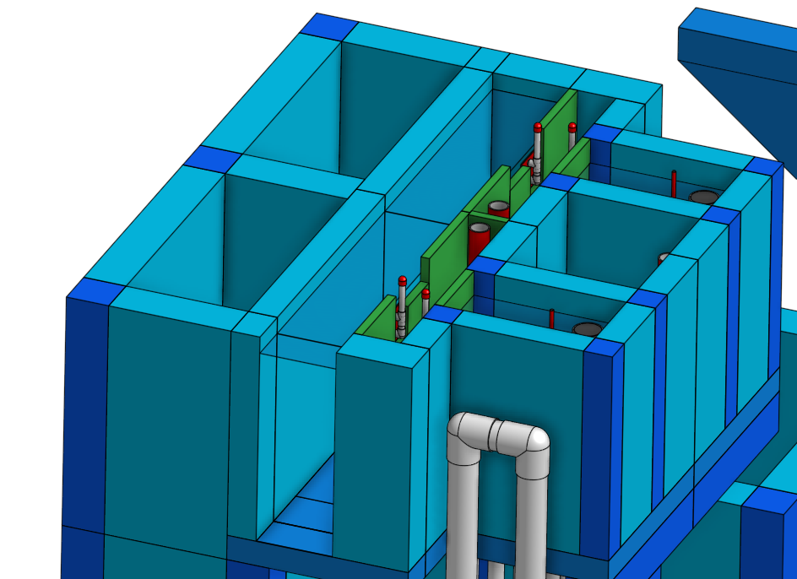
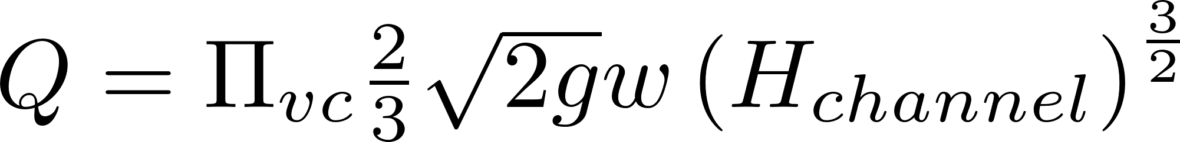
Filter Inlet Channel Design
Channel provides water to all of the filters
Water exits the channel by flowing over the top of sharp crested weirs to enter the filter inlet boxes
Small changes in water elevation in the channel will cause significant changes in flow rate to the filters
Height of water in channel above the weir

Slide 25


Slide 26







Manifold Channel
Looking toward channel from filter inlet boxes
Filter 1
Filter n/2
Filter n
Water in channel
Water in filter inlet

Slide 27



Open channel side exit weir flow distribution
Define the flow ratio
Solve for the maximum manifold velocity
Alternative solution is slope the bottom of the channel (but this doesn’t solve the problem when some filters are off line)
Assumes 5 cm over the weirs

Slide 28






Sed Tank as a Circuit: Flow Distribution Challenge
Piezometric head change from flow acceleration and head loss
Battery creates 5 to 10 cm of potential energy to drive the flow
Launder exit losses
Settled water outlet channel
Launder orifice loss
Floc blanket and plate settlers
Inlet channel
Diffuser exit loss
Inlet manifold
Effluent manifold (Launder)
Piezometric head change from
Flow deceleration and head loss
Flow distribution thru parallel paths is a major hydraulic design challenge
Notes:
We will cover this in manifold hydraulics if we have time. Which resistance is good and improves flow distribution? Which resistance makes flow distribution poor?
Improve by increasing losses in diffusers and in orifices

Slide 29

Manifold flow distribution Including major head loss
We will derive equations in terms of Hydraulic Grade Line (HGL) because piezometric head controls the port flow
Port flow
based on _______ equation
Piezometric head change (ΔΨ) across port
flow expansion
Piezometric head change (ΔΨ) between ports
Darcy-Weisbach and Swamee-Jain
orifice
In manifold

Slide 30




Inlet Manifold
Change in piezometric head from expansion pressure recovery across one port (flow expansion)
Pressure recovery
EGL
HGL
1
2
n-1
n
Major head loss
Notes:
Which port has the highest flow

Slide 31







What is as a function of n? (sum of the change in piezometric head from expansions)
Now sum across all ports
Approaches for large n
_______________ is recovered for very gradual expansion.
All kinetic energy

Slide 32
Outlet Manifold (Launder)
Flow contractions, thus no significant minor loss!
EGL
HGL
All of the changes at the ports sum to
1
2
n-1
n

Slide 33






Head Loss in a Manifold (same for inlet or outlet)
Define manifold length as
Head loss in a manifold is __ of the head loss with constant Q.
1/3

Slide 34





Change in Piezometric Head in an Outlet Manifold
Total change in piezometric head
Note: We have factored out the friction factor knowing that and thus f is not constant

Slide 35


Change in Piezometric Head in an Inlet Manifold
This equation gives the difference in piezometric head between the first port and the last port. Since the two terms have opposite signs the maximum difference could be at an intermediate port. We need to determine if one of these terms dominates to see if the maximum difference really is between the first and last ports.

Slide 36
Conclusions
Manifolds are complicated (and important)!
Manifold head loss is 1/3 the head loss in a pipe
Difference in piezometric head drives the flow through the ports
Manifold kinetic energy is converted to pressure increase
Following slides develop equations for detailed design of manifolds (reference for your future careers!)

Slide 37
Solution Path
The length of the manifold will be determined by the plant geometry
The spacing of the ports will be set by other constraints
We need to determine the diameter of the manifold and the diameter of the ports

Slide 38


Launder: Traditional Design Guidelines
Recommended port velocity is 0.46 to 0.76 m/s (Water Treatment Plant Design 4th edition page 7.28)
The corresponding head loss is 3 to 8 cm through the orifices
How do you design the diameter of the launder? (coming up…)
Would this work if head loss through the manifold were an additional 10 cm? _____
NO!
Notes:
Water Treatment Plant Design 4th edition page 7.28

Slide 39
Design Constraints
For sed tank Inlet Manifold the port velocities and the manifold diameter are set by the _____________________________________
For the outlet manifold that takes clear water from the top of the sed tank bays the goal will be to keep head loss low and greater than construction errors in level of weir (we aim for about 5 cm)
Diffuser jet velocities

Slide 40

Why is the launder diameter so large?
(50L/s /9) launder of 6 inches
The head loss in the launder is small and it would be tempting to use a smaller pipe
Why is such a large pipe necessary?______________
Why do we even need a launder pipe? ___________________________________________ ___________
What is the max velocity above the plate settlers given a 1 m wide tank, 25 cm of water above the plates, a single launder? __________
Equal orifice flow
For uniform flow distribution between (and within) plate settlers
2 mm/s
Notes:
I take the last question as a real question. Do we actually need launders? Would it be better to lay a perforated cloth on top of the plate settlers to help get uniform flow distribution between plates and then use a simple orifice in the channel wall to create 5 cm of head loss to force flow between bays to be equal?

Slide 41
What is the horizontal velocity above the plate settlers without a launder?
This velocity is very large compared with the head loss through the plate settlers (about 1 μm) and thus elimination of the launder would result in preferential flow through the plate settlers closest to the exit

Slide 42
Approach to Find Port Diameter
Calculate the head loss in the manifold
Subtract 50% of that head loss from the target head loss (5 cm) to estimate the port head loss
Calculate the port diameter directly using the orifice equation

Slide 43
Hydraulic Conclusions
The water level in the flocculator and sedimentor is set by the settled water weir
The most significant head loss in the sedimentation tank is the orifices in the effluent manifold
The entrance tank water level is significantly higher than the flocculator due to head loss in the LFOM
The stock tanks have to be even higher to be able to flow by gravity thru the chemical doser and into the entrance tank.

Slide 44

Nomenclature: a start
Symbol | Description | Sub
Q | Flow | P | Port
A | Area | M | Manifold
 | Piezometric head | D | Diffuser
h_{L} | Total Head Loss | e | expansion
HGL | Hydraulic Grade Line | 1 | Short path
EGL | Energy Grade Line | n | Long path
C_{p} | Pressure Coefficient (includes shear and expansion effects)
Π_{vc} | Area of the vena contracta divided by the orifice area = 0.62
D | Diameter
Π | Dimensionless ratio
n | Number of ports
p | Pressure at the centroid of a control surface
 | Average velocity across a control surface

Slide 45

Piezometric head
H
What sets H?
What sets change in piezometric head between port 1 and port n?
Z=0
1
1
Neglect head loss
Piezometric head in an outlet manifold increases in direction of flow!
What is the piezometric head
in the tank?
In the pipe (no flow)?
In the manifold (with flow)
n
Notes:
Fluid goes from high piezometric head to low piezometric head (for ports exiting normal to the flow)
Draw piezometers on
H is set by the flow into the elevated tank and the head loss through orifices
Change in piezometric head

