Slide 1
Reports

Slide 2
Electronic Grading
Latest method… Excel grading sheet embedded in the report.
How do you view comments?
How does Word indicate changes?

Slide 3
Characteristics of the Best Reports
Creative rational for why the experiment was performed
Outline of procedures consistent with the experiment rational
Restatement of the theory including equation development in your own words
Organized presentation of results with logical progression and transitions (Why? What did you learn?)
Conclusion that connects results back to rational
Every sentence clear, Every sentence counts

Slide 4
Report Suggestions
Practice reading your report as if you were an interested reader who had never heard of this experiment
Review the guidelines at the website before submitting each report

Slide 5
Trick to keep the captions with figures and tables
Place both inside a textbox
Set the properties of the textbox to allow text wrapping around the textbox

Slide 6
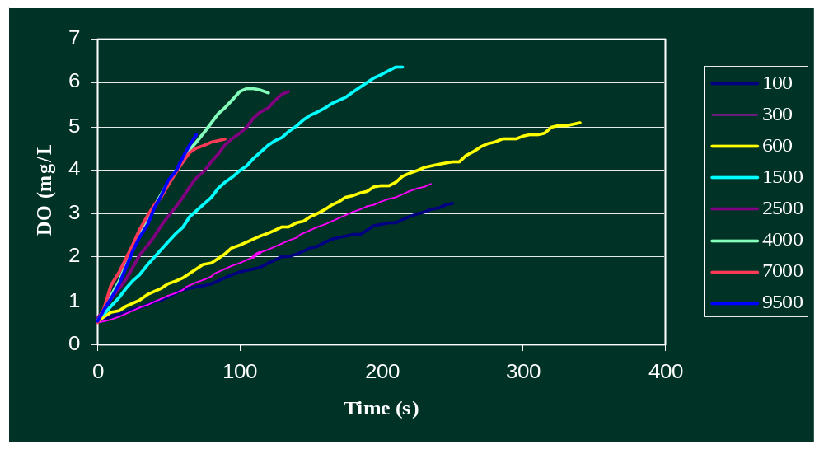
Look at your data!

Slide 7
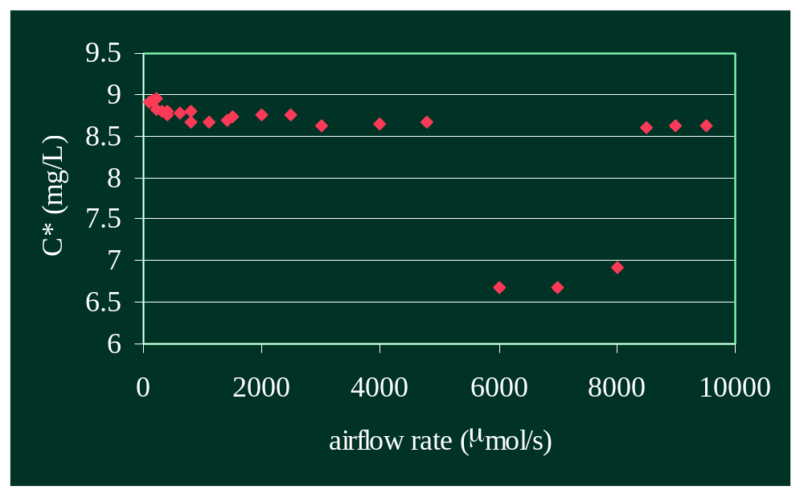
Explaining Data

Slide 8
Explaining Data
Create a hypothesis
See if the hypothesis is consistent with the observed data
  Yes: it is a viable explanation
  No: it isn’t a viable explanation
Human error?

Slide 9
Fluff and Stuff
“Before this flow level, the bubbles surface area is not at the optimal ratio.”
“Data such as this is important to learn general trends in gas transfer and system behavior, and is useful in providing models by which to calculate necessary airflow rates for future systems”
Don’t say you did things just because they are in the lab manual if you really didn’t do them!

Slide 10
Metric System
Become fluent in the Metric system!
You should all have a good feel for 1 L, 10 mL, 30 C, 20 cm…

