Slide 1
Arsenic

Slide 2
Generalize the design process
Water Source
Possible Unit Processes
Contaminants
Select Unit Processes
Disinfection Complications
Regulations
Sequence the unit processes
Client needs
Distribution Complications

Slide 3
Oxidize the arsenic first!
Arsenic can occur in four oxidation states in water (+5, +3, 0, −3) but is usually found only in the trivalent [arsenite, As(III)] and pentavalent [arsenate, As(V)] states.
Arsenate, As(V) is much easier to remove by coagulation
H3AsO3 is dominant form up to
Arsenite, As(III), can be oxidized to As(V) with chlorine, permanganate, or ozone

Slide 4
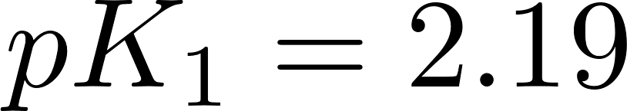
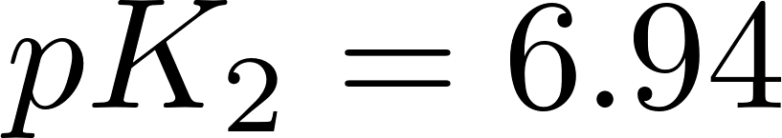
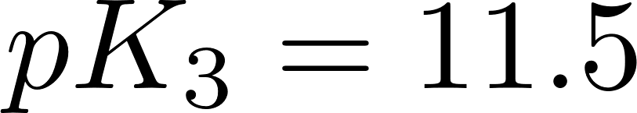
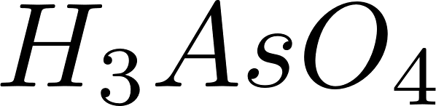
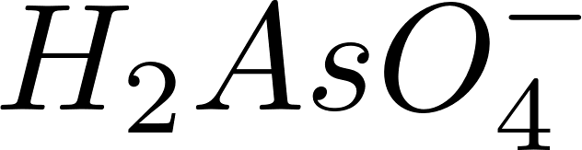
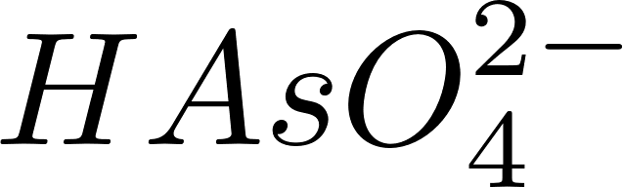
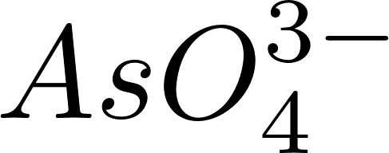
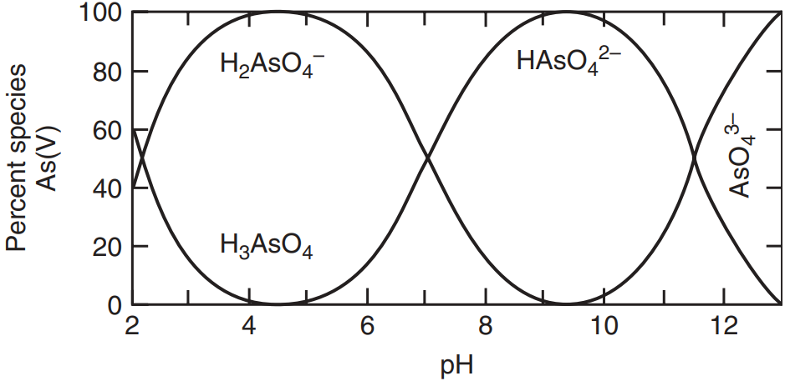
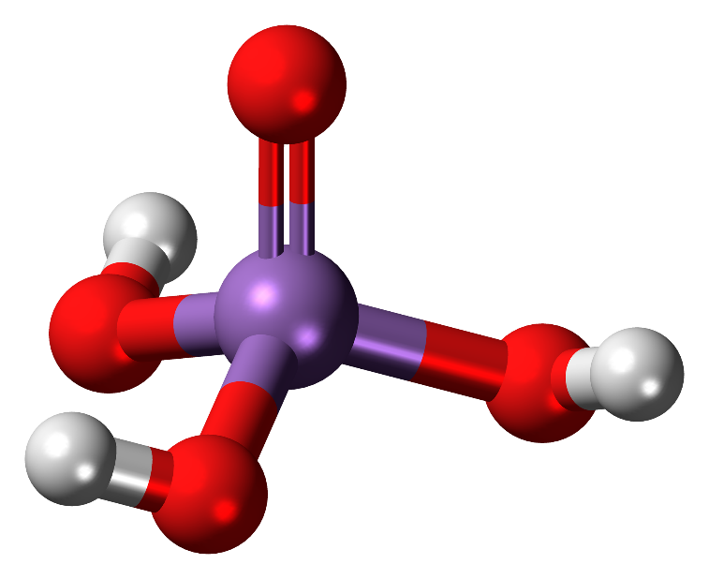
Arsenic(V) acid reactions
Notes:
Species graph from MWH page 1536, Figure 20-1 Predominance diagram for As(III) and As(V) as function of pH. (Adapted from Gupta and Chen, 1978.)
Stick diagram By Jynto (talk) - Own workThis image was created with Discovery Studio Visualizer., CC0, https://commons.wikimedia.org/w/index.php?curid=15368424

Slide 5
Arsenic adsorption onto Al(OH)₃ and Fe(OH)₃

