Slide 1

Arsenic: it is everywhere it is deadly we’ve got options

Slide 2
Our UP selection tool matters!
Client focused: Who is our client?
The price of water matters
Capital costs
Operating costs
Energy
Residuals
Chemicals
Labor
We want to be able to easily characterize these costs!

Slide 3
Volumes and prices of drinking water
Per capita consumption for piped water supplies is about 3 mL/s (250 L/day)
In one month a person uses about 8 cubic meters (8 kL)
Water Bills
Honduras $1 per person per month = $1 per 8 kL = $125/ML
Ithaca Bolton Point water = $2100/ML
CUWFP = $3212/ML
Water Treatment (capital cost, chemicals, energy, labor, residuals)
Water Delivery (capital cost, energy, labor, replacement)
Notes:
My water bill is 60 per 3 months for 3 people
$20 per month
$7 per person per month for water and sewer
More than half of bill is for sewer
Thus $3 per person per month for water
Bolton point
$7.97/1,000 gallons
$2.1/1000 liters
$2100 per ML

Slide 4
Energy
h = 1 m of elevation difference
Energy is ρgh = 10 J/L = 10 MJ/ML
Electricity costs about $30/GJ = $0.03/MJ
1 m elevation costs $0.3/ML (compared with water bill of $3000/ML 1 m elevation change is cheap. Desal energy = 1000 m = $300/ML )

Slide 5
What are the contaminants that are widespread and deadly? (Monroe’s list)
Pathogens
Arsenic and fluoride (mostly naturally occurring)
Disinfection by products (chemical disinfection)
Lead and copper (lead solder and lead pipes)
Nitrate (agricultural fertilizer)
Anthropogenic chemicals

Slide 6
Arsenic in our Drinking Water
EPA primary standard is 10 μg/L (10 ppb)
Skin damage
Carcinogen
Where is it coming from?
Earth’s crust contains 1.8 mg/kg (MWH text page 1534)
Groundwater (or surface water under the influence of groundwater!)
Arsenic was also used as a pesticide and herbicide (What were we thinking???)

Slide 7
Arsenic is a global concern
Notes:
https://www.eawag.ch/en/research/humanwelfare/drinkingwater/wrq/risk-maps/

Slide 8
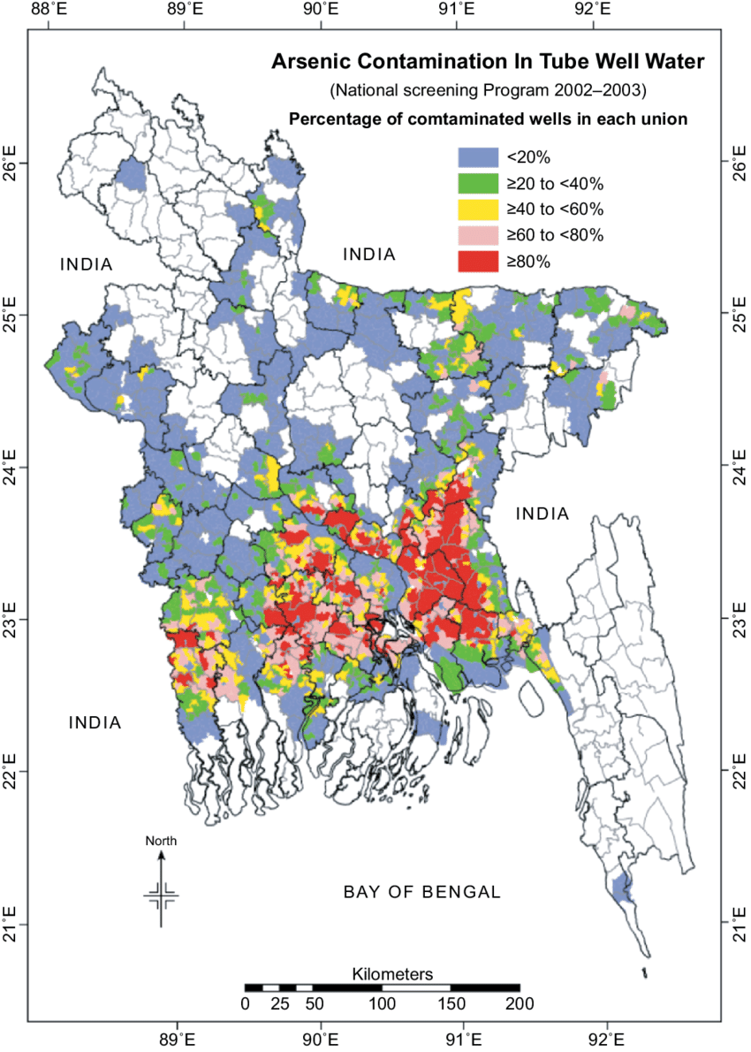
Bangladesh
Relied on surface waters that were contaminated with particles and pathogens
Multiple organizations pushed the switch to wells for safe drinking water
Arsenic poisoning found in several patients in 1987
1990’s extensive testing of wells
21 million people exposed to As>50 ppb
Notes:
In 1983, the first cases of arsenic-induced skin lesions were identified by K.C. Saha then at the Department of Dermatology, School of Tropical Medicine in Calcutta, India (6). The first patients seen were from West Bengal, but by 1987 several had already been identified who came from neighbouring Bangladesh. https://www.who.int/bulletin/archives/78%289%291093.pdf

Slide 9
Arsenic-contaminated drinking-water: a public health emergency
Arsenic exposure in Bangladesh is widespread and involves thousands of wells
Estimates indicate that at least 100,000 cases of skin lesions caused by arsenic have occurred and there may be many more
Skin lesions are occurring in children aged 10 years and younger
Large numbers of cancers are predicted to occur in the future, including fatal internal cancers
The cause is known: each day of continued exposure increases the risk of morbidity and death
Sustained drinking of water containing 500 mg/l of arsenic may result in 1 in 10 people dying from arsenic-related cancers
Unlike other major health problems experienced in Bangladesh, arsenic-caused diseases can be eradicated at relatively low cost
Notes:
https://www.who.int/bulletin/archives/78%289%291093.pdf page 1097

Slide 10
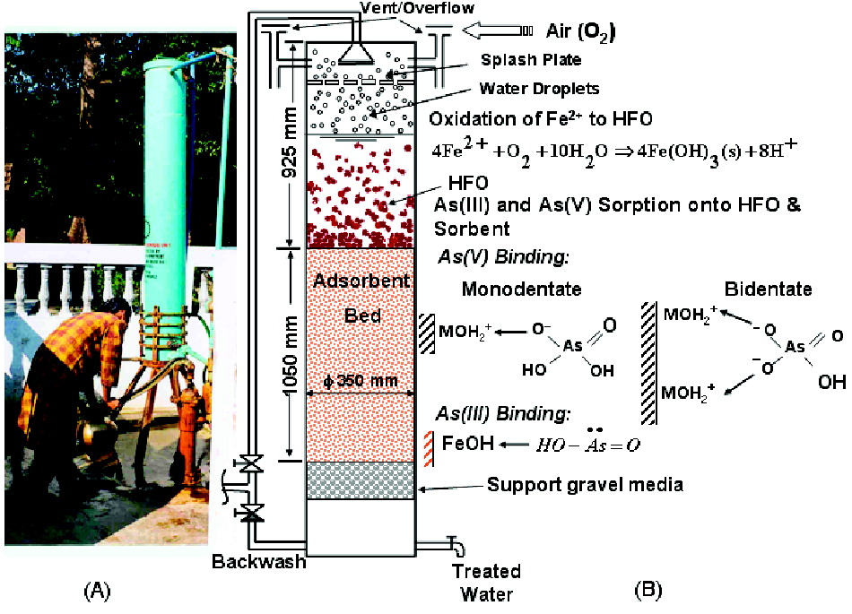
How would you solve this problem?
Sink deeper wells to get to an uncontaminated aquifer
Use rainwater
Install treatment systems to remove arsenic
What would you propose?
How did this whole problem begin?
Notes:
Time to evaluate surface water treatment!
Don’t forget the sludge.
Arsenic Removal from Groundwater and Its Safe Containment in a Rural Environment: Validation of a Sustainable Approach
Sudipta Sarkar†
Lee M. Blaney†
Anirban Gupta‡
Debabrata Ghosh‡
Arup K. SenGupta*†
https://pubs.acs.org/doi/full/10.1021/es702556t

Slide 11
Technologies to remove Arsenic
Adsorption to aluminum and iron based coagulants
Activated alumina (fixed bed of aluminum oxides)
Ion exchange
ArsenX^{np} is the first polymer-based commercially available arsenic-selective sorbent.
Reverse Osmosis
As binds to Fe(III) or Al(III)
https://www.sciencedirect.com/science/article/pii/S1381514807001770
Notes:
https://www.sciencedirect.com/science/article/pii/S1381514807001770

Slide 12
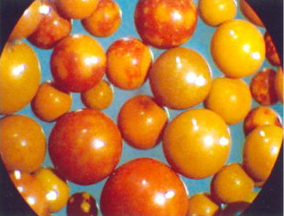
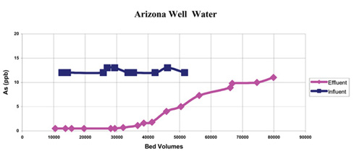
ArsenX^{np} use Fe(OH)₃ nanoparticles that are bound to an exchange resin
Service Flow Rates: 20 - 32 BV/hr
Service Flow Rates: 2.5 - 4 gpm/ft3
Bead Size Range: 0.300 - 1.2 mm
Bulk Density: 790 - 820 g/l
Arsenic Capacity: 0.5 - 4.0 g As/L
Recommended contact time: 2.5 - 3.0 minutes
Temp Limit (Stability): 80 °C
pH Limits: 4.5 - 8.5 (Operating)
Example: 40,000 bed volumes removing about 11 ppb
Notes:
https://www.systematixusa.com/products/media/active_media/arsenx.htm
https://www.sciencedirect.com/science/article/pii/S1381514807001770
Use of ArsenX^{np}, a hybrid anion exchanger, for arsenic removal in remote villages in the Indian subcontinent
Author links open overlay panelSudiptaSarkarªLee M.BlaneyªAnirbanGupta^{b}DebabrataGhosh^{b}Arup K.SenGuptaª
Show more
https://doi.org/10.1016/j.reactfunctpolym.2007.07.047

Slide 13
Regeneration of ArsenX^{np}
the exhausted ArsenX^{np} is reacted with two bed volumes of a solution of 2% NaOH and 2% NaCl in a batch reactor for 45 min
repeat this process 2 times total
During regeneration, pH remains near 12.0
spent alkali is collected (contains concentrated As)
Rinse with well water
Wash with two bed volumes of dilute HCl solution to neutralize the media so that resultant solution pH is 5.5
Rinse the media with well water
Notes:
https://www.sciencedirect.com/science/article/pii/S1381514807001770
Use of ArsenX^{np}, a hybrid anion exchanger, for arsenic removal in remote villages in the Indian subcontinent
Author links open overlay panelSudiptaSarkarªLee M.BlaneyªAnirbanGupta^{b}DebabrataGhosh^{b}Arup K.SenGuptaª
Show more
https://doi.org/10.1016/j.reactfunctpolym.2007.07.047

Slide 14
UP table: Goal is to get enough information to enable quick comparison
Unit Process | Hazardous Waste | Waste volume fraction | Consumable | Energy
Al or Fe coagulants | sludge | ??? | coagulants | Less than 1 m
Activated Al | Liquid from regeneration |  | regenerant | Less than 1 m
Ion Exchange | Caustic regeneration solution | 4/40000* | regenerant | Less than 1 m
Reverse Osmosis | brine | 0.2 to 0.3 | Chemical wash | 850 m ???
* Estimated from Arizona well water example that had 12 ppb As.

Slide 15
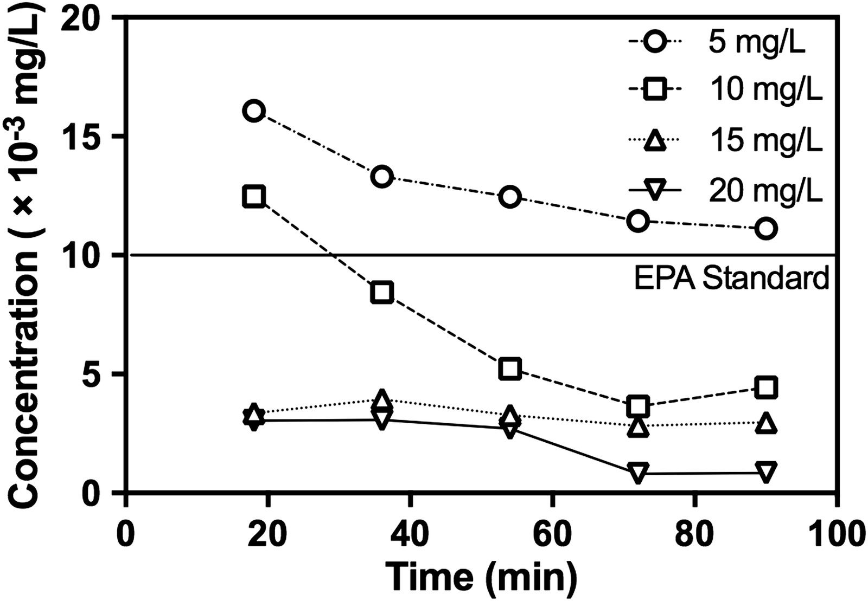
PACl removes As (floc-filtration study)
the average mass of As removed per mass of PACl (Al) in the column system was 5.6 mg As/g Al
As(V) influent was 100 ppb
580 moles of Al per mole As!!!!
Why so inefficient?
Notes:
https://ascelibrary.org/doi/10.1061/%28ASCE%29EE.1943-7870.0001250
Arsenic(V) Removal from Drinking Water by Polyaluminum Chloride in a Sand Filter Medium
Hui Zhi; Monroe Weber-Shirk; and Leonard W. Lion

Slide 16
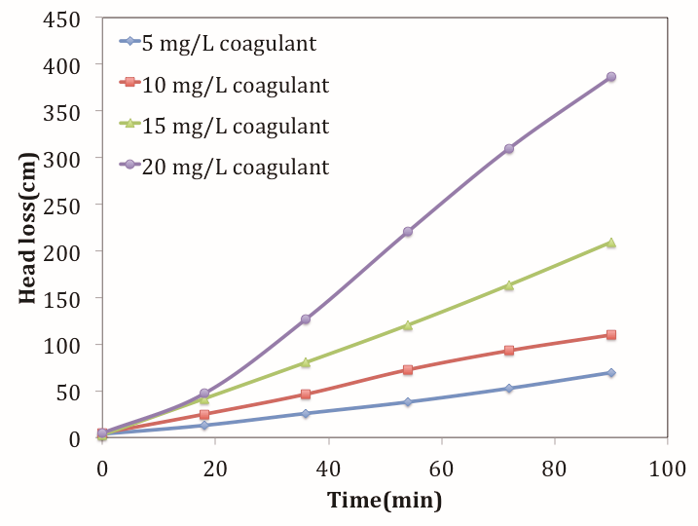
Floc - Filtration method has a problem!
Rapid increase in filter head loss
Will require frequent backwash
Low efficiency of water production

Slide 17
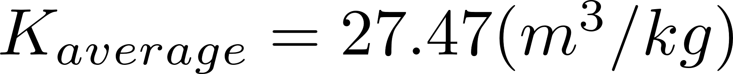
Head loss in filters is controlled by the total amount of coagulant in the filter
Approach velocity of 1 mm/s
0.5 mm sand
0.81 m bed depth
Head loss is
Notes:
https://ascelibrary.org/doi/10.1061/%28ASCE%29EE.1943-7870.0001250
Arsenic(V) Removal from Drinking Water by Polyaluminum Chloride in a Sand Filter Medium
Hui Zhi; Monroe Weber-Shirk; and Leonard W. Lion
The average slope of the head loss versus coagulant mass, m3/kgm3/kg, can be used to predict the head loss as a function of time, filtration velocity, and coagulant dose
HL=Kaverage⋅CPACl⋅Vf⋅t=Kaverage⋅CPACl⋅QA⋅tHL=Kaverage·CPACl·Vf·t=Kaverage·CPACl·QA·t
where HL = head loss in the filter column (m); KaverageKaverage = average slope, 27.47 (m3/kgm3/kg); CPAClCPACl = coagulant dose in the system (kg/m3kg/m3); VfVf = filtration velocity (m/sm/s), which equals to total flow rate Q (m3/sm3/s) divided by filter plan view area A (m2m2); and t = run time(s). However, this relationship is only valid at the experimental filtration velocity of 1×10−3 m/s1×10−3 m/s. Additional experiments would be required to measure the influence of filtration velocity on head loss increase.

Slide 18
Fe(III) and Al(III) bind with As
Hydrated oxides of polyvalent metals like Fe(III), Al(III), Ti(IV) and Zr(IV) exhibit ligand sorption properties by forming inner-sphere complexes
Wondering… Perhaps the coagulant mechanism of binding with As is the same as the mechanism of binding with particles
https://www.sciencedirect.com/science/article/pii/S1381514807001770

Slide 19
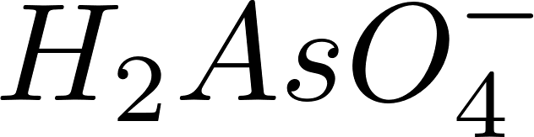
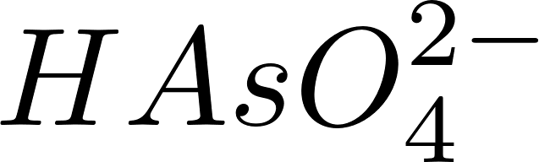
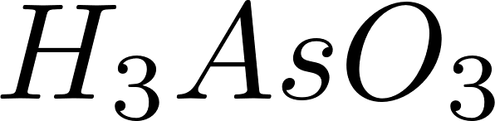
Oxidize the arsenic to make it easier to remove!
Arsenic can occur in four oxidation states in water (+5, +3, 0, −3) but is usually found only in the trivalent [arsenite, As(III)] and pentavalent [arsenate, As(V)] states.
Arsenate, As(V) is much easier to remove with iron and aluminum coagulation
Arsenite, As(III), can be oxidized to As(V) with chlorine, permanganate, or ozone
Notes:
Why is Arsenite hard to remove?

Slide 20
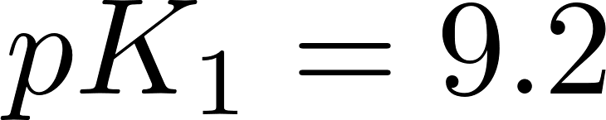
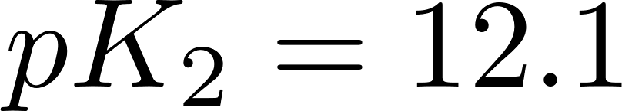
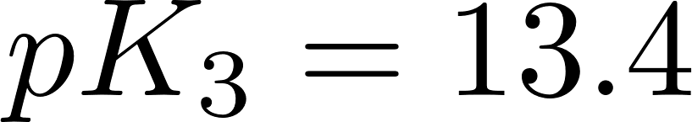
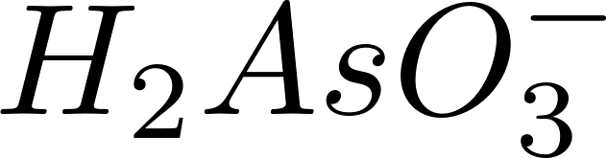
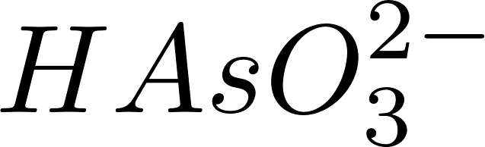
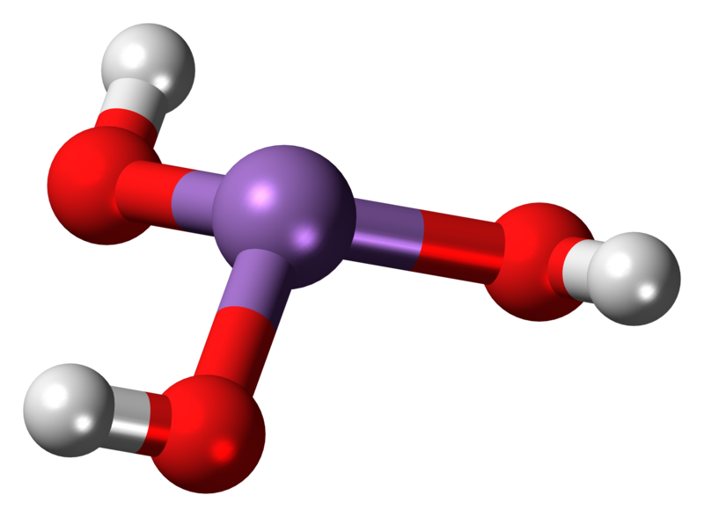
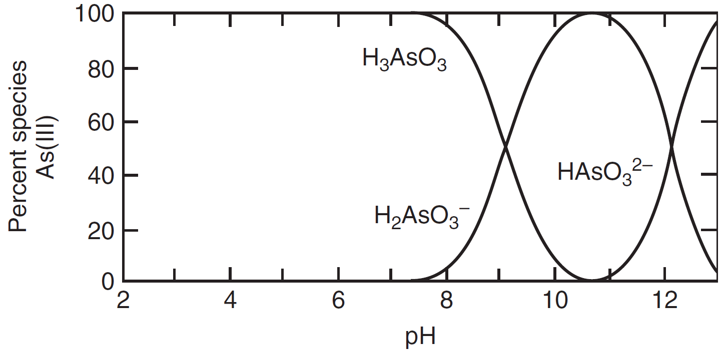
Arsenic(III) acid reactions (Arsenite)
This is hard to remove
Notes:
https://www.researchgate.net/figure/Dissociation-constants-of-arsenate-and-arsenite_tbl1_233675303

Slide 21
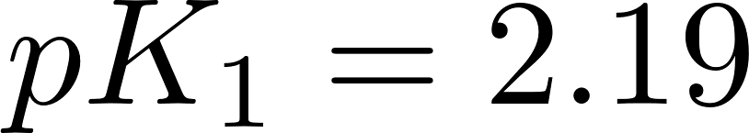
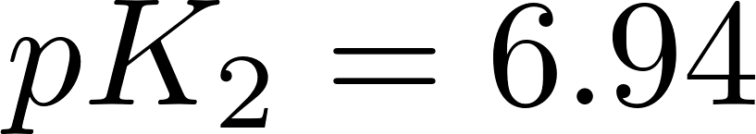
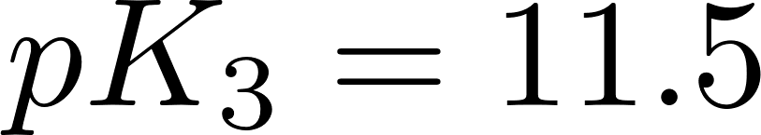
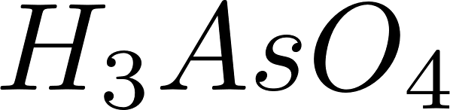
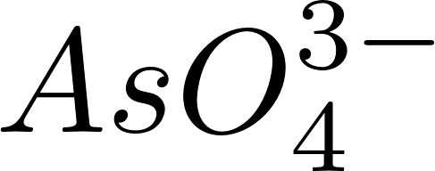
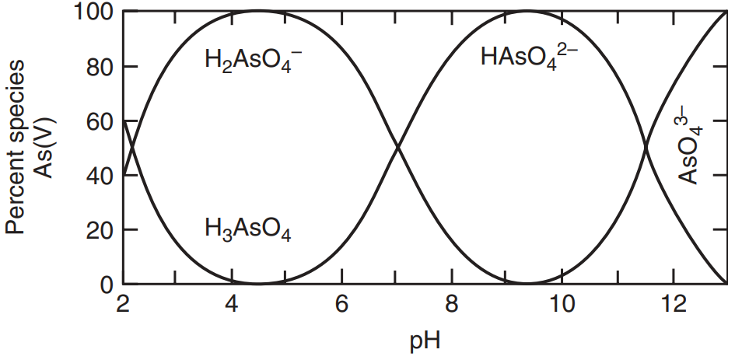
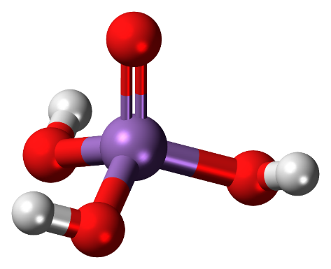
Arsenic(V) acid reactions (Arsenate)
These are easier to remove with Al and Fe
Notes:
Which species dominate a neutral pH?
Species graph from MWH page 1536, Figure 20-1 Predominance diagram for As(III) and As(V) as function of pH. (Adapted from Gupta and Chen, 1978.)
Stick diagram By Jynto (talk) - Own workThis image was created with Discovery Studio Visualizer., CC0, https://commons.wikimedia.org/w/index.php?curid=15368424

Slide 22
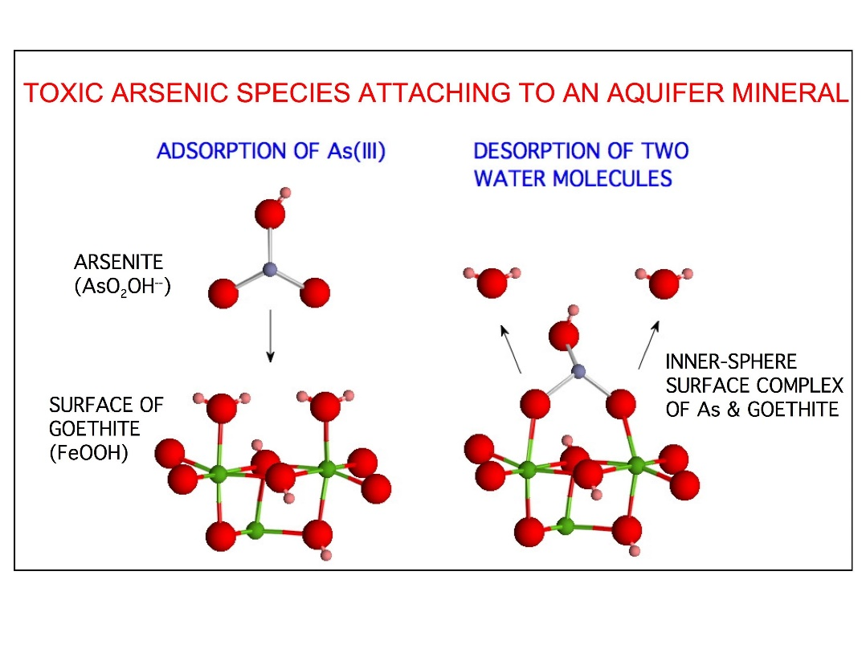
Inner and Outer Sphere Complexes
Inner sphere: molecule forms covalent bonds with the molecules in the surface of aluminum or iron hydroxide
Strong bond
Outer sphere: a water molecule remains between the arsenic and aluminum or iron hydroxide
Transient bond
Not strong enough to displace water
Although this figure is for an aquifer material it would equally apply to an aluminum or iron coagulant precipitate.
Notes:
https://pages.jh.edu/~dsverje1/curr_res.html
What pH would this occur
pH of 10!

Slide 23


Arsenic displaces water molecules to bind with Al and Fe
Negatively charged oxygen in or binds with Fe or Al atom in coagulant nanoparticle
Hydrogens on the Oxygen atoms impede the connection
Thus and are poorly removed
Notes:
https://pages.jh.edu/~dsverje1/curr_res.html
https://commons.wikimedia.org/wiki/File:Arsenous-acid-3D-balls.png
How does As molecule push the water away? Must have stronger bonds. The bonds are polar bonds

Slide 24
Pauling Electronegativity Values
Hydrated oxides of polyvalent metals like Fe(III), Al(III), Ti(IV) and Zr(IV) exhibit ligand sorption properties by forming inner-sphere complexes
H 2.1
Li 1.0 | Be 1.6 |  |  |  |  |  |  |  |  |  |  | B 2.0 | C 2.50 | N 3.0 | O 3.5 | F 4.0
Na 0.9 | Mg 1.3 |  |  |  |  |  |  |  |  |  |  | Al 1.6 | Si 1.9 | P 2.2 | S 2.5 | Cl 3.0
K 0.8 | Ca 1.3 | Sc 1.4 | Ti 1.5 | V 1.6 | Cr 1.7 | Mn 1.6 | Fe 1.8 | Co 1.9 | Ni 1.9 | Cu 1.9 | Zn 1.7 | Ga 1.6 | Ge 2.0 | As 2.2 | Se 2.6 | Br 2.8
Rb 0.8 | Sr 1.0 | Y 1.2 | Zr 1.3 | Nb 1.6 | Mo 2.2 | Te 2.1 | Ru 2.2 | Rh 2.3 | Pd 2.2 | Ag 1.9 | Cd 1.7 | In 1.8 | Sn 2.0 | Sb 2.1 | Te 2.1 | I 2.7
Cs 0.8 | Ba 0.9 | La 1.1 | Hf 1.3 | Ta 1.5 | W 1.7 | Re 1.9 | Os 2.2 | Ir 2.2 | Pt 2.2 | Au 2.4 | Hg 1.9 | Tl 2.0 | Pb 2.3 | Bi 2.0 | Po 2.0 | At 2.2
These metals have low electronegativity, lower than hydrogen!
Thus the oxygen in and are more negative than the oxygen in water
Notes:
https://chem.libretexts.org/Bookshelves/Physical_and_Theoretical_Chemistry_Textbook_Maps/Supplemental_Modules_(Physical_and_Theoretical_Chemistry)/Physical_Properties_of_Matter/Atomic_and_Molecular_Properties/Electronegativity/Allred-Rochow_Electronegativity

Slide 25
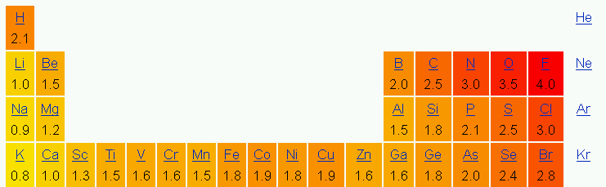
More polar than water?
Fe(III), Al(III), Ti(IV) and Zr(IV) are very weakly electronegative and thus oxygen keeps all of the electrons
Hypothesis*: intermolecular covalent bonds between oxygen and aluminum are stronger than intermolecular polar bonds between oxygen and hydrogen
Therefore Fe(III), Al(III), Ti(IV), and Zr(IV) hydroxides will displace water that is bound to a surface to form inner sphere complexes
O - H = 3.5 - 2.1 = 1.4
Polarity of water
O - Al = 3.5 – 1.5 = 2
Polarity of Al(OH)₃
* Edge of knowledge alert

Slide 26
Conclusions
As can be removed by creating bonds with Al or Fe
Hazardous waste minimization and management are critical issues
Removing As with flocculation/filtration results in dilute waste
Removing As with flocculation/sedimentation may be challenging if the flocs are low density
Why does it take 580 moles of Al to remove 1 mole of As?

