Slide 1
Introduction

Slide 2
History of this class
None

Slide 3
Pedagogy
“When we education engineers, we frequently emphasize predefined, decontextualized, closed-ended technical problem solving... Yet practicing engineers work to define and solve complex contextualized, open-ended sociotechnical problems.” - Jon A Leydens & Juan C. Lucena
Life is not a lecture and a problem set
Life is a flipped classroom
My role is to be a guide by your side
Notes:
Engineering Justice Transforming Engineering Education and Practice
Jon A Leydens, Juan C. Lucena IEEE PCS Professional Engineering Communication Series: Traci Nathans-Kelly, Series Editor (2018)

Slide 4
Reflections on Life Long Learning
How did you learn when you were 3?
How will you learn when you are 30?
The widget model of education
How do you want to respond when you need to do something that you’ve never done before or when you are asked to solve a problem that is completely new to you (and there aren’t office hours)?
Just in time learning

Slide 5
What is wrong with the widget model?
Notes:
It assumes that the problems that need to be solved have already been solved in the textbooks.
It is the same fallacy as the idea that we can close the patent office.
When there is a new problem it is time to hire a new widget.
Fails to recognize our ability to learn

Slide 6
Why are there lectures? Why am I called a senior lecturer?
What was the historical context?
Why were lecturers necessary?

Slide 7
Given the printing press (and the internet), how should a course be designed?
Course design
Role of instructor
Notes:
Have students work on this in teams. Think about
What should be done in class time?
What type of educational activities or learning opportunities should be provided?
Type of prelims
What is my role?
Librarian (curator of resources)
Devise authentic learning experiences (What does authentic mean)
Goal is to develop skills that will translate to new problems.
NOT FE exam style prblems

Slide 8
A Capstone: A culminating design experience with a real project

Slide 9
Water Treatment
With a focus on physical chemical processes
For water that might be destined for municipal drinking water or injection into an aquifer, or return to a pristine lake
Working with an engineering firm in the United States

Slide 10
An introduction to water quality and traditional treatment technologies
Water Quality Considerations
EPA Primary & Secondary MCL; State Primacy Enforcement (Chapter 1 – 4 )
Unregulated Water Quality Issues (Chapter 1 – 4)
Emerging Contaminants (Chapter 4, 20)
Conventional Water Treatment Processes (focus on particles and pathogens)
Screening, Coagulation, Flocculation (Chapter 9)
Sedimentation (Chapter 10)
Granular Filtration (chapter 11)
Membrane Filtration (Chapter 12)
Disinfection (Chapter 13)
Advanced Treatment Technologies (focus on dissolved species and chemicals)
Granular Activated Carbon (Chapter 15)
Ion Exchange Resins (Chapter 16)
High Pressure Membranes (Chapter 17)
Advanced Oxidation Process (Chapter 18)
Water Treatment Process Design Procedure (Chapter 23)

Slide 11
My experience with the predecessor of this course in 1985
I felt like I didn’t really know how to design any of the unit processes
I certainly didn’t know what would happen if I tweaked the design

Slide 12
How did I know that I didn’t know how to design???
Before I studied engineering I built furniture in a wood shop
When you build things you quickly learn that there aren’t ANY dimensions that can be set to any value you want
ALL DIMENSIONS MATTER
So I learned how to design a flocculator…

Slide 13
Flocculator design 101
30 minute residence time
3 equal sized tanks (10 minutes each) with mixers in each flocculator
3 different power inputs (tapered flocculation)
Design flow (let’s take 1000 L/s)
Maybe 2 treatment trains (500 L/s each)
Each tank is 600 s * 500 L/s = 300,000 L = 300 cubic meters
Random 6 m deep and 7x7 square
Done

Slide 14
The tanks each have 3 dimensions I only knew the volume!
There were 2 more degrees of freedom
How might those be selected in the real world?
Notes:
Brainstorm
Dimensions that are better for uniform mixing?
How do the flocculators fit in with the rest of the water treatment plant? (both plan view and elevation view)
Might it make sense to have the sed tanks and the flocculator share the same bottom elevation for ease of construction?

Slide 15
Resources Matrix
We have multiple resources (and, of course, the internet)
MWH
AguaClara
Lectures given in a previous version of this course
EPA Water Treatability Database

Slide 16
How do consulting firms, construction firms, venders, municipalities (clients) create a project?

Slide 17
How do you skim and evaluate the resources? Skepticism!
Traditional explanations of rapid mix, flocculation, floc blankets, and sand filtration should be viewed with skepticism because none of those processes have been well understood

Slide 18
Aware of what we know
Unknown
Knowns
Known
Knowns
Things that we think we understand that we don’t actually understand
Unknown – (Knowledge) - Known
Unknown
unknowns
Known
unknowns
Unaware – (Awareness) - Aware

Slide 19
What I thought I knew
Flocculation is charge neutralization
Unknown – (Knowledge) - Known
Observations are inconsistent with charge neutralization
Unaware – (Awareness) - Aware

Slide 20
Aware of what I know
New flocculation model
Unknown – (Knowledge) - Known
Observations are inconsistent with charge neutralization
Flocculation is charge neutralization
Unaware – (Awareness) - Aware

Slide 21
Reflections
What is something that you were confident that you knew that you then realized was incorrect?
What helped you realize your mistake?

Slide 22
Signs that we are still figuring it out…
Lots of mechanisms that are all supposedly important
Example: slow sand filters: biofilms, predation, straining
Principle: usually one mechanism dominates in a process
Lots of equations, but no equations that lead to a design
Example: rapid sand filtration, flocculation, plate settlers
Principle: If the physics are understood, then equations for the design can be obtained
What went wrong: Known principles applied to a new problem where those principles don’t apply
Notes:
Filtration equations only describe clean bed, but can’t predict how long a filter run will last or how deep the filter should be
Flocculation equations couldn’t predict the settled water turbidity.
Flocculation equations can’t predict the optimal velocity gradient
Plate settler equations couldn’t predict the

Slide 23
So we are on an adventure

Slide 24
Generalize the design process
Water Source
Possible Unit Processes
Contaminants
Select Unit Processes
Disinfection Complications
Regulations
Sequence the unit processes
Client needs
Distribution Complications

Slide 25
Unit Processes
Rapid sand
Trash rack
Flocculation
Sedimentation
Slow sand
Membrane
Activated Carbon
Ion Exchange
Reverse Osmosis
Reverse Osmosis
Notes:
a. Screening, Coagulation, Flocculation (Chapter 9)
b. Sedimentation (Chapter 10)
c. Granular Filtration (chapter 11)
d. Membrane Filtration (Chapter 12)
e. Disinfection (Chapter 13)
3. Advanced Treatment Technologies (focus on dissolved species and chemicals)
a. Granular Activated Carbon (Chapter 15)
b. Ion Exchange Resins (Chapter 16)
c. High Pressure Membranes (Chapter 17)
d. Advanced Oxidation Process (Chapter 18)
4. Water Treatment Process Design Procedure (Chapter 23)

Slide 26
For each unit process
Concept: how does it work?
Types of contaminants that can be treated
Range of approach velocities
Range of hydraulic residence times
Energy required (J/L)
Inputs required or method of regeneration
Type of waste stream produced and disposal requirements

Slide 28
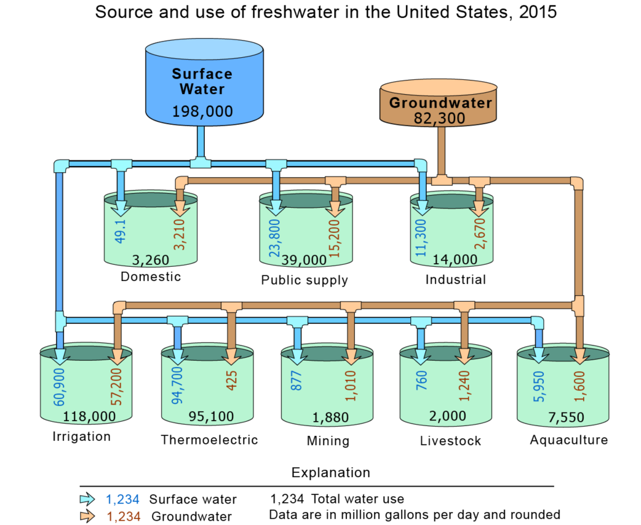
Water sources
https://www.usgs.gov/special-topic/water-science-school/science/groundwater-use-united-states?qt-science_center_objects=0#qt-science_center_objects

