Slide 1

Fluid Mechanics
CEE 331
December 18, 2012

Slide 2
Course Logistics
Instructor
Monroe Weber-Shirk (HO 115)
Teaching Assistant
Seth Schweitzer (HO 113)
section, labs, homework grading, and office hours
Where can you get the latest updates?
CEE 331 web site
Introductions…
http://ceeserver.cee.cornell.edu/mw24/cee331/

Slide 3
Section/Laboratory Organization
Laboratory (Tuesdays)
Hollister 150 (Environmental Teaching Laboratory)
Section (Thursdays)
Hollister 162
Discuss questions, work on examples and homework, review for exams

Slide 4
Hands-on Laboratory Experiments
Statics
Static Surface Forces
Free Jet and Bernoulli
Momentum and Energy Conservation:
Determination of the Friction Factor
Hydraulic jump

Slide 5
Homework
Your chance to practice using the concepts presented in class
Teamwork with one solution per team
Many of the problems are taken from old exams
Guidelines at the web site!!!

Slide 6
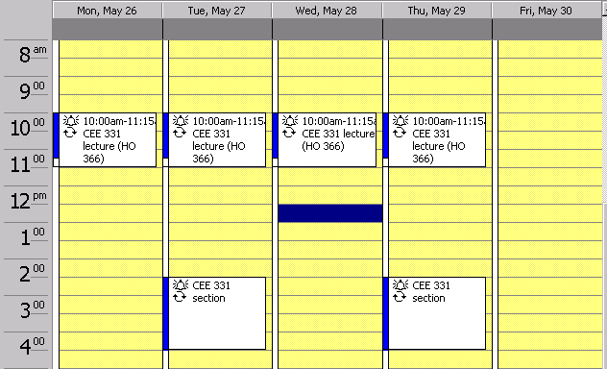
Course Schedule
Homework due
Exams, lec
HO 162
162
162
162
162
Office hours
HO 114
Lab HO 150
162

Slide 7
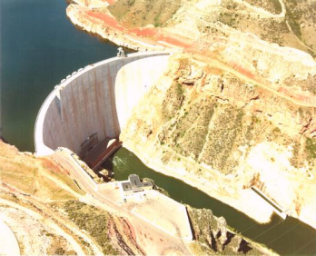
Why Fluids?
Brainstorm a list of engineered or biological devices that require an understanding of fluids to explain how they work.
What fluids properties do you think would be important in explaining each of the devices?

Slide 8
Course Topics
Fluid Properties
Statics
Explain the advantage of radial gates
Bernoulli Equation
Explain why a ping-pong ball can be held in an air jet
Control Volume Analysis
Quantify the effects of mass, momentum and energy flux
Explain why lawn sprinklers rotate

Slide 9
Course Topics
Pipe Flow
How big does the tunnel have to be that carries drinking water into NYC?
External Flows
How much power does it take to drive a Toyota Matrix at 100 kph?
Open Channel Flow
How deep will the water be in Fall Creek during a spring snow melt caused by a warm rain?

Slide 10
My Goals for the next six weeks...
That each of you develop an intuition for the fundamental principles of fluid mechanics
That you leave this course saying, “Fluids are fascinating” and “I can tackle fluids problems.”
That we have an enjoyable 6 weeks learning together

Slide 11

Dams and Reservoirs

Slide 12
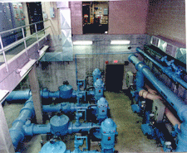
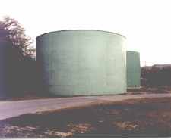
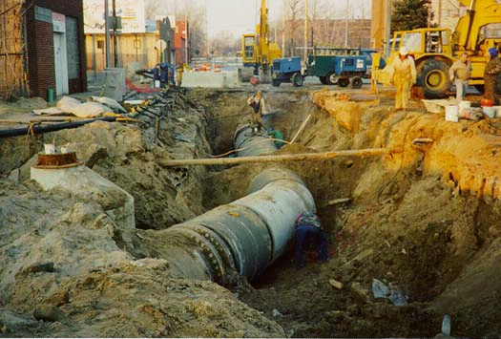
Water Distribution

Slide 13
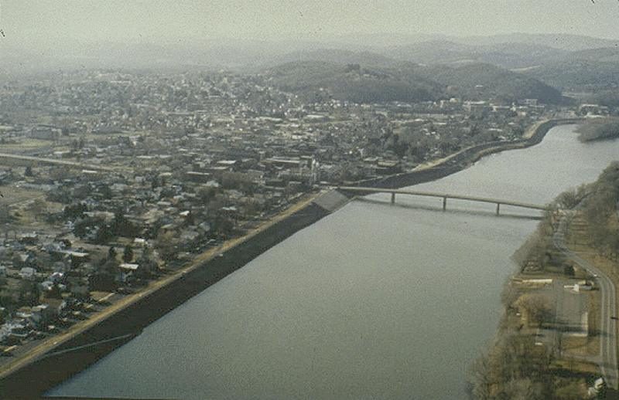
Lock Haven Flood Protection Project
Cost: $85M
http://www.nab.usace.army.mil/pbriefs/lhfloodpro.html

Slide 14
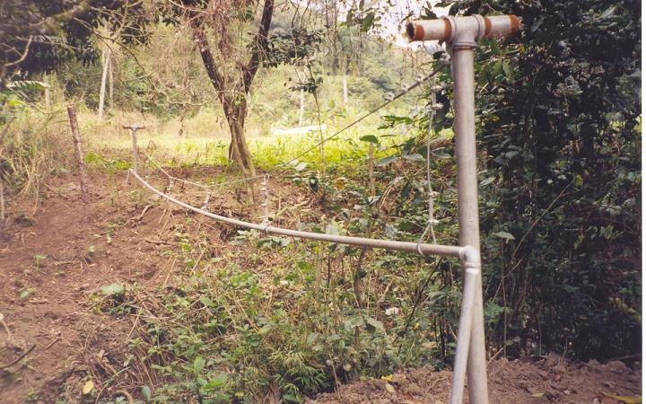
Stream Crossing
Joanna Mauer – Peace Corp volunteer in the Dominican Republic

Slide 15
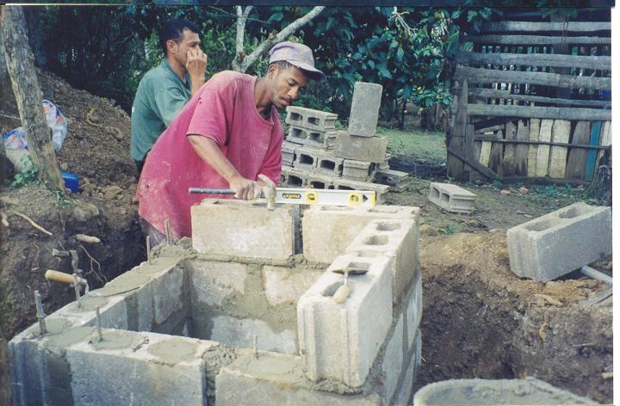
Pressure Break
Joanna Mauer – Peace Corp volunteer in the Dominican Republic

Slide 16
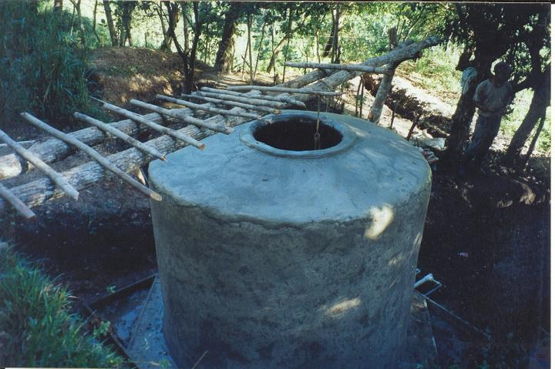
Tank
Joanna Mauer – Peace Corp volunteer in the Dominican Republic

Slide 17
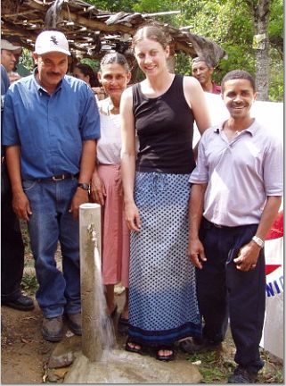
Inauguration
Joanna Mauer – Peace Corp volunteer in the Dominican Republic

