Slide 1

Fluid Properties and Units
CEE 331
December 18, 2012

Slide 2
Dimensions and Units
The dimensions have to be the same for each term in an equation
Dimensions of mechanics are
length
time
mass
force
temperature
L
T
M
MLT⁻²
Θ

Slide 3
Dimensions and Units
Quantity Symbol Dimensions
Velocity V LT⁻¹
Acceleration a LT⁻²
Area A L²
Volume ∀ L³
Discharge Q L³T⁻¹
Pressure p ML⁻¹T⁻²
Gravity g LT⁻²
Temperature T’ Θ
Mass concentration C ML⁻³
Show this!

Slide 4
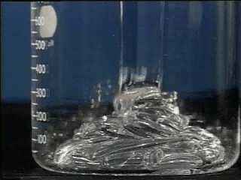
Dimensions and Units
Quantity Symbol Dimensions
Density ρ ML⁻³
Specific Weight γ ML⁻²T⁻²
Dynamic viscosity μ ML⁻¹T⁻¹
Kinematic viscosity ν L²T⁻¹
Surface tension σ MT⁻²
Bulk mod of elasticity E ML⁻¹T⁻²
fluid
These are _______ properties!
4
How many independent properties? _____

Slide 5
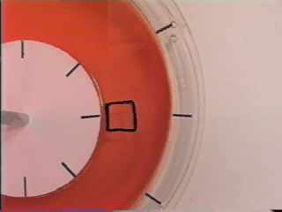
Definition of a Fluid
“a fluid, such as water or air, deforms continuously when acted on by shearing stresses of any magnitude.” - Young, Munson, Okiishi
Why isn’t steel a fluid?
Notes:
what is this?

Slide 6
Fluid Deformation between Parallel Plates
F
U
t
Side view
F
=
Force F causes the top plate to have velocity U.
What other parameters control how much force is required to get a desired velocity?
Distance between plates (t)
If this parameter increases, what does F do?
Area of plates (A)
Viscosity! (μ)

Slide 7
Shear Stress
dimension of
Tangential force per unit area
Rate of angular deformation
change in velocity with respect to distance
rate of shear
Our general equation relating shear and viscosity

Slide 8
Fluid Viscosity
Examples of highly viscous fluids
______________________________
Fundamental mechanisms
Gases - transfer of molecular momentum
Viscosity __________ as temperature increases.
Viscosity __________ as pressure increases.
Liquids - cohesion and momentum transfer
Viscosity decreases as temperature increases.
Relatively independent of pressure (incompressible)
molasses, tar, 20w-50 oil, glycerin
increases
increases
_______

Slide 9
Example: Measure the viscosity of water
Outer cylinder
The inner cylinder is 10 cm in diameter and rotates at 10 rpm. The fluid layer is 2 mm thick and 20 cm high. The power required to turn the inner cylinder is 100x10⁻⁶ watts. What is the dynamic viscosity of the fluid?
Inner cylinder
Thin layer of water

Slide 10
Solution Scheme
Restate the goal
Identify the given parameters and represent the parameters using symbols
Outline your solution including the equations describing the physical constraints and any simplifying assumptions
Solve for the unknown symbolically
Substitute numerical values with units and do the arithmetic
Check your units!
Check the reasonableness of your answer

Slide 11
Viscosity Measurement: Solution
Outer cylinder
ωr
2πrh
r = 5 cm
t = 2 mm
h = 20 cm
P = 100 x 10⁻⁶ W
10 rpm
Inner cylinder
Fωr
Thin layer of water

Slide 12
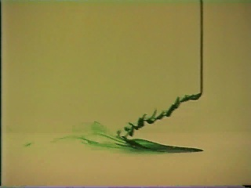
Role of Viscosity
Statics
Fluids at rest have no relative motion between layers of fluid and thus du/dy = 0
Therefore the shear stress is _____ and is independent of the fluid viscosity
Dynamics
Fluid viscosity is very important when the fluid is moving
zero

Slide 13
Dynamic and Kinematic Viscosity
nu
Kinematic viscosity (__) is a fluid property obtained by dividing the dynamic viscosity (__) by the fluid density
[m²/s]
Connection to Reynolds number!

Slide 14
Density and Specific Weight
1000
Density (mass/unit volume) ρ ___________
density of water:
density of air at atmospheric pressure and 15 °C:
Specific Weight of water (weight per unit volume) γ
__________________
990
980
Specific mass
Density (kg/m³)
970
1000 kg/m³
960
950
0
50
100
Temperature (C)
1000
1.22 kg/m³
999
Density (kg/m³)
998
997
γ = ρg = 9806 N/m³
0
10
20
Temperature (C)

Slide 15
Perfect Gas Law
Note deviation from the text!
PV = nRT
R is the universal gas constant
T is in Kelvin
M_{gas} is molecular mass
M_{gas} for air is 0.029 kg/mole
Why is this M_{gas} for air reasonable?
_______________________________
N₂ 28 g/mol, O₂ 32 g/mol

Slide 16
Bulk Modulus of Elasticity
Relates the change in volume to a change in pressure
changes in density at high pressure
pressure waves
_________
______ __________
2.35
2.30
2.25
2.20
Bulk Modulus of elasticity (GPa)
2.15
Water
sound
2.10
2.05
water hammer
2.00
0
20
40
60
80
100
How much does water compress?
Temperature (C)

Slide 17
Compression and Expansion of Gases: What is E_{v}?
Isothermal (constant temperature)
Isentropic (no heat exchanged)
where
(specific heat ratio)

Slide 18
Speed of Sound (c)
and
. Solve for
c is large for difficult to compress fluids
For gasses, if no heat exchanged (isentropic) then we have
It can be shown that (homework)
Connection to Mach number!

Slide 19
Vapor Pressure
8000
7000
6000
water
5000
Vapor pressure (Pa)
4000
3000
liquid
2000
1000
0
0
10
20
30
40
Temperature (C)
What is vapor pressure of water at 100°C?
101 kPa
Cavitation!
When absolute pressure increases to exceed vapor pressure

Slide 20

Surface Tension
Pressure increase in a spherical droplet
0.080
0.075
0.070
Surface tension (N/m)
0.065
0.060
F_{p}=
ΔpπR²
0.055
0.050
F_{σ}=
2πRσ
0
20
40
60
80
100
Temperature (C)
Surface molecules
ΔpπR² = 2πRσ

Slide 21
Example: Surface Tension
Estimate the difference in pressure (in Pa) between the inside and outside of a bubble of air in 20ºC water. The air bubble is 0.3 mm in diameter.
σ = 0.073 N/m
R = 0.15 x 10⁻³ m
What is the difference between pressure in a water droplet and pressure in an air bubble?

Slide 22
Review: Fluid Properties
Viscosity
Density and Specific Weight
Elasticity
Vapor Pressure
Surface Tension

