Slide 1
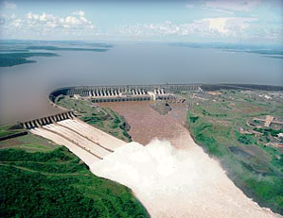
Statics
CEE 331
December 18, 2012

Slide 2
Definitions and Applications
Statics: no relative motion between adjacent fluid layers.
Shear stress is zero
Only _______ can be acting on fluid surfaces
Gravity force acts on the fluid (____ force)
Applications:
Pressure variation within a reservoir
Forces on submerged surfaces
Tensile stress on pipe walls
Buoyant forces
pressure
body

Slide 3
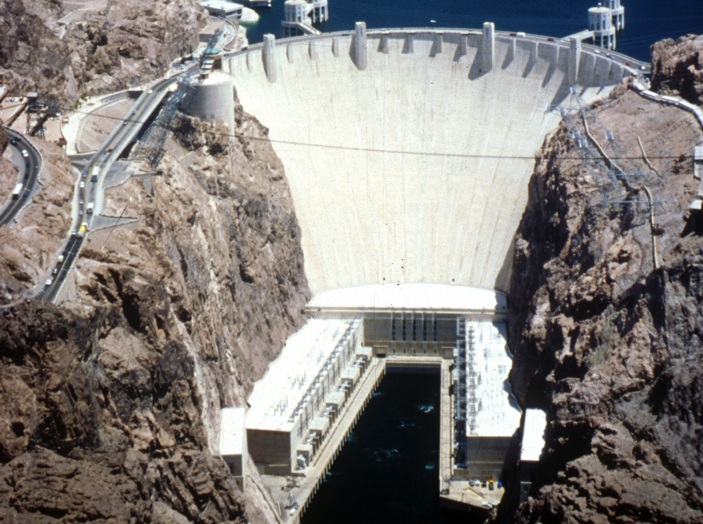
Motivation?
What are the pressure forces behind the Hoover Dam?

Slide 4
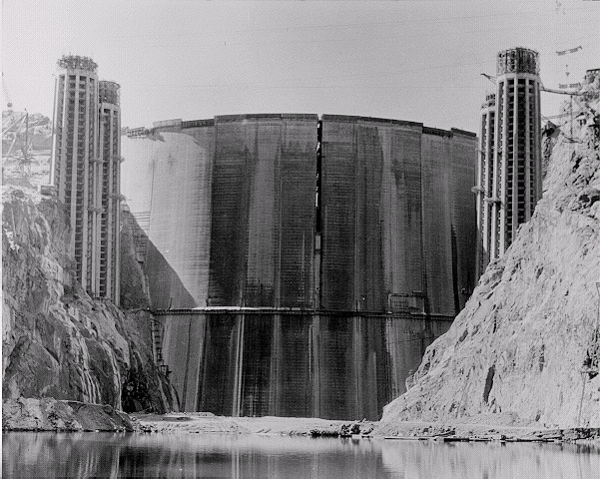
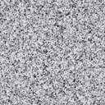
Upstream face of Hoover Dam
Crest thickness: 13.7 m
Base thickness: 201 m
WHY???
Upstream face of Hoover Dam in 1935

Slide 5
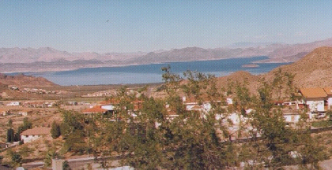
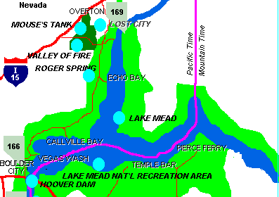
What do you think?
Lake Mead, the lake behind Hoover Dam, is the world's largest artificial body of water by volume (35 km³). Is the pressure at the base of Hoover Dam affected by the volume of water in Lake Mead?

Slide 6
What do we need to know?
Pressure variation with direction
Pressure variation with location
How can we calculate the total force on a submerged surface?

Slide 7
Pressure Variation with Direction (Pascal’s law)
Surface forces
Equation of Motion
y
F = ma
Body forces
p_{s}δs
p_{x}δy
δy
δs
p_{x}δy - p_{s}δs sinθ
δx
θ
x
p_{y}δx
Pressure is independent of direction!

Slide 8
Pressure Field (pressure variation with location)
In the absence of shearing forces (no relative motion between fluid particles) what causes pressure variation within a fluid?
Consider a soda can in space…
Throw the soda can to another astronaut…
Throw the soda can toward the moon
What causes pressure gradients?

Slide 9
Pressure Field
Small element of fluid in pressure gradient with arbitrary __________.
Forces acting on surfaces of element
acceleration
z
Pressure is p at center of element
Mass…
y
x
Now let’s sum the forces in the y direction
Same in x!

Slide 10
Simplify the expression for the force acting on the element
Same in xyz!
This begs for vector notation!
Forces acting on element of fluid due to pressure gradient

Slide 11
Apply Newton’s Second Law
A surface of constant pressure?
Obtain a general vector expression relating pressure gradient to acceleration and write the 3 component equations.
Mass of element of fluid
Substitute into Newton’s 2nd Law
Text version of eq.
3 component equations
Pressure in direction of a.
We are effectively accelerating upward at g when we are “at rest” on earth’s surface!
At rest

Slide 12
Pressure Variation When the Specific Weight is Constant
What are the two things that could make specific weight (γ) vary in a fluid?
γ = ρg
Changing density
Changing gravity
Constant specific weight!
Piezometric head is constant in a static incompressible fluid
Generalize to any a!

Slide 13

Example: Pressure at the bottom of a Tank of Water?
z
Free surface
1
Does the pressure at the bottom of the tank increase if the diameter of the tank increases?
No!
h
What is the pressure at the top of the tank?
Suppose I define pressure and elevation as zero at the water surface. What is the piezometric head everywhere in the tank?
2
Zero!

Slide 14
Units and Scales of Pressure Measurement
Gage pressure
Absolute pressure
Standard atmospheric pressure
1 atmosphere
101.325 kPa
14.7 psi
______ m H₂0
760 mm Hg
Local atmospheric pressure
Suction vacuum
(gage pressure)
10.34
Local barometer reading
Absolute zero (complete vacuum)
6894.76 Pa/psi

Slide 15
Mercury Barometer (team work)
What is the local atmospheric pressure (in kPa) when R is 750 mm Hg?
2
Assume constant ρ
P₂ = Hg vapor pressure
R
1

Slide 16
Pressure Variation in a Compressible Fluid
Perfect gas at constant temperature (Isothermal)
Perfect gas with constant temperature gradient

Slide 17
Perfect Gas at Constant Temperature (Isothermal)
ρ is function of p
M_{gas} is molecular mass
Integrate…

Slide 18
Perfect Gas with Constant Temperature Gradient
The atmosphere can be modeled as having a constant temperature gradient
β = 0.00650 K/m
Lapse rate
Mt. Everest
8,850 m

Slide 19
Pressure Measurement
Barometers
Manometers
Standard
Differential
Pressure Transducers
Measure atmospheric pressure
Pressure relative to atm.
Pressure difference between 2 pts.

Slide 20
Standard Manometers
gage
What is the pressure at A given h?
Pressure in water distribution systems commonly varies between 25 and 100 psi (175 to 700 kPa). How high would the water rise in a manometer connected to a pipe containing water at 500 kPa?
p = γh
h
h = p/γ
A
h = 500,000 Pa/(9800 N/m³)
h = 51 m
Why is this a reasonable pressure?

Slide 21
Manometers for High Pressures
Find the gage pressure in the center of the sphere. The sphere contains fluid with γ₁ and the manometer contains fluid with γ₂.
What do you know? _____
Use statics to find other pressures.
1
γ₂
P₁ = 0
?
h₁
3
γ₁
h₂
P₁
+ h₁γ₂
- h₂γ₁
=P₃
2
For small h₁ use fluid with high density.
Mercury!

Slide 22
Differential Manometers
p₁
Water
p₂
h₃
orifice
h₁
h₂
Mercury
Find the drop in pressure between point 1 and point 2.
p₁
+ h₁γ_{w}
- h₂γ_{Hg}
- h₃γ_{w}
= p₂
p₁ - p₂ = (h₃-h₁)γ_{w} + h₂γ_{Hg}
p₁ - p₂ = h₂(γ_{Hg} - γ_{w})

Slide 23
Procedure to keep track of pressures
Start at a known point or at one end of the system and write the pressure there using an appropriate symbol
Add to this the change in pressure to the next meniscus (plus if the next meniscus is lower, and minus if higher)
Continue until the other end of the gage is reached and equate the expression to the pressure at that point
p₁ + Δp = p₂

Slide 24
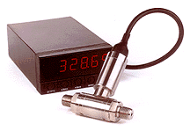
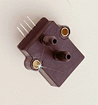
Pressure Transducers
Excitation: 10 Vdc regulated
Output: 100 millivolts
Accuracy: ±1% FS
Proof Pressure: 140 kPa (20 psi) for 7 kPa model
No Mercury!
Can be monitored easily by computer
Myriad of applications
Volume of liquid in a tank
Flow rates
Process monitoring and control
Full Scale

Slide 25
Types of Diaphragms Used for Pressure Measurements
Stainless Steel
Strain gages bonded to the stainless steel
Typical full scale output of 3 mV/V
Piezoresistive
Strain gage diffused into silicon wafers
Typical full scale output of 10 mV/V

Slide 26
Silicon
Ideal material for receiving the applied force
Perfect crystal
Returns to its initial shape (no hysteresis)
Good elasticity
No need for special bonding between material receiving force and strain gage

Slide 27
Pressure Sensor Failure
High pressures – rupture crystal (beware of resulting leak!)
Water hammer –
High speed pressure waves (speed of sound)
Result from flow transients such as rapidly shutting valves
Install pressure snubber!
Incompatible materials
Elastic tubing or gas chamber

Slide 28
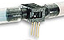
Absolute vs. Gage vs. Differential
Absolute
Port 2 sealed with vacuum on bottom side of silicon crystal
Gage
Port 2 open to atmosphere
Differential
Both ports connected to system
Port 1
Port 2

Slide 29
Summary for Statics
direction
Pressure is independent of
Pressure increases with
constant density
gas at constant temperature
gas with constant temperature gradient
Pressure scales
units
datum
Pressure measurement
depth
p = γh
Use ideal gas law

Slide 30
Review
Pressure increases or decreases as we move in the direction of the acceleration vector?
The free surface is _______ to the acceleration vector.
What is an equation that describes the change in pressure with depth in a fluid?
Suppose a tank of fuel is accelerating upward at 2g. What is the change in pressure with depth in the fuel?
normal

Slide 31
Statics example
What is the air pressure in the cave air pocket?

Slide 32
Statics Lab
How did the bubbler work?
How does the pressure sensor read pressure at the bottom of the tank?
Must the pump be running if the water depth is decreasing?

Slide 33
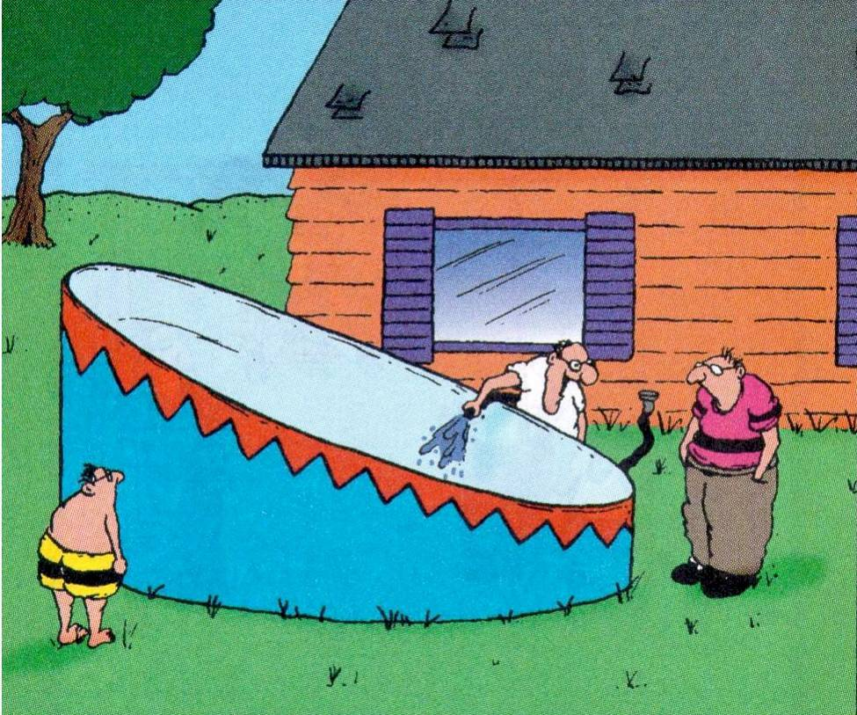
“Somebody finally got smart and came up with an above-ground pool that’s got a deep end and a shallow end.”

