Slide 1
Statics
hinge
?
Surface Forces

Slide 2
Static Surface Forces
Forces on plane areas
Forces on curved surfaces
Buoyant force
Stability submerged bodies

Slide 3
Forces on Plane Areas
Two types of problems
Horizontal surfaces (pressure is _______)
Inclined surfaces
Two unknowns
____________
____________
Two techniques to find the line of action of the resultant force
Moments
Pressure prism
constant
Total force
Line of action

Slide 4
Forces on Plane Areas: Horizontal surfaces
net
P = 500 kPa
What is the force on the bottom of this tank of water?
What is p?
gage
Side view
h
p = ρgh
F_{R}
= volume
h = _____________ _____________
Vertical distance to free surface
F_{R} =
weight of overlying fluid!
F is normal to the surface and towards the surface if p is positive.
A
centroid
F passes through the ________ of the area.
Top view

Slide 5
Forces on Plane Areas: Inclined Surfaces
Direction of force
Magnitude of force
integrate the pressure over the area
pressure is no longer constant!
Line of action
Moment of the resultant force must equal the moment of the distributed pressure force
Normal to the plane

Slide 6
Forces on Plane Areas: Inclined Surfaces
y
Where could I counteract pressure by supporting potato at a single point?
g
θ
x
y
centroid
The coordinate system origin is at the centroid (y_{c}=0)
center of pressure

Slide 7
Magnitude of Force on Inclined Plane Area
Change in pressure due to change in elevation
g
y
θ
for y origin at centroid
centroid of the area
p_{c} is the pressure at the __________________

Slide 8
First Moments
Moment of an area A about the y axis
Location of centroidal axis
Plate thickness
For a plate of uniform thickness the intersection of the centroidal axes is also the center of gravity

Slide 9
Second Moments
moment of inertia
Also called _______________ of the area
Could define i as I/A…
I_{xc} is the 2nd moment with respect to an axis passing through its centroid and parallel to the x axis.
The 2nd moment originates whenever one computes the moment of a distributed load that varies linearly from the moment axis.

Slide 10
Product of Inertia
A measure of the asymmetry of the area
Product of inertia
I_{xyc} = 0
I_{xyc} = 0
y
y
x
x
If x = x_{c} or y = y_{c} is an axis of symmetry then the product of inertia I_{xyc} is zero.______________________________________
(the resulting force will pass through x_{c})

Slide 11
Properties of Areas
b
I_{xc}
a
y_{c}
a
I_{xc}
y_{c}
b
d
R
I_{xc}
y_{c}

Slide 12
Properties of Areas
I_{xc}
y_{c}
R
b
a
I_{xc}
y_{c}
y_{c}
R

Slide 13
Forces on Plane Areas: Center of Pressure: x_{R}
The center of pressure is not at the centroid (because pressure is increasing with depth)
x coordinate of center of pressure: x_{R}
Moment of resultant = sum of moment of distributed forces

Slide 14
Center of Pressure: x_{R}
For x,y origin at centroid
x_{R} is zero if the x axis or y axis is a line of symmetry

Slide 15
Center of Pressure: y_{R}
Sum of the moments

Slide 16
Center of Pressure: y_{R}
g
F_{R}
θ
For y origin at centroid
Location of line of action is below centroid along slanted surface.
│y_{R} │ is distance between centroid and line of action
The moment about the centroid is independent of pressure!

Slide 17
Location of average pressure vs. line of action
0
1
2
3
4
5
6
7
8
9
10
What is the average depth of blocks?
3 blocks
Where does that average occur?
5
Where is the resultant?
Use moments

Slide 18
Inclined Surface Findings
0
The horizontal center of pressure and the horizontal centroid ________ when the x or y axis is a line of symmetry for the surface
The center of pressure is always _______ the centroid
The vertical distance between the centroid and the center of pressure _________ as the surface is lowered deeper into the liquid
The center of pressure is at the centroid for horizontal surfaces
coincide
below
>0
decreases

Slide 19
Example using Moments
An elliptical gate covers the end of a pipe 4 m in diameter. If the gate is hinged at the top, what normal force F applied at the bottom of the gate is required to open the gate when water is 8 m deep above the top of the pipe and the pipe is open to the atmosphere on the other side? Neglect the weight of the gate.
Solution Scheme
teams
-
Magnitude of the force applied by the water
hinge
8 m
water
Location of the resultant force
F
4 m
Find F using moments about hinge

Slide 20
Team Work
How will you define a coordinate system?
What is the pressure datum?
What are the major steps required to solve this problem?
What equations will you use for each step?
hinge
8 m
water
F
4 m

Slide 21
Magnitude of the Force
g
y
Pressure datum? _____ Y axis?
atm
8 m
water
hinge
F_{R}
θ
F
4 m
h_{c} = _____
Depth to the centroid
10 m
p_{c} = ___
a = 2.5 m
F_{R}= ________
1.54 MN
b = 2 m

Slide 22
Location of Resultant Force
g
hinge
8 m
water
F_{R}
4
p_{c} = ___
F
4 m
5
a = 2.5 m
cp
0.125 m
0
b = 2 m

Slide 23
Force Required to Open Gate
g
How do we find the required force?
hinge
8 m
water
F_{R}
Moments about the hinge
F
4 m
=Fl_{tot} - F_{R}l_{cp}
l_{cp}=2.625 m
2.5 m
l_{tot}
cp
F = ______
b = 2 m
809 kN

Slide 24
Forces on Plane Surfaces Review
The average magnitude of the pressure force is the pressure at the centroid
The horizontal location of the pressure force was at x_{c} (WHY?) ____________________ ___________________________________
The vertical location of the pressure force is below the centroid. (WHY?) ___________ ___________________
The gate was symmetrical about at least one of the centroidal axes.
Pressure increases with depth.

Slide 25
Forces on Curved Surfaces
Horizontal component
Vertical component
Tensile Stress in pipes and spheres

Slide 26
Forces on Curved Surfaces: Horizontal Component
What is the horizontal component of pressure force on a curved surface equal to? (Prove it!)
The center of pressure is located using the moment of inertia technique.
The horizontal component of pressure force on a closed body is _____.
teams
net
zero

Slide 27
Forces on Curved Surfaces: Vertical Component
What is the magnitude of the vertical component of force on the cup?
F = pA
h
p = ρgh
F = ρghπr²
=W!
r
What if the cup had sloping sides?
What if the cup bottom were a hemisphere?

Slide 28
Forces on Curved Surfaces: Vertical Component
The vertical component of pressure force on a curved surface is equal to the weight of liquid vertically above the curved surface and extending up to the
surface where the pressure is equal to the reference pressure.

Slide 29
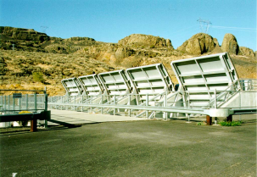
Example: Forces on Curved Surfaces
Find the resultant force (magnitude and location) on a 1 m wide section of the circular arc.
water
F_{V} =
W₁ + W₂
W₁
3 m
= (3 m)(2 m)(1 m)γ + π/4(2 m)²(1 m)γ
= 58.9 kN + 30.8 kN
2 m
= 89.7 kN
W₂
2 m
F_{H} =
= γ(4 m)(2 m)(1 m)
= 78.5 kN

Slide 30
Example: Forces on Curved Surfaces
The vertical component line of action goes through the centroid of the volume of water above the surface.
Expectation???
A
Take moments about a vertical axis through A.
water
3 m
W₁
2 m
W₂
2 m
= 0.948 m (measured from A) with magnitude of 89.7 kN

Slide 31
Example: Forces on Curved Surfaces
The location of the line of action of the horizontal component is given by
A
1
water
3 m
W₁
b
2 m
a
W₂
2 m
4 m
y
x

Slide 32
Example: Forces on Curved Surfaces
78.5 kN
horizontal
0.948 m
4.083 m
89.7 kN
vertical
119.2 kN
resultant

Slide 33
Cylindrical Surface Force Check
0.948 m
89.7kN
All pressure forces pass through point C.
The pressure force applies no moment about point C.
The resultant must pass through point C.
C
1.083 m
78.5kN
(78.5kN)(1.083m) - (89.7kN)(0.948m) = ___
0

Slide 34
Curved Surface Trick
Find force F required to open the gate.
The pressure forces and force F pass through O. Thus the hinge force must pass through O!
Hinge carries only horizontal forces! (F = ________)
A
water
3 m
W₁
O
2 m
F
W₂
W₁ + W₂

Slide 35
Tensile Stress in Pipes: High Pressure
pressure center is approximately at the center of the pipe
b
per unit length
2rp_{c}
(p_{c} is pressure at center of pipe)
F_{H} = ___
T₁
rp_{c}
r
T = ___
F_{H}
T₂
rp_{c}/e
(e is wall thickness)
σ = ____
σ is tensile stress in pipe wall
How does pipe wall thickness change with diameter?

Slide 36
Tensile Stress in Pipes: Low pressure
pressure center can be calculated using moments
T₂ __ T₁
b
>
2p_{c}r
F_{H} = ___
T₁
r
F_{H}
d
T₂
Projected area
d
Use moments to calculate T₁ and T₂.
b

Slide 37
Solution Scheme
Determine total acceleration vector (a) including acceleration of gravity
Locate centroid of the surface
Draw y axis with origin at the centroid (projection of total acceleration vector on the surface)
Set pressure datum equal to pressure on the other side of the surface of interest
Determine the pressure at the centroid of the surface
Calculate total force (p_{c}A)
Calculate y_{R}

Slide 38
Static Surface Forces Summary
Forces caused by gravity (or _______________) on submerged surfaces
horizontal surfaces (normal to total acceleration)
inclined surfaces (y coordinate has origin at centroid)
curved surfaces
Horizontal component
Vertical component (________________________)
total acceleration
A is projected area
weight of fluid above surface

Slide 39
Questions
What is p?
Why does F_{R} = Weight?
Why can we use projection to calculate the horizontal component?
How can we calculate F_{R} based on pressure at the centroid, but then say the line of action is below the centroid?
Side view
h
F_{R}

Slide 40

Review
How do the equations change if the surface is the bottom of an aquarium on a jet aircraft during takeoff? (accelerating at 4 m/s²)
Use total acceleration
h_{c}
θ
Alternate method?
y
Where is y?
a_{total}
g
θ = angle between and
a_{total} y
a_{total}
a_{jet}
The jet is pressurized…

Slide 41
Circular Port
P=-2 kPa
Equivalent problem
0.5 m
air
0.5 m
ρ = 800 kg/m³
ρ = 1000 kg/m³
1 m

Slide 42
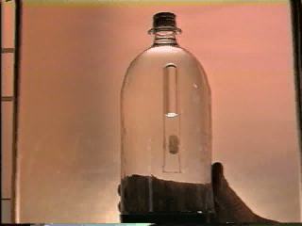
Buoyant Force
The resultant force exerted on a body by a static fluid in which it is fully or partially submerged
The projection of the body on a vertical plane is always ____.
The vertical components of pressure on the top and bottom surfaces are _________
zero
(Two surfaces cancel, net horizontal force is zero.)
different

Slide 43
Buoyant Force: Thought Experiment
Place a thin wall balloon filled with water in a tank of water.
What is the net force on the balloon? _______
Does the shape of the balloon matter? ________
What is the buoyant force on the balloon? _____________ _________
F_{B}
zero
no
Weight of water displaced

Slide 44
Buoyant Force: Line of Action
The buoyant force acts through the centroid of the displaced volume of fluid (center of buoyancy)
Moment of resultant = sum of moments of distributed forces
Definition of centroid of volume
∀ = volume
γd∀= distributed force
x_{c} = centroid of volume
If γ is constant!

Slide 45
Buoyant Force: Applications
F₁
F₂
γ₁ γ₂
Using buoyancy it is possible to determine:
_______ of an object
_______ of an object
_______________ of an object
>
∀γ₁
∀γ₂
W
W
Weight
Volume
Specific gravity
Force balance

Slide 46
Buoyant Force: Applications
(force balance)
Equate weights
Equate volumes
Suppose the specific weight of the first fluid is zero

Slide 47
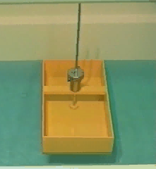
Rotational Stability of Submerged Bodies
A completely submerged body is stable when its center of gravity is _____ the center of buoyancy
below
B
B
G
G

Slide 48
Buoyant Force (Just for fun)
A sailboat is sailing on Cayuga Lake. The captain is in a hurry to get to shore and decides to cut the anchor off and toss it overboard to lighten the boat. Does the water level of Cayuga Lake increase or decrease?
Why?_______________________________ ____________________________________ ____________________
----------- ________
The anchor displaces less water when it is lying on the bottom of the lake than it did when in the boat.

Slide 49
End of Lecture
What didn’t you understand so far about statics?
Ask the person next to you
Circle any questions that still need answers

Slide 50
End of Lecture Question
Write an equation for the pressure acting on the bottom of a conical tank of water.
Write an equation for the total force acting on the bottom of the tank. (not including forces from the side walls)
d₁
Side view
L
d₂

Slide 51

Gates

Slide 52
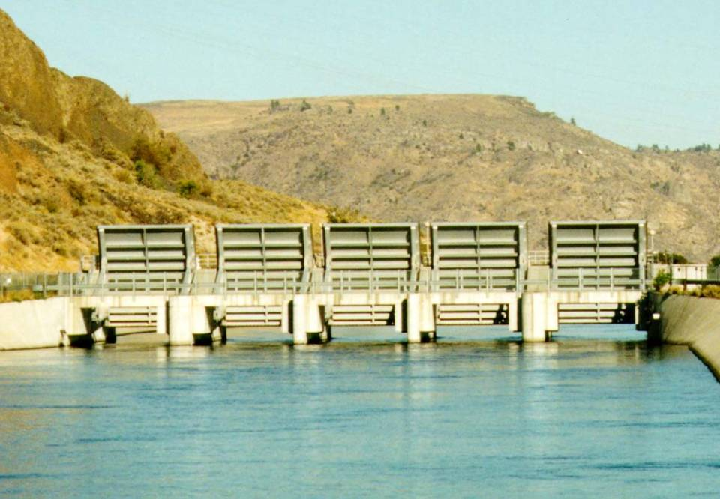
Gates

Slide 53
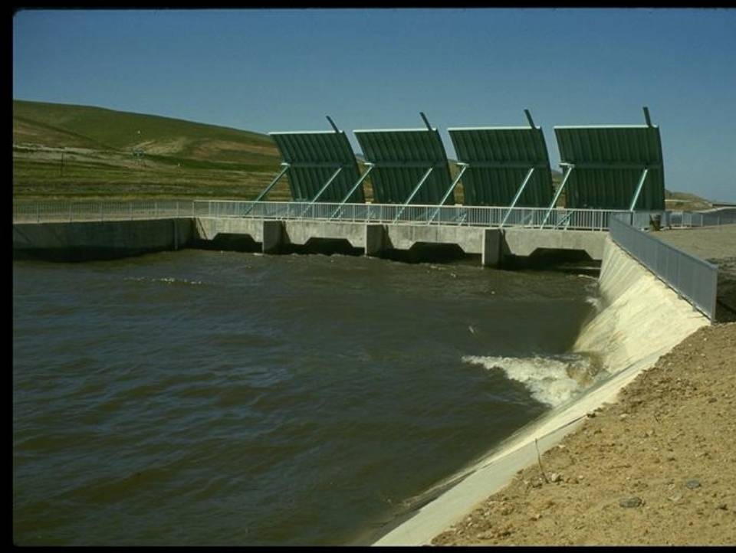
Radial Gates

Slide 54
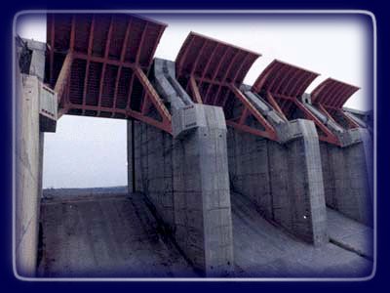
Gates at Itaipu: Why this shape?

