Slide 1
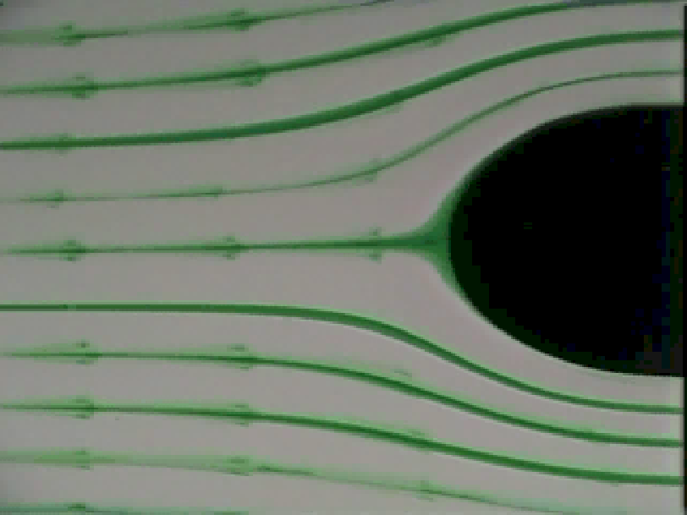
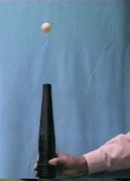
Elementary Fluid Dynamics: The Bernoulli Equation
CEE 331
September 7, 2015

Slide 2
Bernoulli Along a Streamline
z
Separate acceleration due to gravity. Coordinate system may be in any orientation!
k is vertical, s is in direction of flow, n is normal.
Component of g in s direction
Note: No shear forces! Therefore flow must be frictionless.
Steady state (no change in p wrt time)
y
x

Slide 3
Bernoulli Along a Streamline
Can we eliminate the partial derivative?
Chain rule
Write acceleration as derivative wrt s
0 (n is constant along streamline, dn=0)
and

Slide 4
Integrate F=ma Along a Streamline
Eliminate ds
Now let’s integrate…
But density is a function of ________.
pressure
If density is constant…

Slide 5
Bernoulli Equation
Assumptions needed for Bernoulli Equation
Eliminate the constant in the Bernoulli equation? _______________________________________
Bernoulli equation does not include
___________________________
___________________________
Frictionless
Steady
Constant density (incompressible)
Along a streamline
Apply at two points along a streamline.
Mechanical energy to thermal energy
Heat transfer, Shaft Work

Slide 6
Bernoulli Equation
The Bernoulli Equation is a statement of the conservation of ____________________
Mechanical Energy
p.e.
k.e.
Pressure head
Hydraulic Grade Line
Piezometric head
Elevation head
Energy Grade Line
Velocity head
Total head

Slide 7
Bernoulli Equation: Simple Case (V = 0)
z
Reservoir (V = 0)
Put one point on the surface, one point anywhere else
1
Pressure datum
2
Elevation datum
We didn’t cross any streamlines so this analysis is okay!
Same as we found using statics

Slide 8
Hydraulic and Energy Grade Lines (neglecting losses for now)
Mechanical energy
Mechanical Energy Conserved
The 2 cm diameter jet is 5 m lower than the surface of the reservoir. What is the flow rate (Q)?
z
Teams
z
Elevation datum
Atmospheric pressure
Pressure datum? __________________

Slide 9
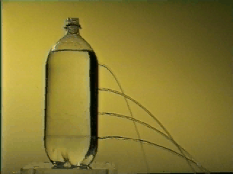
Bernoulli Equation: Simple Case (p = 0 or constant)
What is an example of a fluid experiencing a change in elevation, but remaining at a constant pressure? ________
Free jet

Slide 10
Bernoulli Equation Application: Stagnation Tube
What happens when the water starts flowing in the channel?
Does the orientation of the tube matter? _______
How high does the water rise in the stagnation tube?
How do we choose the points on the streamline?
Yes!
Stagnation point

Slide 11
Bernoulli Equation Application: Stagnation Tube
1a-2a
_______________
1b-2a
_______________
1a-2b
_______________ _____________
V = f(Δp)
2b
z
Same streamline
1b
V = f(Δp)
Crosses || streamlines
1a
2a
V = f(z₂)
Doesn’t cross streamlines
In all cases we don’t know p₁

Slide 12
Stagnation Tube
Great for measuring __________________
How could you measure Q?
Could you use a stagnation tube in a pipeline?
What problem might you encounter?
How could you modify the stagnation tube to solve the problem?
EGL (defined for a point)

Slide 13
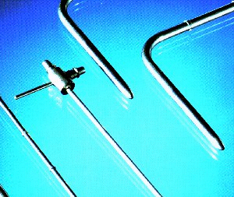
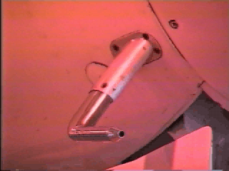
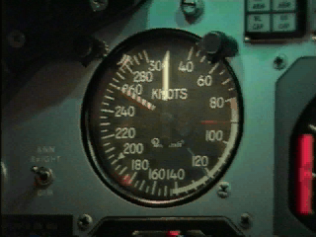
Pitot Tubes
Used to measure air speed on airplanes
Can connect a differential pressure transducer to directly measure V²/2g
Can be used to measure the flow of water in pipelines
Point measurement!

Slide 14
Pitot Tube
Stagnation pressure tap
Static pressure tap
2
V₁ =
0
V
1
z₁ = z₂
Connect two ports to differential pressure transducer. Make sure Pitot tube is completely filled with the fluid that is being measured.
Solve for velocity as function of pressure difference

Slide 15
Relaxed Assumptions for Bernoulli Equation
Frictionless (velocity not influenced by viscosity)
Steady
Constant density (incompressible)
Along a streamline
Small energy loss (accelerating flow, short distances)
Or gradually varying
Small changes in density
Don’t cross streamlines

Slide 16
Bernoulli Normal to the Streamlines
Separate acceleration due to gravity. Coordinate system may be in any orientation!
Component of g in n direction

Slide 17
Bernoulli Normal to the Streamlines
R is local radius of curvature
n is toward the center of the radius of curvature
0 (s is constant normal to streamline)

Slide 18
Integrate F=ma Normal to the Streamlines
Multiply by dn
Integrate
(If density is constant)

Slide 19
Pressure Change Across Streamlines
If you cross streamlines that are straight and parallel, then ___________ and the pressure is ____________.
n
r
hydrostatic
As r decreases p ______________
decreases

Slide 20
End of pipeline?
What must be happening when a horizontal pipe discharges to the atmosphere?
Try applying statics…
(assume straight streamlines)
Streamlines must be curved!

Slide 21
Nozzle Flow Rate: Find Q
z
1
Crossing streamlines
90 cm
D₁=30 cm
Along streamline
h
Q
2
3
Coordinate system
h=105 cm
D₂=10 cm
gage pressure
Pressure datum____________

Slide 22
Solution to Nozzle Flow
1
z
h=105 cm
D₁=30 cm
3
Q
2
D₂=10 cm
Now along the streamline
Two unknowns…
_______________
h
Mass conservation

Slide 23
Solution to Nozzle Flow (continued)
1
z
h=105 cm
D₁=30 cm
3
Q
2
D₂=10 cm

Slide 24
Incorrect technique…
1
z
h=105 cm
D₁=30 cm
3
Q
2
D₂=10 cm
The constants of integration are not equal!

Slide 25
Bernoulli Equation Applications
Stagnation tube
Pitot tube
Free Jets
Orifice
Venturi
Sluice gate
Sharp-crested weir
Applicable to contracting streamlines (accelerating flow).

Slide 26
Ping Pong Ball
Teams
Why does the ping pong ball try to return to the center of the jet?
What forces are acting on the ball when it is not centered on the jet?
n
r
How does the ball choose the distance above the source of the jet?

Slide 27
Summary
By integrating F=ma along a streamline we found…
That energy can be converted between pressure, elevation, and velocity
That we can understand many simple flows by applying the Bernoulli equation
However, the Bernoulli equation can not be applied to flows where viscosity is large, where mechanical energy is converted into thermal energy, or where there is shaft work.
mechanical

Slide 28
Jet Problem
How could you choose your elevation datum to help simplify the problem?
How can you pick 2 locations where you know enough of the parameters to solve for the velocity?
You have one equation (so one unknown!)

Slide 29
Jet Solution
The 2 cm diameter jet is 5 m lower than the surface of the reservoir. What is the flow rate (Q)?
z
Elevation datum
Are the 2 points on the same streamline?

Slide 30
What is the radius of curvature at the end of the pipe?
1
z
h=105 cm
D₁=30 cm
3
Q
Uniform velocity
2
D₂=10 cm
Assume R>>D₂
1
2
R

Slide 31
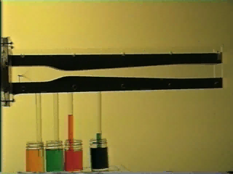
Example: Venturi

Slide 32
Example: Venturi
How would you find the flow (Q) given the pressure drop between point 1 and 2 and the diameters of the two sections? You may assume the head loss is negligible. Draw the EGL and the HGL over the contracting section of the Venturi.
How many unknowns?
What equations will you use?
Δh
1
2

Slide 33
Example Venturi

