Slide 1
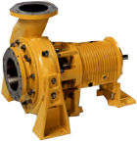
Finite Control Volume Analysis
Application of Reynolds Transport Theorem
CEE 331
September 7, 2015

Slide 2
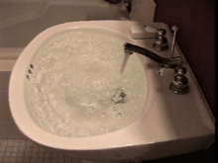
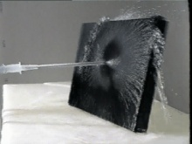
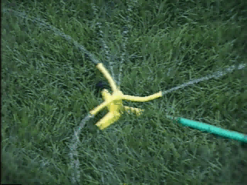

Moving from a System to a Control Volume
Mass
Linear Momentum
Moment of Momentum
Energy
Putting it all together!

Slide 3

Conservation of Mass
B = Total amount of ____ in the system
b = ____ per unit mass = __
mass
mass
1
cv equation
But DM_{sys}/Dt = 0!
Continuity Equation
mass leaving - mass entering = - rate of increase of mass in cv

Slide 4
Conservation of Mass
If mass in cv is constant
2
1
V₁
A₁
Unit vector is ______ to surface and pointed ____ of cv
normal
[M/T]
out
ρ
We assumed uniform ___ on the control surface
is the spatially averaged velocity normal to the cs

Slide 5
Continuity Equation for Constant Density and Uniform Velocity
Density is constant across cs
Density is the same at cs₁ and cs₂
[L³/T]
Simple version of the continuity equation for conditions of constant density. It is understood that the velocities are either ________ or _______ ________.
uniform
spatially averaged

Slide 6
Example: Conservation of Mass?
The flow out of a reservoir is 2 L/s. The reservoir surface is 5 m x 5 m. How fast is the reservoir surface dropping?
h
Constant density
Velocity of the reservoir surface
Example

Slide 7
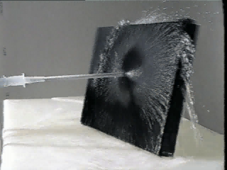
Linear Momentum Equation
cv equation
momentum
momentum/unit mass
Vectors!
Steady state
This is the “ma” side of the F = ma equation!

Slide 8
Linear Momentum Equation
Assumptions
Uniform density
Uniform velocity
V ⊥ A
Steady
V fluid velocity relative to cv
Vectors!!!

Slide 9
Steady Control Volume Form of Newton’s Second Law
What are the forces acting on the fluid in the control volume?
Gravity
Shear at the solid surfaces
Pressure at the solid surfaces
Pressure on the flow surfaces
Why no shear on control surfaces? _______________________________
No velocity tangent to control surface

Slide 10
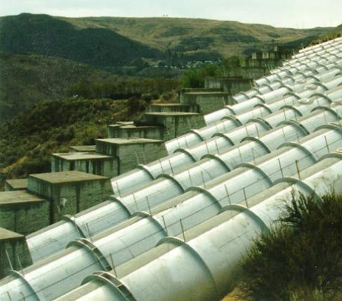
Resultant Force on the Solid Surfaces
The shear forces on the walls and the pressure forces on the walls are generally the unknowns
Often the problem is to calculate the total force exerted by the fluid on the solid surfaces
The magnitude and direction of the force determines
size of _____________needed to keep pipe in place
force on the vane of a pump or turbine...
thrust blocks
=force applied by solid surfaces

Slide 11
Linear Momentum Equation
F_{p2}
M₂
F_{ssx}
Forces by solid surfaces on fluid
The momentum vectors have the same direction as the velocity vectors
M₁
F_{ssy}
F_{p1}
W

Slide 12
Example: Reducing Elbow
2
Reducing elbow in vertical plane with water flow of 300 L/s. The volume of water in the elbow is 200 L.
Energy loss is negligible.
Calculate the force of the elbow on the fluid.
W = ________________________
section 1 section 2
D 50 cm 30 cm
A ____________ ____________
V ____________ ____________
p 150 kPa ____________
M ____________ ____________
F_{p} ____________ ____________
1 m
1
−ρg*volume=-1961 N ↑
z
0.196 m²
0.071 m²
1.53 m/s ↑
4.23 m/s →
?
x
-459 N ↑
1270 N →
Direction of V vectors
29,400 N ↑
?←

Slide 13
Example: What is p₂?
P₂ = 132 kPa
F_{p2} = 9400 N

Slide 14
Example: Reducing Elbow Horizontal Forces
2
F_{p2}
M₂
1
z
Force of pipe on fluid
x
Fluid is pushing the pipe to the ______
left

Slide 15
Example: Reducing Elbow Vertical Forces
2
W
1
F_{p1}
M₁
z
28 kN acting downward on fluid
up
Pipe wants to move _________
x

Slide 16

Example: Fire nozzle
A small fire nozzle is used to create a powerful jet to reach far into a blaze. Estimate the force that the water exerts on the fire nozzle. The pressure at section 1 is 1000 kPa (gage). Ignore frictional losses in the nozzle.
8 cm
2.5 cm

Slide 17
Fire nozzle: Solution
Identify what you need to know
Determine what equations you will use
P₂, V₁, V₂, Q, M₁, M₂, F_{ss}
Bernoulli, continuity, momentum
8 cm
2.5 cm
1000 kPa

Slide 18
Find the Velocities
continuity→

Slide 19
Fire nozzle: Solution
2.5 cm
8 cm
1000 kPa
Which direction does the nozzle want to go? ______
Is F_{ssx} the force that the firefighters need to brace against? ____ __________
NO!
Moments!
force applied by nozzle on water

Slide 20
Example: Momentum with Complex Geometry
Find Q₂, Q₃ and force on the wedge in a horizontal plane.
θ₂
cs₂
y
x
cs₁
cs₃
θ₁
θ₃
Q₂, Q₃, V₂, V₃, F_{x}
Unknown: ________________

Slide 21
5 Unknowns: Need 5 Equations
Identify the 5 equations!
Unknowns: Q₂, Q₃, V₂, V₃, F_{x}
Continuity
Bernoulli (2x)
θ₂
cs₂
y
x
cs₁
Momentum (in x and y)
θ₁
cs₃
θ₃

Slide 22
Solve for Q₂ and Q₃
atmospheric pressure
Component of velocity in y direction
y
Mass conservation
θ
x
Negligible losses – apply Bernoulli

Slide 23
Solve for Q₂ and Q₃
Eliminate Q₃
Why is Q₂ greater than Q₃?
+
+
-

Slide 24
Solve for F_{ssx}
Force of wedge on fluid

Slide 25
Vector solution

Slide 26
Vector Addition
θ₂
cs₂
y
x
cs₁
cs₃
θ₁
θ₃
Where is the line of action of F_{ss}?

Slide 27
Moment of Momentum Equation
cv equation
Moment of momentum
Moment of momentum/unit mass
Steady state

Slide 28
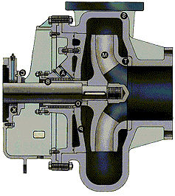
Application to Turbomachinery
rV_{t}
V_{n}
V_{n}
V_{t}
r₂
cs₁
cs₂
r₁

Slide 29
Example: Sprinkler
v_{t}
cs₂
ω
θ
10 cm
Total flow is 1 L/s.
Jet diameter is 0.5 cm.
Friction exerts a torque of 0.1 N-m-s² ω².
θ = 30º.
Find the speed of rotation.
V_{t} and V_{n} are defined relative to control surfaces.

Slide 30
Example: Sprinkler
a = 0.1Nms²
b = (1000 kg/m³)(0.001 m³/s) (0.1 m) ² = 0.01 Nms
c = -(1000 kg/m³)(0.001 m³/s)²(0.1m)(2sin30)/3.14/(0.005 m)²
c = -1.27 Nm
ω = 127/s
What is ω if there is no friction? ___________
ω = 3.5/s
0
What is V_{t} if there is no friction ?__________
= 34 rpm
Reflections

Slide 31
Energy Equation
cv equation
DE/Dt
What is for a system?
First law of thermodynamics: The heat Q_{H} added to a system plus the work W done on the system equals the change in total energy E of the system.

Slide 32
dE/dt for our System?
Pressure work
Shaft work
Heat transfer

Slide 33
General Energy Equation
1st Law of Thermo
cv equation
z
Total
Potential
Kinetic
Internal (molecular spacing and forces)

Slide 34
Simplify the Energy Equation
0
Steady
Assume...
Hydrostatic pressure distribution at cs
ŭ is uniform over cs
not uniform
But V is often ____________ over control surface!

Slide 35
Energy Equation: Kinetic Energy
V = point velocity
V = average normal velocity over cs
If V tangent to n
kinetic energy correction term
α = _________________________
α =___ for uniform velocity
1

Slide 36
Energy Equation: steady, one-dimensional, constant density
mass flux rate

Slide 37
Energy Equation: steady, one-dimensional, constant density
divide by g
mechanical
thermal
Lost mechanical energy
h_{P}

Slide 38
Thermal Components of the Energy Equation
For incompressible liquids
Water specific heat = 4184 J/(kg*K)
Change in temperature
Heat transferred to fluid
Example

Slide 39
Example: Energy Equation (energy loss)
An irrigation pump lifts 50 L/s of water from a reservoir and discharges it into a farmer’s irrigation channel. The pump supplies a total head of 10 m. How much mechanical energy is lost?
What is h_{L}?
cs₂
4 m
2.4 m
2 m
cs₁
datum
Why can’t I draw the cs at the end of the pipe?
h_{L} = 10 m - 4 m

Slide 40
Example: Energy Equation (pressure at pump outlet)
The total pipe length is 50 m and is 20 cm in diameter. The pipe length to the pump is 12 m. What is the pressure in the pipe at the pump outlet? You may assume (for now) that the only losses are frictional losses in the pipeline.
50 L/s
h_{P} = 10 m
cs₂
4 m
2.4 m
2 m
cs₁
0
/
0
/
0
/
datum
0
/
We need _______ in the pipe, __, and ____ ____.
velocity
α
head loss

Slide 41
Example: Energy Equation (pressure at pump outlet)
How do we get the velocity in the pipe?
How do we get the frictional losses?
What about α?
Q = VA
A = πd²/4
V = 4Q/( πd²)
V = 4(0.05 m³/s)/[ π(0.2 m)²] = 1.6 m/s
Expect losses to be proportional to length of the pipe
h_{l} = (6 m)(12 m)/(50 m) = 1.44 m

Slide 42
Kinetic Energy Correction Term: α
α is a function of the velocity distribution in the pipe.
For a uniform velocity distribution ____
For laminar flow ______
For turbulent flow _____________
Often neglected in calculations because it is so close to 1
α is 1
α is 2
1.01 < α < 1.10

Slide 43
Example: Energy Equation (pressure at pump outlet)
V = 1.6 m/s
α = 1.05
h_{L} = 1.44 m
50 L/s
h_{P} = 10 m
4 m
2.4 m
2 m
datum
= 59.1 kPa

Slide 44
Example: Energy Equation (Hydraulic Grade Line - HGL)
We would like to know if there are any places in the pipeline where the pressure is too high (_________) or too low (water might boil - cavitation).
Plot the pressure as piezometric head (height water would rise to in a piezometer)
How?
pipe burst

Slide 45
Example: Energy Equation (Energy Grade Line - EGL)
Loss due to shear
Exit loss
H_{P} = 10 m
Entrance loss
50 L/s
p = 59 kPa
4 m
2.4 m
2 m
datum
What is the pressure at the pump intake?

Slide 46
EGL (or TEL) and HGL
Energy Grade Line
Hydraulic Grade Line
Piezometric head
Elevation head (w.r.t. datum)
velocity
head
Pressure head (w.r.t. reference pressure)
What is the difference between EGL defined by Bernoulli and EGL defined here?

Slide 47
EGL (or TEL) and HGL
The energy grade line may never slope upward (in direction of flow) unless energy is added (______)
The decrease in total energy represents the head loss or energy dissipation per unit weight
EGL and HGL are ____________and lie at the free surface for water at rest (reservoir)
Whenever the HGL falls below the point in the system for which it is plotted, the local pressures are lower than the __________________
pump
coincident
reference pressure

Slide 48
Example HGL and EGL
velocity head
pressure head
energy grade line
hydraulic grade line
z
elevation
pump
z = 0
datum

Slide 49
Bernoulli vs. Control Volume Conservation of Energy
Find the velocity and flow. How would you solve these two problems?
pipe
Free jet

Slide 50
Bernoulli vs. Control Volume Conservation of Energy
Point to point along streamline
Control surface to control surface
No frictional losses
Has a term for frictional losses
average
point
Based on velocity
Based on velocity
Requires kinetic energy correction factor
Includes shaft work
Has direction!

Slide 51
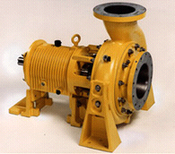



Power and Efficiencies
P = FV
Electrical power
Shaft power
Impeller power
Fluid power
Motor losses
EI
bearing losses
Tω
pump losses
Tω
γQH_{p}
Prove this!

Slide 52


Example: Hydroplant
2.45 MW
Water power =
Overall efficiency =
efficiency of turbine =
efficiency of generator =
0.857
0.893
0.96
50 m
Reservoir
Powerhouse
2100 kW
Q = 5 m³/s
Penstock
116 kN·m
180 rpm
River
solution

Slide 53
Energy Equation Review
Control Volume equation
Simplifications
steady
constant density
hydrostatic pressure distribution across control surface (streamlines parallel)
Direction of flow matters (in vs. out)
We don’t know how to predict head loss

Slide 54
Conservation of Energy, Momentum, and Mass
Most problems in fluids require the use of more than one conservation law to obtain a solution
Often a simplifying assumption is required to obtain a solution
neglect energy losses (_______) over a short distance with no flow expansion
neglect shear forces on the solid surface over a short distance
mechanical
to heat

Slide 55
Head Loss: Minor Losses
Head (or energy) loss due to: outlets, inlets, bends, elbows, valves, pipe size changes
Losses due to expansions are ________ than losses due to contractions
Losses can be minimized by gradual transitions
Losses are expressed in the form where K_{L} is the loss coefficient
greater
When V, KE  thermal

Slide 56
Head Loss due to Sudden Expansion: Conservation of Energy
z
x
in
out
At centroid of control surface
Where is p measured?___________________________
z_{in} = z_{out}
Relate V_{in} and V_{out}?
Mass
Relate p_{in} and p_{out}?
Momentum

Slide 57
Head Loss due to Sudden Expansion: Conservation of Momentum
A₂
A₁
x
1
2
Apply in direction of flow
Neglect surface shear
Pressure is applied over all of section 1.
Momentum is transferred over area corresponding to upstream pipe diameter.
V_{in} is velocity upstream.
Divide by (A_{out} γ)

Slide 58
Head Loss due to Sudden Expansion
Energy
Mass
Momentum
2
2
2
Discharge into a reservoir?_________
K_{L}=1

Slide 59
Pressure recovery in Manifolds
Is there pressure recovery in a manifold that has water exiting the manifold through side ports?
Velocity in the manifold is decreasing. Is kinetic energy converted to pressure?

Slide 60
Head Loss due to reduced flow caused by side port outlet
x
1
2
Apply in direction of flow
Neglect surface shear

Slide 61
Head Loss due to deceleration
x
1
2
Energy
Must add term for energy lost through side port
Momentum
This analysis is incorrect.
Shows negative energy loss…

Slide 62
Jet expansion in a confined channel: pressure recovery?
Is there pressure recovery in a hydraulic flocculator?

Slide 65
Example: Losses due to Sudden Expansion in a Pipe (Teams!)
A flow expansion discharges 0.5 L/s directly into the air. Calculate the pressure immediately upstream from the expansion
1 cm
3 cm
We can solve this using either the momentum equation or the energy equation (with the appropriate term for the energy losses)!
Use the momentum equation…
Solution

Slide 66
Scoop
A scoop attached to a locomotive is used to lift water from a stationary water tank next to the train tracks into a water tank on the train. The scoop pipe is 10 cm in diameter and elevates the water 3 m.
Draw several streamlines in the left half of the stationary water tank (use the scoop as your frame of reference) including the streamlines that attach to the submerged horizontal section of the scoop.
Use the streamlines to help you draw a control volume and clearly label the control surfaces.
How fast must the locomotive be moving (V_{scoop}) to get a flow of 4 L/s if the frictional losses in the pipe are equal to 1.8 V²/2g where V is the average velocity of the water in the pipe. (V_{scoop} = 7.7 m/s)

Slide 67
Scoop
Q = 4 L/s
d = 10 cm
3 m
V_{scoop}
stationary water tank

Slide 68
Scoop Problem: ‘The Real Scoop’
Energy
Bernoulli
moving water tank

Slide 69
Summary
Control volumes should be drawn so that the surfaces are either tangent (no flow) or normal (flow) to streamlines.
In order to solve a problem the flow surfaces need to be at locations where all but 1 or 2 of the energy terms are known
When possible choose a frame of reference so the flows are steady

Slide 70
Summary
Control volume equation: Required to make the switch from Lagrangian to Eulerian
Any conservative property can be evaluated using the control volume equation
mass, energy, momentum, concentrations of species
Many problems require the use of several conservation laws to obtain a solution
end

Slide 71
Scoop Problem
stationary water tank

Slide 72
Scoop Problem: Change your Perspective
moving water tank

Slide 73
Scoop Problem: Be an Extremist!
Very long riser tube
Very short riser tube

Slide 74
Example: Conservation of Mass (Team Work)
The flow through the orifice is a function of the depth of water in the reservoir
Find the time for the reservoir level to drop from 10 cm to 5 cm. The reservoir surface is 15 cm x 15 cm. The orifice is 2 mm in diameter and is 2 cm off the bottom of the reservoir. The orifice coefficient is 0.6.
CV with constant or changing mass.
Draw CV, label CS, solve using variables starting with to integration step

Slide 75
Example Conservation of Mass Constant Volume
cs₁
h
cs₂

Slide 76
Example Conservation of Mass Changing Volume
cs₁
h
cs₂

Slide 77
Example Conservation of Mass

Slide 78
Pump Head
h_{p}

Slide 79
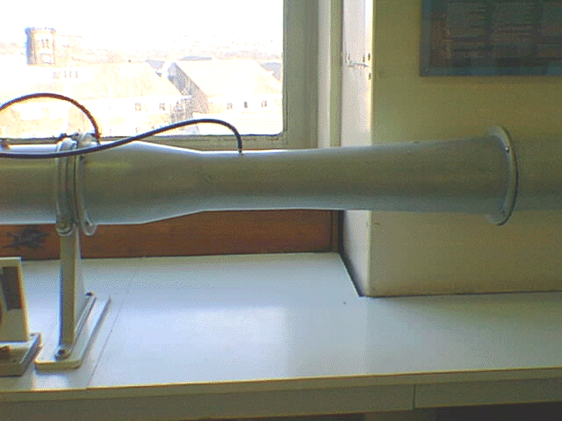
Example: Venturi

Slide 80
Example: Venturi
Find the flow (Q) given the pressure drop between section 1 and 2 and the diameters of the two sections. Draw an appropriate control volume. You may assume the head loss is negligible. Draw the EGL and the HGL.
Δh
1
2

Slide 81
Example Venturi

Slide 82
Reflections
What is the name of the equation that we used to move from a system (Lagrangian) view to the control volume (Eulerian) view?
Explain the analogy to your checking account.
The velocities in the linear momentum equation are relative to …?
When is “ma” non-zero for a fixed control volume?
Under what conditions could you generate power from a rotating sprinkler?
What questions do you have about application of the linear momentum and momentum of momentum equations?

Slide 83
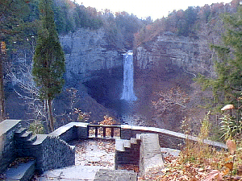
Temperature Rise over Taughanock Falls
Drop of 50 meters
Find the temperature rise
Ignore kinetic energy

Slide 84
Hydropower

Slide 85
Solution: Losses due to Sudden Expansion in a Pipe
A flow expansion discharges 0.5 L/s directly into the air. Calculate the pressure immediately upstream from the expansion
1 cm
3 cm
Carburetors and water powered vacuums

