Slide 1
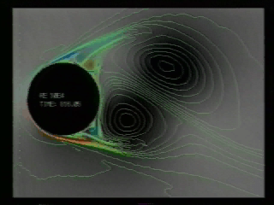
Basic Governing Differential Equations
CEE 331
April 14, 2013

Slide 2
Overview
Continuity Equation
Navier-Stokes Equation
(a bit of vector notation...)
Examples (all laminar flow)
Flow between stationary parallel horizontal plates
Flow between inclined parallel plates
Pipe flow (Hagen Poiseuille)

Slide 3



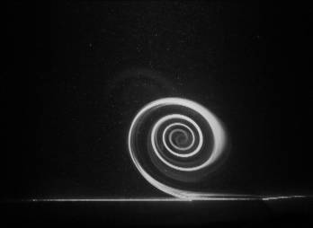
Why Differential Equations?
A droplet of water
Clouds
Wall jet
Hurricane

Slide 4
Conservation of Mass in Differential Equation Form
Mass flux out of differential volume
Rate of change of mass in differential volume
Mass flux into differential volume

Slide 5
Continuity Equation
Mass flux out of differential volume
Higher order term
out
in
Rate of mass decrease
1-d continuity equation

Slide 6
Continuity Equation
3-d continuity equation
divergence
u, v, w are velocities in x, y, and z directions
Vector notation
If density is constant...
or in vector notation
True everywhere! (contrast with CV equations!)

Slide 7
Continuity Illustrated
y
What must be happening?
<
>
x

Slide 8
Navier-Stokes Equations
Derived by Claude-Louis-Marie Navier in 1827
General Equation of Fluid Motion
Based on conservation of ___________ with forces…
____________
___________________
___________________
U.S. National Academy of Sciences has made the full solution of the Navier-Stokes Equations a top priority
momentum
Gravity
Pressure
Shear

Slide 9
Navier-Stokes Equations
Navier-Stokes Equation
g is constant
a is a function of t, x, y, z
Inertial forces [N/m³], a is Lagrangian acceleration
Is acceleration zero when ∂V/ ∂ t = 0?
NO!
Pressure gradient (not due to change in elevation)
If _________ then _____
Shear stress gradient

Slide 10
Notation: Total Derivative Eulerian Perspective
Total derivative (chain rule)
Material or substantial derivative
Lagrangian acceleration

Slide 11
Application of Navier-Stokes Equations
The equations are nonlinear partial differential equations
No full analytical solution exists
The equations can be solved for several simple flow conditions
Numerical solutions to Navier-Stokes equations are increasingly being used to describe complex flows.

Slide 12
Navier-Stokes Equations: A Simple Case
No acceleration and no velocity gradients
xyz could have any orientation
−ρg
Let y be vertical upward
Component of g in the x,y,z direction
For constant ρ

Slide 13
Infinite Horizontal Plates: Laminar Flow
Derive the equation for the laminar, steady, uniform flow between infinite horizontal parallel plates.
y
x
x
Hydrostatic in y
y
z

Slide 14
Infinite Horizontal Plates: Laminar Flow
Pressure gradient in x balanced by shear gradient in y
No a so forces must balance!
Now we must find A and B… Boundary Conditions

Slide 15
Infinite Horizontal Plates: Boundary Conditions
y
No slip condition
u = 0 at y = 0 and y = a
a
τ
u
x
let
negative
be___________
What can we learn about τ?

Slide 16
Laminar Flow Between Parallel Plates
y
a
U
x
u
No fluid particles are accelerating
θ
Write the x-component

Slide 17
Flow between Parallel Plates
u is only a function of y
General equation describing laminar flow between parallel plates with the only velocity in the x direction

Slide 18
Flow Between Parallel Plates: Integration
y
a
U
x
u
θ

Slide 19
Boundary Conditions
Boundary condition
u = 0 at y = 0
Boundary condition
u = U at y = a

Slide 20
Discharge
Discharge per unit width!

Slide 21
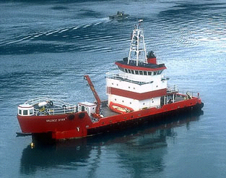
Example: Oil Skimmer
An oil skimmer uses a 5 m wide x 6 m long moving belt above a fixed platform (θ=60º) to skim oil off of rivers (T=10 ºC). The belt travels at 3 m/s. The distance between the belt and the fixed platform is 2 mm. The belt discharges into an open container on the ship. The fluid is actually a mixture of oil and water. To simplify the analysis, assume crude oil dominates. Find the discharge and the power required to move the belt.
g
x
h
ρ = 860 kg/m³
60º
l
μ = 1x10⁻² Ns/m²

Slide 22
Example: Oil Skimmer
g
x
60º
0
dominates
(per unit width)
q = 0.0027 m²/s
In direction of belt
Q = 0.0027 m²/s (5 m) = 0.0136 m³/s

Slide 23
Example: Oil Skimmer Power Requirements
How do we get the power requirement?
___________________________
What is the force acting on the belt?
___________________________
Remember the equation for shear?
_____________ Evaluate at y = a.
Power = Force x Velocity [N·m/s]
Shear force (τ · L · W)
τ = μ(du/dy)

Slide 24
Example: Oil Skimmer Power Requirements
FV
(shear by belt on fluid)
= 3.46 kW
How could you reduce the power requirement? __________
Decrease τ

Slide 25
Example: Oil Skimmer Where did the Power Go?
Where did the energy input from the belt go?
Potential and kinetic energy
Heating the oil (thermal energy)
Potential energy
h = 3 m

Slide 26
Velocity Profiles
Pressure gradients and gravity have the same effect.
In the absence of pressure gradients and gravity the velocity profile is ________
linear

Slide 27
Example: No flow
Find the velocity of a vertical belt that is 5 mm from a stationary surface that will result in no flow of glycerin at 20°C (m = 0.62 Ns/m² and ρ =1250 kg/m³)
Draw the glycerin velocity profile.
What is your solution scheme?

Slide 28
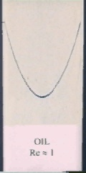
Laminar Flow through Circular Tubes
Different geometry, same equation development (see Munson, et al. p 327)
Apply equation of motion to cylindrical sleeve (use cylindrical coordinates)

Slide 29
Laminar Flow through Circular Tubes: Equations
R is radius of the tube
Max velocity when r = 0
Velocity distribution is paraboloid of revolution therefore _____________ _____________
average velocity (V) is 1/2 v_{max}
Q = VA =
VπR²

Slide 30
Laminar Flow through Circular Tubes: Equations no gravity
R is radius of the tube
Max velocity when r = 0
Velocity distribution is paraboloid of revolution therefore _____________ _____________
average velocity (V) is 1/2 v_{max}
Q = VA =
VπR²

Slide 31
Laminar Flow through Circular Tubes: Diagram
Velocity
Shear (wall on fluid)
Laminar flow
Shear at the wall
Next slide!
True for Laminar or Turbulent flow
Remember the approximations of no shear, no head loss?

Slide 32
Relationship between head loss and pressure gradient for pipes
cv energy equation
Constant cross section
In the energy equation the z axis is tangent to g
x is tangent to V
z
x
l is distance between control surfaces (length of the pipe)

Slide 33
The Hagen-Poiseuille Equation
Relationship between head loss and pressure gradient
Hagen-Poiseuille Laminar pipe flow equations
From Navier-Stokes
What happens if you double the pressure gradient in a horizontal tube? ____________
flow doubles
V is average velocity

Slide 34
Example: Laminar Flow (Team work)
Calculate the discharge of 20ºC water through a long vertical section of 0.5 mm ID hypodermic tube. The inlet and outlet pressures are both atmospheric. You may neglect minor losses.
What is the total shear force?
What assumption did you make? (Check your assumption!)

Slide 35
Example: Hypodermic Tubing Flow
= weight!

Slide 36
Summary
Navier-Stokes Equations and the Continuity Equation describe complex flow including turbulence
The Navier-Stokes Equations can be solved analytically for several simple flows
Numerical solutions are required to describe turbulent flows

Slide 37
Glycerin
y

