Slide 1
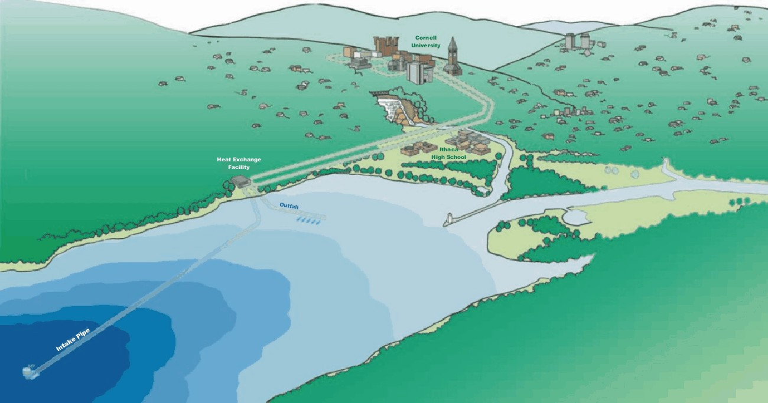
Viscous Flow in Pipes
CEE 331 Fluid Mechanics
December 18, 2012

Slide 2
Types of Engineering Problems
How big does the pipe have to be to carry a flow of x m³/s?
What will the pressure in the water distribution system be when a fire hydrant is open?
Can we increase the flow in this old pipe by adding a smooth liner?

Slide 3
Viscous Flow in Pipes: Overview
Boundary Layer Development
Turbulence
Velocity Distributions
Energy Losses
Major
Minor
Solution Techniques

Slide 4
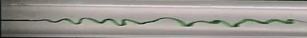
Laminar and Turbulent Flows
Reynolds apparatus
inertia
damping
Transition at Re of 2000

Slide 5
Boundary layer growth: Transition length
What does the water near the pipe wall experience? _________________________
Why does the water in the center of the pipe speed up? _________________________
Drag or shear
Conservation of mass
Non-Uniform Flow
v
v
v

Slide 6
Entrance Region Length
Distance for velocity profile to develop
Shear in the entrance region vs shear in long pipes?
laminar
turbulent

Slide 7
Velocity Distributions
Turbulence causes transfer of momentum from center of pipe to fluid closer to the pipe wall.
Mixing of fluid (transfer of momentum) causes the central region of the pipe to have relatively _______velocity (compared to laminar flow)
Close to the pipe wall, eddies are smaller (size proportional to distance to the boundary)
uniform

Slide 8
Log Law for Turbulent, Established Flow, Velocity Profiles
Dimensional analysis and measurements
Valid for
Turbulence produced by shear!
Shear velocity
Velocity of large eddies
rough
smooth
Force balance
y
u/u_{max}

Slide 9
Pipe Flow: The Problem
We have the control volume energy equation for pipe flow
We need to be able to predict the head loss term.
We will use the results we obtained using dimensional analysis

Slide 10
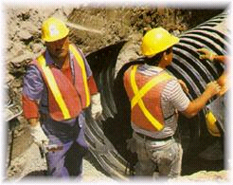
Viscous Flow: Dimensional Analysis
Remember dimensional analysis?
Two important parameters!
Re - Laminar or Turbulent
ε/D - Rough or Smooth
Flow geometry
internal _______________________________
external _______________________________
Where
and
in a bounded region (pipes, rivers): find C_{p}
flow around an immersed object : find C_{d}

Slide 11
Pipe Flow Energy Losses
Dimensional Analysis
More general
Assume horizontal flow
Always true (laminar or turbulent)
Darcy-Weisbach equation

Slide 12
Friction Factor : Major losses
Laminar flow
Turbulent (Smooth, Transition, Rough)
Colebrook Formula
Moody diagram
Swamee-Jain

Slide 13
Laminar Flow Friction Factor
Hagen-Poiseuille
Darcy-Weisbach
f independent of roughness!
-1
Slope of ___ on log-log plot

Slide 14
Turbulent Flow: Smooth, Rough, Transition
Hydraulically smooth pipe law (von Karman, 1930)
Rough pipe law (von Karman, 1930)
Transition function for both smooth and rough pipe laws (Colebrook)
(used to draw the Moody diagram)

Slide 15
Moody Diagram
0.10
0.08
0.05
0.06
0.04
0.03
0.05
0.02
0.04
0.015
0.01
0.008
friction factor
0.006
0.03
0.004
laminar
0.002
0.02
0.001
0.0008
0.0004
0.0002
0.0001
0.01
0.00005
smooth
1E+03
1E+04
1E+05
1E+06
1E+07
1E+08
Re

Slide 16
Swamee-Jain
1976
limitations
ε/D < 2 x 10⁻²
Re >3 x 10³
less than 3% deviation from results obtained with Moody diagram
easy to program for computer or calculator use
no f
Colebrook
Each equation has two terms. Why?

Slide 17
Pipe roughness
pipe material
pipe roughness
ε
(mm)
glass, drawn brass, copper
0.0015
commercial steel or wrought iron
0.045
asphalted cast iron
0.12
Must be dimensionless!
galvanized iron
0.15
cast iron
0.26
concrete
0.18-0.6
rivet steel
0.9-9.0
corrugated metal
45
PVC
0.12

Slide 18
Solution Techniques
find head loss given (D, type of pipe, Q)
find flow rate given (head, D, L, type of pipe)
find pipe size given (head, type of pipe,L, Q)

Slide 19
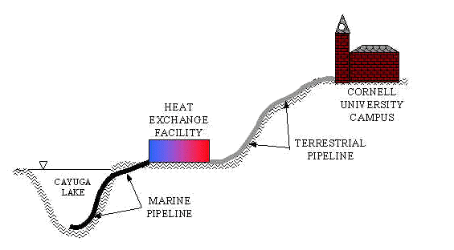
Example: Find a pipe diameter
The marine pipeline for the Lake Source Cooling project will be 3.1 km in length, carry a maximum flow of 2 m³/s, and can withstand a maximum pressure differential between the inside and outside of the pipe of 28 kPa. The pipe roughness is 2 mm. What diameter pipe should be used?

Slide 20
Minor Losses: Expansions!
We previously obtained losses through an expansion using conservation of energy, momentum, and mass
Most minor losses can not be obtained analytically, so they must be measured
Minor losses are often expressed as a loss coefficient, K, times the velocity head.
High Re
Venturi

Slide 21
Sudden Contraction
EGL
HGL
c
2
V₁
V₂
vena contracta
Losses are reduced with a gradual contraction
Equation has same form as expansion equation!

Slide 22
Entrance Losses
Losses can be reduced by accelerating the flow gradually and eliminating the
Estimate based on contraction equations!
vena contracta

Slide 23
Head Loss in Bends
High pressure
Head loss is a function of the ratio of the bend radius to the pipe diameter (R/D)
Velocity distribution returns to normal several pipe diameters downstream
high
low
Possible separation from wall
n
R
D
Low pressure
K_{b} varies from 0.6 - 0.9

Slide 24
Head Loss in Valves
Function of valve type and valve position
The complex flow path through valves can result in high head loss (of course, one of the purposes of a valve is to create head loss when it is not fully open)
What is V?
Yes!
Can K_{v}be greater than 1? ______

Slide 25
Solution Techniques
Neglect minor losses
Equivalent pipe lengths
Iterative Techniques
Using Swamee-Jain equations for D and Q
Using Swamee-Jain equations for head loss
Assume a friction factor
Pipe Network Software

Slide 26
Solution Technique: Head Loss
Can be solved explicitly

Slide 27
Find D or Q Solution Technique 1
Assume all head loss is major head loss
Calculate D or Q using Swamee-Jain equations
Calculate minor losses
Find new major losses by subtracting minor losses from total head loss

Slide 28
Find D or Q Solution Technique 2: Solver
Iterative technique
Solve these equations
Use goal seek or Solver to find discharge that makes the calculated head loss equal the given head loss.
Spreadsheet

Slide 29
Find D or Q Solution Technique 3: assume f
The friction factor doesn’t vary greatly
If Q is known assume f is 0.02, if D is known assume rough pipe law
Use Darcy Weisbach and minor loss equations
Solve for Q or D
Calculate Re and ε/D
Find new f on Moody diagram
Iterate

Slide 30
Example: Minor and Major Losses
Find the maximum dependable flow between the reservoirs for a water temperature range of 4ºC to 20ºC.
25 m elevation difference in reservoir water levels
Water
Reentrant pipes at reservoirs
Standard elbows
2500 m of 8” PVC pipe
Sudden contraction
Gate valve wide open
1500 m of 6” PVC pipe
Spreadsheet
Directions

Slide 31
Example (Continued)
What are the Reynolds numbers in the two pipes?
Where are we on the Moody Diagram?
What is the effect of temperature?
Why is the effect of temperature so small?
What value of K would the valve have to produce to reduce the discharge by 50%?
90,000 & 125,000
ε/D= 0.0006, 0.0008
140
Spreadsheet

Slide 32
Example (Continued)
Yes
Were the minor losses negligible?
Accuracy of head loss calculations?
What happens if the roughness increases by a factor of 10?
If you needed to increase the flow by 30% what could you do?
5%
f goes from 0.02 to 0.035
Increase small pipe diameter

Slide 33
Pipe Flow Summary (1)
Shear increases _________ with distance from the center of the pipe (for both laminar and turbulent flow)
Laminar flow losses and velocity distributions can be derived based on momentum (Navier Stokes) and energy conservation
Turbulent flow losses and velocity distributions require ___________ results
linearly
experimental

Slide 34
Pipe Flow Summary (2)
Energy equation left us with the elusive head loss term
Dimensional analysis gave us the form of the head loss term (pressure coefficient)
Experiments gave us the relationship between the pressure coefficient and the geometric parameters and the Reynolds number (results summarized on Moody diagram)

Slide 35
Pipe Flow Summary (3)
Dimensionally correct equations fit to the empirical results can be incorporated into computer or calculator solution techniques
Minor losses are obtained from the pressure coefficient based on the fact that the pressure coefficient is _______ at high Reynolds numbers
Solutions for discharge or pipe diameter often require iterative or computer solutions
constant

Slide 36
Pressure Coefficient for a Venturi Meter
10
p
C
1
1E+00
1E+01
1E+02
1E+03
1E+04
1E+05
1E+06
Re

Slide 37
Moody Diagram
0.1
0.05
0.04
0.03
0.02
0.015
0.01
0.008
friction factor
0.006
0.004
laminar
0.002
0.001
0.0008
0.0004
0.0002
0.0001
0.01
0.00005
smooth
1E+03
1E+04
1E+05
1E+06
1E+07
1E+08
Minor Losses
Re

Slide 38
LSC Pipeline
z = 0
cs₁
cs₂
0
Ignore minor losses
KE will be small
-2.85 m
28 kPa is equivalent to 2.85 m of water

Slide 39
Directions
Assume fully turbulent (rough pipe law)
find f from Moody (or from von Karman)
Find total head loss (draw control volume)
Solve for Q using symbols (must include minor losses) (no iteration required)
Solution
Pipe roughness

Slide 40
Find Q given pipe system

