Slide 1
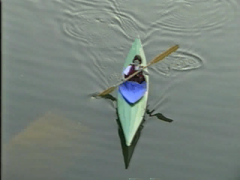
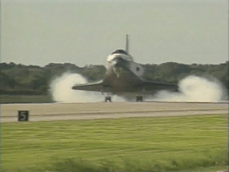
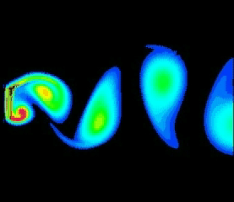
External Flows
CEE 331
December 18, 2012

Slide 2
Overview
The F_{ss} connection to Drag
Boundary Layer Concepts
Drag
Shear Drag
Pressure Drag
Pressure Gradients: Separation and Wakes
Drag coefficients
Vortex Shedding

Slide 3
F_{ss}: Shear and Pressure Forces
Major losses in pipes
Shear forces:
viscous drag, frictional drag, or skin friction
caused by shear between the fluid and the solid surface
function of ___________and ______of object
Pressure forces
pressure drag or form drag
caused by _____________from the body
function of area normal to the flow
surface area
length
Flow expansion losses
flow separation
Projected area

Slide 4
Non-Uniform Flow
In pipes and channels the velocity distribution was uniform (beyond a few pipe diameters or hydraulic radii from the entrance or any flow disturbance)
In external flows the boundary layer (the flow influenced by the solid object) is always growing and the flow is non-uniform
We need to calculate shear in this non-uniform flow!

Slide 5
Boundary Layer Concepts
Two flow regimes
Laminar boundary layer
Turbulent boundary layer
with laminar sub-layer
Calculations of
boundary layer thickness
Shear (as a function of location on the surface)
Viscous Drag (by integrating the shear over the entire surface)

Slide 6
Flat Plate: Parallel to Flow
U
U
U
boundary layer thickness
τ_{o}
y
U
δ
x
shear
Why is shear maximum at the leading edge of the plate?
is maximum

Slide 7
Laminar Boundary Layer: Shear and Drag Force
square root
Boundary Layer thickness increases with the _______ ______ of the distance from the leading edge of the plate
Based on momentum and mass conservation and assumed velocity distribution
Integrate along length of plate
On one side of the plate!

Slide 8
Laminar Boundary Layer: Coefficient of Drag
Dimensional analysis

Slide 9
Transition to Turbulence
The boundary layer becomes turbulent when the Reynolds number is approximately 500,000 (based on length of the plate)
The length scale that really controls the transition to turbulence is the _________________________
boundary layer thickness
=
Re_{δ} = 3500

Slide 10
Boundary Layer Transition to Turbulence
U
U
U
δ
y
turbulent
U
x
Viscous
sublayer
τ_{o}
This slope (du/dy) controls τ₀.
Transition (analogy to pipe flow)

Slide 11
Turbulent Boundary Layer: (Smooth Plates)
Grows ____________ than laminar
more rapidly
Derived from momentum conservation and assumed velocity distribution
x 5/4
Integrate shear over plate
5 x 10⁵ < Re_{l} < 10⁷

Slide 12
Boundary Layer Thickness
Water flows over a flat plate at 1 m/s. How long is the laminar region?
x = 0.5 m
Grand Coulee

Slide 13
Flat Plate Drag Coefficients
rough
1 x 10⁻³
5 x 10⁻⁴
2 x 10⁻⁴
laminar
1 x 10⁻⁴
5 x 10⁻⁵
2 x 10⁻⁵
1 x 10⁻⁵
5 x 10⁻⁶
2 x 10⁻⁶
1 x 10⁻⁶
transitional
Turbulent boundary

Slide 14
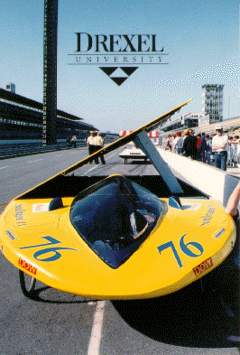
Example: Solar Car
Solar cars need to be as efficient as possible. They also need a large surface area for the (smooth) solar array. Estimate the power required to counteract the viscous drag on the solar panel at 40 mph
Dimensions: L: 5.9 m W: 2 m H: 1 m
Max. speed: 40 mph on solar power alone
Solar Array: 1200 W peak
ν_{air} = 14.6 x10⁻⁶ m²/s
ρ_{air} = 1.22 kg/m³

Slide 15
Viscous Drag on Ships
The viscous drag on ships can be calculated by assuming a flat plate with the wetted area and length of the ship
scales with ____ (based on _______ similarity)
L_{r}³
Froude

Slide 16
Separation and Wakes
Separation often occurs at sharp corners
fluid can’t accelerate to go around a sharp corner
Velocities in the Wake are ______ (relative to the free stream velocity)
Pressure in the Wake is relatively ________ (determined by the pressure in the adjacent flow)
small
constant

Slide 17
Pressure Gradients: Separation and Wakes
Diverging streamlines
Van Dyke, M. 1982. An Album of Fluid Motion. Stanford: Parabolic Press.

Slide 18
Adverse Pressure Gradients
Streamlines diverge behind object
Increasing pressure in direction of flow
Fluid is being decelerated
Fluid in boundary layer has less ______ than the main flow and may be completely stopped.
If boundary layer stops flowing then separation occurs
inertia

Slide 19
Point of Separation
Predicting the point of separation on smooth bodies is beyond the scope of this course.
Expect separation to occur where streamlines are diverging (flow is slowing down)
Separation can be expected to occur around any sharp corners
(where streamlines diverge rapidly)

Slide 20
Flat Plate: Streamlines
3
U
2
4
0
1
Point v C_{p} p
1 ______ ________ ____
2 ______ ________ ____
3 ______ ________ ____
4 ______ ________ ____
0
C_{p} = 1
>p₀
<U
0 < C_{p} < 1
>p₀
>U
C_{p} < 0
<p₀
<U
C_{p} < 0
<p₀
Points outside boundary layer!
p in wake is uniform

Slide 21
Application of Bernoulli Equation
In air pressure change due to elevation is small
U = velocity of body relative to fluid

Slide 22
Flat Plate: Pressure Distribution
>U
3
<U
2
Front of plate
0
1
Back of plate
C_{d} = 2
1
0.8
0
C_{p}
-1
-1.2

Slide 23
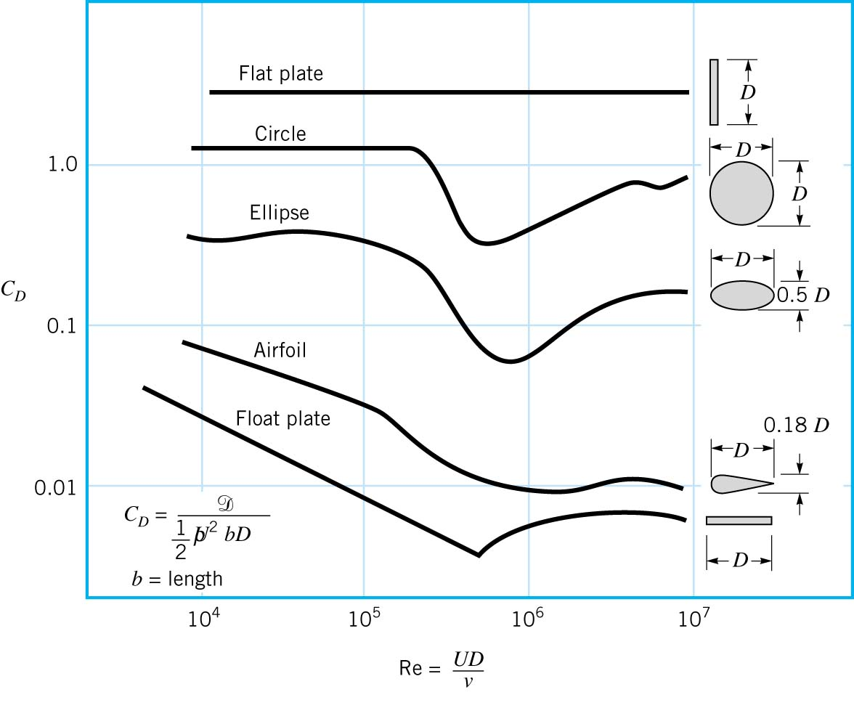
Drag Coefficient of Blunt and Streamlined Bodies
Drag dominated by viscous drag, the body is __________.
Drag dominated by pressure drag, the body is _______.
Whether the flow is viscous-drag dominated or pressure-drag dominated depends entirely on the shape of the body.
This drag coefficient is calculated from a measured value of ____
streamlined
bluff
Flat plate
Fss
Bicycle page at Princeton

Slide 24
Drag Coefficient at High Reynolds Numbers
Figures 9.28-9.30 bodies with drag coefficients on p 593-595 in text.
hemispherical shell 0.38
hemispherical shell 1.42
cube 1.1
parachute 1.4
Why?
Velocity at separation point determines pressure in wake.
?
Vs
The same!!!

Slide 25
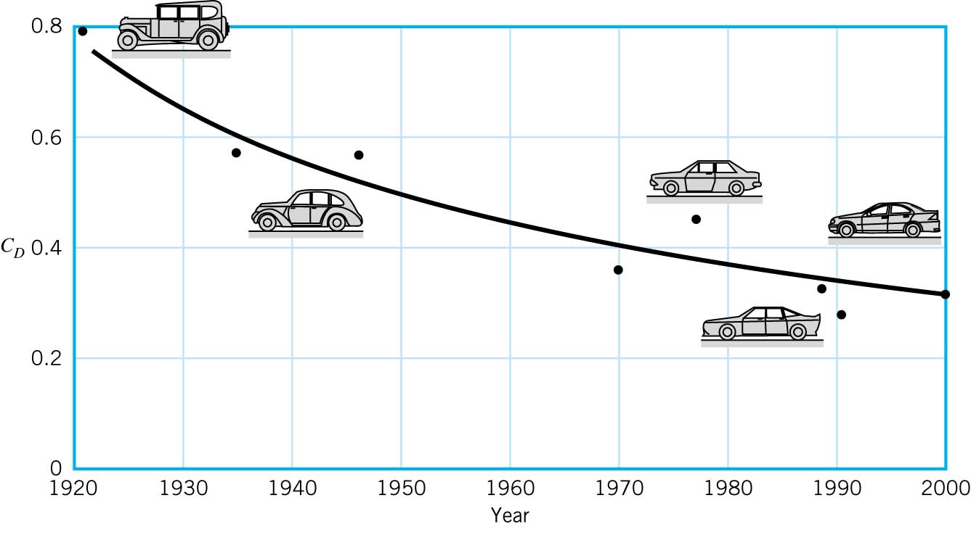
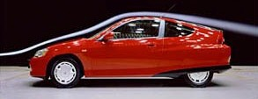
SUVs have got Drag…
Ford Explorer 2002 C_{d} = 0.41

Slide 26
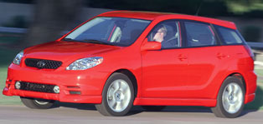
Automobile Drag Coefficients (High Reynolds Number)
C_{d} = 0.32
Height = 1.539 m
Width = 1.775 m
Length = 4.351 m
Ground clearance = 15 cm
100 kW at 6000 rpm
Max speed is 124 mph
Where does separation occur?
Calculate the power required to overcome drag at 60 mph and 120 mph.
What is the projected area?

Slide 27
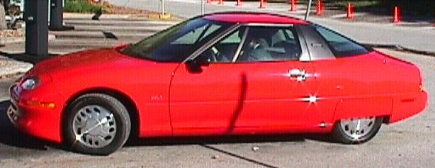
Electric Vehicles
Electric vehicles are designed to minimize drag.
Typical cars have a coefficient drag of 0.30-0.40.
The EV1 has a drag coefficient of 0.19.
Smooth connection to windshield
Plan view of car?

Slide 28
Velocity and Drag: Spheres
General relationship for submerged objects
Spheres only have one shape and orientation!
Where C_{d} is a function of Re

Slide 29
Sphere Terminal Fall Velocity

Slide 30
Sphere Terminal Fall Velocity (continued)
General equation for falling objects
Relationship valid for spheres

Slide 31
Drag Coefficient on a Sphere
1000
100
Stokes Law
Drag Coefficient
10
1
0.1
0.1
1
10
10²
10³
10⁴
10⁵
10⁶
10⁷
Re=500000
Reynolds Number
Turbulent Boundary Layer

Slide 32
Drag Coefficient for a Sphere: Terminal Velocity Equations
Valid for laminar and turbulent
Laminar flow R < 1
Transitional flow 1 < R < 10⁴
Fully turbulent flow R > 10⁴

Slide 33
Example Calculation of Terminal Velocity
Determine the terminal settling velocity of a cryptosporidium oocyst having a diameter of 4 μm and a density of 1.04 g/cm³ in water at 15°C.
Reynolds

Slide 34

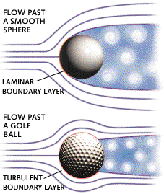
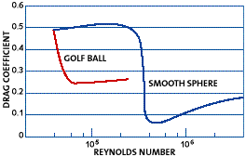
Drag on a Golf Ball
Drag on a golf ball comes mainly from pressure drag. The only practical way of reducing pressure drag is to design the ball so that the point of separation moves back further on the ball.
The golf ball's dimples increase the turbulence in the boundary layer, increase the _______ of the boundary layer, and delay the onset of separation.
What is the Reynolds number where the boundary layer begins to become turbulent with a golf ball? _________
Why not use this for aircraft or cars?
inertia
40,000
Boundary layer is already turbulent

Slide 35
At what velocity is the boundary layer laminar for an automobile?

Slide 36
Effect of Turbulence Levels on Drag
Flow over a sphere with a trip wire.
Causes boundary layer to become turbulent
Re=15,000
Re=30,000
Point of separation

Slide 37
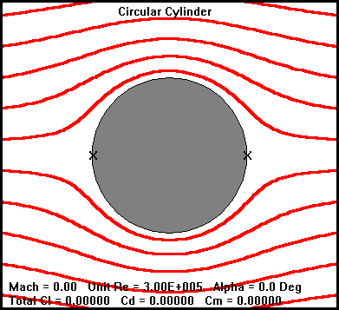
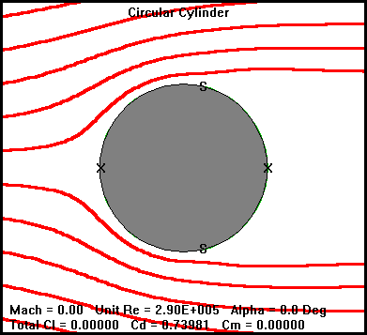
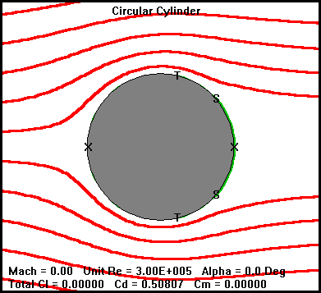
Effect of Boundary Layer Transition
Ideal (non viscous) fluid
Real (viscous) fluid: laminar boundary layer
Real (viscous) fluid: turbulent boundary layer
Increased inertia in boundary layer
No shear!

Slide 38
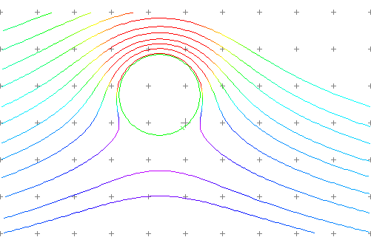
Spinning Spheres
What happens to the separation points if we start spinning the sphere?
LIFT!

Slide 39
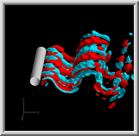
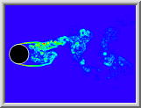
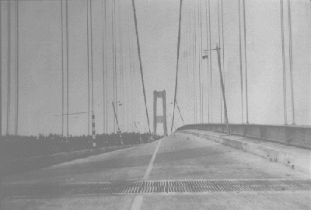
Vortex Shedding
Vortices are shed alternately from each side of a cylinder
The separation point and thus the resultant drag force oscillates
Frequency of shedding (n) given by Strouhal number S
S is approximately 0.2 over a wide range of Reynolds numbers (100 - 1,000,000)

Slide 40
Summary: External Flows
Spatially varying flows
boundary layer growth
Example: Spillways
Two sources of drag (F_{ss})
shear (surface area of object)
pressure (projected area of object)
Separation and Wakes
Interaction of viscous drag and adverse pressure gradient

Slide 41
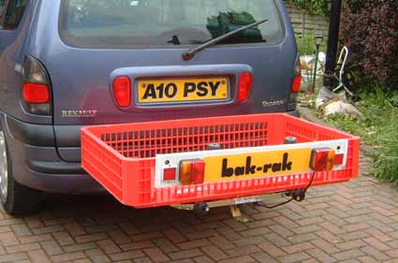
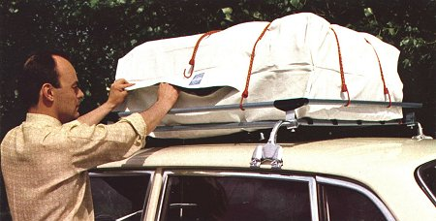
Challenge
I’m going on vacation and I can’t back all of our luggage in my Matrix. Should I put it on the roof rack or on the hitch?

Slide 42
Challenges
How long would L have to be to double the drag of a sphere?
L
V=30 m/s
D = 3 m

Slide 43
Challenges
How long would L have to be to double the drag of a sphere?
V=30 m/s
L
D = 3 m
Find drag of sphere
Guess at Re for plate
Find drag coefficient for plate (note different area)
Solve for L

Slide 44
Elongated sphere
V=30 m/s
L
D = 3 m

Slide 45
Solution: Solar Car
U = 17.88 m/s
l = 5.9 m
ν_{air} = 14.6 x 10⁻⁶ m²/s
ρ_{air} = 1.22 kg/m³
Re_{l} = 7.2 x 10⁶
C_{d} = 3 x 10⁻³
F_{d} =14 N
A = 5.9 m x 2 m = 11.8 m²
P =F*U=250 W

Slide 46
Reynolds Number Check
R = 1.1 x 10⁻⁶
R<<1 and therefore in Stokes Law range

Slide 47
Solution: Power a Toyota Matrix at 60 or 120 mph
P = 9.3 kW at 60 mph
P = 74 kW at 120 mph

Slide 48
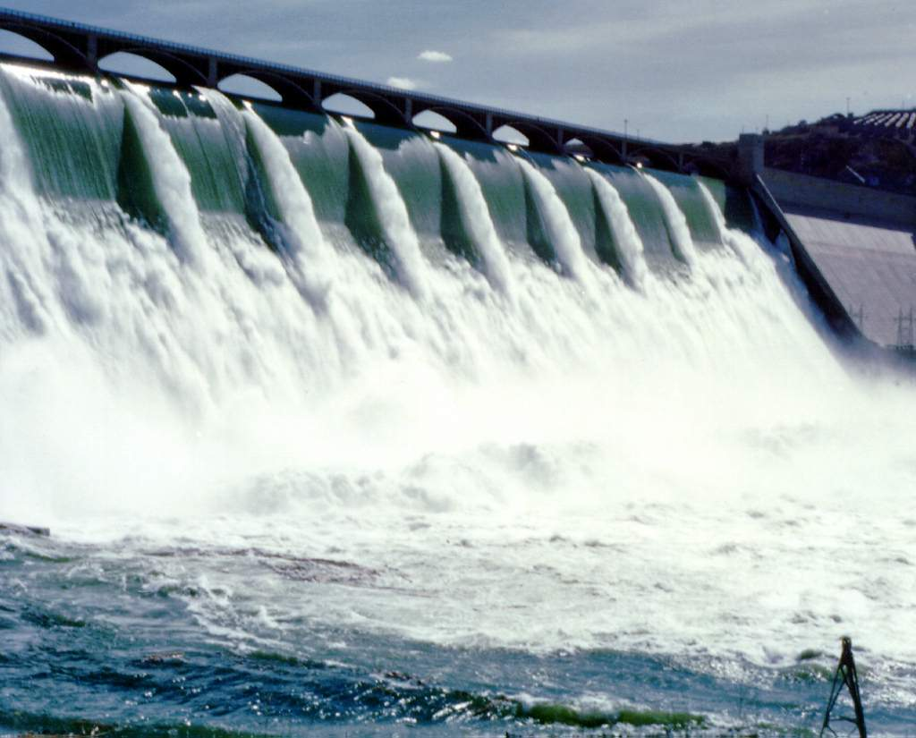
Grand Coulee Dam
Turbulent boundary layer reaches surface!

Slide 49
Reflections on Drag
What are 3 similarities with Moody diagram?
Laminar
Smooth
Rough
Why 2 curves for smooth (red and green)
Fully turbulent boundary layer
Transition between laminar and turbulent on the plate
Why more detail in transition region here than in Moody diagram?
Are any lines missing on the graph?
Function of conditions at leading edge

Slide 50
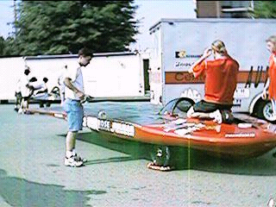
Drexel SunDragon IV
http://cbis.ece.drexel.edu/SunDragon/Cars.html
Vehicle ID: SunDragon IV (# 76) Dimensions: L: 19.2 ft. (5.9 m) W: 6.6 ft. (2 m) H: 3.3 ft. (1 m) Weight: 550 lbs. (249 kg) Solar Array: 1200 W peak; 8 square meters terrestrial grade solar cells; manf: ASE Americas Batteries: 6.2 kW capacity lead-acid batteries; manf: US Battery Motor: 10 hp (7.5 kW) brushless DC; manf: Unique Mobility Range: Approximately 200 miles (at 35 mph on batteries alone) Max. speed: 40 mph on solar power alone, 80 mph on solar and battery power. Chassis: Graphite monocoque (Carbon fiber, Kevlar, structural glass, Nomex) Wheels: Three 26 in (66 cm) mountain bike, custom hubs Brakes: Hydraulic disc brakes, regenerative braking (motor)

