Slide 1
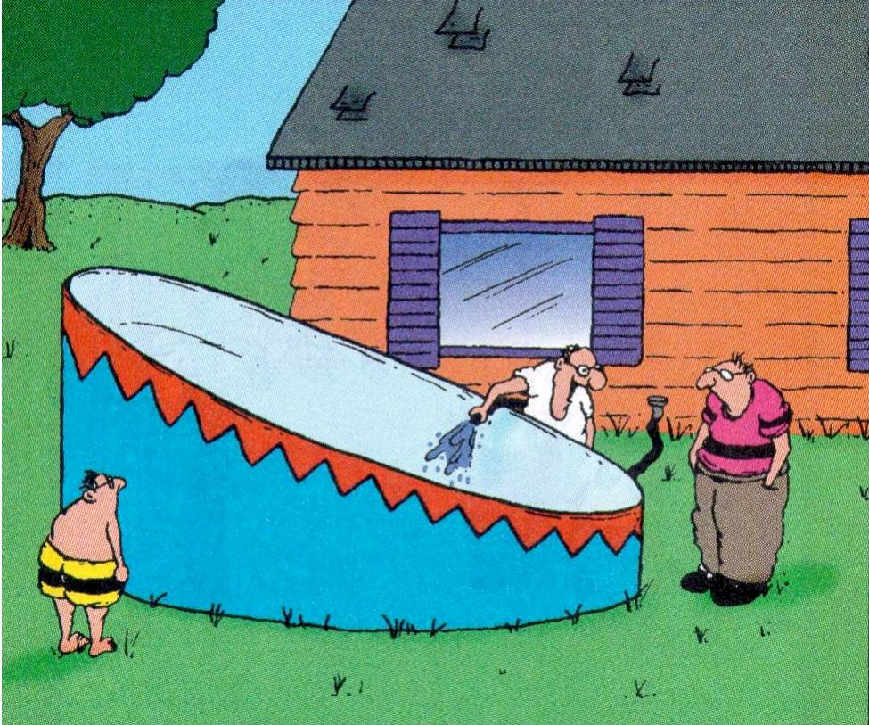
“Somebody finally got smart and came up with an above-ground pool that’s got a deep end and a shallow end.”

