Slide 1
Environmental Fluid Mechanics

Slide 2
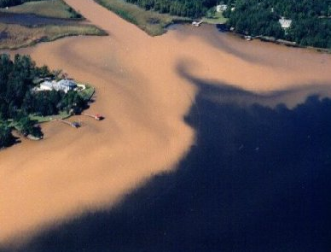
Environmental Fluid Mechanics
Scope of Environmental Fluid Mechanics
Transport Processes
molecular diffusion
turbulent diffusion (detour into turbulence)
advection
Turbulent Diffusion + Advection
Jet and Plumes

Slide 3
Sources
* Mixing in Inland and Coastal Waters. Hugo B. Fisher, E. John List, Robert C. Y. Koh, Jörg Imberger, and Norman H. Brooks. 1979. Academic Press, New York.
Fluid Mechanics. Victor L. Streeter and E. Benjamin Wylie. 1985. Eighth edition, McGraw-Hill Book Company, New York.
A First Course in Turbulence. H. Tennekes and J. L. Lumley. 1972. MIT Press, Cambridge.

Slide 4
Environmental Fluid Mechanics
Motion and mixing of fluids in the environment
Interested in the substances and properties transported by the fluid
Examples
wastewater discharge into stream, estuary, or ocean
junction of two rivers
smokestack discharge into atmosphere
contaminant spill into ocean or river
mixing of salt and fresh water in estuaries
mixing of warm and cold water in lakes

Slide 5
Water as transportation...
Water transports substances and properties
Physical
Heat
Turbidity
Color
Suspended Solids
Chemical
Salinity
Dissolved oxygen
Dissolved solids
Metals
Pesticides
BOD
pH
Biological
Fish eggs
Protozoa
Bacteria
Viruses

Slide 6
Hydrologic Transport Processes*
Advection: Transport by an ________ ________, as in a river or coastal waters.
Convection: Vertical transport induced by _________ ________, such as the flow over a heated plate, or below a chilled water surface in a lake.
Diffusion (Molecular): The scattering of particles by random molecular motions.
Diffusion (Turbulent): The random scattering of particles by turbulent motion.
imposed current
hydrostatic instability

Slide 7
Hydrologic Transport Processes*
Dispersion: The scattering of particles or a cloud of contaminants by the combined effects of ______ and transverse _________
Mixing: Diffusion or dispersion as described above; turbulent diffusion in buoyant jets and plumes; any process which causes one parcel of water to be mingled with or diluted by another.
shear
diffusion

Slide 8
Molecular Diffusion
Diffusion of particles (e.g. molecules of a substance) by random motion due to molecular ______ ______
Fick’s law of diffusion
Empirical description
Mass flux is proportional to ________ of mass concentration
kinetic energy
gradient

Slide 9
Fick’s law
=
D_{m}: coefficient of molecular diffusion
C: concentration (e.g. mg/liter)
J: mass flux
Does the gradient cause the diffusion? _____
NO!

Slide 10
Coefficient of Molecular Diffusion
D = f(solvent, solute, temperature)
Carrying Fluid Solute D_{m}(cm²/s)
H₂O O₂ 2.4x10⁻⁵
H₂O NaCl 1.545x10⁻⁵
H₂O C₆H₁₂O₆ 0.673x10⁻⁵
Air H₂ 0.634
Air O₂ 0.178
Air C O₂ 0.139
Gas molecules have much more kinetic energy (higher velocity) and greater distance between molecules and thus diffusion in air is higher than diffusion in water.

Slide 11
Similarity of Transport Mechanisms: (Mass, Momentum, Heat)
Newton’s law of viscosity
Shear Stress
(Momentum transport/area)
coefficient of viscosity
coefficient of momentum diffusivity

Slide 12
Similarity of Transport Mechanisms: (Mass, Momentum, Heat)
Fourier’s law of heat transport
coefficient of conductivity
coefficient of heat diffusivity
specific heat/volume

Slide 13
Combination of Mass Transport & Mass Conservation
C
Only diffusion, no advection
A
x
dx
change in mass = net transport (in - out)

Slide 14
Governing Equation for 1-D mass transport by diffusion
Mass conservation
Fick’s 1st Law
If D_{m} constant
Can be generalized to 2 and 3 dimensions

Slide 15
Diffusion
Fick's first law
C
Fick's second law
x
What does it look like a short time later?
C
x

Slide 16
Solutions to diffusion of slug
Fundamental Solution - response to the introduction of slug of mass M
A
x
note:

Slide 17
Solution to 1-D problem
A
120
D_{m} = 0.673 x 10⁻⁵ cm²/s
M = 1 g
A = 1 cm²
100
1 s
80
concentration (g/mL)
60
40
10 s
20
100 s
0
−0.1
−0.05
0
0.05
0.1
distance (cm)

Slide 18
Lateral Distribution of Slug
Example: Find the distance from the center of the plume where the concentration is 10% of the maximum (as a function of time).
?
Solution

Slide 19
Molecular Diffusion Example
How long does it take for a slug of sugar to spread so that the concentration 10 cm away is 10% of the maximum?
10 cm
dissolved sugar layer

Slide 20
Diffusion in the Environment
How long would it take for the same glucose concentration gradient to disperse in Fall Creek?
Turbulence!!!!
Flow
Fall Creek (idealized)
glucose

Slide 21
Mean and Variation*
Fluctuations and irregularities in hydrologic systems are just as important as the mean flows for pollutant analysis!
The mean flows provide the advection, the fluctuations (turbulence) provide the mixing.

Slide 22
Turbulence
A characteristic of the ____. (contrast with diffusion)
How can we characterize turbulence?
intensity of the velocity fluctuations
size of the fluctuations (length scale)
flow
instantaneous
velocity
mean
velocity
velocity
fluctuation
t

Slide 23
Turbulence: Size of the Fluctuations or Eddies
Eddies must be smaller than the physical dimension of the flow
Generally the largest eddies are of similar size to the smallest dimension of the flow
Examples of turbulence length scales
rivers: _________
pipes: __________
A spectrum of eddy sizes
depth
diameter

Slide 24
Turbulence: Flow Instability
In turbulent flow (high Reynolds number) the force leading to stability (viscosity) is small relative to the force leading to instability (inertia).
Any disturbance in the flow results in large scale motions superimposed on the mean flow.
Some of the kinetic energy of the flow is transferred to these large scale motions (eddies). (__________)
Large scale instabilities gradually lose kinetic energy to smaller scale motions.
The kinetic energy of the smallest eddies is dissipated by _________ resistance and turned into ______.
head loss!
viscous
heat

Slide 25
Turbulent Diffusion
Mechanism of turbulent diffusion is different than the mechanism of molecular diffusion, but the effect is similar.
Scale of the motion generating turbulent diffusion is much larger than for molecular diffusion!
If plume size >> eddy size
C = time averaged concentration (no fluctuations)
Turbulent diffusion coefficient

Slide 26
Turbulent Diffusion
Example: grid generated turbulence. Vortex shedding from grid will generate turbulence in the cup.
Sugar will spread much faster. How fast?
Recall molecular diffusion - (3 weeks)!
Grid
10 cm
dissolved sugar layer

Slide 27
Reynolds Analogy
In turbulent processes all properties are exchanged at the same rate
momentum
heat
mass
Diffusion is a function of path length and velocity
Molecular diffusion: ________ between molecules, _________ of molecules
Turbulent diffusion: _____ of eddies, velocity of fluid in eddy relative to mean flow
All transported by fluid at rate >> molecular transfer
Why?
distance
velocity
size

Slide 28
Magnitude of Turbulent Diffusion in a River
for order of magnitude estimate we need to
estimate velocity fluctuations - u’
estimate size of eddies - __
l=d
(depth of river)
We could measure u’ directly or estimate it!
where u’ = standard deviation of the velocity (often called root mean square or rms velocity)
Bottom shear
u’ ≈ u* = shear velocity =
Force balance

Slide 29
Magnitude of RMS Velocity (u’) in a River
Example: moderately sloped river
Susquehanna at Binghamton
S = 10⁻⁴
d = 1 m = 100 cm
Manning Eq. (SI) units
assume n of 0.03
wide channel so R_{h} = __
d
Velocity fluctuations in rivers
are typically ­ _____
0.1V

Slide 30
Magnitude of Turbulent Diffusion in a River
α ­ 0.2 for straight channels
α ­ 0.5 ± 0.2 for natural rivers
Example: moderately sloped river
Susquehanna at Binghamton
S = 10⁻⁴
d = 1 m = 100 cm
Recall D_{m} is approximately 10⁻⁵ cm²/s
D_{t} is 7 orders of magnitude larger than D_{m}!
Remember D_{t} is property of fluid _____.
flow

Slide 31
Summary
Water as transportation medium
Similarity of transport processes
Fundamental equation describing diffusion
Mechanisms of mixing
molecular diffusion
turbulent diffusion
Reynolds analogy
Estimates of the magnitude of turbulent diffusion in rivers

Slide 32
Advection and Turbulent Diffusion: Passive Plume in River
y
Top view
x
U
x
U
d
Side view
x
x=0
dx
Assume complete mixing in the vertical direction!
Concentration gradients in x are small.

Slide 33
Passive Plume in River
Correspondence Table
Pure diffusion Advective diffusion
instantaneous continuous
release release
x _____
t _____
M _____
A ____= ____
C(x,t) _____
y
x/U
C(y,x)

Slide 34
Passive Plume in River
y
x
x
x=0

Slide 35
Example: Turbulent Diffusion in the Susquehanna (1)
Wastewater containing 20 mg/L COD (chemical oxygen demand) is discharged at 0.5 m³/s into the center of Susquehanna River at Binghamton. How wide is the plume (defined by 10% of the centerline concentration) as a function of distance downstream and what is the centerline concentration?
d = 1 m
D_{t} =160 cm²/s = 0.016 m²/s
U = 1 m/s
Solution

Slide 36
Example: Turbulent Diffusion in the Susquehanna (2)
Narrow plume
Dilution by factor of 10 in 120 meters
Our solution does not apply in the region close to the source (_______)
size of plume must be greater than eddy size for equation to be applicable
maximum concentration can not exceed discharge pipe concentration!
25
6
20
5
4
15
(mg/L)
Plume width (m)
3
width (m)
10
y=0
Concentration (mg/L)
2
C
nearfield
5
1
0
0
0
500
1000
distance downstream (m)

Slide 37
River isn’t infinitely wide!
Region 1
mixing in vertical direction
plume __ largest eddies
point source: 3-D problem
Region 2
river width __ plume __ river depth
line source: 2-D problem
Region 3
plume development is affected by river banks
image sources
Region 4
river is completely mixed
plane source
<
>
>

Slide 38
Region 3: Image Sources
image
______ source
real source
Significant reflection
0
x

Slide 39
Sampling time
If we sample for less time than it takes for a large eddy to rotate then our average value may not be a good average
Need an estimate of the integral time scale (t_{I}).

Slide 40
Pollutant Mixing in Open Channel Flow: Objectives
Characterize turbulent flow
integral velocity
integral length
“but it doesn’t look turbulent”
Apply the advective dispersion equation
Measure the dispersion coefficient

Slide 41
Experiment description
Flume (laboratory river)
46 cm wide, 7 m long, variable depth
tap water supply (1.8 L/s)
Plume
sodium chloride (to increase conductivity)
red dye #40 (for qualitative observations)
discharged by peristaltic pump through single port

Slide 42
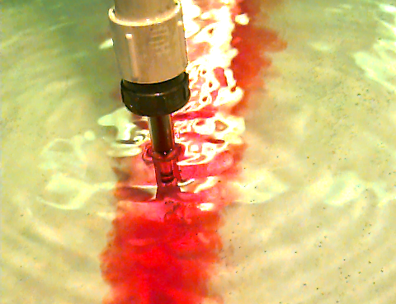
Conductivity probe
Platinum electrodes

Slide 43
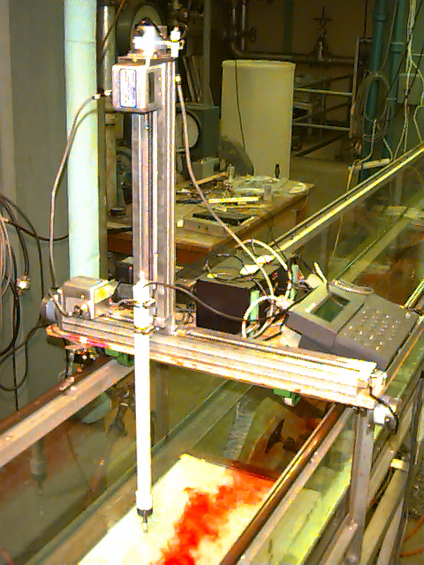
The Instrument
positioning system controller
vertical (z) slide
horizontal (y) slide
pH/ion/conductivity meter
x
horizontal (x) tracks
y
conductivity probe
z

Slide 44
Plume in a Flume Coming up...
Environmental Fluid Mechanics
Apply the advective dispersion equation
Discuss turbulent dispersion
Quantitative analysis
Estimate the dispersion coefficient
Compare model and data
Qualitative observations

Slide 45
Passive Plume in Turbulent Flow: Theory
C concentration
E_{y} dispersion coefficient
U advective velocity
M rate of mass input
d depth of water
x distance in direction of flow from source
y distance from plume centerline

Slide 46
Quantitative Analysis
Estimate the dispersion coefficient from the centerline concentration in region 2
Compare the measured dispersion coefficient with “rule of thumb” estimates
Compare measured concentration profiles with theoretical predictions

Slide 47
Dispersion Coefficient (E_{y}) Measurements
Concentration at center of plume
Estimate the dispersion coefficient at each x position

Slide 48
Dispersion Coefficient (E_{y}) Measurements
Plume Centerline Concentrations
200
150
100
NaCl (mg/L)
50
0
0
100
200
300
400
x (cm)

Slide 49
Centerline concentration: Vertical Mixing
2500
Region 1
Incomplete vertical mixing
2000
1500
NaCl (mg/L)
Measured with conductivity probe
1000
500
0
0
50
100
x (cm)

Slide 50
Dispersion Coefficient (E_{y}) “rule of thumb” Expectations
U
d
Integral velocity
Integral length
Plume Transects

Slide 51
Qualitative Observations
Depth of flow
Objects in flow
Momentum of discharge

Slide 52

Effect of Depth with Constant Flow
2.5 cm depth
5 cm depth
10 cm depth

Slide 53
Kármán Vortex Shedding
U
D
4.3D
Strouhal number
Reynolds number
Frequency of eddy shedding
Distance between eddies

Slide 54


Kármán Vortex Street
Control (no objects in flow)
8 cm diameter cylinder at side of port
L
8 cm diameter cylinder downstream of port

Slide 55
Summary
Mixing of a passive plume in a river is controlled by the large scale river turbulence
The largest scale of turbulence is roughly equal to the smallest dimension of the flow (in this case the depth of the river)
Instantaneous measurements of velocity and concentrations vary with time in a turbulent environment
The solution to the advective dispersion equation is a time averaged solution

Slide 56
Solution: Lateral Distribution of Slug
=1

Slide 57
Susquehanna: Plume Width
10% of centerline
in meters

Slide 58
Susquehanna: Centerline Concentration

Slide 59
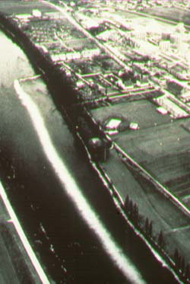
Plume in River
http://steens.ese.ogi.edu/

Slide 60
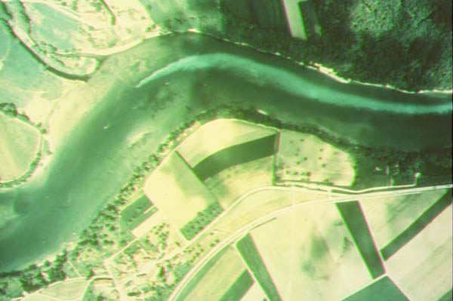
Plume contraction!
http://steens.ese.ogi.edu/

Slide 61
Plume transect 50 cm from source
200
150
100
NaCl (mg/L)
50
0
-20.0
-10.0
0.0
10.0
20.0
y (cm)

Slide 62
Plume transect 100 cm from source
200
150
100
NaCl (mg/L)
50
0
-20.0
-10.0
0.0
10.0
20.0
y (cm)

Slide 63
Plume transect 200 cm from source
200
150
100
NaCl (mg/L)
50
0
-20.0
-10.0
0.0
10.0
20.0
y (cm)

Slide 64
Plume transect 300 cm from source
200
150
100
NaCl (mg/L)
50
0
-20.0
-10.0
0.0
10.0
20.0
y (cm)

Slide 65
Steady-Uniform Flow: Force Balance
τ_{o}P Δ x
Shear force =________
Energy grade line
P
Hydraulic grade line
Wetted perimeter = __
b
γA Δx sinθ
c
Gravitational force = ________
Δx
a
d
W cos θ
θ
θ
Shear force
W
Hydraulic radius
W sin θ
Turbulence
Relationship between shear and velocity? ______________

