Slide 1
Flood Control

Slide 2
Flood Control
Beneficial effects of flooding
Flood control methods
Delineation of flood plain
Flood routing

Slide 3
Beneficial Effects of Flooding
Scour channel bottom of deposited sediment
increase carrying capacity of channel
deposit sediment on banks creating beaches
Move minerals from the mountains down to the plains
deposit sediments on flood plain
source of nutrients for crops
flood plains are often rich agricultural region (Nile, Mississippi...)
Engineered flooding
intentional large release from reservoir
Grand Canyon - to reestablish sand bars/beaches
http://www.pbs.org/kuat/grandcanyonflood/index.html

Slide 4
Definitions
Main channel - where the river usually flows
Flood plain
the flat land along rivers or streams that is periodically flooded
attractive for agriculture (fertile land)
attractive for development (navigation access and flat)
usually defined by 100-yr flood
Floodway
Federal Emergency Management Agency (FEMA)
the part of the stream channel that could contain the 100-yr peak flow with not more than a 1.0 ft increase in depth above that which would occur if the entire cross section carried the 100-yr peak flow

Slide 5
Flood Control Methods
Store part of the flood water in a reservoir
Land management (Soil Conservation Service) to increase:
infiltration
interception
depression storage - farm ponds
Divert flood flows into a flood bypass channel
Divert flood flows into another river basin
Regulate use of flood plains
US Flood Disaster Protection Act of 1973
keep people away from floods rather than floods away from people

Slide 6
Rethinking Floodplains
PAGE ONE -- Risky Construction on Floodplains Experts starting to question concept of `100-year flood' Michael Cabanatuan, Chronicle Staff Writer Monday,March 23, 1998 ©1998 San Francisco Chronicle
``People are continuing to build in bad locations and then turn to the federal government for assistance when they flood,'' said Jason Fanselau, spokesman for the U.S. Army Corps of Engineers. ``It's an endless cycle.''
The cycle is perpetuated by ... dependence on a dubious flood-prevention standard -- the 100-year floodplain.
A 100-year floodplain is a statistical guess that the area faces a 1 in 100 chance of flooding each year. Federal engineers look at river elevation figures and topography and draw a line on a map. That line guides flood insurance, levee and dam construction and the location of new homes. Over the life of the standard 30-year mortgage, there's a 26 percent chance it will be inundated.
``It's this ephemeral line in the sand that separates those perceived as at risk and those who are perceived as not at risk,'' said Jeffery Mount, a University of California at Davis geologist and authority on California rivers. ``And it's all wrong.''
``Historical records just don't go back that far,'' Fanselau said. ``In Europe they go back 1,000 years or more; on the East Coast they go back hundreds. In Sacramento they go 95 years back. The West is so relatively new that we have to use the best information we have. But it's not sufficient.''

Slide 7
Rethinking Floodplains
With floods becoming a seemingly annual occurrence, the tide shows signs of turning. From geologists and hydrologists to the Army Corps of Engineers, the Federal Emergency Management Agency and the state, officials are calling for renewed scrutiny of floodplains and new construction.
For years, the state's booming population and the rising demand for affordable housing have spurred development in the Central Valley -- most of which is a historic floodplain. New subdivisions are springing up -- many in vulnerable areas that could be inundated underneath as much as 30 feet of water.
East of the Altamont Pass in San Joaquin County, developers plan to build Califia (formerly Gold Rush City) -- up to 9,000 houses and condominiums, four theme parks and three golf courses -- on Stewart Tract, an island in the Sacramento-San Joaquin River Delta that spent the first two months of 1997 underwater. They plan $15 million in levee improvements.
On the northern edge of Sacramento, at least 30,000 homes are envisioned in North Natomas, an area wedged between the Sacramento and American rivers and ringed by levees. A levee break would cause the area to ``fill up like a bathtub'' with 20 to 30 feet of water, said Mount.
``People are going to die when those areas flood,'' said Fanselau.
Not building on such floodplains may sound like common sense and sound planning. But state and federal lawmakers have steered clear of prohibiting floodplain development, and few policies discourage such growth.
While the federal government helps bail out flood victims with assistance and loans, decisions on who builds what in a floodplain remain the province of cities and counties that often feel economic or political pressure to grow.

Slide 8
Flood Control Projects
Tennessee Valley Authority (TVA)
36 major dams on the Tennessee River
14 dams on adjoining rivers
106,000 km² (40,900 mi²) drainage basin
14.8 km³ (12,000,000 acre-ft) reserved for flood storage
14 cm of flood storage over entire basin!
Columbia River
210 projects
76.5 km³ (62,000,000 acre-ft) reserved for flood storage
665,400 km³ (256,900 mi² ) drainage basin
11.5 cm of flood storage over entire basin!

Slide 9
Tennessee Valley Authority
TVA manages the Tennessee River and its tributaries to control flooding and enable transportation along the 652-mile Tennessee River system, the nation's fifth-largest river system.
TVA's flood control program prevented an estimated $1 billion in flood damages across the Valley in 1994. Without the protection of TVA's reservoir system, the city of Chattanooga would have been devastated twice by floodwaters during the heavy rains of 1994.
Besides preventing floods, TVA's network of dams and locks makes possible the transportation of some 48 million tons of cargo annually.

Slide 10
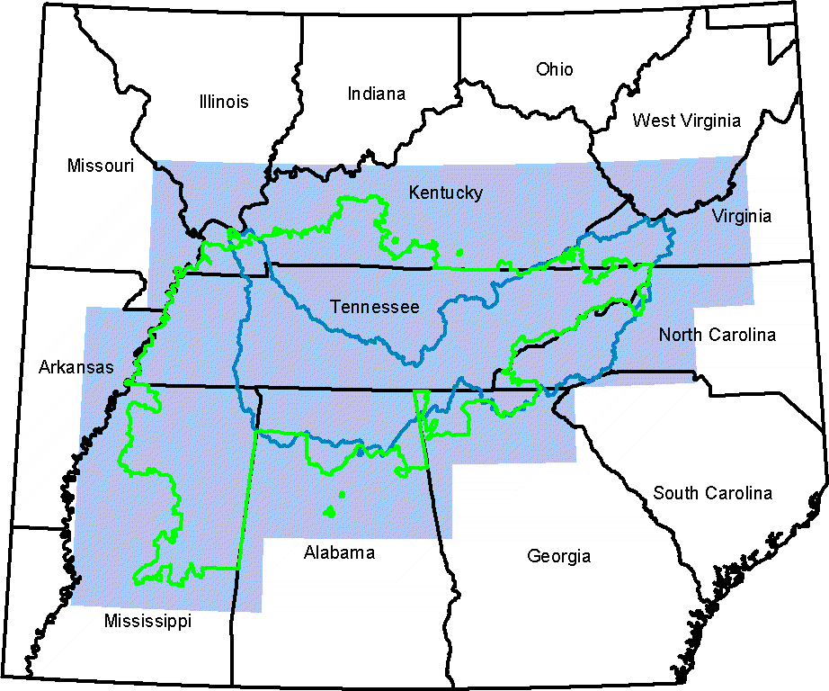
Tennessee Valley Authority

Slide 11
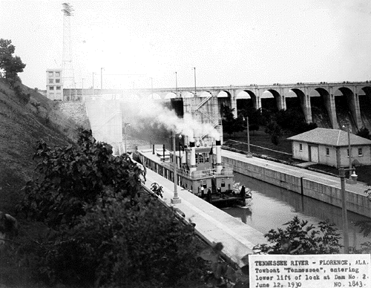
Navigation
Towboat "Tennessee" entering lower lift of lock at Dam No. 2. Florence, Alabama. June 12, 1930

Slide 12
Flood Routing
Level-pool routing
movement of flood through a lake/reservoir
based on mass balance and stage/discharge relationship for lake
River routing
attempts to apply similar technique to a section of a river
storage in the river section is a not a simple function of elevation at the downstream end
Muskingum method of storage routing - 1938

Slide 13
Level Pool Routing
flood storage
flood stage reservoir level
I
S
normal maximum reservoir level
O
for a specified Dt (routing interval)

Slide 14
Level Pool Routing: Solution
select a value for the routing interval and plot a curve between O and (2S/Δt)+O
At the beginning of each time interval the values I_{i}, I_{i+1} and O_{i} are known (O_{i} = O_{i+1} from the previous time interval)
Estimate using the curve and
Now everything on the right hand side of the equation is known
Given find O_{i+1} using the curve.

Slide 15
Level Pool Routing: General Expectations
2500
Inflow
outflow peak less than inflow peak
outflow peak occurs after inflow peak
maximum outflow occurs when inflow equals outflow
Maximum at intersection
Q (m³/hour)
Outflow
500
0
10
20
30
40
50
t (hours)

Slide 16
River Routing
Flow curve (m³/s)
Storage curve (area under curve is total storage along reach) (m²)
Depth curve (m)
Distance along reach

Slide 17
River Routing
For uniform flow in a river, storage can be expressed as a function of either the inflow or the outflow (inflow = outflow for uniform flow)
For nonuniform flow, storage is a function of the depth of the river along the reach
To simplify computations we make the approximation that storage is a function of the flow of the river at the ends of the reach
X is a dimensionless weighting factor between 0 and 1
K has units of time (turns out to be the time for a small wave to travel the reach)
both can be estimated from previous flood data

Slide 18
River Routing: Finite Difference Equations
Write for beginning and end of time step, then substitute both equations into the finite difference form of the mass balance equation
Solve for outflow at the end of the time step (the unknown)
Dimensionless coefficients that are only functions of the time interval, K, and X

Slide 19
Definitions
Bank full capacity - ­mean annual flood (exceeded about once every two years)
Flood return periods - will be selected depend on the potential loss associated with flooding
Nuclear Power Plants - PMF
Industrial development
Residential development
Agricultural land - 5-20 year return period

Slide 20
Estimates of Maximum Flood Flow
Extreme events of interest for high risk facilities
Difficult to estimate because record keeping only began recently
Record flood flow = f(climate, storm structure, drainage area, basin morphology,...)
Creager equation
Exceeds most recorded flood flows
Does not necessarily correlate with Probable Maximum Flood
Q_{p} = peak flow (cfs)
A = drainage area (mi²)
C ­ 100

Slide 21
Estimates of Maximum Flood Flow: Probable Maximum Flood
Estimate probable maximum precipitation
Define design storm (duration and intensity)
Estimate rainfall excess
Use unit hydrograph
duration should not exceed 20% of time of concentration
use superposition of hydrographs for longer duration storms

Slide 22
Design Floods
Used to delineate where development can occur
Used to design flood protection schemes
U.S. Army Corps of Engineers
responsible for flood control on all navigable streams
Standard Project Flood
based on recorded floods
not necessarily designed to have any given return period
political benefit that people can often remember the flood

