Slide 1
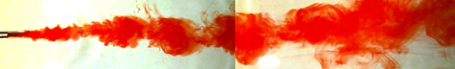
Plume in a Flume
Monroe Weber-Shirk

Slide 2
Overview
Pollutant Mixing in Open Channel Flow
Experiment description
Instrumentation
Results and Analysis

Slide 3
Pollutant Mixing in Open Channel Flow: Objectives
Characterize turbulent flow
integral velocity
integral length
“but it doesn’t look turbulent”
Apply the advective dispersion equation
Measure the dispersion coefficient

Slide 4
Experiment description
Flume (laboratory river)
46 cm wide, 7 m long, variable depth
tap water supply (1.8 L/s)
Plume
sodium chloride (to increase conductivity)
red dye #40 (for qualitative observations)
discharged by peristaltic pump through single port

Slide 5
Virtual Instrument
Simultaneous control of
3 axes positioning system
position conductivity probe anywhere in flume
pH/ion/conductivity meter
measure conductivity
Automatic measurement of conductivity along a transect (in x, y, or z direction)

Slide 6
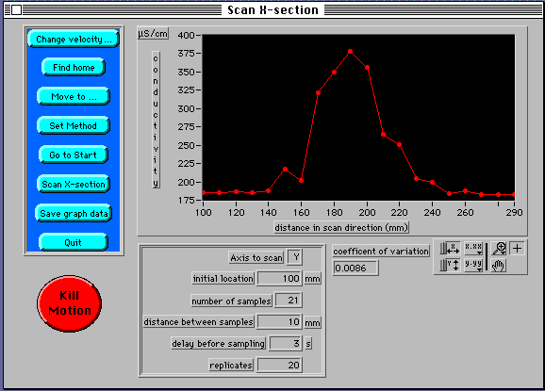
Virtual Instrument Control Panel

Slide 7
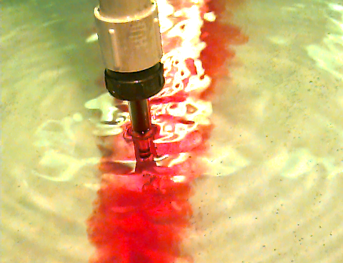
Conductivity probe
Platinum electrodes

Slide 8
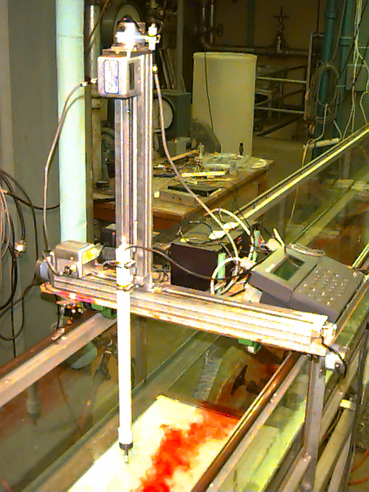
The Instrument
positioning system controller
vertical (z) slide
horizontal (y) slide
pH/ion/conductivity meter
x
horizontal (x) tracks
y
conductivity probe
z

Slide 9
Plume in a Flume Coming up...
Environmental Fluid Mechanics
Apply the advective dispersion equation
Discuss turbulent dispersion
Quantitative analysis
Estimate the dispersion coefficient
Compare model and data
Qualitative observations

Slide 10
Passive Plume in Turbulent Flow: Theory
C concentration
E_{y} dispersion coefficient
U advective velocity
M rate of mass input
d depth of water
x distance in direction of flow from source
y distance from plume centerline

Slide 11
Quantitative Analysis
Estimate the dispersion coefficient from the centerline concentration in region 2
Compare the measured dispersion coefficient with “rule of thumb” estimates
Compare measured concentration profiles with theoretical predictions

Slide 12
Dispersion Coefficient (E_{y}) Measurements
Concentration at center of plume
Estimate the dispersion coefficient at each x position

Slide 13
Dispersion Coefficient (E_{y}) Measurements
Plume Centerline Concentrations
200
150
100
NaCl (mg/L)
50
0
0
100
200
300
400
x (cm)

Slide 14
Centerline concentration: Vertical Mixing
2500
Region 1
Incomplete vertical mixing
2000
1500
NaCl (mg/L)
Measured with conductivity probe
1000
500
0
0
50
100
x (cm)

Slide 15
Dispersion Coefficient (E_{y}) “rule of thumb” Expectations
U
d
Integral velocity
Integral length

Slide 16
Plume transect 50 cm from source
200
150
100
NaCl (mg/L)
50
0
-20.0
-10.0
0.0
10.0
20.0
y (cm)

Slide 17
Plume transect 100 cm from source
200
150
100
NaCl (mg/L)
50
0
-20.0
-10.0
0.0
10.0
20.0
y (cm)

Slide 18
Plume transect 200 cm from source
200
150
100
NaCl (mg/L)
50
0
-20.0
-10.0
0.0
10.0
20.0
y (cm)

Slide 19
Plume transect 300 cm from source
200
150
100
NaCl (mg/L)
50
0
-20.0
-10.0
0.0
10.0
20.0
y (cm)

Slide 20
Qualitative Observations
Depth of flow
Objects in flow
Momentum of discharge

Slide 21

Effect of Depth with Constant Flow
2.5 cm depth
5 cm depth
10 cm depth

Slide 22
Kármán Vortex Shedding
U
D
4.3D
Strouhal number
Reynolds number
Frequency of eddy shedding
Distance between eddies

Slide 23


Kármán Vortex Street
Control (no objects in flow)
8 cm diameter cylinder at side of port
L
8 cm diameter cylinder downstream of port

Slide 24
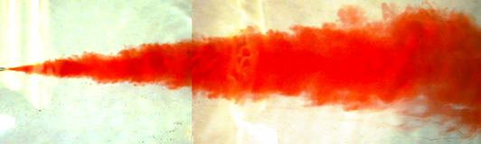

Momentum of Discharge
small port
⇧ momentum
⇧ jet mixing
large port
⇩ momentum
⇩ jet mixing

