Slide 1
Gravity Water Supply Design
What information do you need?
What kinds of data would you expect to have?

Slide 2
Gravity Water Supply Design
Design flows
Population projection
Demand variability
Tank buffering
Transmission line design algorithms
Air in pipelines

Slide 3
Population Projection
Example from Agua Para el Pueblo (Honduras)
Count the houses
Assume 6 people per house
Assume linear growth for design period
N = design period
K = growth rate

Slide 4
Water Demand
Assume a per capita demand (this might be based on a governmental regulation)
Multiply per capita demand by the future population to get design average demand
Multiply average demand by peak factors to get maximum day demand and maximum hour demand

Slide 5
Peak Flow Factors
Δt range typical value
day 1.5 - 3.0 1.8
hour 2.0 - 4.0 3.25
Running average over time Δt
“In small water systems, demand factors may be significantly higher than those shown…”
C Chin. Water-Resources Engineering
Notes:
C Chin. Water-Resources Engineering.

Slide 6
Peak Flow Factors (2)
A dimensionless quantity
What is it a function of?
__________________
Longest interval _____
Shortest interval _____
__________________
Averaging interval
year
?
Number of taps
(Population)
1 day
Where is steep slope?______

Slide 7
Population and Peak Flow Factor
What is the instantaneous peak factor for one person?
Average flow (100 l/d)
Max flow (5 l/min = 7200 l/d)
What is the maximum (typical) duration of this high flowrate?
20 minutes would get average daily flow so perhaps this is a reasonable guess (1200 s)
7200
72
100

Slide 8
Peak factors and Transmission Lines
The smallest diameter transmission line that could possible work is one that would exactly provide the average demand
We would need to accommodate the variable demand with a very large storage tank (that could handle seasonal fluctuations)

Slide 9
Tank size – Pipe diameter tradeoff
The peak factor is small for time periods greater than 1 day
The storage volume required for long time periods is great
Tanks are typically designed to accommodate fluctuations over periods of time less than one day
Transmission lines are designed to accommodate flow for the maximum day
If the transmission line has a length of zero meters, what size should the distribution tank be?
Eliminate the tank???

Slide 10
Distribution Storage Tank Functions
Buffers demand fluctuations
Chlorine contact time for disinfection
Can be used during transmission line maintenance operations to provide continuous supply
If transmission line fails the system continues to provide water
Fire protection
Which function dominates?

Slide 11
Design Flows
Transmission Line Design flow
Based on maximum daily demand at the end of the system design life
Distribution system design flows
Take maximum hourly flow at the end of the system design life
Divide that flow by the current number of houses to get a flow per house
The flow in each pipe is calculated based on the number of houses downstream
This flow scheme doesn’t work for small systems!!!!
Tank provides buffering for 1 day

Slide 12
Pipe Diameters
How are pipe sizes chosen?
Energy Equation
An equation for head loss
Requirement of minimum pressure in the system
Pipes must also withstand maximum pressure
V is typically less than 3 m/s for pipelines

Slide 13
Transmission Line Design
EGL
Distribution Tank
HGL
Spring box
Air release valves

Slide 14
Hydraulic Grade Line Minimum
Avoid having the HGL below the point in the system for which it is plotted (negative pressure)
Air will accumulate at intermediate high points in the pipeline and the air release valve won’t be able to discharge the air if the pressure is negative

Slide 15


Air Release Valves
Air release valves are prone to failure
Must be located precisely
I hope to provide more info in section on air in pipes
http://www.apcovalves.com/airvalve.htm
http://www.ipexinc.com/industrial/airreleasevalves.html

Slide 16
Transmission Line Design
Where do we get each term in the equation for pipe diameter?
What is wrong with the slope of my lines?
Critical point

Slide 17
Transmission Line Design Steps
Calculate the ratio for each known point along transmission line starting from the source.
L is the total pipe length (not horizontal distance)
Find the maximum ratio
Find the minimum pipe size

Slide 18
Transmission Line Design Steps Continued
Round up to the next real pipe size (check your materials database)
Calculate the location of the HGL given the real pipe size
Calculate the location of the HGL at critical point i
Now begin at point i at the HGL elevation and repeat the analysis

Slide 19
Designing the next section
We are finding the HGL that meets the requirement “HGL must be above the pipeline”
Actual HGL given real pipe size
Pipelines can have multiple critical points or a single critical point (the end of the line!)

Slide 20
Alternate Pipe Size Selection Procedure
Given design flow rate, calculate for each pipe
Given the required ratio of pipe length to elevation drop select a pipe from the appropriate schedule that has a value of that is greater than the required value

Slide 21
Mix pipe sizes to get design flow
We could mix a large pipe and a small pipe to more closely deliver the design flow
Given total pipeline length (L) and total elevation difference (h_{f})
Select a pipe with smaller (L/h_{f})₁ and a pipe with larger (L/h_{f})₂
Calculate length of each pipe required subject to total length and total head loss constraints

Slide 22
Two Pipe Size Mix
Head loss constraint
Length constraint

Slide 23
Mixing pipe sizes
If you install the small pipe upstream from the large pipe it is possible that the HGL will drop below the pipeline
If there aren’t any other constraints, install the large pipe diameter upstream
If possible, use the small pipe where higher pressure rating PVC or galvanized iron pipe is required

Slide 24
Pressure Constraints
Different “schedules” of pipe can withstand different pressures (higher pressure means thicker walls means more money)
The system must be designed so that a valve can be closed right at the distribution tank and the pipes must withstand the resulting static pressure (p=ρgh)

Slide 25
PVC Schedules
Schedule | Max pressure (psi) | Max Static Head (m)
SDR 26 | 160 | 112
SDR 21 | 200 | 141
SDR 17 | 250 | 176
SDR 13.5 | 315 | 221
40 and 80 | f(diameter) | f(diameter)

Slide 26
Schedules 40 and 80

Slide 27
Different pipe materials
Galvanized iron pipe is more expensive than PVC and is rougher (has more head loss)
So it can be logical to use smaller galvanized iron pipe than PVC pipe even though the head loss will be much greater through the iron pipe!

Slide 28
Goal is to get design flow rate at minimum cost
I am not sure what the correct algorithm is!
The available energy can be “spent” as head loss wherever you like
Goal is to use the energy where it reduces the project cost most
Use smaller diameter pipes for high pressure sections of PVC pipe or for galvanized iron pipe
Head loss changes rapidly as pipe size changes, so it will only be possible to use slightly smaller pipes.

Slide 29
Hydraulic Gradeline
2”
1.5”
HGL
Static HGL
112 m

Slide 30
Pressure Break
A small tank (with a free surface) in a pipeline used to prevent high pressure downstream from the pressure break
Inflow can be regulated by a float valve
If inflow is unregulated excess water will exit through an overflow
Pressure breaks can be installed to make it possible to use cheaper pipes

Slide 31


Surveying
Vertical angle
θ
Δx
r
Δz

Slide 32
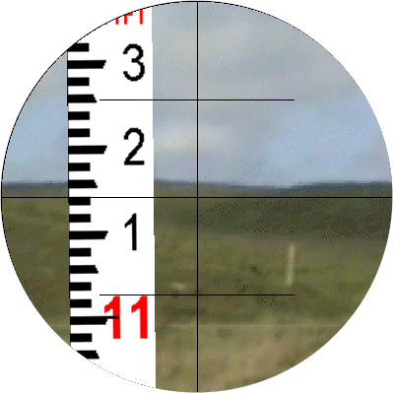
Surveying using Stadia
Vertical angle
θ
Δx
r
Δz
b
c
The reading is on a vertical rod, so it needs to be corrected to the smaller distance measured perpendicular to a straight line connecting the theodolite to the rod.
a

Slide 33
Horizontal Distance
Trig identity
M is the Stadia multiplier (often 100)
c is the Stadia reading

Slide 34
Vertical Distance
Trig identities

Slide 35
GPS surveying accuracy
100 meters: Accuracy of the original GPS system, which was subject to accuracy degradation under the government-imposed Selective Availability (SA) program.
15 meters: Typical GPS position accuracy without SA.
3-5 meters: Typical differential GPS (DGPS) position accuracy.
< 3 meters: Typical WAAS position accuracy
WAAS not available everywhere

Slide 36
GPS with Barometric Altimeter
15 m isn’t nearly good enough for vertical measurements when designing pipelines
Barometric pressure decreases with elevation
Can we use barometric pressure to measure elevation?
We need an accurate measure of______

Slide 37
Perfect Gas at Constant Temperature (Isothermal)
ρ is function of p
M_{gas} is molecular mass
Integrate…

Slide 38
Perfect Gas with Constant Temperature Gradient
The atmosphere can be modeled as having a constant temperature gradient
β = 0.00650 K/m
Lapse rate
Mt. Everest
8,850 m

Slide 39
Pressure Differential
To measure a 1 meter difference in elevation the altimeter must be able to resolve a 10 Pa difference in pressure given a total pressure of approximately 100,000 Pa
Barometric altimeters require extremely high resolution (5 or 6 digits of precision)

Slide 40
Elevations that are as Changeable as the Weather
Changes in the weather can produce barometric pressure differences of 2500 Pa
This pressure change translate to an elevation error of 220 m!
Compensation for barometric pressure fluctuations is essential
Use a 2nd barometric altimeter to log elevation while at a fixed location
Notes:
http://www.globalw.com/support/barocomp.html

Slide 41
Air in Pipelines
Three sources of air
Startup
Low flow
Air super saturation

Slide 42
Air Outline
Will the water flow with air in the pipeline?
HGL for a pipeline with air
Trapped air volumes
Dimensional Analysis?
Under what conditions will the air be forced through the pipeline?
Air handling strategies
Air release valve at all high points
Conventional strategy
Valves must be placed carefully
Design high flow rates that carry air downstream

Slide 43
Will water flow in the pipeline?
Constant pressure
What is the slope of the HGL in the section of pipe with air? ___________________
How much head is lost in the air section?______
What does the HGL look like if a valve is closed at the end of the pipeline?
How much head is available for major losses?
Same as slope of pipeline
height

Slide 44
What is the volume of air?
Function of
Topography
Air entrapped during filling
Air carried in during operation
Worst case
All downward sloping pipe downstream of a high point (other than the source) could be filled with air

Slide 45
Air purge: length, velocity, density, forces
Length:
Velocity: average water velocity
Density:
Forces:
pipe diameter, pipe length, elevation change
water density, air density
inertia, viscosity, gravity, surface tension
Will there be a transition in water surface elevation?
Froude number!

Slide 46
What mechanism moves the air?
Shear between water and air
Entrainment of air by turbulence
Hydraulic jump at the bottom of the air column
Waves and whitecaps down the incline
As the flow rate increases, is there a transition when it is no longer possible for the water to switch to open channel flow?
Notes:
Water is flowing too fast to transition to a shallower depth (energy conservation or wave speed requirement)

Slide 47
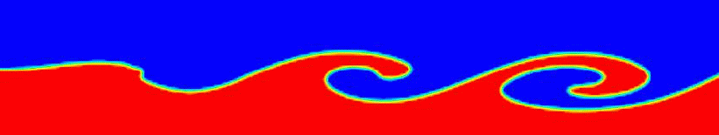
Air Entrainment by surface breakup
β_{e} Air Entrainment (perhaps fraction of fluid that is air)
But according to Gilles Corcos the entire “sock” of air is carried through the system at once.
Another mechanism moves the water out before shear gets this large!
Is the air pulled out or pushed out?

Slide 48
Subcritical vs. Supercritical
The energy grade line must always drop in the direction of flow
If the flow switches from full pipe to partial pipe the velocity must increase as the depth decreases ______________
At a certain critical velocity it is no longer possible to reduce the depth because it would require a net increase in energy ___________________________________
K.E. increases
K.E. increase > P.E. decrease
Froude number

Slide 49
Waves…
Another way to think of this…
The air is forced out of the pipeline by a wave that is traveling down the pipe
The wave is forced to travel down the pipe when the wave speed is less than the water velocity!
Froude number is the ratio of the water velocity to the wave speed!
Mach is pressure wave speed, Froude is gravity wave speed

Slide 50
Wave propagation
c is wave velocity relative to water
The wave speed is not a function of the air pressure!
y is the water depth…
… water depth in a pipe
r
A
y
Better definition
T

Slide 51
Energy Equation at Transition to Open Channel Flow
cs₁
cs₂
z
A contraction (but no vena contracta)
Mechanical Energy is conserved
y is water depth

Slide 52
Flow in Round Conduits
radians
r
θ
A
y
T

Slide 53
50% full case
Suppose the conduit is running 50% full of water
Then if Q is greater than a wave would be forced downstream
What determines if Q is greater than this critical flow? ______________ ___________________ ___________________
Flow in the pipeline given lost head due to trapped air

Slide 54
Celerity in Conduits
The area of the pipe filled with water
The top width of the water surface
So if V is greater than c a wave has to travel downstream
The wave celerity must vary with the depth of water
How? Plot celerity as function of depth in a pipe

Slide 55
Celerity vs. Water Depth in a Pipe
As water depth increases, so does the wave velocity
This suggests that it is more difficult to purge air when the pipe is running almost full
If pipe is 80% full the wave celerity would be 1.5 x the wave celerity of a 50% full pipe

Slide 56
95% full case
Suppose the conduit is running 95% full of water
Then if Q is greater than a wave would be forced downstream
So we expect critical flow to be between
Gilles Corcos Emeritus professor of fluid mechanics U. of California Berkeley , M.E. Department

Slide 57
Design to move the air
Only a problem if there is an intermediate high point
Attention to detail when laying the pipe!
A design procedure is given in Air in Pipelines
Or install air release valves at high points where the flow rate is less than the critical flow

Slide 58
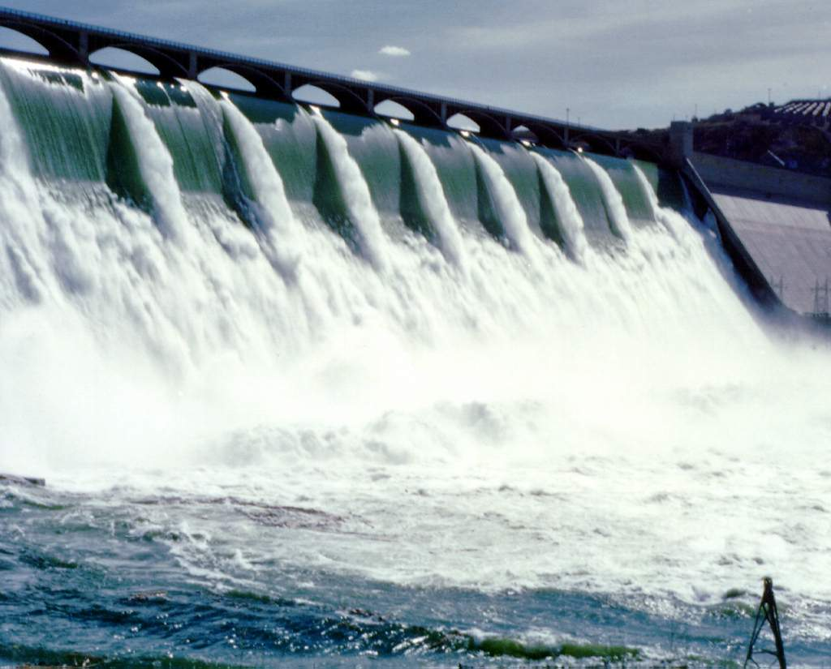
Grand Coulee Dam

