Slide 1
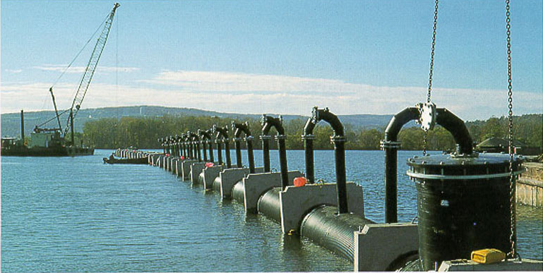
Manifold Hydraulics
Cayuga Lake
Ithaca WWTP Outfall

Slide 2
Manifolds
Examples
Sprinkler and drip irrigation systems
wastewater discharge (multiport diffuser)
Design objectives
distribute a given discharge through multiple ports
choose pipe size given constraints of head loss, flow distribution, and cost
uniformly

Slide 3
Multiport Diffuser
Objectives
Minimize detrimental effects of the discharge on the environment
Maximize initial
Meet regulatory requirements
Pollutants
treated wastewater
Cooling water from power plant
Sites
Rivers, Lakes, Oceans
BOD, N, P, metals
dilution
Heat

Slide 4
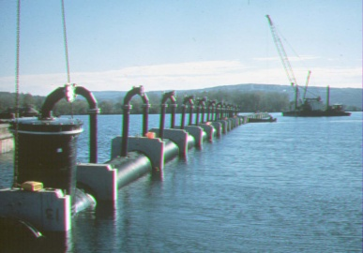
Multiport Diffuser
energy grade line
hydraulic grade line
Remember Expansions
?
z = 0
Representation of EGL and HGL for multiport diffuser. Does it make sense?
What happens to HGL across the ports?

Slide 5
Multiport Diffuser: Flow Calculations
HGL
We will derive equations in terms of ________ because pressure controls the port flow
Port flow
based on ______ equation
head loss through port (possibly including a riser)
Piezometric head change (ΔH) across port
flow expansion
Piezometric head change (Δ H) between ports
Darcy-Weisbach and Swamee-Jain
energy
In diffuser

Slide 6
Port types
Nozzle riser
diffuser can be buried
nozzle can give direction to discharge
Port cast in wall of diffuser pipe
can’t be used if diffuser pipe is buried
generally not recommended

Slide 7
The Problem
Given a desired discharge
Calculate the head (pressure) required
Calculate the flow from each port
Develop a strategy to solve this problem
Simple Solution
________ ________ in the diffuser pipe
Each port is an ________________
Complete Solution
Determine HGL for the diffuser pipe
Constant pressure
exit (minor losses)

Slide 8
Strategy
The diffuser has many ports. If we can develop equations describing pressures and flows at one port we can then apply them to all of the ports.
We need equations describing
Flow from a port as a function of pressure (HGL) in the diffuser
Head loss (and pressure drop) in the diffuser
Flow in the diffuser _________________
(mass conservation)

Slide 9
Port Flow
z = 0 at water surface
port
piezometric head
riser
0
Control volume?
diffuser pipe

Slide 10
Riser Head Loss
continuity

Slide 11
Riser Head Loss Coefficient
(riser loss coefficient)
Note that the riser coefficient is a function of ________ number.
Reynolds
Port velocity (or flow) given piezometric head in diffuser and a riser loss coefficient
Orifice equation!

Slide 12
Head Loss across Port
expansion
Flow ____________
Same equation applies as derived previously
The velocities upstream and downstream from the port are determined from continuity
separation
V_{i}
V_{i+1}
1
2
Pressure
Momentum
_________ applied over entire cross section
___________ transferred over smaller area

Slide 13
HGL in Diffuser across Port
EGL
Head loss occurs between section 1 and section 2 some distance downstream (~5 times the diameter of the diffuser)
We will treat this head loss as if it all occurred immediately after the port
Although there is head loss past the port the pressure (HGL) will __________ (proof coming up)
HGL
ΔH from pressure recovery
V_{i}
V_{i+1}
increase
1
2

Slide 14
HGL in Diffuser across Port
energy
________ equation using definition of piezometric head
pressure increase across abrupt expansion

Slide 15
HGL in Diffuser across Port
How can we find velocity downstream of port i? ___________
continuity
Now we have the velocity downstream of the next port
And we can calculate the increase in HGL across the port

Slide 16
HGL between Ports
HGL is parallel to EGL so ΔH = ΔE between diffusers
ΔE = -h_{f} and is due to friction loss (major losses)

Slide 17
Multiport Diffuser: Solution
The diffuser number, spacing, and jet velocity would be determined in part by the mixing required in the ambient water (Environmental Fluid Mechanics)
Available head and total flow would be determined by the water source hydraulics
A criteria may also be established for uniformity of flow from the ports
Alternate design criteria may dictate different solution methods

Slide 18
Multiport Diffuser: Solution
Given total discharge, pipe diameter, port size...
Calculate the piezometric head (measured from the water surface) required to give the necessary discharge in the first port
loss coefficient for port
head required to get desired flow from port

Slide 19
Multiport Diffuser: Solution
Starting with the first port and proceeding to the last port ...
Calculate the discharge from port i
Calculate velocity change in diffuser past port i
Calculate the piezometric head increase across port i
Calculate the piezometric head decrease between ports i and i+1
Calculate the piezometric head at port i+1

Slide 20
Sum up all the expansion gains

Slide 21
Sum up all the head losses

Slide 22
Multiport Diffuser: Solution
4
HGL
1
decrease
(_________ in pressure)
3
increase
(__________ in pressure)
V_{i}
2
Known from previous step
5

Slide 23
Multiport Diffuser: Solution
Calculate the total discharge from the ports
Compare with design discharge
Adjust the _________ ____ at first port to give design discharge (use goal seeking, solver, or trial and error on spreadsheet). Alternately, set velocity past last port = 0 by changing piezometric head at first port.
It may be necessary to adjust diffuser or port diameter.
It will likely be possible to decrease the size of the diffuser pipe as the flow decreases. This may also help increase the discharge uniformity of the ports.
piezometric head

Slide 24
Multiport Diffuser: Example Solution (1 m pipe)
SI units

Slide 25
Multiport Diffuser: Example Solution (0.63 m pipe)
SI units

Slide 26
Design Guidelines
The port discharge velocity should be _______ to achieve good mixing with the ambient water.
The sum of all port areas must be less than the diffuser pipe area. The best area ratio (port area/diffuser area) is usually between 1/3 and 2/3.
The effects of pipe friction and pressure recovery will tend to cancel when
L_{d} is the total length of the diffuser pipe and the friction factor, f, is obtained by iteration since it is a function of the pipe diameter.
If the diffuser area obtained using this method is less than 1.5 x port area then this design criteria can not be used.
~3 m/s
Notes:
Mixing in Inland and Coastal Waters
Hugo b Fischer, E. John List, Robert C.Y. Koh, Jorg Imberger, Norman H. Brooks
1979, Academic Press

Slide 27
Multiport Diffuser: Thought Experiments
What happens to the uniformity of flow rates from the ports as the size of the diffuser pipe decreases? (Assume the pressure in the feeder pipe is varied to maintain constant flow while the port size remains the same.) ______________
What happens to the uniformity of flow rates from the ports as the size of the ports decreases? ______________
If the goal is uniform flow distribution why not use very small ports? ____________________
Which port will have the highest flow rate? _____________
Less Uniform
More Uniform
Energy requirements
First or last!

Slide 28
Diffuser Homework
20 ports
Hometown WWTP
300 m
95 m

Slide 29
Quiz
The friction factor for major losses in pipe flow is relatively constant for a given geometry at high Reynolds numbers. Head loss is proportional to the friction factor. Therefore head loss is independent of Reynolds number at high Reynolds numbers. Explain why this is or isn’t true.
In large multiport diffusers the diameter of the main diffuser pipe is decreased in increments as the flow decreases (due to discharge from the ports). If you compare discharge from a port upstream from a decrease in diffuser pipe diameter with the port just downstream from a diameter change which port will have the highest flow? You may assume the transition in diffuser pipe diameter is smooth. Explain your answer and sketch the HGL and EGL.

