Slide 1
Turbulent Jets and Plumes

Slide 2
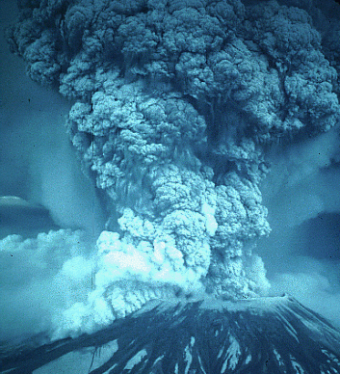
Turbulent Jets and Plumes
Discharge of society’s wastes into the environment
smokestacks
wastewater discharges
automobile exhaust
Natural events
volcanoes
forest fires
dragons
http://www.riverdale.k12.or.us/helens/slides/slide.htm
Dragons

Slide 3
Some definitions
Jet
driven by _________ of the source
Ex. garden hose submerged in swimming pool
Plume
driven by ________ differences
Ex. smoke from open fire
Buoyant Jet
combination of momentum of source and density
Ex. Wastewater discharge into ocean
initial flow controlled by _________
far from source controlled by _________
momentum
density
momentum
buoyancy

Slide 4
Turbulent Jet and Plume Characteristics
Jet
efficient mixing with the ambient fluid
kinetic energy is lost to turbulence
momentum is conserved
Plume
efficient mixing with the ambient fluid
potential energy is converted to kinetic energy
kinetic energy is lost to turbulence
momentum is conserved (but must take body force into account)

Slide 5
Jet Parameters
initial jet velocity
initial turbulence of discharge
jet mass flux
jet momentum flux
jet tracer material
heat
salinity
contaminant

Slide 6
Environmental Parameters
ambient turbulence levels
currents
cross flows
co flows
counter flows
density stratification
thermal
salinity

Slide 7
Geometrical Factors
jet discharge port shape
orientation
proximity to adjacent jets
proximity to solid boundaries
attitude of the jet
distance to free surface

Slide 8
What we’d like to know
Contaminant concentration as function of distance from source
Velocity of jet or plume as function of distance
Width of jet or plume as function of distance
3 unknowns, so we need 3 equations!

Slide 9
Tools to get there
From basic principles
conservation of momentum
conservation of mass (of tracer)
conservation of energy
rate of spread of jet (spreading law)?
From dimensional analysis
need to identify the important parameters
still need spreading law

Slide 10
Cases to analyze
Jet
round jet
plane jet
Plume
round plume
plane plume

Slide 11
Axisymmetric Jet
Geometry
round
axisymmetric
3-d problem
Ambient water
much less shear than in jet
no flow (for this simple case)
velocity profile
(statistical mean)
edge of jet turbulence
Ambient: , V=0, C=0
d
Jet: , V_{o}, C_{o}

Slide 12
Simple Jet Spreading
s
velocity fluctuations at any location are proportional to the velocity of the jet at that location
b
d

Slide 13
Momentum: Axisymmetric Jet
s
M term here?
external forces balance
b
substitute for area
control
volume
jet spreading equation
d

Slide 14
Concentration of Conservative Tracer: Axisymmetric Jet
s
at steady state mass flux [M/T] is constant
b
d

Slide 15
Concentration of Conservative Tracer: Axisymmetric Jet
s
b
(jet spreading)
(velocity in jet)
d

Slide 16
Round Jet: Empirical Constants
b is defined such that the velocity is ____________ of the centerline velocity
37% (1/e)
d
Centerline velocity and concentration
Jet: , V_{o}, C_{o}

Slide 17
Plane: (2-D) Jets
Spreading of the jet will be by the same mechanism
Momentum conservation will give a different relationship for centerline velocity
Per unit length
show this for HW

Slide 18
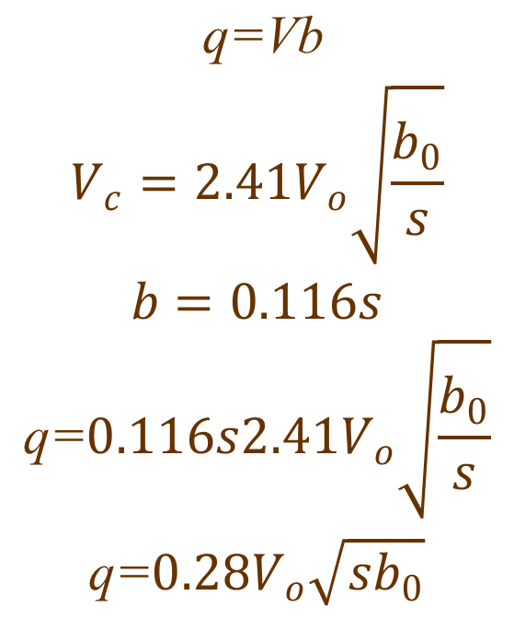
Plane Jets: Empirical Coefficients
$$\begin{matrix} \text{q}\text{=}\text{Vb} \\ V_{c}=2.41V_{o}\sqrt{\frac{b_{0}}{s}} \\ b=0.116s \\ \text{q}\text{=}0.116s2.41V_{o}\sqrt{\frac{b_{0}}{s}} \\ \text{q}\text{=}0.28V_{o}\sqrt{sb_{0}}\end{matrix}$$

Slide 19
Jet Design Problem
Given a discharge with an environmental requirement of achieving a high dilution measured at the surface of a body of water. What are the three things you can do to maximize the dilution of the discharge before the jet reaches the water surface?
plane jet
Increase depth of submergence
Discharge at an angle
Decrease port size (multiple ports!)
round jet

Slide 20
Plumes
less well defined boundary between plume and ambient (billows)
full description of velocities and concentrations is very complex
time averaged shape of plume similar to jet (same spreading law)
momentum still conserved but with inclusion of a ____ force (due to buoyancy)
body

Slide 21
Plume Exercise
What parameters are important in determining the time averaged centerline velocity in the plume?
Develop an expression for centerline velocity that is dimensionally correct.
Does your expression make sense?

Slide 22
Round Plume: Equation Development
Dimensional
analysis
Buoyancy flux
tracer mass conservation

Slide 23
Plume coefficients
round plume
plane plume
Independent of s!

Slide 24
Buoyant Jets
A jet whose density differs from the receiving water
Jet-like characteristics close to the source
Plume-like characteristics far from the source
the plume-like characteristics always win!
Examples

Slide 25
CORMIX
CORMIX
Simulation of turbulent buoyant jet mixing behavior in the…
near-field (the initial jet characteristics of momentum flux, buoyancy flux, and outfall geometry influence the jet trajectory and mixing)
far-field (density current region followed by a passive diffusion region)
The hydrodynamic simulation system contains a collection of regional flow models based on…
Integral (conservation of mass, heat, and momentum)
length scale (based on dimensional analysis)
passive diffusion (turbulence in the ambient environment becomes the dominating mixing mechanism)

Slide 26
Jets and Plumes: Summary
Simple analytical equations describe time averaged values for velocity and concentrations in jets and plumes
Interactions with the environment (boundaries, cross flows, density differences) complicate the description of jets and plumes
Computer based expert system developed at Cornell (CORMIX) can be used to predict interaction of jets and plumes with the environment
Predictions based on combination of theory and empirical studies using dimensional analysis

Slide 27
Dragon Day Plume

Slide 28
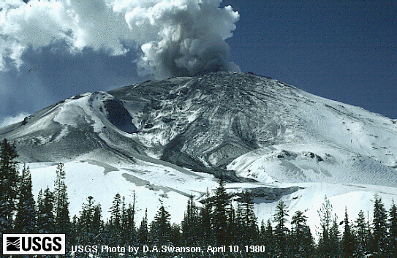
Mount Saint Helens
http://www.riverdale.k12.or.us/helens/slides/slide.htm

Slide 29
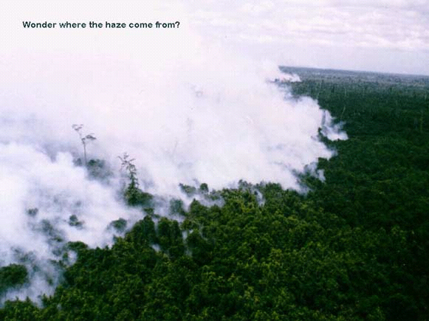
Integrated Forest Fire Management Project (IFFM) Indonesia

Slide 30
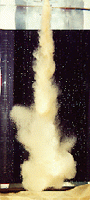
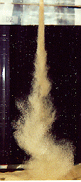
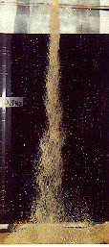
Slurry Plumes
slurry plumes for three increasing sizes of near-uniform sand diffusing in an ambient. The smallest size is around 0.2mm
http://maligne.civil.ualberta.ca/water/research/restopics/arbind/slplume.html

Slide 31
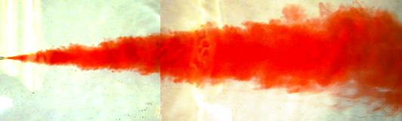
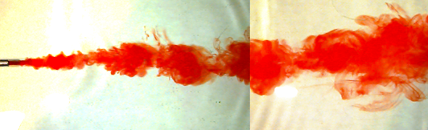
Momentum of Discharge
small port
⇧ momentum
⇧ jet mixing
large port
⇩ momentum
⇩ jet mixing

Slide 32
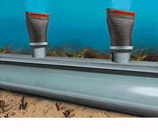
Multiport Diffuser Valves
http://www.redvalve.com/brochure/diffuser.html

Slide 33
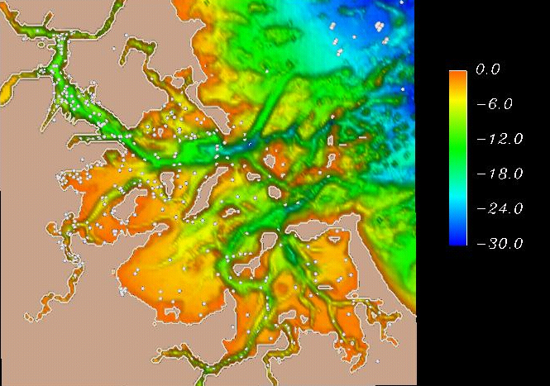
Boston Harbor
http://crusty.er.usgs.gov/

Slide 34
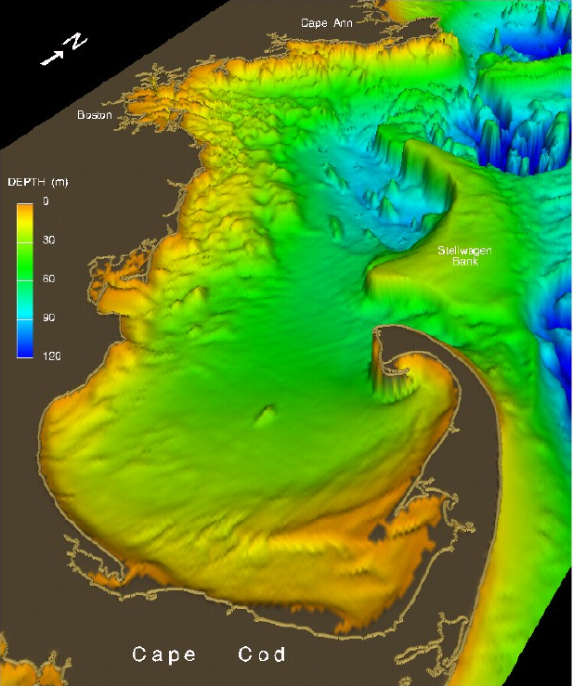
Massachusetts Bay
http://crusty.er.usgs.gov/

Slide 35
Tidal Flushing of Boston Harbor
Simulation of tidal exchange in Boston Harbor , based on a high-resolution (100 m grid spacing) depth-averaged computer model. Water in Boston Harbor is dyed red, and tracked over three tidal cycles. Colors between red and blue represent mixing of Boston Harbor water with Massachusetts Bay water (dyed blue). Due to the jet-like behavior of the ebb tidal currents, water is expelled from the harbor in pulses, leading to effective flushing of the harbor over several days.
Boston Harbor tidal cycles
http://crusty.er.usgs.gov/

Slide 36
Spring Freshet in Massachusetts Bay: April-May 1992
Near-surface salinity (2 m depth) is tracked during May 1992, revealing a plume of fresh water from the Merrimack River that moves into Massachusetts Bay. The yellow arrow that flops around indicates the wind direction and speed. Note that a snapshot of the salinity on May 22 (as one might sample from a monthly CTD cruise) would give the distinct visual impression of a large plume from Boston Harbor, when in fact most of this water came from the Merrimack River!
Spring Freshet
http://crusty.er.usgs.gov/

Slide 37
Boston Harbor Sewage Outfalls Effluent Concentration
Simulation of effluent dilution from the existing and future Boston Sewage effluent outfalls based on a three-dimensional circulation model of Massachusetts Bay during Jan-Mar 1990 and Jun-Aug 1990. Isosurfaces (three-dimensional contours) of effluent concentration are shown representing 1 part effluent to 200 parts seawater. This is a level below which nutrient inputs due to the outfall should be hard to distinguish above background fluctuations. During both the winter and summer months the effluent from the future outfall (represented by the blue isosurface) covers a smaller region than the effluent from the existing outfall (represented by the purple isosurface).
These simulations were used as evidence to assess the impact of the future outfall on endangered right whales.
http://crusty.er.usgs.gov/
Effect of new Boston Outfall

