Slide 1
Serial Killer
A Practical Guide to Bit Serial Computing Ken Boak OSHCamp August 2024

Slide 2
In this presentation I will discuss the techniques and practical hardware required for bit-serial computation.
Commencing with the basic full adder circuit, we show how it is applied to bit serial addition and subtraction and then extend it to provide the common logic functions AND, OR, XOR and ZERO. In may also be used for invertion of a number, ones complement, and twos complement (negation). Increment and Decrement are also possible with simple extensions to the control of the ALU.
As well as the ALU, shift registers are the fundamental storage device for bit-serial computer architectures. I summarise the basic types, their function and use and give example available cheaply in 74HCxx and 4000 series logic.
The discussion concludes with a step by step illustration of how a small, experimental bit-serial computer can be built up. This exercise is the object of tomorrow’s Workshop session. Build up and keep your own bit-serial machine.

Slide 3
Until 1960, almost all computers used serial arithmetic
It used considerably fewer vacuum tubes or transistors
It only had to process a pair of bits at a time
It made the hardware viable, practical and affordable
Easily extended to longer word sizes
Kept hardware costs “manageable”
The trade off, was it was relatively slow. EDSAC (1949) managed 600 operations per second.
With 74HCxx logic we can achieve 750,000 16-bit additions per second.

Slide 4
1 and 1 is 10…….
The principle is very simple – it’s just like basic addition that we all learned in primary school, except that it is in binary.
Starting with the least significant bits, A0 and B0, we add them together. If a carry is generated, we store it in a flipflop so that it can be added into the next addition, A1 plus B1.
We repeat this process until we have completed the whole word.
To do this we need a pair of shift registers oto feed the serialised data into a full adder, which is just two XOR gates and 3 NAND gates, plus a flipflop to hold the interstage carry.

Slide 5
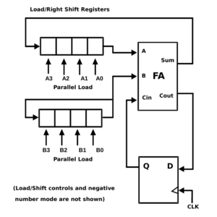
This sketch adjacent is of a typical serial adder. It uses two shift registers A3:A0 and B3:B0. Shift register A is normally called the Accumulator. It can be parallel loaded from a bus, or serially loaded via register B. Note how the least significant bits A0 and A1 are processed first!
The full adder FA, generates the Sum and Carry terms of the applied bits. The sum is recirculated back to the A shift register.
Any carry generated is stored in a D-type flipflop and fed to the carry input Cin, so that it can be included in the next cycle.
The cycle repeats until all n-bits have been processed, and all bits are stored in the Accumulator – in the position of their correct binary weighting. This basic design is easily modified for subtraction and other logical functions.

Slide 6
The Arithmetic and Logic Unit ALU
The ALU provides addition, subtraction and 3 logic functions AND, OR and XOR. It also can generate zero, which is good for clearing the accumulator.
It operates on A and B inputs, one bit at a time – plus any carry that was generated from the previous bit-sum.
It is based around a full adder which generates sum and carry outputs. As the sum is the XOR of the inputs and the Carry is AND, we get these logic functions almost for free.
Using 74Hxxx logic the ALU is just 5 ICs – regardless of the length of the word to be processed.
Because of its compactness the ALU could be programmed into a small ROM (256 bytes) to replace the combinational logic of XOR and NAND gates

Slide 7
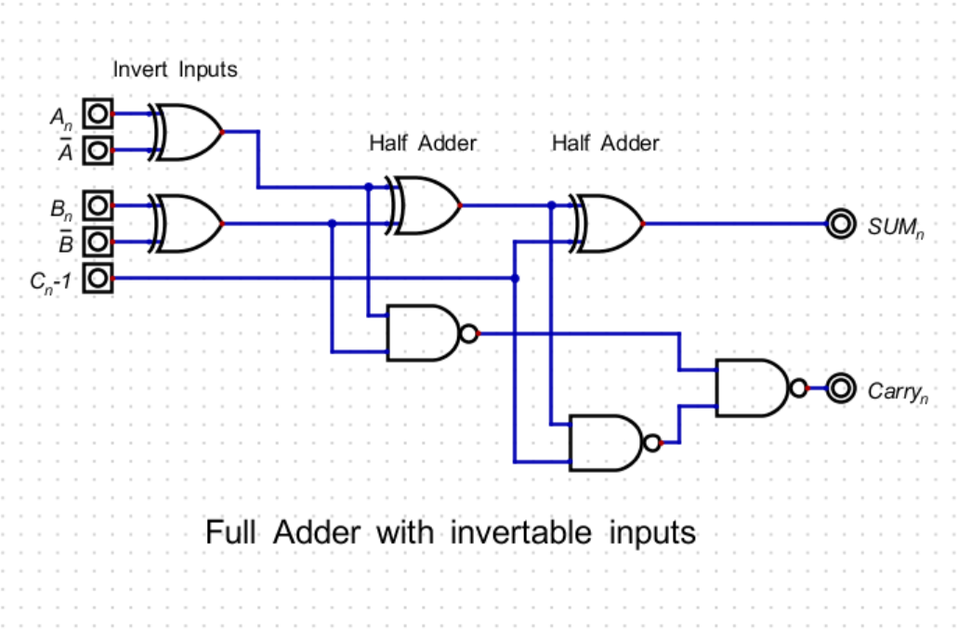
The ALU design commences with a full adder, with its inputs invertible, using a pair of XOR gates. It produces the two terms, Sum and Carry, which are the XOR and the AND functions of its inputs.

Slide 8
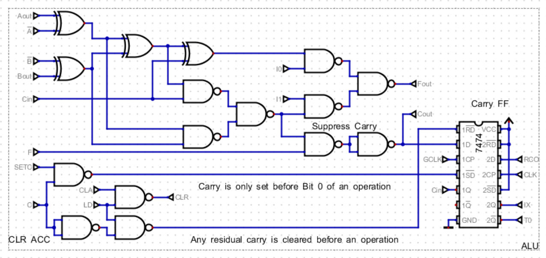
Full Adder is extended with multiplexer output, carry suppress, and Carry Flipflop. 7 control signals define which instruction is selected and control the Carry logic.

Slide 9
Shift Registers - Demystified
Shift registers are a fundamental building block of serial arithmetic.
Essentially just a chain of D-type flipflops, with some surrounding support logic
Widely forgotten or misunderstood by our generation of engineers and hobbyists.
5 or 6 types available in 74HCxx logic. Available in 4, 8, 64(dual) bits in length.
Serial In – Serial Out CD4517 (Dual 64-bit)
Serial In – Parallel Out 74HC164 (8-bit)
Parallel In – Serial Out 74HC165 (8-bit)
Serial In – Latched Parallel Out (Tristate) 74HC595 (8-bit)
Universal, Bidirectional, Parallel In/Out (Tristate), 8-bit Serial In/Out 74HC299
Up to 64 or 128 stages in length. CD4517is dual 64-bit, CD4557 is 1 to 64 bit
They provide the interface between the parallel and serial domains and allow communication of data via a 4 wire interface at clock speeds of up to 20MHz.

Slide 10
Shift Registers are Key to SPI Serial Communication
A word is transferred from Master to Slave, whilst simultaneously the Slave transfers a word back to the Master.
This can be easily done using 74HC299 universal shift registers
Requires a minimum of 4 wires between Master and Slave
Easy to implement and economical in pcb traces

Slide 11
Serial Memory
Memory was originally implemented as serial delay lines ( mercury acoustic delay lines used in EDSAC 1949).
Disks and magnetic drums are fundamentally serial devices in
Serial EEPROM, Flash and SRAM appeared in the mid-1990s
Low cost, 8-pin packages and relatively easy to use, with SPI and industry standard packages and instruction set.

Slide 12
“TICK” – A Bit Serial SBC for Experimentation
Combines a versatile ALU with examples of most of the common shift register types.
Bit Serial arithmetic up to 64-bit word length
Direct interface to SPI
Through hole components for simplified construction
8K x 8-bit SPI FRAM (ferroelectric RAM) for non-volatile program and data storage
Arduino (or clone) NANO provides user interface loading and debugging
Link selectable clock frequency from 1kHz to 1MHz
Shift registers programmable to 16, 32, 48 or 64 bit length
Single stepping and debug to laptop
Integrated hexadecimal 8 digit, 7-segment display, 8 LEDs and 8 user switches
Affordable – about $25 on 100x100 mm pcb from JLC PCB

Slide 13
Part 1- An Introduction to Shift Registers
In this tutorial we present three common types of shift register. They will be used together to build the first stage of the processor – a bit serial adder. This adder will ;ater be augmented with more ICs, to extend it to a fully capable ALU.
The first shift register is a 74HC164, an 8-bit serial input, parallel output device, in a compact 14-pin package. It can be clocked at approaching 80MHz.
The complementary part is the 74HC165 which is an 8-bit parallel input, serial output part. It has a greater than 50MHz maximum clock frequency at 5V
The third device is the 74HC595, which is similar to the 74HC164, but incorporates an 8-bit tristate output, parallel register. This makes it compatible with parallel-bus oriented systems. Some manufacturer’s 74HC595s will clock at 90 to 110MHz.

Slide 14
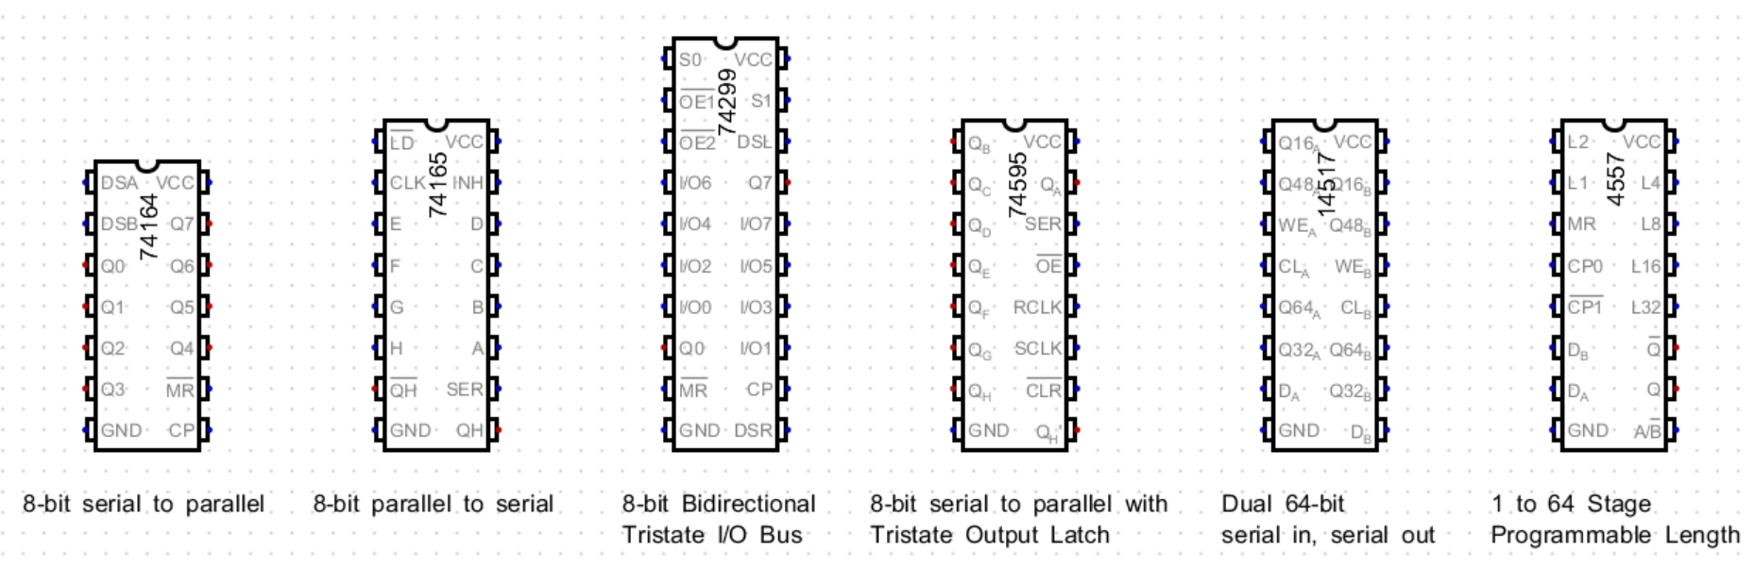
Common types of shift register in 74HCxx and 4xxx series CMOS Logic

Slide 15
The Clock Sequencer
This is a Johnson Ring Counter made from a programmable length shift register, the 74HC4557. It is wired such that it produces one low going pulse every N clock cycles, where N can be from 1 to 64 in length.
These pulses trigger an SR flip-flop and generate a clock gating pulse, which is used to generate a sequence of N pulses.

Slide 16
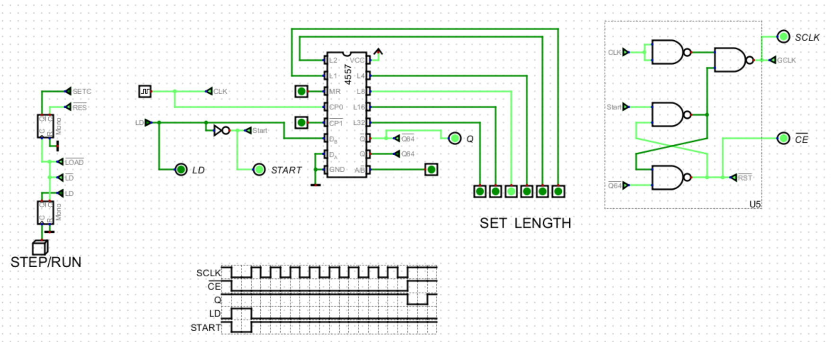
A one-shot monostable generates the STEP/RUN pulse LD and Start. The SR Latch generates the !CE signal and gates the system clock to produce a train of 8-clock pulses, in this example. Bursts of up to 64 pulses can be generated in this way.

Slide 17
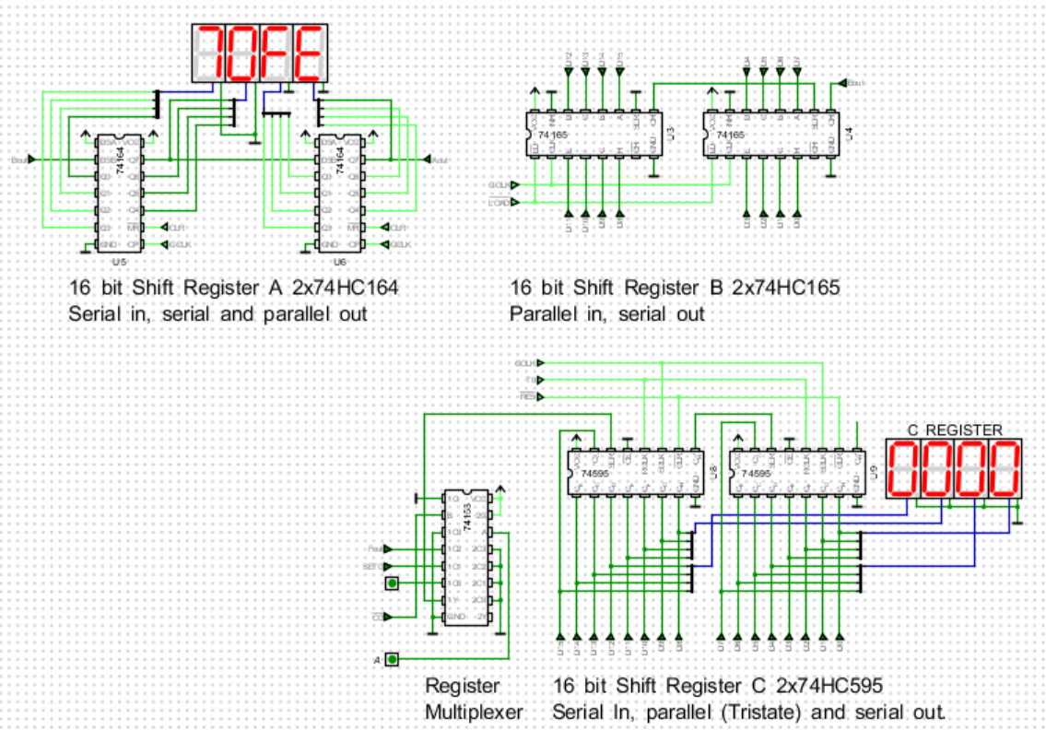

Slide 18
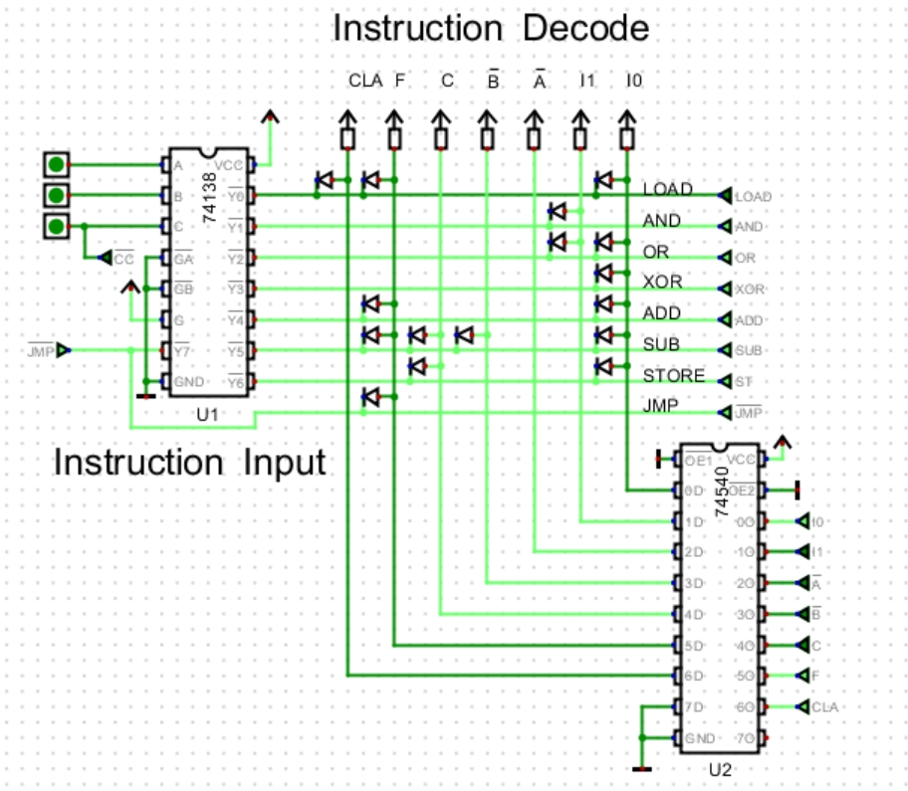
A 3 bit instruction is applied to the 74HC138, 3 to 8-line decoder on the left. One of its outputs goes low and this is decoded into 8-control signals by the diode array. A 74HC540 inverter/driver buffers the output signal

Slide 19
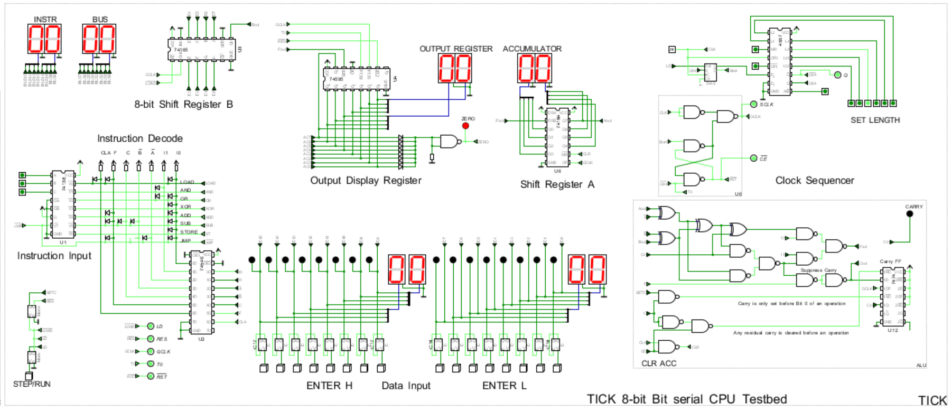
The various system elements are combined to make a simple 8-bit processor. For workshop purposes, The instruction decoder and data entry inputs, and display of results will be handled using an Arduino NANO. This reduces the total package count to about 12 parts, whilst experimenting, flexibly with longer shift registers.

