Slide 1
Capstone Two – Predicting Housing Prices in Washington, D.C.
Gbatchin Kochoni

Slide 2
Project Overview
Goal: Predict residential property prices in Washington, D.C.
Dataset: DC_Properties.csv
Audience: Homebuyers, real estate analysts, city planners
Key Steps: Wrangling, EDA, Feature Engineering, Preprocessing, Modeling, Evaluation

Slide 3
Dataset Overview
Target Variable: PRICE
Features: ROOMS, BEDRM, BATHRM, LANDAREA, WARD, HEAT, STRUCT
~150,000 records
Cleaned: Removed duplicates, invalid prices, null rows

Slide 4
Modeling Approach
Baseline: Linear Regression
Tree-based: Decision Tree (tuned), Random Forest (tuned)
Evaluation Metrics: MAE, RMSE, R²
GridSearchCV used for hyperparameter tuning

Slide 5
Model Comparison (Test Set)
Model | MAE ($) | RMSE ($) | R² | Selected
Linear Regression | 233,660.42 | 400,869.24 | 0.4954 | No
Decision Tree (Tuned) | 276,701.55 | 468,127.76 | 0.3119 | No
Random Forest (Tuned) | 225,166.54 | 376,057.71 | 0.5559 | Yes

Slide 6
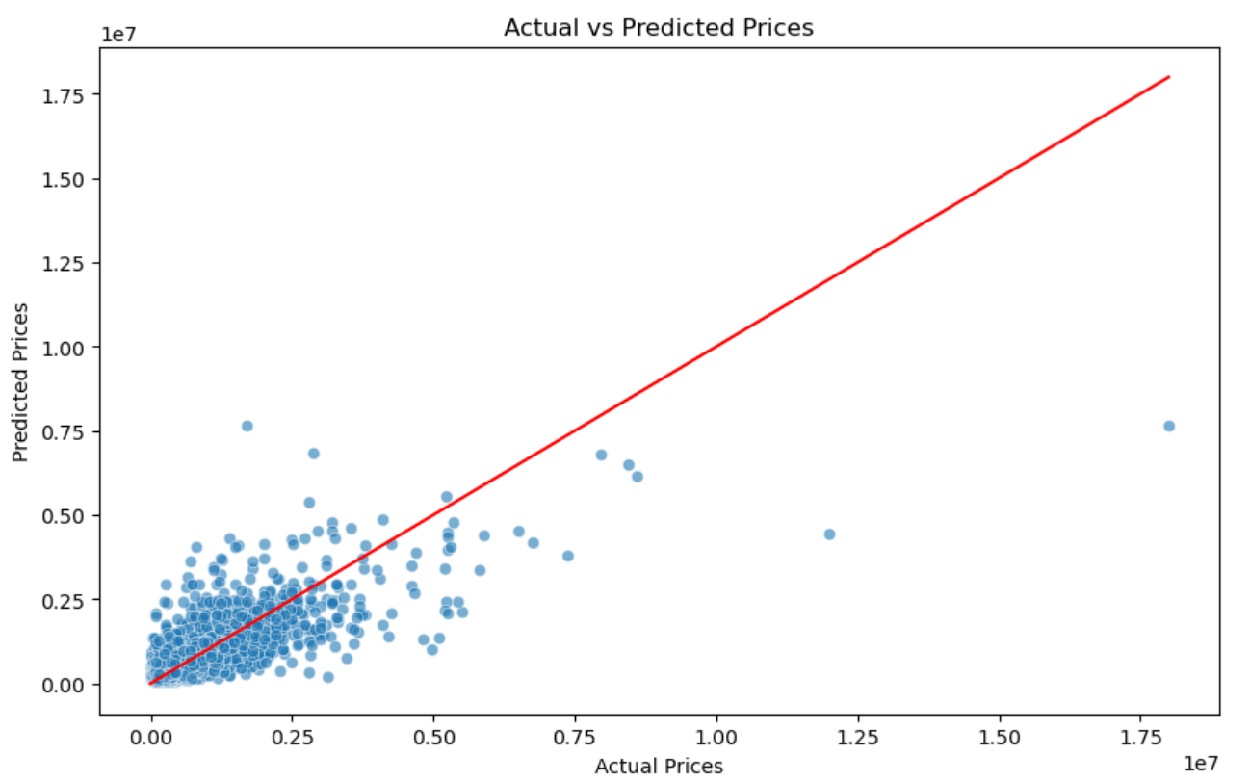
Visualizing the model's performance

Slide 7
Conclusion and Next Steps
Random Forest Regressor selected for deployment
Strong performance: Best MAE, RMSE, R²
Next steps:
- Add external features (crime, school data)
- Test XGBoost, Gradient Boosting
- Deploy as web or API

