Slide 1
Big Mountain Ski Resort Pricing Strategy
By Gbatchin Kochoni

Slide 2
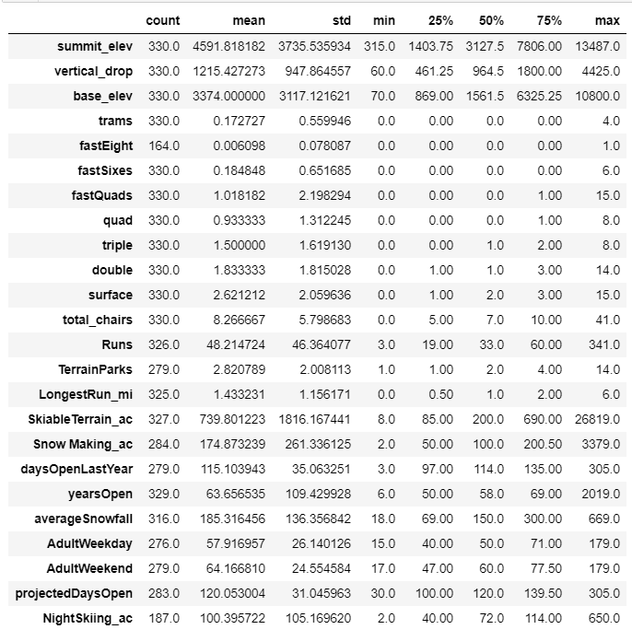
Problem identification
Big Mountain Resort's business needs a new pricing strategy.
How can we create a pricing model to determine a competitive price based on data from other ski resorts nationwide?
How can that price accurately reflect the significance of Big Mountain Resort’s facilities?

Slide 3
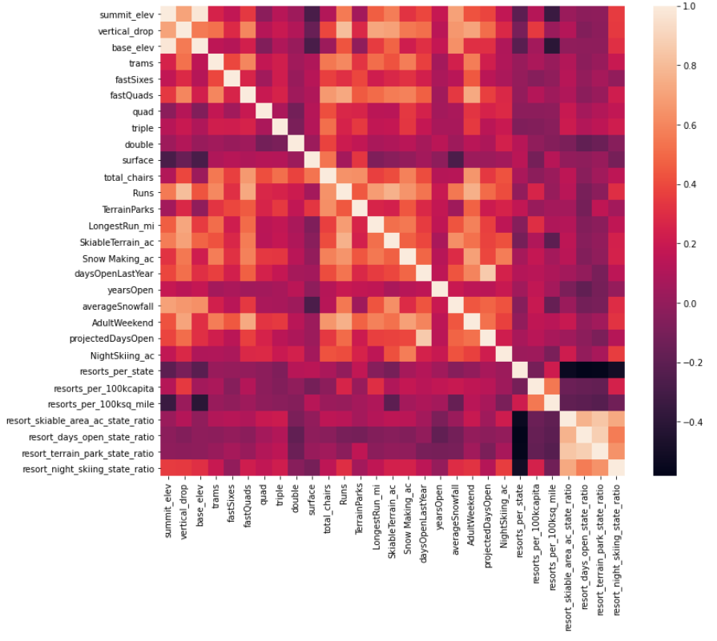
Key findings and Recommendation
The most significant correlations were observed with fastQuads, Runs, and Snow Making_ac.
Visitors value the permanence of snow, which would cost money for snowmaking equipment and drive up prices and costs.

Slide 4
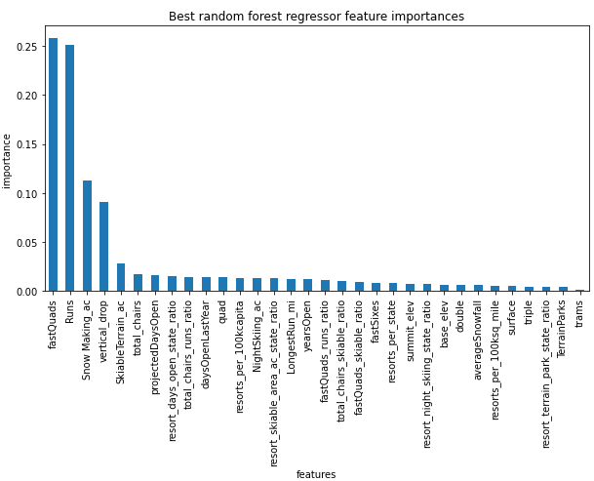
Modeling results and analysis
The random forest appeared clearly as the best regression option.
Imputing the median value can estimate the average price of four components previously identified.
Acceptable variability: The mean absolute error is only about $1.
The model was created using the principal components and random forest regression method.

Slide 5
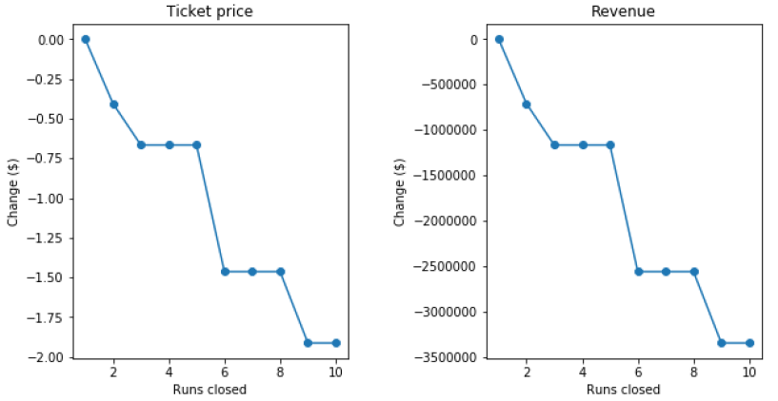
Modeling results and analysis
The model can be designed to be as accurate as possible. While the current rate at Big Mountain Resort is $81.00, the modeled rate is $95.87, suggesting there is room for substantial price increases.
The model also predicts that keeping up to five runs closed without significantly impacting revenue is possible.

Slide 6
Summary and conclusion
Finally, BMR can do much better with pricing.
Seven of eight characteristics favor a ticket price of at least $10.
In addition, there are margins for savings, particularly in closing unprofitable runs.
Big Mountain Resort has the opportunity to enhance its revenues while delivering quality services to its guests. We hope these results will enable resort management to make informed decisions that ensure the sustainability of its operations.

